Slide 1
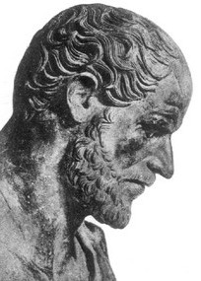
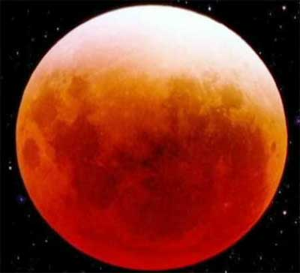
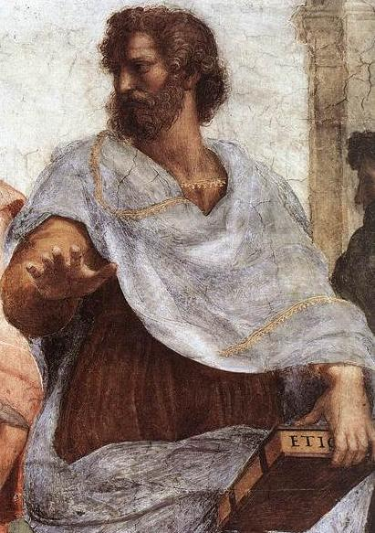
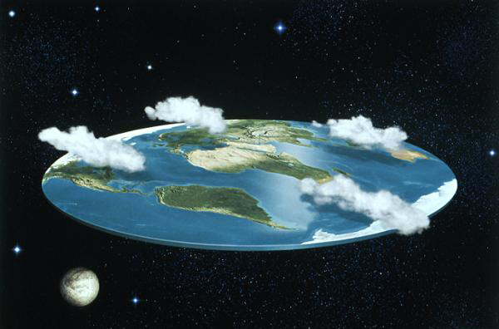
Aristotle’s Conclusion Time and Space

Slide 2

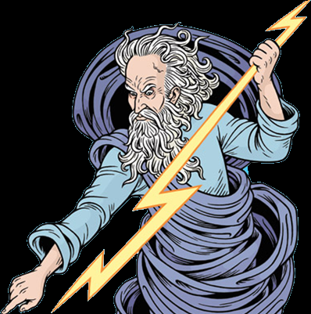
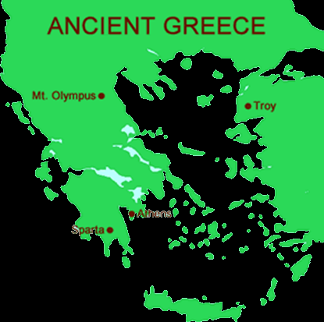

Aristotle’s Conclusion Time and Space
Aristotle lived in Greece more than three hundred years before the Common Era (or Before Christ). In Aristotle’s time, most people believed that many gods ruled the universe. A happy god might allow an abundant harvest while an angry god would show his fury with storms or earthquakes.

Slide 3

Aristotle’s Conclusion Time and Space
Aristotle decided he could understand the world through observation and by using logic and reason. Later scientists called Aristotle the Father of Natural Science because centuries after the ancient scholar's death, his methods formed the basis of the scientific method.

Slide 4
Aristotle’s Conclusion Time and Space
Most people in Aristotle’s time believed the earth was flat, but Aristotle concluded that the earth was round. The Greek thinker realized that a lunar eclipse occurred when the earth came between the sun and the moon. He observed that the shape of the earth’s shadow was round. The shadow would have a much different shape if the earth was flat.

Slide 5
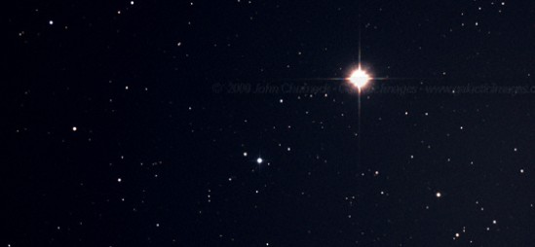
Aristotle’s Conclusion Time and Space
Next, Aristotle considered the position of the North Star. The further north a person journeyed, the closer the North Star seemed to move to the middle of the sky. If a person traveled south of what we now call the equator, he or she could not see the North Star at all.

Slide 6
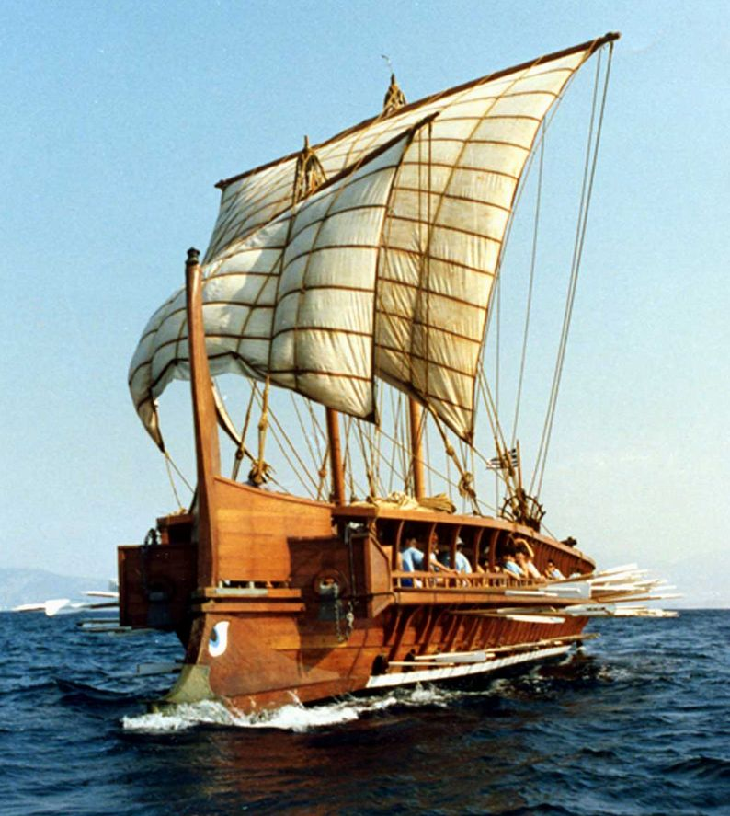
Aristotle’s Conclusion Time and Space
Finally, Aristotle watched ships sailing into port. He noticed that at a distance, he could see the tops of the ships' sails before he saw the rest of the ship. Aristotle deduced that this was because of the curvature of the earth.

Slide 7
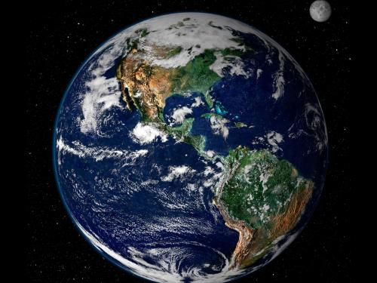
Aristotle’s Conclusion Time and Space
We know today that Aristotle’s conclusions were correct because humans have traveled around the globe and we have seen pictures of the earth from space.

Slide 8
Aristotle’s Conclusion Time and Space

