Slide 1


The Fourth Dimension Time and Space
A straight line has only one dimension.
A square has two dimensions. A dimension is a property of space, or an extension in a given direction.
A cube has three dimensions.

Slide 2
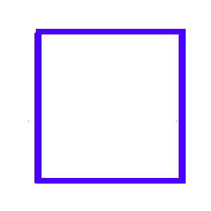
The Fourth Dimension Time and Space
A straight line has only one dimension.
A square has two dimensions. A dimension is a property of space, or an extension in a given direction.
A cube has three dimensions.

Slide 3
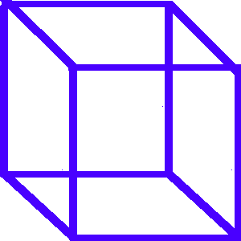
The Fourth Dimension Time and Space
A straight line has only one dimension.
A square has two dimensions. A dimension is a property of space, or an extension in a given direction.
A cube has three dimensions.

Slide 4


The Fourth Dimension Time and Space
When you watch a movie in "3-D," or three dimensions, you are probably required to wear special glasses that trick your mind into seeing depth on a flat screen.

Slide 5
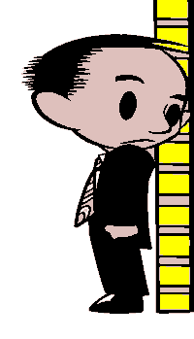
The Fourth Dimension Time and Space
We will also work with a fourth dimension—time. The distance from the floor to the top of your head is your height. Stretching your arms out, the distance from one fingertip to the other is an example of width. Putting your hands in front of you provides you with the third dimension—depth.

Slide 6

The Fourth Dimension Time and Space
Think about the future. It is likely that your size and shape will change over time, so in this case, time can be considered the fourth dimension.

Slide 7
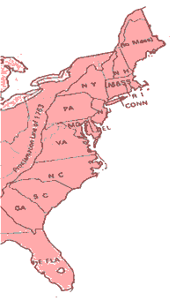
The Fourth Dimension Time and Space
The sizes and shapes of nations and regions can also change over time. In 1776, the United States consisted of only thirteen states along or near the coast of the Atlantic Ocean.

Slide 8
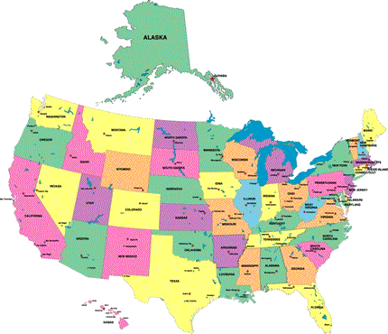
The Fourth Dimension Time and Space
By 1912, 48 states stretched across the mainland of North America. The United States expanded even further west as Alaska and Hawaii joined the union in 1959.

Slide 9

Music courtesy of Kevin MacLeod
http://incompetech.com/music/royalty-free/
Learn more about history at
www.mrdowling.com

