Slide 1
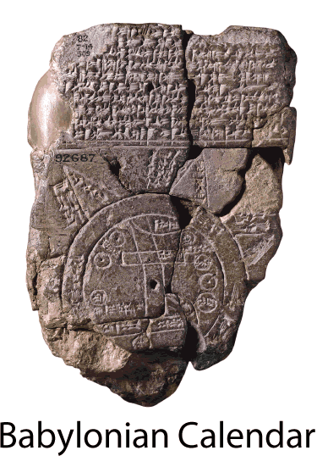

Numbering Years Mesopotamia
Ancient calendars were generally based on the beginning of a ruler's reign; for example, the third year of Hammurabi’s
rule. Most people today
use the Western
calendar (also known as
the Gregorian calendar)
for everyday purposes.
About AD525, a Christian
monk named Dionysius
Exiguus marked the year
Christ was born as 1.

Slide 2

Numbering Years Mesopotamia
AD refers to the anno Domini, a Latin phrase that means “the year of the Lord.” The years before the birth of Christ are numbered backward from his birth. The year before AD 1 was 1 BC, or one year “before Christ.”

Slide 3
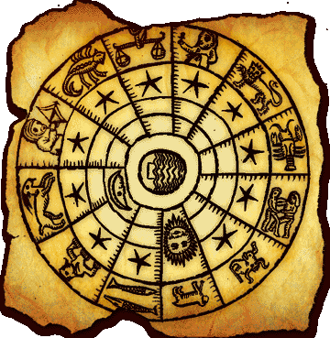
Numbering Years Mesopotamia
When referring to dates before the birth of Christ, the higher the number the earlier the year. Since we
mark years from a
set point known
as 1—there is no
year 0—3500BC
was more than
5500 years ago.

Slide 4
Numbering Years Mesopotamia
Non-Christians often use the term CE in place of AD. CE refers to “Common Era” or “Christian Era.” BCE can describe the era preceding the Common Era. This can mean “Before the Common Era,” “Before the Current Era,” or “Before the Christian Era.”

Slide 5
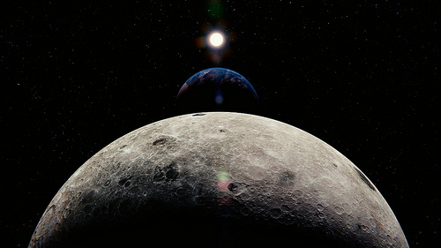
Numbering Years Mesopotamia
Most people use the
Western Calendar today,
but other calendars are
used for cultural and
religious purposes. The
Islamic calendar is based on the cycle of the moon, so it is ten or eleven days shorter than the Western calendar. The first year of the Islamic calendar is the year the prophet Muhammad and his followers migrated from Mecca to Medina. On a Western calendar, this is AD 622.

Slide 6
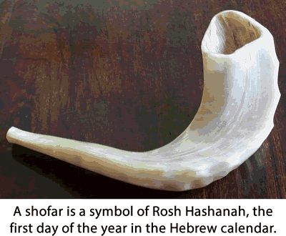
Numbering Years Mesopotamia
The Hebrew calendar is used for Jewish religious services. The Hebrew year 5774 began at sunset on September 4, 2013. Years are marked AM on
The Hebrew
calendar for a
Latin phrase
that means
“the beginning
of the world.”

Slide 7

Numbering Years Mesopotamia
The Chinese calendar
is used for festivals
and holidays in many
East Asian nations.
In the Chinese
calendar, most of
2013 was known as
the Year of the Snake.

Slide 8

Numbering Years Mesopotamia
On Western calendars there are ten years in a decade, one hundred years in a century, and one thousand years in a millennium. This is considered the twenty-first century of the Common Era. The first century lasted from January 1, AD1 to December 31, AD100. On December 31, 1999, many
people celebrated the
coming of the new
millennium, but the
millennium did not end
until December 31, 2000.

Slide 9
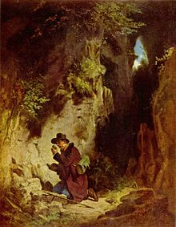
Numbering Years Mesopotamia
We also use terms such as era or epoch to describe periods of time. A geologist is someone who studies how the earth has changed, and for a geologist, an era might last millions of years.

Slide 10
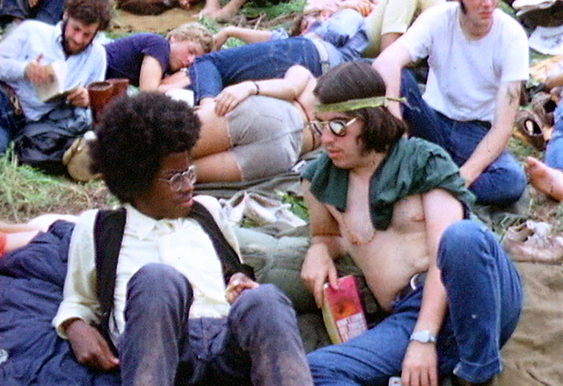
Numbering Years Mesopotamia
For our purposes, an era will be any significant period of time. For example, you are in the middle school era of your life. You may see photographs of people wearing different styles of clothing that
reflect the era
when the pictures
were taken.

Slide 11

Numbering Years Mesopotamia
An epoch is a particular moment that marks the beginning or the end of an era. Your thirteenth birthday is the epoch that begins your teenage years.

Slide 12

Numbering Years Mesopotamia
Music courtesy of Kevin MacLeod
http://incompetech.com/music/royalty-free/
Learn more about history at
www.mrdowling.com

