Slide 1
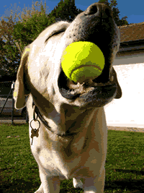
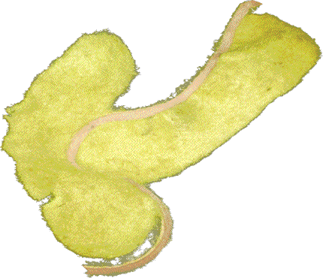
Map Projections Time and Space
When you try to flatten a tennis ball, what happens? The sides split, and the shape is changed. The same thing happens when you try to take a world map and flatten it onto a piece of paper. It can’t be done without stretching some places. This stretching is called distortion.

Slide 2
Map Projections Time and Space
When you try to flatten a tennis ball, what happens? The sides split, and the shape is changed. The same thing happens when you try to take a world map and flatten it onto a piece of paper. It can’t be done without stretching some places. This stretching is called distortion.

Slide 3
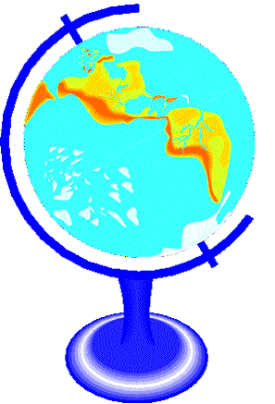
Map Projections Time and Space
A globe can show size, shape, distance, and direction accurately, but since paper is not three dimensional, we have to use map projections. A map projection is a way to show a drawing of the earth on a flat surface. All flat maps have distortion, so we use different map projections to meet different needs.

Slide 4
Map Projections Time and Space
A globe can show size, shape, distance, and direction accurately, but since paper is not three dimensional, we have to use map projections. A map projection is a way to show a drawing of the earth on a flat surface. All flat maps have distortion, so we use different map projections to meet different needs.

Slide 5

Music courtesy of Kevin MacLeod
http://incompetech.com/music/royalty-free/
Learn more about history at
www.mrdowling.com

