Slide 1
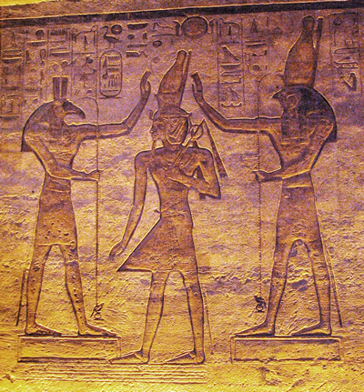
Isis, Osiris and the Egyptian Afterlife Ancient Egypt
The people of ancient Egypt did not have scientific explanations for natural phenomena. They believed sunshine and the great Nile River were gifts from their many gods. The beliefs of the ancient Egyptians slowly changed over time, but many of their legends influenced Egyptian culture for thousands of years.

Slide 2
Isis, Osiris and the Egyptian Afterlife Ancient Egypt
The people of ancient Egypt did not have scientific explanations for natural phenomena. They believed sunshine and the great Nile River were gifts from their many gods. The beliefs of the ancient Egyptians slowly changed over time, but many of their legends influenced Egyptian culture for thousands of years.

Slide 3
Isis, Osiris and the Egyptian Afterlife Ancient Egypt
The people of ancient Egypt did not have scientific explanations for natural phenomena. They believed sunshine and the great Nile River were gifts from their many gods. The beliefs of the ancient Egyptians slowly changed over time, but many of their legends influenced Egyptian culture for thousands of years.

Slide 4
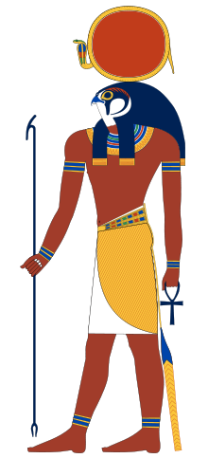
Isis, Osiris and the Egyptian Afterlife Ancient Egypt
The ancient Egyptians believed Ra was the sun god who came to earth as the first ruler of Egypt. Egypt became very rich during Ra’s rule, but the people grew lazy and neglected to honor the sun god, so Ra used his magic to create a bloodthirsty lioness god called Sekhmet. Sekhmet reminded the Egyptian people of the power of Ra by terrorizing the Nile River Valley.

Slide 5
Isis, Osiris and the Egyptian Afterlife Ancient Egypt
The ancient Egyptians believed Ra was the sun god who came to earth as the first ruler of Egypt. Egypt became very rich during Ra’s rule, but the people grew lazy and neglected to honor the sun god, so Ra used his magic to create a bloodthirsty lioness god called Sekhmet. Sekhmet reminded the Egyptian people of the power of Ra by terrorizing the Nile River Valley.

Slide 6
Isis, Osiris and the Egyptian Afterlife Ancient Egypt
The ancient Egyptians believed Ra was the sun god who came to earth as the first ruler of Egypt. Egypt became very rich during Ra’s rule, but the people grew lazy and neglected to honor the sun god, so Ra used his magic to create a bloodthirsty lioness god called Sekhmet. Sekhmet reminded the Egyptian people of the power of Ra by terrorizing the Nile River Valley.

Slide 7
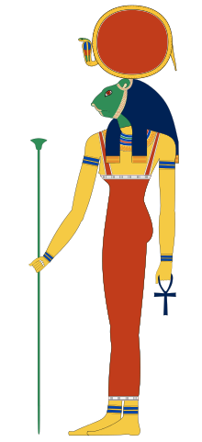
Isis, Osiris and the Egyptian Afterlife Ancient Egypt
When the Egyptian people showed their appreciation, Ra used magic to tame Sekhmet and turn her into Hathor, the goddess of love. This lesson tells us that the Egyptian people both valued and feared the sun. The sun made it possible for Egyptian crops to grow, but the sun could also turn good farmland into desert where no crops would grow.

Slide 8
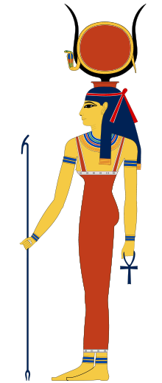
Isis, Osiris and the Egyptian Afterlife Ancient Egypt
When the Egyptian people showed their appreciation, Ra used magic to tame Sekhmet and turn her into Hathor, the goddess of love. This lesson tells us that the Egyptian people both valued and feared the sun. The sun made it possible for Egyptian crops to grow, but the sun could also turn good farmland into desert where no crops would grow.

Slide 9
Isis, Osiris and the Egyptian Afterlife Ancient Egypt
When the Egyptian people showed their appreciation, Ra used magic to tame Sekhmet and turn her into Hathor, the goddess of love. This lesson tells us that the Egyptian people both valued and feared the sun. The sun made it possible for Egyptian crops to grow, but the sun could also turn good farmland into desert where no crops would grow.

Slide 10
Isis, Osiris and the Egyptian Afterlife Ancient Egypt
When the Egyptian people showed their appreciation, Ra used magic to tame Sekhmet and turn her into Hathor, the goddess of love. This lesson tells us that the Egyptian people both valued and feared the sun. The sun made it possible for Egyptian crops to grow, but the sun could also turn good farmland into desert where no crops would grow.

Slide 11
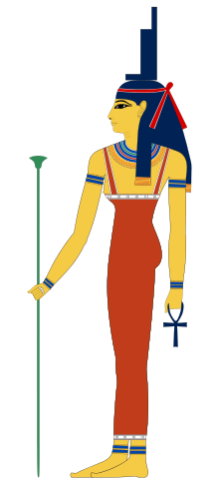
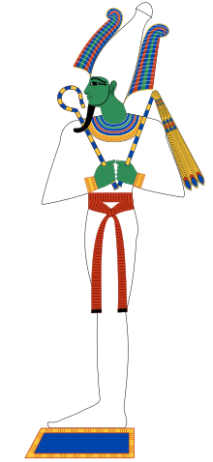
Isis, Osiris and the Egyptian Afterlife Ancient Egypt
Ra’s many children included Osiris and Isis, the brother and sister who ruled the Nile River Valley after they taught the Egyptians to farm and domesticate animals. The Egyptian people praised Osiris and Isis for the many gifts they bestowed on their civilization.

Slide 12
Isis, Osiris and the Egyptian Afterlife Ancient Egypt
Ra’s many children included Osiris and Isis, the brother and sister who ruled the Nile River Valley after they taught the Egyptians to farm and domesticate animals. The Egyptian people praised Osiris and Isis for the many gifts they bestowed on their civilization.

Slide 13
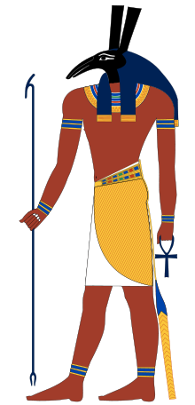
Isis, Osiris and the Egyptian Afterlife Ancient Egypt
Seth was their jealous brother and the god of storms. Seth invited all of the gods to a great party. Near the end of the feast, Seth brought in a beautiful cedar chest.

Slide 14
Isis, Osiris and the Egyptian Afterlife Ancient Egypt
Seth was their jealous brother and the god of storms. Seth invited all of the gods to a great party. Near the end of the feast, Seth brought in a beautiful cedar chest.

Slide 15
Isis, Osiris and the Egyptian Afterlife Ancient Egypt
Seth was their jealous brother and the god of storms. Seth invited all of the gods to a great party. Near the end of the feast, Seth brought in a beautiful cedar chest.

Slide 16
Isis, Osiris and the Egyptian Afterlife Ancient Egypt
"I will give this chest to whosoever fits in it most exactly!" The gods tried to fit into the box, but everyone was either too big or too small. Seth had carefully measured his brother so that only he would fit in the chest space. Osiris was the last of the guests to lie down in the chest.

Slide 17
Isis, Osiris and the Egyptian Afterlife Ancient Egypt
"I will give this chest to whosoever fits in it most exactly!" The gods tried to fit into the box, but everyone was either too big or too small. Seth had carefully measured his brother so that only he would fit in the chest space. Osiris was the last of the guests to lie down in the chest.

Slide 18
Isis, Osiris and the Egyptian Afterlife Ancient Egypt
"I will give this chest to whosoever fits in it most exactly!" The gods tried to fit into the box, but everyone was either too big or too small. Seth had carefully measured his brother so that only he would fit in the chest space. Osiris was the last of the guests to lie down in the chest.

Slide 19
Isis, Osiris and the Egyptian Afterlife Ancient Egypt
"I will give this chest to whosoever fits in it most exactly!" The gods tried to fit into the box, but everyone was either too big or too small. Seth had carefully measured his brother so that only he would fit in the chest space. Osiris was the last of the guests to lie down in the chest.

Slide 20
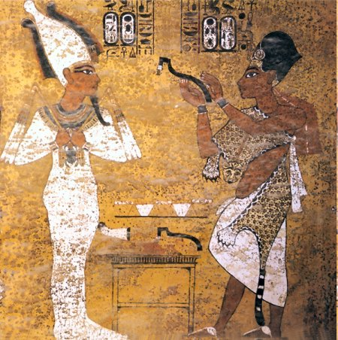
Isis, Osiris and the Egyptian Afterlife Ancient Egypt
“I am the exact fit, so the chest is mine,” cried Osiris and he climbed into the chamber.
“It is your chest and it is where you will be forever,” replied Seth as he sealed the lid and cast the chest and Osiris into the Nile.

Slide 21
Isis, Osiris and the Egyptian Afterlife Ancient Egypt
“I am the exact fit, so the chest is mine,” cried Osiris and he climbed into the chamber.
“It is your chest and it is where you will be forever,” replied Seth as he sealed the lid and cast the chest and Osiris into the Nile.

Slide 22
Isis, Osiris and the Egyptian Afterlife Ancient Egypt
Isis recovered her brother’s body and returned it to Egypt. When Seth discovered what Isis had done, he ripped opened the chest, tore the body of Osiris into fourteen pieces, and scattered the pieces along the whole length of the Nile.

Slide 23
Isis, Osiris and the Egyptian Afterlife Ancient Egypt
Isis recovered her brother’s body and returned it to Egypt. When Seth discovered what Isis had done, he ripped opened the chest, tore the body of Osiris into fourteen pieces, and scattered the pieces along the whole length of the Nile.

Slide 24
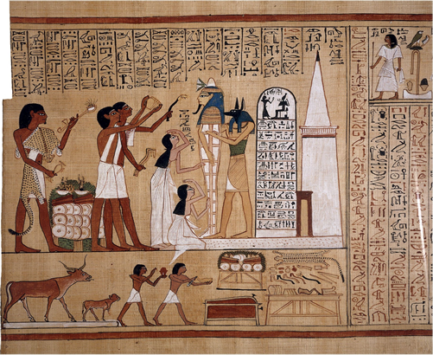
Isis, Osiris and the Egyptian Afterlife Ancient Egypt
The people of ancient Egypt believed that when their gods left this world they could live in an afterlife. The afterlife was a perfect version of ancient Egypt.
In order to get to
the afterlife,
however, the
gods first had to
pass through the underworld.

Slide 25
Isis, Osiris and the Egyptian Afterlife Ancient Egypt
The people of ancient Egypt believed that when their gods left this world they could live in an afterlife. The afterlife was a perfect version of ancient Egypt.
In order to get to
the afterlife,
however, the
gods first had to
pass through the underworld.

Slide 26
Isis, Osiris and the Egyptian Afterlife Ancient Egypt
The people of ancient Egypt believed that when their gods left this world they could live in an afterlife. The afterlife was a perfect version of ancient Egypt.
In order to get to
the afterlife,
however, the
gods first had to
pass through the underworld.

Slide 27
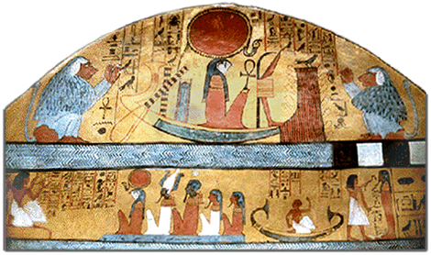
Isis, Osiris and the Egyptian Afterlife Ancient Egypt
The underworld was a strange and dangerous place filled with fantastic and forbidding creatures. Traveling through the afterworld required the Egyptian gods to be very clever because they had to complete many tasks.

Slide 28
Isis, Osiris and the Egyptian Afterlife Ancient Egypt
The underworld was a strange and dangerous place filled with fantastic and forbidding creatures. Traveling through the afterworld required the Egyptian gods to be very clever because they had to complete many tasks.

Slide 29
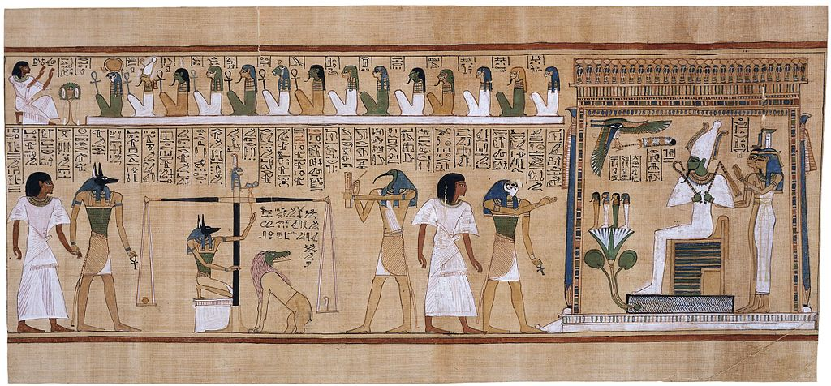
Isis, Osiris and the Egyptian Afterlife Ancient Egypt
The Egyptians believed that their gods could not reach the afterlife unless their bodies remained in one piece in Egypt. Isis knew the body of Osiris had to be intact and buried in Egyptian sand, so when she found the pieces of her brother, she buried Osiris in a secret place where Seth could not find him.

Slide 30
Isis, Osiris and the Egyptian Afterlife Ancient Egypt
The Egyptians believed that their gods could not reach the afterlife unless their bodies remained in one piece in Egypt. Isis knew the body of Osiris had to be intact and buried in Egyptian sand, so when she found the pieces of her brother, she buried Osiris in a secret place where Seth could not find him.

Slide 31
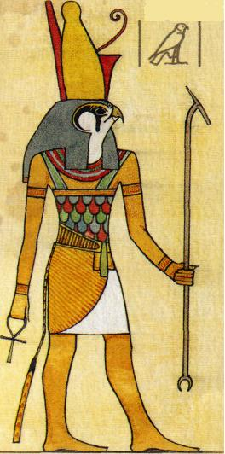
Isis, Osiris and the Egyptian Afterlife Ancient Egypt
Horus was the son of Isis and the god of the sky. Horus took the form of a falcon and brought the sun with him each day as he flew across the sky. The eyes of Horus were said to be the sun and the moon, but the moon was not as bright because it was damaged by Seth in their great battle.

Slide 32
Isis, Osiris and the Egyptian Afterlife Ancient Egypt
Horus was the son of Isis and the god of the sky. Horus took the form of a falcon and brought the sun with him each day as he flew across the sky. The eyes of Horus were said to be the sun and the moon, but the moon was not as bright because it was damaged by Seth in their great battle.

Slide 33
Isis, Osiris and the Egyptian Afterlife Ancient Egypt
Horus was the son of Isis and the god of the sky. Horus took the form of a falcon and brought the sun with him each day as he flew across the sky. The eyes of Horus were said to be the sun and the moon, but the moon was not as bright because it was damaged by Seth in their great battle.

Slide 34
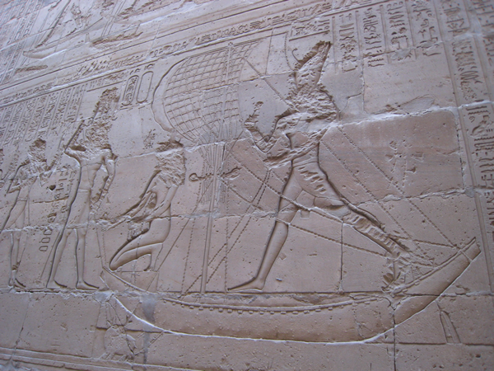
Isis, Osiris and the Egyptian Afterlife Ancient Egypt
Horus subdued Seth, but he was never able to kill his uncle. This legend of Horus and Seth helps to explain why the Egyptians believed that they could never completely defeat evil and chaos.

Slide 35
Isis, Osiris and the Egyptian Afterlife Ancient Egypt
Horus subdued Seth, but he was never able to kill his uncle. This legend of Horus and Seth helps to explain why the Egyptians believed that they could never completely defeat evil and chaos.

Slide 36
Isis, Osiris and the Egyptian Afterlife Ancient Egypt
Music courtesy of Kevin MacLeod
http://incompetech.com/music/royalty-free/
Learn more about history at
www.mrdowling.com

