Slide 1
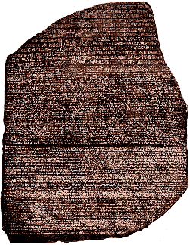
The Rosetta Stone Ancient Egypt
The writing of the ancient Egyptians was a great mystery until the discovery of the Rosetta Stone. In 1799, French soldiers were building a fort near the Egyptian village of Rosetta. The soldiers unearthed a dark grey-pinkish granite stone that stood about four feet tall and 2½ feet wide.

Slide 2
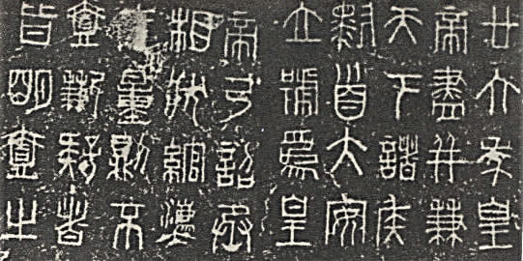
The Rosetta Stone Ancient Egypt
The Rosetta Stone was inscribed with three languages. One language was Greek, but the others were forms of Egyptian writing that were unreadable at that time.

Slide 3
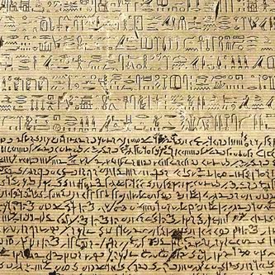
The Rosetta Stone Ancient Egypt
The Greek writing described a law written in 196BCE. Scholars decided the Greek writing might give clues to the meaning of the Egyptian symbols.

Slide 4
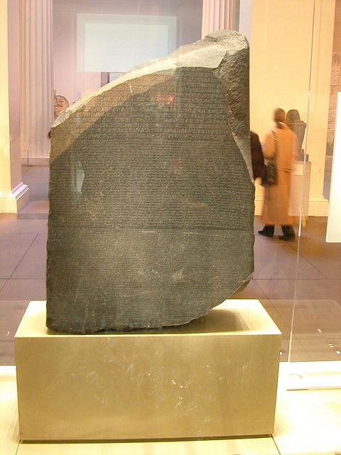
The Rosetta Stone Ancient Egypt
The British seized Egypt in 1801 and transported the Rosetta Stone to the British Museum. Scholars carefully studied the writing on the Rosetta Stone, but their work proceeded slowly because parts of the stone had crumbled.

Slide 5
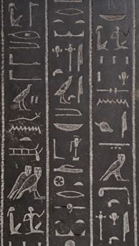
The Rosetta Stone Ancient Egypt
In time, the scholars concluded that the law was written in hieroglyphics and demotic scripts. Hieroglyphics was the sacred writing of ancient Egypt and was known only by the most learned priests.

Slide 6
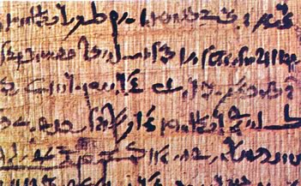
The Rosetta Stone Ancient Egypt
Demotic was a cursive script that the Egyptians used for less formal writing. Demotic writing shared some similarities with Greek.

Slide 7
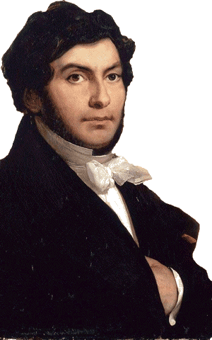
The Rosetta Stone Ancient Egypt
In 1822, a French linguist named Jean Champollion matched several characters from the three texts and slowly deciphered an alphabet of hieroglyphics. Champollion concluded that hieroglyphics had originally been pictographs, but the symbols stood for sounds in later times.

Slide 8
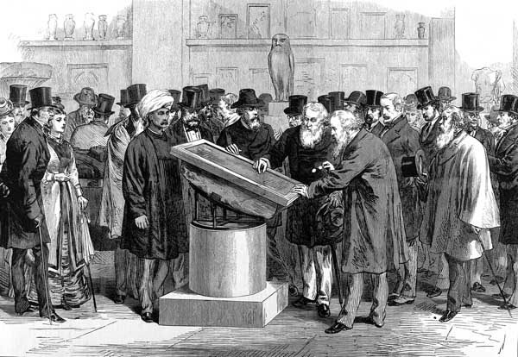
The Rosetta Stone Ancient Egypt
Using Champollion’s key, the mysterious hieroglyphic text became readable. Within a few years, scholars were able to find the explanation for the pyramids and many of the
other mysteries
of ancient
Egypt.

Slide 9
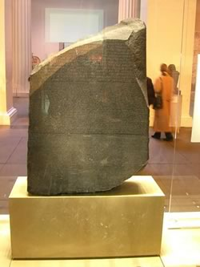
The Rosetta Stone Ancient Egypt
In 2003, Egypt formally requested that the British return the Rosetta Stone to its original home. The British Museum and other leading world museums responded by issuing a joint statement
rejecting Egypt’s request.
The statement explained
that ancient artifacts such
as the Rosetta Stone
belong not to their home
nation but to all of humanity.

Slide 10

The Rosetta Stone Ancient Egypt
Music credit:
I Feel You by Kevin McLeod
at incompetech.com
Licensed under Creative Commons: By Attribution 3.0
http://creativecommons.org/licenses/by/3.0/
Learn more about history at
www.mrdowling.com

