Slide 1
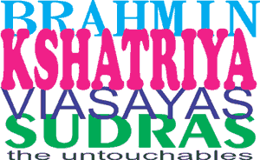
THE ARYANS AND THE CASTE SYSTEM

Slide 2
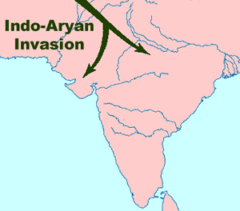
THE ARYANS AND THE CASTE SYSTEM
About 1500bc, powerful nomadic warriors known as Aryans began to appear in northern India. Their skill on horseback allowed the Aryans to conquer the native people and to expand south into the subcontinent.

Slide 3
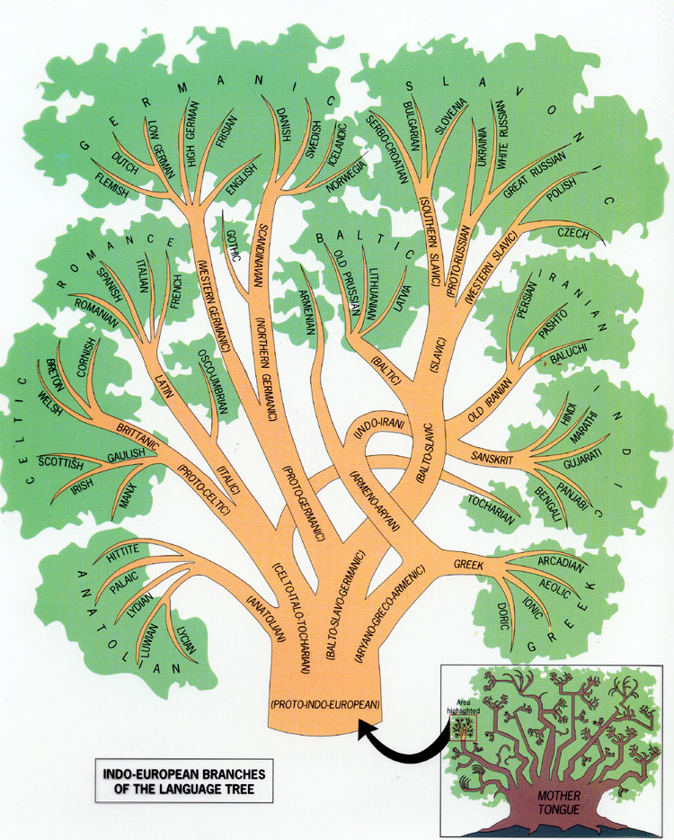
THE ARYANS AND THE CASTE SYSTEM
The Aryans spoke Sanskrit, a language that is similar to what is spoken in Europe, but unlike the Dravidian languages spoken in India before the Aryan invasion. The similarities with European languages suggest the Aryans may have migrated to India from Central Asia, but we cannot be sure because the writings of the Aryans do not suggest they came from somewhere else.

Slide 4
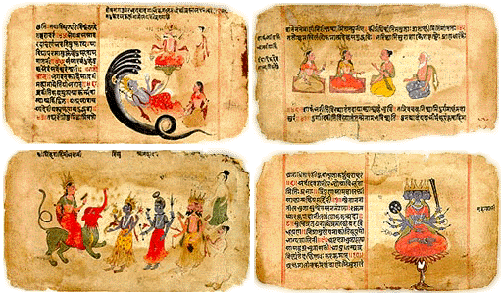
THE ARYANS AND THE CASTE SYSTEM
The Aryans wrote songs and stories about their gods. The stories were called the Vedas. The Vedas were handed down by word of mouth for hundreds of years until about 500bc, when the Aryans learned to write.
The Rig Veda is a collection of more than 1000 songs that survives to this day. The influence of these stores is why the period of Indian history lasting from about 1500bc to 322bc is known as the Vedic Age.

Slide 5
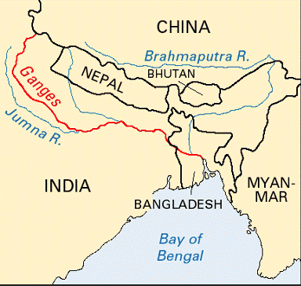
THE ARYANS AND THE CASTE SYSTEM
About 1000bc, the Aryans discovered iron ore in the Ganges River Valley. The Aryans used the iron to build strong plows to grow crops. They also used iron weapons to control the Dravidian people and to impose a rigid social structure called the caste system.

Slide 6
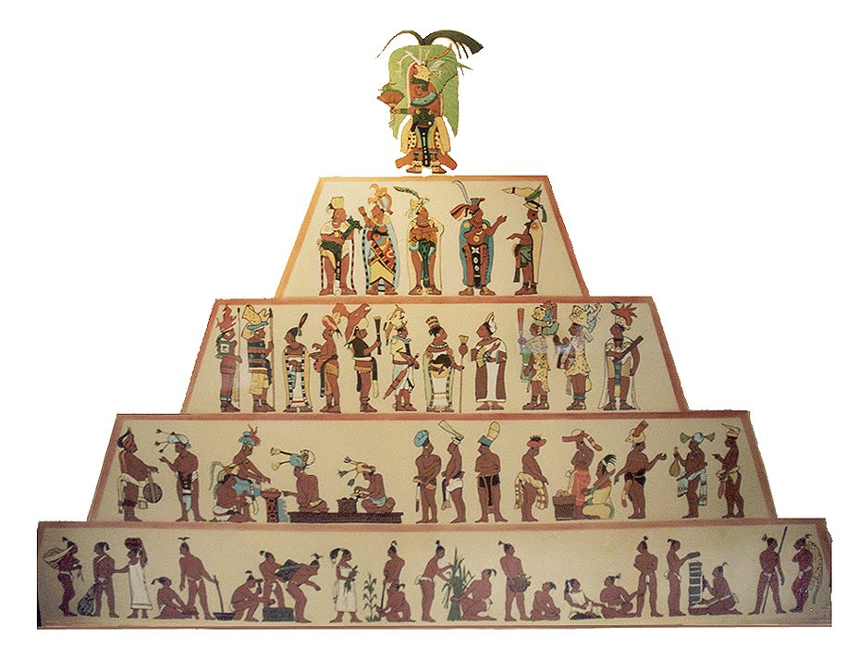
THE ARYANS AND THE CASTE SYSTEM
Caste members lived, ate, married, and worked with their own group. A person born into one caste rarely changed castes or mixed with members of other castes.

Slide 7
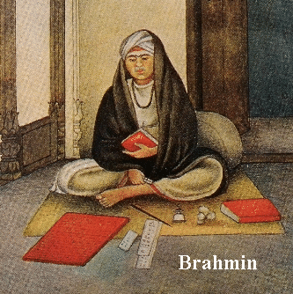
THE ARYANS AND THE CASTE SYSTEM
At the top of the caste system were the Brahmin and the Kshatriya . The Brahmin were the priests, teachers, and judges who understood dharma. Dharma were the spiritual laws that the people of ancient India believed governed the universe. The Brahman often lived apart from the rest of society in temples.

Slide 8
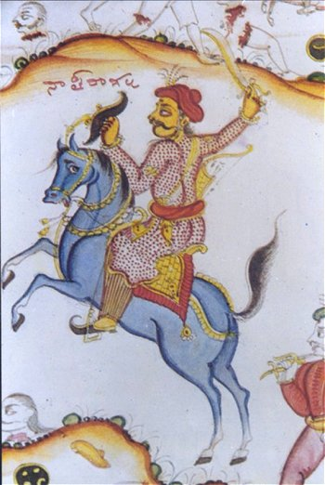
THE ARYANS AND THE CASTE SYSTEM
The Kshatriya were the warrior caste who made everyday decisions and ran the government. The Kshatriya had most of the power in everyday life, but their decisions could be overruled by the Brahmin.

Slide 9
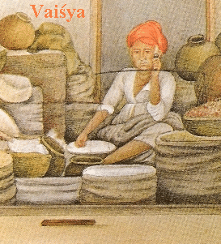
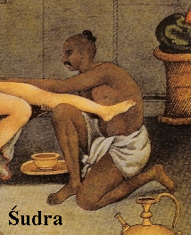
THE ARYANS AND THE CASTE SYSTEM
The Visayas were skilled farmers and merchants. They occasionally had leadership positions in local villages.
The unskilled workers were of the Sudras caste. Members of the Sudras caste often worked on the farms of the people of higher castes.

Slide 10
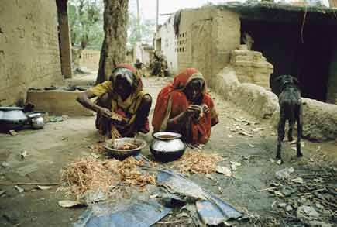
THE ARYANS AND THE CASTE SYSTEM
Foreigners, lawbreakers, people from isolated tribes, and people suffering from contagious diseases were called the untouchables or “outcastes.” Members of this caste were traditionally regarded as unsuitable for personal relations with people in the caste system.

Slide 11
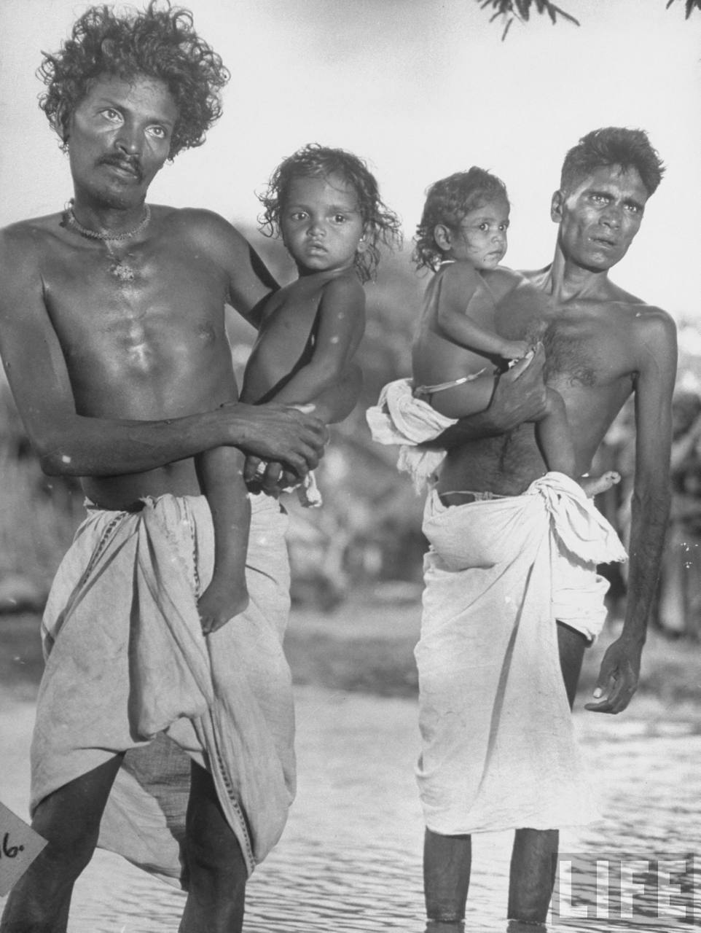
THE ARYANS AND THE CASTE SYSTEM
These “untouchables” had jobs or habits that involved “polluting activities” such as having a job that involved ending a life. Caste members were vegetarians, so people who ate meat or fish were not accepted into their society. Untouchables were hired to do work that members of the caste system would not do.

Slide 12
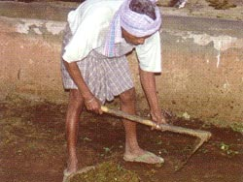
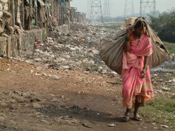
THE ARYANS AND THE CASTE SYSTEM
These jobs included killing or disposing of dead cattle or working with their hides. The untouchables also worked as sweepers, washers, or in other jobs that required contact with human emissions such as sweat, urine, or feces.

Slide 13
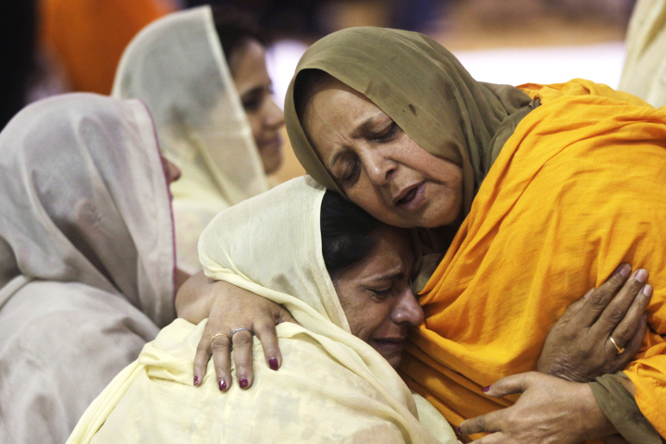
THE ARYANS AND THE CASTE SYSTEM
Untouchables were often forbidden to enter temples, schools and wells where caste members drew water. In some parts of India, even the sight of untouchables was thought to be polluting. The untouchables were often forced to sleep during the day and work at night.
The caste system became less rigid as the Indian people were exposed to outside ideas. Many untouchables left their rigid social structure by converting to Islam, Buddhism, or Christianity.

Slide 14
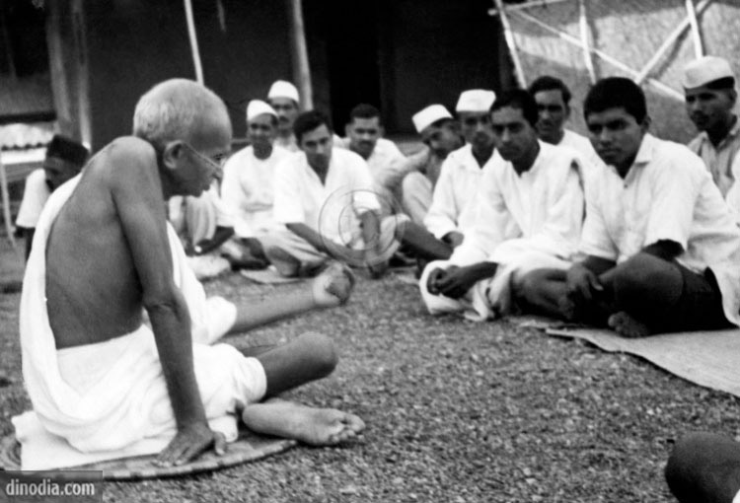
THE ARYANS AND THE CASTE SYSTEM
Gandhi referred to the untouchables as the Harijan, a term that means “blessed” because Gandhi believed the Harijan were blessed by their suffering. In modern usage, Gandhi’s term has been rejected as demeaning. The Harijan prefer call themselves the Dalit, a term that can be translated as “oppressed.”

Slide 15
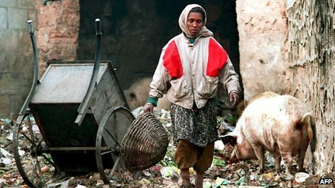
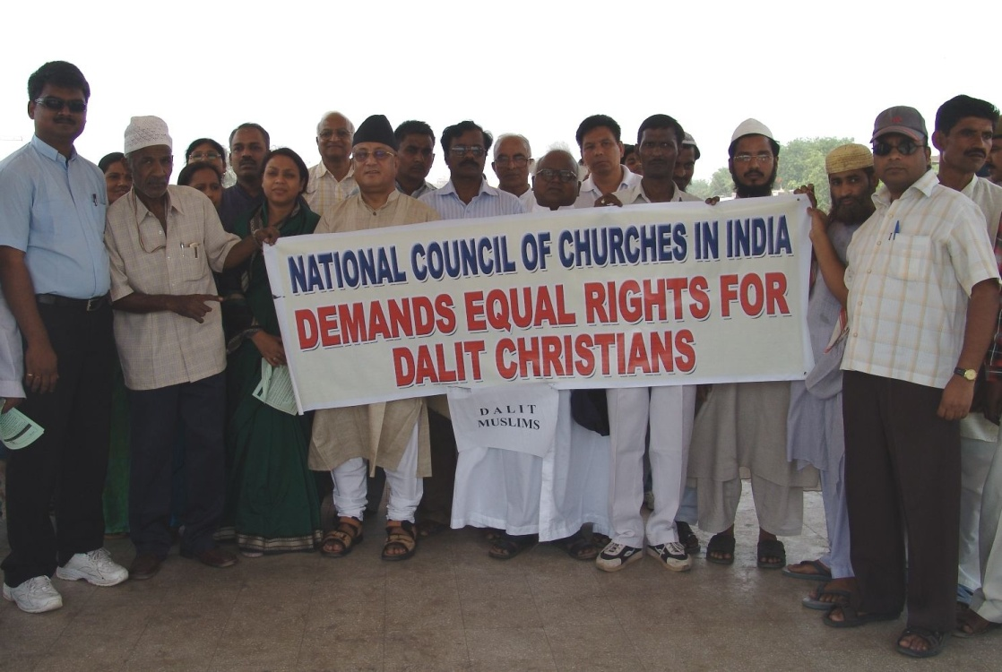
THE ARYANS AND THE CASTE SYSTEM
The Indian government has provided the Dalit with specific employment privileges, and granted them special representation in the Indian parliament. Despite such measures, the Dalit continue to have fewer educational and employment opportunities than Indians whose families belonged to the caste system.

Slide 16
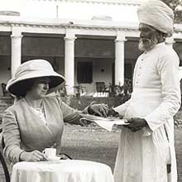
THE ARYANS AND THE CASTE SYSTEM
The British controlled part or all of the Indian subcontinent from 1612 to 1947. The British thought that caste members believed they would have to live out their lives in a particular caste in order to be reborn into a higher caste. We now know that some Indian people did have an opportunity to join higher castes, but this didn’t happen very often.

Slide 17
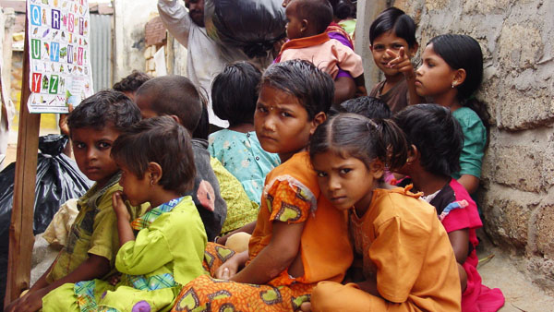
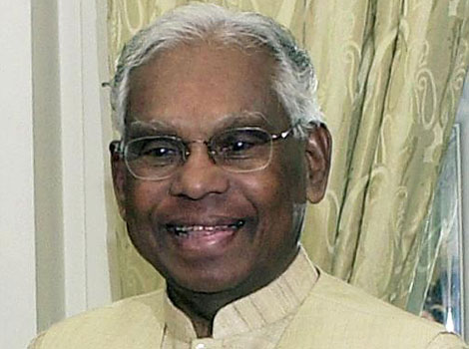
THE ARYANS AND THE CASTE SYSTEM
Discrimination against the Dalit has been forbidden by the Indian Constitution since 1950 but many of India’s 160 million Dalit continue to live in poverty. Indian people with family names associated with the Dalit often face prejudice, though, the Indian people elected a Dalit to the presidency. K. R. Narayanan served in that position from 1997 to 2002.

