Slide 1
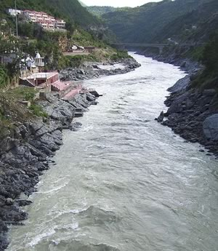
Hinduism Ancient India
Every spring the Ganges River swells with water as snow melts in the Himalayas. The water brings life as trees and flowers bloom and crops grow. This cycle of rebirth is a metaphor for Hinduism, the religious faith of most people in India.

Slide 2
Hinduism Ancient India
Every spring the Ganges River swells with water as snow melts in the Himalayas. The water brings life as trees and flowers bloom and crops grow. This cycle of rebirth is a metaphor for Hinduism, the religious faith of most people in India.

Slide 3
Hinduism Ancient India
Every spring the Ganges River swells with water as snow melts in the Himalayas. The water brings life as trees and flowers bloom and crops grow. This cycle of rebirth is a metaphor for Hinduism, the religious faith of most people in India.

Slide 4
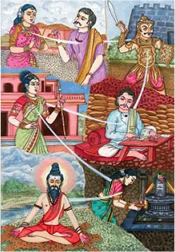
Hinduism Ancient India
Hindus believe that every living thing has a soul, which comes from the creator, Brahman. They believe that people’s souls live on after death, and that all living things can be reborn. This is called reincarnation.

Slide 5
Hinduism Ancient India
Hindus believe that every living thing has a soul, which comes from the creator, Brahman. They believe that people’s souls live on after death, and that all living things can be reborn. This is called reincarnation.

Slide 6
Hinduism Ancient India
Hindus believe that every living thing has a soul, which comes from the creator, Brahman. They believe that people’s souls live on after death, and that all living things can be reborn. This is called reincarnation.

Slide 7
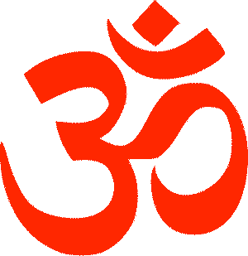
Hinduism Ancient India
Hinduism is the traditional religion of India. It is a combination of Aryan, Dravidian and other Indian cultures and traditions. Hinduism has no single founder, but is influenced by the Vedas and other scriptures. The world’s oldest religion, Hinduism is practiced by nearly one billion people, who live almost exclusively on the Indian subcontinent.

Slide 8
Hinduism Ancient India
Hinduism is the traditional religion of India. It is a combination of Aryan, Dravidian and other Indian cultures and traditions. Hinduism has no single founder, but is influenced by the Vedas and other scriptures. The world’s oldest religion, Hinduism is practiced by nearly one billion people, who live almost exclusively on the Indian subcontinent.

Slide 9
Hinduism Ancient India
Hinduism is the traditional religion of India. It is a combination of Aryan, Dravidian and other Indian cultures and traditions. Hinduism has no single founder, but is influenced by the Vedas and other scriptures. The world’s oldest religion, Hinduism is practiced by nearly one billion people, who live almost exclusively on the Indian subcontinent.

Slide 10
Hinduism Ancient India
Hinduism is the traditional religion of India. It is a combination of Aryan, Dravidian and other Indian cultures and traditions. Hinduism has no single founder, but is influenced by the Vedas and other scriptures. The world’s oldest religion, Hinduism is practiced by nearly one billion people, who live almost exclusively on the Indian subcontinent.

Slide 11
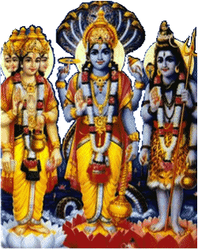
Hinduism Ancient India
Hinduism teaches that there is one universal spirit called Brahman. But Hindus seldom worship Brahman directly. They instead worship Brahma, Vishnu and Shiva, three gods that are different forms of Brahman.

Slide 12
Hinduism Ancient India
Hinduism teaches that there is one universal spirit called Brahman. But Hindus seldom worship Brahman directly. They instead worship Brahma, Vishnu and Shiva, three gods that are different forms of Brahman.

Slide 13
Hinduism Ancient India
Hinduism teaches that there is one universal spirit called Brahman. But Hindus seldom worship Brahman directly. They instead worship Brahma, Vishnu and Shiva, three gods that are different forms of Brahman.

Slide 14
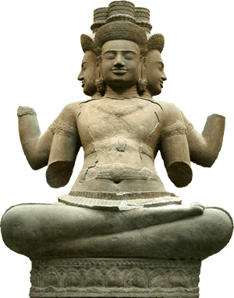
Hinduism Ancient India
Brahma is the god of knowledge and the creator of the universe whose work is almost complete. Brahma is often pictured with four heads facing in different directions.

Slide 15
Hinduism Ancient India
Brahma is the god of knowledge and the creator of the universe whose work is almost complete. Brahma is often pictured with four heads facing in different directions.

Slide 16
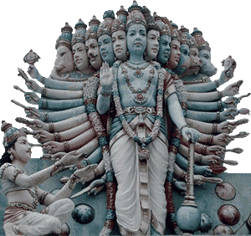
Hinduism Ancient India
Vishnu is the preserver of the universe who protects us from evil. Hindus believe that Vishnu often takes on human forms called avatars, so he can guide all living things.

Slide 17
Hinduism Ancient India
Vishnu is the preserver of the universe who protects us from evil. Hindus believe that Vishnu often takes on human forms called avatars, so he can guide all living things.

Slide 18
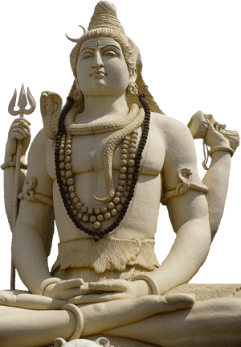
Hinduism Ancient India
Shiva is the god of destruction and re-creation. Shiva represents change, from day to night, across the seasons, and throughout our lives. Shiva is often depicted as having four arms, which represent the different directions we can take in life.

Slide 19
Hinduism Ancient India
Shiva is the god of destruction and re-creation. Shiva represents change, from day to night, across the seasons, and throughout our lives. Shiva is often depicted as having four arms, which represent the different directions we can take in life.

Slide 20
Hinduism Ancient India
Shiva is the god of destruction and re-creation. Shiva represents change, from day to night, across the seasons, and throughout our lives. Shiva is often depicted as having four arms, which represent the different directions we can take in life.

Slide 21
Hinduism Ancient India
Many Hindus believe that our status in this life depends upon the karma that human beings accumulate in previous lives. Karma can be defined as the rewards or punishments a person faces because of their thoughts, words, and actions. A happy person who treats others with kindness and respect creates good karma. Likewise, a person who mistreats others will in turn be mistreated. This is bad karma.

Slide 22
Hinduism Ancient India
Many Hindus believe that our status in this life depends upon the karma that human beings accumulate in previous lives. Karma can be defined as the rewards or punishments a person faces because of their thoughts, words, and actions. A happy person who treats others with kindness and respect creates good karma. Likewise, a person who mistreats others will in turn be mistreated. This is bad karma.

Slide 23
Hinduism Ancient India
Many Hindus believe that our status in this life depends upon the karma that human beings accumulate in previous lives. Karma can be defined as the rewards or punishments a person faces because of their thoughts, words, and actions. A happy person who treats others with kindness and respect creates good karma. Likewise, a person who mistreats others will in turn be mistreated. This is bad karma.

Slide 24
Hinduism Ancient India
Many Hindus believe that our status in this life depends upon the karma that human beings accumulate in previous lives. Karma can be defined as the rewards or punishments a person faces because of their thoughts, words, and actions. A happy person who treats others with kindness and respect creates good karma. Likewise, a person who mistreats others will in turn be mistreated. This is bad karma.

Slide 25
Hinduism Ancient India
Many Hindus believe that our status in this life depends upon the karma that human beings accumulate in previous lives. Karma can be defined as the rewards or punishments a person faces because of their thoughts, words, and actions. A happy person who treats others with kindness and respect creates good karma. Likewise, a person who mistreats others will in turn be mistreated. This is bad karma.

Slide 26
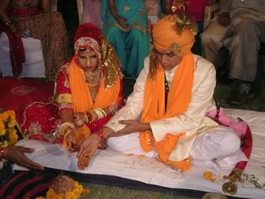
Hinduism Ancient India
Traditionally, the people of the subcontinent believed that a person who followed the rules of their caste would be reborn as a higher form in the next life. Someone who neglected their duties would be reborn in a lower form of life, perhaps as an animal or insect.

Slide 27
Hinduism Ancient India
Traditionally, the people of the subcontinent believed that a person who followed the rules of their caste would be reborn as a higher form in the next life. Someone who neglected their duties would be reborn in a lower form of life, perhaps as an animal or insect.

Slide 28
Hinduism Ancient India
The goal of Hinduism is to escape the cycle of rebirth by reaching Nirvana. Nirvana is a Sanskrit word that means ending. Hindus and Buddhists believe Nirvana is a state of happiness without change or pain.

Slide 29
Hinduism Ancient India
The goal of Hinduism is to escape the cycle of rebirth by reaching Nirvana. Nirvana is a Sanskrit word that means ending. Hindus and Buddhists believe Nirvana is a state of happiness without change or pain.

Slide 30
Hinduism Ancient India
The goal of Hinduism is to escape the cycle of rebirth by reaching Nirvana. Nirvana is a Sanskrit word that means ending. Hindus and Buddhists believe Nirvana is a state of happiness without change or pain.

Slide 31
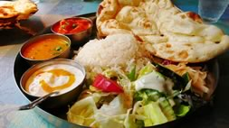
Hinduism Ancient India
Because they believe all living things have souls, most Hindus are vegetarians; they believe that animals should live their natural lives and should not be killed for food. Some Hindus are vegan, which means they will not eat any animal products, including eggs or cheese.

Slide 32
Hinduism Ancient India
Because they believe all living things have souls, most Hindus are vegetarians; they believe that animals should live their natural lives and should not be killed for food. Some Hindus are vegan, which means they will not eat any animal products, including eggs or cheese.

Slide 33
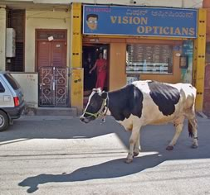
Hinduism Ancient India
Other Hindus will eat poultry and fish, but will not consume beef. Cows are particularly sacred to Hindus because they are associated with Brahma; it is not unusual to see a cow wandering through the streets of an Indian city.

Slide 34
Hinduism Ancient India
Other Hindus will eat poultry and fish, but will not consume beef. Cows are particularly sacred to Hindus because they are associated with Brahma; it is not unusual to see a cow wandering through the streets of an Indian city.

Slide 35
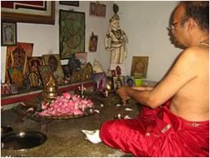
Hinduism Ancient India
Many Hindus worship privately by performing rituals known as puja at a shrine in their homes. A Hindu may practice yoga, a system of exercise and meditation that teaches the practitioner mastery of their mind, body and emotions. There are Hindu temples
(mandirs) and holy
locations, but there
are no set rules for
worship.

Slide 36
Hinduism Ancient India
Many Hindus worship privately by performing rituals known as puja at a shrine in their homes. A Hindu may practice yoga, a system of exercise and meditation that teaches the practitioner mastery of their mind, body and emotions. There are Hindu temples
(mandirs) and holy
locations, but there
are no set rules for
worship.

Slide 37
Hinduism Ancient India
Many Hindus worship privately by performing rituals known as puja at a shrine in their homes. A Hindu may practice yoga, a system of exercise and meditation that teaches the practitioner mastery of their mind, body and emotions. There are Hindu temples
(mandirs) and holy
locations, but there
are no set rules for
worship.

Slide 38
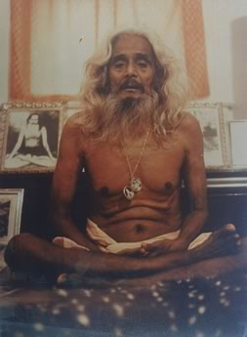
Hinduism Ancient India
A guru is a spiritual teacher who understands dharma, the spiritual laws that govern the universe. Many Hindus are loyal to their gurus because they regard the gurus as representatives of Brahma who can help them escape the cycle of death and rebirth.

Slide 39
Hinduism Ancient India
A guru is a spiritual teacher who understands dharma, the spiritual laws that govern the universe. Many Hindus are loyal to their gurus because they regard the gurus as representatives of Brahma who can help them escape the cycle of death and rebirth.

Slide 40
Hinduism Ancient India
Hindus believe that water is holy because water brings life, particularly if the water is flowing in a river. The holiest of rivers is the Ganges River.

Slide 41
Hinduism Ancient India
Hindus believe that water is holy because water brings life, particularly if the water is flowing in a river. The holiest of rivers is the Ganges River.

Slide 42
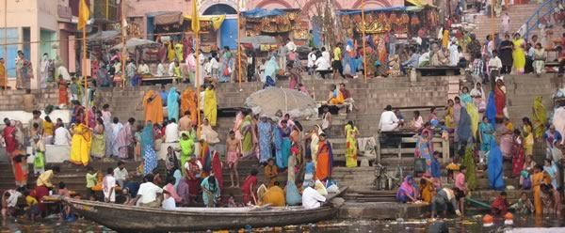
Hinduism Ancient India
Lately, the Ganges has become very polluted, but Hindus believe the water from the Himalayas will purify the souls of those who drink or bathe in its waters.

Slide 43
Hinduism Ancient India
Many Hindus make a pilgrimage to the Ganges. Others travel to the river at the end of their lives so they may die near the banks of the Ganges.

Slide 44
Hinduism Ancient India
Many Hindus make a pilgrimage to the Ganges. Others travel to the river at the end of their lives so they may die near the banks of the Ganges.

Slide 45
Music credit:
Dhaka by Kevin MacLeod at incompetech.com
Licensed under Creative Commons: By Attribution 3.0
http://creativecommons.org/licenses/by/3.0/
Learn more about history at
www.mrdowling.com

