Slide 1
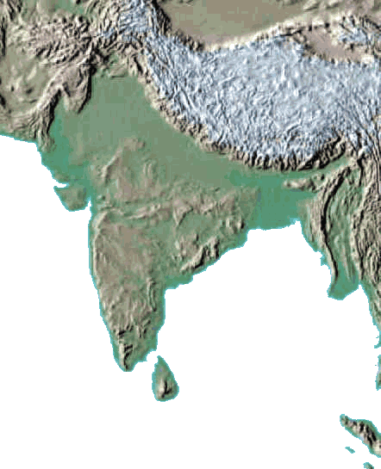

Subcontinent Ancient India
The Indian subcontinent
is a peninsula that juts
southward from the rest
of Asia like an enormous
arrowhead. The Himalayan
Mountains separate the
subcontinent from the rest of
Asia. The first three letters of
the word tell us that while it is
a distinct landmass, the
subcontinent of India is not large enough to be considered a continent.

Slide 2
Subcontinent Ancient India
The Indian subcontinent
is a peninsula that juts
southward from the rest
of Asia like an enormous
arrowhead. The Himalayan
Mountains separate the
subcontinent from the rest of
Asia. The first three letters of
the word tell us that while it is
a distinct landmass, the
subcontinent of India is not large enough to be considered a continent.

Slide 3
Subcontinent Ancient India
The Indian subcontinent
is a peninsula that juts
southward from the rest
of Asia like an enormous
arrowhead. The Himalayan
Mountains separate the
subcontinent from the rest of
Asia. The first three letters of
the word tell us that while it is
a distinct landmass, the
subcontinent of India is not large enough to be considered a continent.

Slide 4
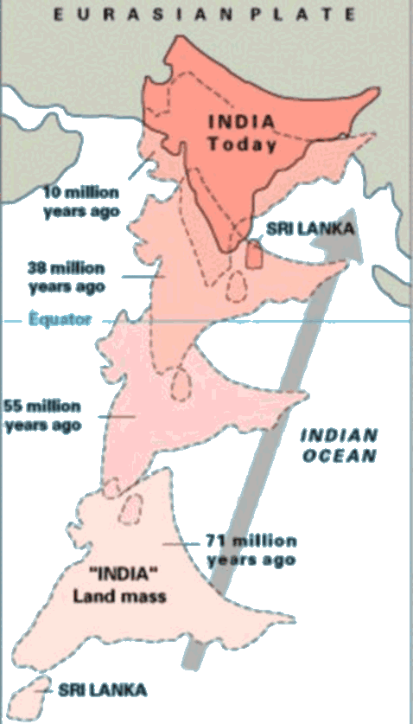
Subcontinent Ancient India
The Indian subcontinent is part of a tectonic plate that has been moving for more than 200 million years. The plate was once attached to Africa, Australia and Antarctica, but it separated and began a slow collision with Asia 50 million years ago.

Slide 5
Subcontinent Ancient India
The Indian subcontinent is part of a tectonic plate that has been moving for more than 200 million years. The plate was once attached to Africa, Australia and Antarctica, but it separated and began a slow collision with Asia 50 million years ago.

Slide 6
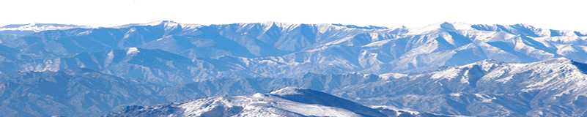
Subcontinent Ancient India
When the two landmasses met, the terrain was forced upward to create the Himalayas. Scientists believe the Himalayas are likely to continue rising for the next several million years. Many of the peaks that make up the Himalayan mountains tower more than five miles above sea level, making them the world’s tallest mountain chain. Himalaya means “home of snow” because the tallest peaks of the mountain range are always capped with snow.

Slide 7
Subcontinent Ancient India
When the two landmasses met, the terrain was forced upward to create the Himalayas. Scientists believe the Himalayas are likely to continue rising for the next several million years. Many of the peaks that make up the Himalayan mountains tower more than five miles above sea level, making them the world’s tallest mountain chain. Himalaya means “home of snow” because the tallest peaks of the mountain range are always capped with snow.

Slide 8
Subcontinent Ancient India
When the two landmasses met, the terrain was forced upward to create the Himalayas. Scientists believe the Himalayas are likely to continue rising for the next several million years. Many of the peaks that make up the Himalayan mountains tower more than five miles above sea level, making them the world’s tallest mountain chain. Himalaya means “home of snow” because the tallest peaks of the mountain range are always capped with snow.

Slide 9
Subcontinent Ancient India
When the two landmasses met, the terrain was forced upward to create the Himalayas. Scientists believe the Himalayas are likely to continue rising for the next several million years. Many of the peaks that make up the Himalayan mountains tower more than five miles above sea level, making them the world’s tallest mountain chain. Himalaya means “home of snow” because the tallest peaks of the mountain range are always capped with snow.

Slide 10
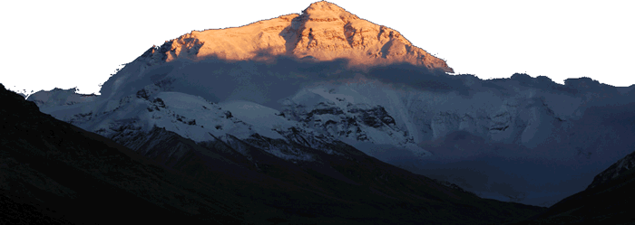
Subcontinent Ancient India
The Himalayas include Mount Everest, the tallest mountain in the world. Everest rises 29,028 feet above sea level on the border between India and Nepal. No plant life grows near the mountain’s peak due to powerful winds, extremely cold temperatures, and a lack of carbon
dioxide.

Slide 11
Subcontinent Ancient India
The Himalayas include Mount Everest, the tallest mountain in the world. Everest rises 29,028 feet above sea level on the border between China and Nepal. No plant life grows near the mountain’s peak due to powerful winds, extremely cold temperatures, and a lack of carbon
dioxide.

Slide 12
Subcontinent Ancient India
The Himalayas include Mount Everest, the tallest mountain in the world. Everest rises 29,028 feet above sea level on the border between China and Nepal. No plant life grows near the mountain’s peak due to powerful winds, extremely cold temperatures, and a lack of carbon
dioxide.

Slide 13
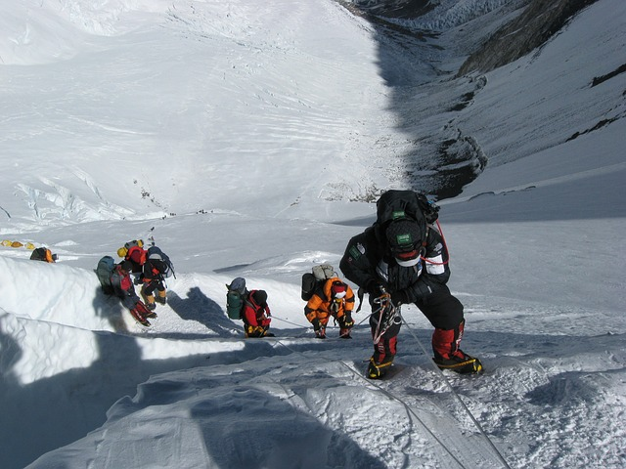
Subcontinent Ancient India
Many adventurous people attempt to climb Everest every year. Often their venture ends in sickness or death. Most people are unable to breathe 20,000 feet above sea level because there is not enough oxygen in the atmosphere.
A person will suffer
brain damage when
they are unable to
breathe.

Slide 14
Subcontinent Ancient India
Many adventurous people attempt to climb Everest every year. Often their venture ends in sickness or death. Most people are unable to breathe 20,000 feet above sea level because there is not enough oxygen in the atmosphere.
A person will suffer
brain damage when
they are unable to
breathe.

Slide 15
Subcontinent Ancient India
Many adventurous people attempt to climb Everest every year. Often their venture ends in sickness or death. Most people are unable to breathe 20,000 feet above sea level because there is not enough oxygen in the atmosphere.
A person will suffer
brain damage when
they are unable to
breathe.

Slide 16
Subcontinent Ancient India
Many adventurous people attempt to climb Everest every year. Often their venture ends in sickness or death. Most people are unable to breathe 20,000 feet above sea level because there is not enough oxygen in the atmosphere.
A person will suffer
brain damage when
they are unable to
breathe.

Slide 17
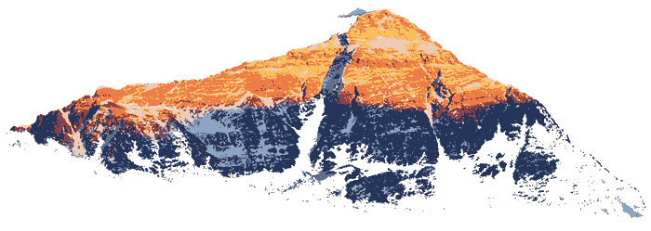
Subcontinent Ancient India
Strong winds and frigid temperatures combined with the lack of oxygen make the Himalayan climate very rigorous. Clearly the peak of Mount Everest is a place for only the heartiest of people.

Slide 18
Subcontinent Ancient India
Strong winds and frigid temperatures combined with the lack of oxygen make the Himalayan climate very rigorous. Clearly the peak of Mount Everest is a place for only the heartiest of people.

Slide 19

Subcontinent Ancient India
Music credit:
Desert City by Kevin MacLeod (incompetech.com)
Licensed under Creative Commons: By Attribution 3.0
http://creativecommons.org/licenses/by/3.0/
Learn more about history at
www.mrdowling.com

