Slide 1

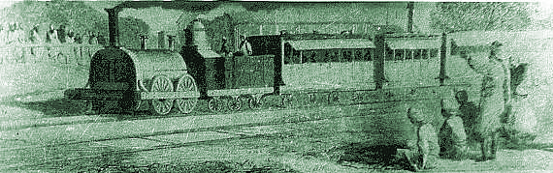
Harappa and Mohenjo Daro Ancient India
In 1856, a group of British railroad engineers uncovered an ancient and advanced civilization. The engineers were laying tracks through the Indus River Valley in present day Pakistan.

Slide 2
Harappa and Mohenjo Daro Ancient India
In 1856, a group of British railroad engineers uncovered an ancient and advanced civilization. The engineers were laying tracks through the Indus River Valley in present day Pakistan.

Slide 3
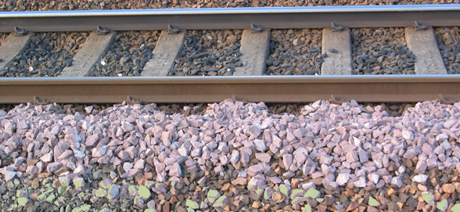
Harappa and Mohenjo Daro Ancient India
They searched the area for stone to make ballast. Ballast is crushed rock placed around railroad tracks to drain water from the path of the train.

Slide 4
Harappa and Mohenjo Daro Ancient India
They searched the area for stone to make ballast. Ballast is crushed rock placed around railroad tracks to drain water from the path of the train.

Slide 5
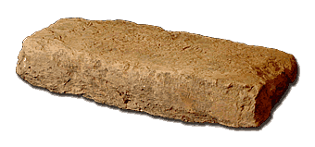
Harappa and Mohenjo Daro Ancient India
The engineers found bricks that seemed very old, but were formed exactly alike. The local people told the engineers of the ruins of an ancient city made of the same bricks. The engineers soon realized that the bricks were part of one of the earliest advanced civilizations in history.

Slide 6
Harappa and Mohenjo Daro Ancient India
The engineers found bricks that seemed very old, but were formed exactly alike. The local people told the engineers of the ruins of an ancient city made of the same bricks. The engineers soon realized that the bricks were part of one of the earliest advanced civilizations in history.

Slide 7
Harappa and Mohenjo Daro Ancient India
The engineers found bricks that seemed very old, but were formed exactly alike. The local people told the engineers of the ruins of an ancient city made of the same bricks. The engineers soon realized that the bricks were part of one of the earliest advanced civilizations in history.

Slide 8
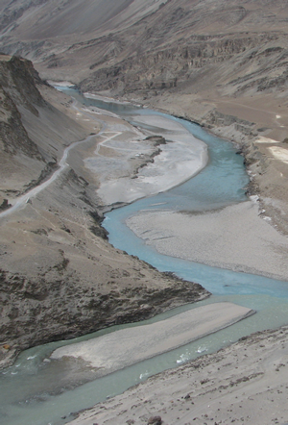
Harappa and Mohenjo Daro Ancient India
Archaeologists later discovered more than 1500 additional settlements along the banks of the Indus River. As with Mesopotamia and Egypt, the river’s silt provided the civilization with rich topsoil for farming.

Slide 9
Harappa and Mohenjo Daro Ancient India
Archaeologists later discovered more than 1500 additional settlements along the banks of the Indus River. As with Mesopotamia and Egypt, the river’s silt provided the civilization with rich topsoil for farming.

Slide 10
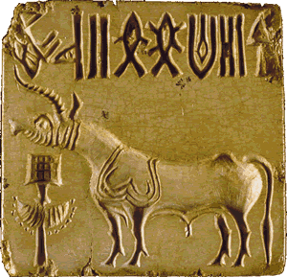
Harappa and Mohenjo Daro Ancient India
Thousands of clay tablets
indicate that the people
of the Indus River Valley
developed a writing
system that may be even
older than Sumerian
writing. Archaeologists
have not yet deciphered
the writing of the Indus River Valley civilization, so their form of government, their religious beliefs, or the social structure of their society remain a mystery.

Slide 11
Harappa and Mohenjo Daro Ancient India
Thousands of clay tablets
indicate that the people
of the Indus River Valley
developed a writing
system that may be even
older than Sumerian
writing. Archaeologists
have not yet deciphered
the writing of the Indus River Valley civilization, so their form of government, their religious beliefs, or the social structure of their society remain a mystery.

Slide 12
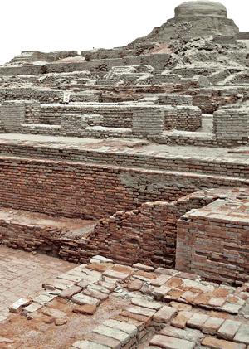
Harappa and Mohenjo Daro Ancient India
The Indus River civilization developed about 3000BCE and flourished for about 1500 years before mysteriously going into a period of decline. We don’t know
what those ancient people
called the cities they lived
in, but we now refer to the
two largest as Harappa,
after a nearby village, and
Mohenjo Daro, a local
term that means “hill of
the dead.”

Slide 13
Harappa and Mohenjo Daro Ancient India
The Indus River civilization developed about 3000BCE and flourished for about 1500 years before mysteriously going into a period of decline. We don’t know
what those ancient people
called the cities they lived
in, but we now refer to the
two largest as Harappa,
after a nearby village, and
Mohenjo Daro, a local
term that means “hill of
the dead.”

Slide 14
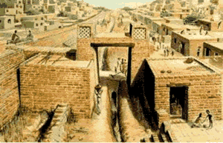
Harappa and Mohenjo Daro Ancient India
Harappa and Mohenjo Daro
were expertly planned cities
built with a grid pattern of
wide, straight streets. Thick
walls surrounded the cities.
Many people lived in sturdy brick houses that had as many as three floors. Some houses had bathrooms and toilets that connected to the world’s first sewer system. An irrigation system of canals provided a reliable source of water for growing wheat and barley. There is also evidence that people herded sheep, cattle and goats.

Slide 15
Harappa and Mohenjo Daro Ancient India
Harappa and Mohenjo Daro
were expertly planned cities
built with a grid pattern of
wide, straight streets. Thick
walls surrounded the cities.
Many people lived in sturdy brick houses that had as many as three floors. Some houses had bathrooms and toilets that connected to the world’s first sewer system. An irrigation system of canals provided a reliable source of water for growing wheat and barley. There is also evidence that people herded sheep, cattle and goats.

Slide 16
Harappa and Mohenjo Daro Ancient India
Harappa and Mohenjo Daro
were expertly planned cities
built with a grid pattern of
wide, straight streets. Thick
walls surrounded the cities.
Many people lived in sturdy brick houses that had as many as three floors. Some houses had bathrooms and toilets that connected to the world’s first sewer system. An irrigation system of canals provided a reliable source of water for growing wheat and barley. There is also evidence that people herded sheep, cattle and goats.

Slide 17
Harappa and Mohenjo Daro Ancient India
Harappa and Mohenjo Daro
were expertly planned cities
built with a grid pattern of
wide, straight streets. Thick
walls surrounded the cities.
Many people lived in sturdy brick houses that had as many as three floors. Some houses had bathrooms and toilets that connected to the world’s first sewer system. An irrigation system of canals provided a reliable source of water for growing wheat and barley. There is also evidence that people herded sheep, cattle and goats.

Slide 18
Harappa and Mohenjo Daro Ancient India
Harappa and Mohenjo Daro
were expertly planned cities
built with a grid pattern of
wide, straight streets. Thick
walls surrounded the cities.
Many people lived in sturdy brick houses that had as many as three floors. Some houses had bathrooms and toilets that connected to the world’s first sewer system. An irrigation system of canals provided a reliable source of water for growing wheat and barley. There is also evidence that people herded sheep, cattle and goats.

Slide 19
Harappa and Mohenjo Daro Ancient India
Harappa and Mohenjo Daro
were expertly planned cities
built with a grid pattern of
wide, straight streets. Thick
walls surrounded the cities.
Many people lived in sturdy brick houses that had as many as three floors. Some houses had bathrooms and toilets that connected to the world’s first sewer system. An irrigation system of canals provided a reliable source of water for growing wheat and barley. There is also evidence that people herded sheep, cattle and goats.

Slide 20
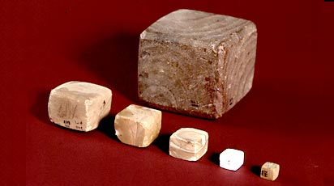
Harappa and Mohenjo Daro Ancient India
The ancient people of the Indus River Valley had a highly advanced knowledge of mathematics and a sophisticated system of weights and measures. The bricks–even those used in different cities–are the same size, suggesting that the cities may have had the same government.

Slide 21
Harappa and Mohenjo Daro Ancient India
The ancient people of the Indus River Valley had a highly advanced knowledge of mathematics and a sophisticated system of weights and measures. The bricks–even those used in different cities–are the same size, suggesting that the cities may have had the same government.

Slide 22
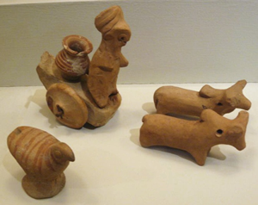
Harappa and Mohenjo Daro Ancient India
Archaeologists have also found evidence of musical instruments, toys and games, and pottery. The people of the Indus River valley were very interested in cleanliness. Archeologists have uncovered evidence of combs, soaps, and medicine. The cities were also practicing some
form of dentistry because
archaeologists found a
gravesite with the remains
of people whose teeth
had been drilled.

Slide 23
Harappa and Mohenjo Daro Ancient India
Archaeologists have also found evidence of musical instruments, toys and games, and pottery. The people of the Indus River valley were very interested in cleanliness. Archeologists have uncovered evidence of combs, soaps, and medicine. The cities were also practicing some
form of dentistry because
archaeologists found a
gravesite with the remains
of people whose teeth
had been drilled.

Slide 24
Harappa and Mohenjo Daro Ancient India
Archaeologists have also found evidence of musical instruments, toys and games, and pottery. The people of the Indus River valley were very interested in cleanliness. Archeologists have uncovered evidence of combs, soaps, and medicine. The cities were also practicing some
form of dentistry because
archaeologists found a
gravesite with the remains
of people whose teeth
had been drilled.

Slide 25
Harappa and Mohenjo Daro Ancient India
Archaeologists have also found evidence of musical instruments, toys and games, and pottery. The people of the Indus River valley were very interested in cleanliness. Archeologists have uncovered evidence of combs, soaps, and medicine. The cities were also practicing some
form of dentistry because
archaeologists found a
gravesite with the remains
of people whose teeth
had been drilled.

Slide 26
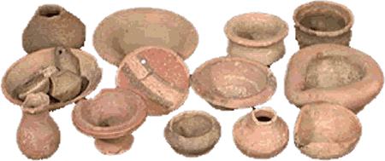
Harappa and Mohenjo Daro Ancient India
The Indus River Valley cities traded with distant foreign cultures. Archaeologists have found jewelry made in Harappa as far away as Mesopotamia. Traders also sold cotton cloth and hardwood from the teak trees that grew in the valley.

Slide 27
Harappa and Mohenjo Daro Ancient India
The Indus River Valley cities traded with distant foreign cultures. Archaeologists have found jewelry made in Harappa as far away as Mesopotamia. Traders also sold cotton cloth and hardwood from the teak trees that grew in the valley.

Slide 28
Harappa and Mohenjo Daro Ancient India
The Indus River Valley cities traded with distant foreign cultures. Archaeologists have found jewelry made in Harappa as far away as Mesopotamia. Traders also sold cotton cloth and hardwood from the teak trees that grew in the valley.

Slide 29
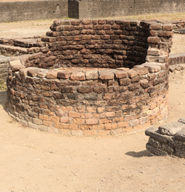
Harappa and Mohenjo Daro Ancient India
Ancient cities along the Indus River Valley may have been home to more than five million people, but the civilization went into decline about 1700BCE and seems to have been abandoned by about 1500BCE. Archaeologists have many ideas from the clues left behind, but no definite answers.

Slide 30
Harappa and Mohenjo Daro Ancient India
Ancient cities along the Indus River Valley may have been home to more than five million people, but the civilization went into decline about 1700BCE and seems to have been abandoned by about 1500BCE. Archaeologists have many ideas from the clues left behind, but no definite answers.

Slide 31
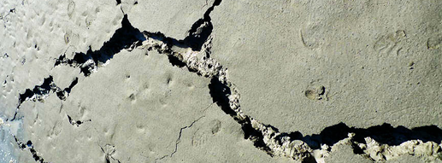
Harappa and Mohenjo Daro Ancient India
Perhaps a natural disaster could a destroyed the civilization. There may have been a prolonged drought, or the moving tectonic plates that created the Himalayas may have caused a devastating earthquake. Some evidence suggests the Indus Valley cities were invaded by nomadic warriors who destroyed their advanced culture.

Slide 32
Harappa and Mohenjo Daro Ancient India
Perhaps a natural disaster could a destroyed the civilization. There may have been a prolonged drought, or the moving tectonic plates that created the Himalayas may have caused a devastating earthquake. Some evidence suggests the Indus Valley cities were invaded by nomadic warriors who destroyed their advanced culture.

Slide 33
Harappa and Mohenjo Daro Ancient India
Perhaps a natural disaster could a destroyed the civilization. There may have been a prolonged drought, or the moving tectonic plates that created the Himalayas may have caused a devastating earthquake. Some evidence suggests the Indus Valley cities were invaded by nomadic warriors who destroyed their advanced culture.

Slide 34
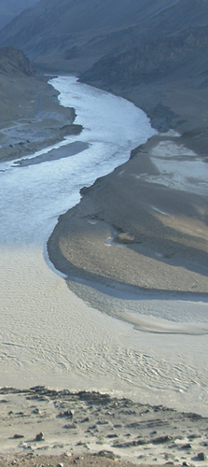
Harappa and Mohenjo Daro Ancient India
It is also possible that the people of the Indus Valley cities may have unintentionally destroyed their environment. They may have overgrazed their land, exhausted their soil, or cut down the forests in their region. The people may have been left without wood for building and fuel, and without the trees to hold the topsoil in place, the land was vulnerable to severe flooding.

Slide 35
Harappa and Mohenjo Daro Ancient India
It is also possible that the people of the Indus Valley cities may have unintentionally destroyed their environment. They may have overgrazed their land, exhausted their soil, or cut down the forests in their region. The people may have been left without wood for building and fuel, and without the trees to hold the topsoil in place, the land was vulnerable to severe flooding.

Slide 36
Harappa and Mohenjo Daro Ancient India
It is also possible that the people of the Indus Valley cities may have unintentionally destroyed their environment. They may have overgrazed their land, exhausted their soil, or cut down the forests in their region. The people may have been left without wood for building and fuel, and without the trees to hold the topsoil in place, the land was vulnerable to severe flooding.

Slide 37
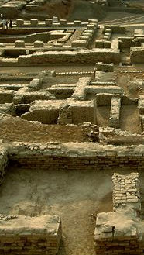
Harappa and Mohenjo Daro Ancient India
Archaeologists have excavated only a fraction of the many cities and settlements of the Indus River Valley civilization, so our understanding of the region is still evolving. Perhaps we may one day decipher their writing so we can learn how these ancient cities developed, how their citizens learned to create an advanced civilization, and why the cities were eventually abandoned.

Slide 38
Harappa and Mohenjo Daro Ancient India
Archaeologists have excavated only a fraction of the many cities and settlements of the Indus River Valley civilization, so our understanding of the region is still evolving. Perhaps we may one day decipher their writing so we can learn how these ancient cities developed, how their citizens learned to create an advanced civilization, and why the cities were eventually abandoned.

Slide 39

Harappa and Mohenjo Daro Ancient India
Music credit:
Imagine Magenta by
Dan-O at DanoSongs.com
Licensed under Creative Commons: By Attribution 3.0
http://creativecommons.org/licenses/by/3.0/
Learn more about history at
www.mrdowling.com

