Slide 1
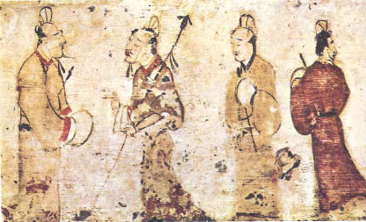
Dynasty Ancient China
From at least 1766BCE to the twentieth century of the Common Era, China was ruled by dynasties. A dynasty is a family that passes control from one generation to the next. A dynasty does not have to last for a long time. One Chinese dynasty lasted
more than 800
years while
another lasted only fifteen years.

Slide 2
Dynasty Ancient China
From at least 1766BCE to the twentieth century of the Common Era, China was ruled by dynasties. A dynasty is a family that passes control from one generation to the next. A dynasty does not have to last for a long time. One Chinese dynasty lasted
more than 800
years while
another lasted only fifteen years.

Slide 3
Dynasty Ancient China
From at least 1766BCE to the twentieth century of the Common Era, China was ruled by dynasties. A dynasty is a family that passes control from one generation to the next. A dynasty does not have to last for a long time. One Chinese dynasty lasted
more than 800
years while
another lasted only fifteen years.

Slide 4
Dynasty Ancient China
From at least 1766BCE to the twentieth century of the Common Era, China was ruled by dynasties. A dynasty is a family that passes control from one generation to the next. A dynasty does not have to last for a long time. One Chinese dynasty lasted
more than 800
years while
another lasted only fifteen years.

Slide 5
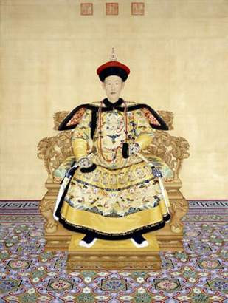
Dynasty Ancient China
The ancient Chinese believed their ancestors in heaven had chosen their leaders. They called this the Mandate of Heaven. The Chinese people often rebelled against a weak leader if they believed he had lost the Mandate of Heaven.

Slide 6
Dynasty Ancient China
The ancient Chinese believed their ancestors in heaven had chosen their leaders. They called this the Mandate of Heaven. The Chinese people often rebelled against a weak leader if they believed he had lost the Mandate of Heaven.

Slide 7
Dynasty Ancient China
The ancient Chinese believed their ancestors in heaven had chosen their leaders. They called this the Mandate of Heaven. The Chinese people often rebelled against a weak leader if they believed he had lost the Mandate of Heaven.

Slide 8
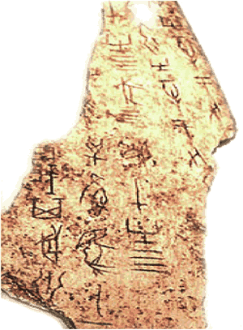
Dynasty Ancient China
There are indications of an earlier Hsia Dynasty, but the Shang were the first dynasty to leave written records. The Shang also developed a lunar calendar consisting of twelve months of 30 days each. The Shang Dynasty ruled China from approximately 1766BCE to about 1040BCE. Shang rulers expanded the borders of their kingdom to include all of the land between Mongolia and the Pacific Ocean.

Slide 9
Dynasty Ancient China
There are indications of an earlier Hsia Dynasty, but the Shang were the first dynasty to leave written records. The Shang also developed a lunar calendar consisting of twelve months of 30 days each. The Shang Dynasty ruled China from approximately 1766BCE to about 1040BCE. Shang rulers expanded the borders of their kingdom to include all of the land between Mongolia and the Pacific Ocean.

Slide 10
Dynasty Ancient China
There are indications of an earlier Hsia Dynasty, but the Shang were the first dynasty to leave written records. The Shang also developed a lunar calendar consisting of twelve months of 30 days each. The Shang Dynasty ruled China from approximately 1766BCE to about 1040BCE. Shang rulers expanded the borders of their kingdom to include all of the land between Mongolia and the Pacific Ocean.

Slide 11
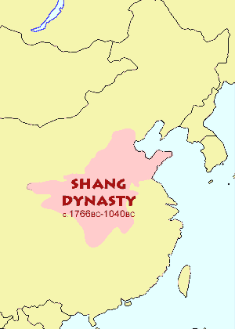
Dynasty Ancient China
There are indications of an earlier Hsia Dynasty, but the Shang were the first dynasty to leave written records. The Shang also developed a lunar calendar consisting of twelve months of 30 days each. The Shang Dynasty ruled China from approximately 1766BCE to about 1040BCE. Shang rulers expanded the borders of their kingdom to include all of the land between Mongolia and the Pacific Ocean.

Slide 12
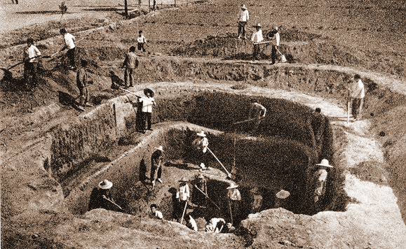
Dynasty Ancient China
The Shang practiced human sacrifice. If a Shang king died, many of his subjects would join the ruler in his grave. Some people were beheaded first but others were buried alive.

Slide 13
Dynasty Ancient China
The Shang practiced human sacrifice. If a Shang king died, many of his subjects would join the ruler in his grave. Some people were beheaded first but others were buried alive.

Slide 14
Dynasty Ancient China
The Shang practiced human sacrifice. If a Shang king died, many of his subjects would join the ruler in his grave. Some people were beheaded first but others were buried alive.

Slide 15
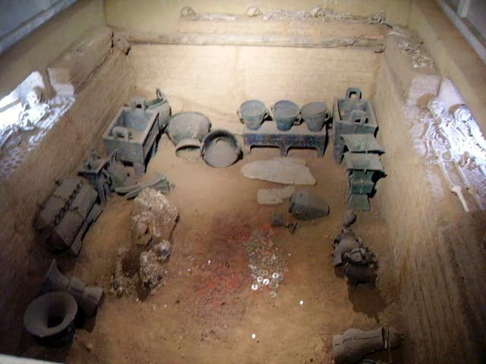
Dynasty Ancient China
When a Shang king died, his next oldest brother replaced him. When there were no brothers, the ruler’s oldest maternal nephew became king. A maternal nephew would be a child of one of the deceased king’s cousins – that is, a son of his mother’s siblings.

Slide 16
Dynasty Ancient China
When a Shang king died, his next oldest brother replaced him. When there were no brothers, the ruler’s oldest maternal nephew became king. A maternal nephew would be a child of one of the deceased king’s cousins – that is, a son of his mother’s siblings.

Slide 17
Dynasty Ancient China
When a Shang king died, his next oldest brother replaced him. When there were no brothers, the ruler’s oldest maternal nephew became king. A maternal nephew would be a child of one of the deceased king’s cousins – that is, a son of his mother’s siblings.

Slide 18
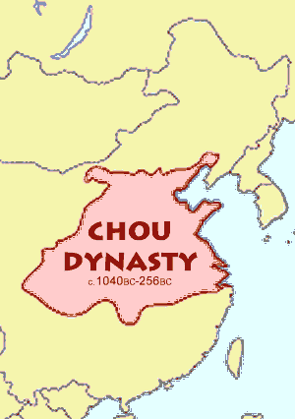
Dynasty Ancient China
The Chou were initially nomads who lived west of the Shang. They overthrew the Shang and ruled China from 1040BCE to the third century before the Common Era. The Chou gained power, in part, from their ability to extract iron from rocks. They used the metal to create powerful weapons.

Slide 19
Dynasty Ancient China
The Chou were initially nomads who lived west of the Shang. They overthrew the Shang and ruled China from 1040BCE to the third century before the Common Era. The Chou gained power, in part, from their ability to extract iron from rocks. They used the metal to create powerful weapons.

Slide 20
Dynasty Ancient China
The Chou were initially nomads who lived west of the Shang. They overthrew the Shang and ruled China from 1040BCE to the third century before the Common Era. The Chou gained power, in part, from their ability to extract iron from rocks. They used the metal to create powerful weapons.

Slide 21
Dynasty Ancient China
The Chou were initially nomads who lived west of the Shang. They overthrew the Shang and ruled China from 1040BCE to the third century before the Common Era. The Chou gained power, in part, from their ability to extract iron from rocks. They used the metal to create powerful weapons.

Slide 22
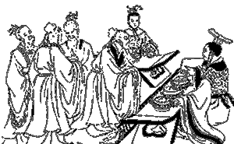
Dynasty Ancient China
The Chou developed a feudal system in China. In a feudal system, the rulers appoint nobles to govern smaller parts of an empire. The nobles divided the land into farms for extended families. An extended family might include generations and would often include cousins and second cousins. Landholding families were loyal to their nobles and the nobles
were in turn loyal to the Chou rulers.

Slide 23
Dynasty Ancient China
The Chou developed a feudal system in China. In a feudal system, the rulers appoint nobles to govern smaller parts of an empire. The nobles divided the land into farms for extended families. An extended family might include generations and would often include cousins and second cousins. Landholding families were loyal to their nobles and the nobles
were in turn loyal to the Chou rulers.

Slide 24
Dynasty Ancient China
The Chou developed a feudal system in China. In a feudal system, the rulers appoint nobles to govern smaller parts of an empire. The nobles divided the land into farms for extended families. An extended family might include generations and would often include cousins and second cousins. Landholding families were loyal to their nobles and the nobles
were in turn loyal to the Chou rulers.

Slide 25
Dynasty Ancient China
The Chou developed a feudal system in China. In a feudal system, the rulers appoint nobles to govern smaller parts of an empire. The nobles divided the land into farms for extended families. An extended family might include generations and would often include cousins and second cousins. Landholding families were loyal to their nobles and the nobles
were in turn loyal to the Chou rulers.

Slide 26
Dynasty Ancient China
The Chou developed a feudal system in China. In a feudal system, the rulers appoint nobles to govern smaller parts of an empire. The nobles divided the land into farms for extended families. An extended family might include generations and would often include cousins and second cousins. Landholding families were loyal to their nobles and the nobles
were in turn loyal to the Chou rulers.

Slide 27
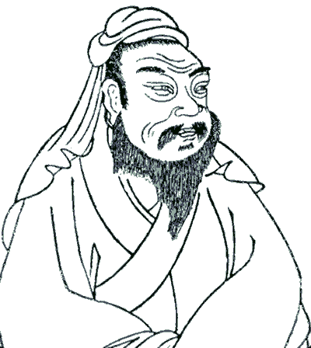
Dynasty Ancient China
The Chou rulers taxed their subjects, but they used the wealth they collected to build huge walls to defend their cities from nomadic warriors. The Chou also built roads, irrigation systems, and dams.

Slide 28
Dynasty Ancient China
The Chou rulers taxed their subjects, but they used the wealth they collected to build huge walls to defend their cities from nomadic warriors. The Chou also built roads, irrigation systems, and dams.

Slide 29
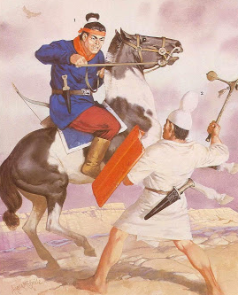
Dynasty Ancient China
Chinese nobles gradually gained more power than the Chou rulers in a period of Chinese history that historians call the Age of Warring States. It was during this period of instability that a great teacher named Confucius tried to develop good government.

Slide 30
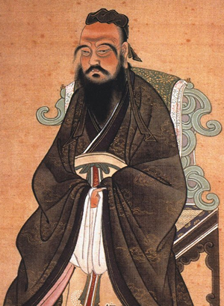
Dynasty Ancient China
Chinese nobles gradually gained more power than the Chou rulers in a period of Chinese history that historians call the Age of Warring States. It was during this period of instability that a great teacher named Confucius tried to develop good government.

Slide 31
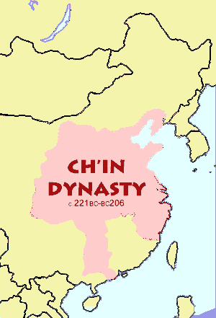
Dynasty Ancient China
Rulers of the Ch'in dynasty managed to
unify China and end the Age of Warring
States by 221BCE. The Ch'in rulers
clearly explained their laws to the
people—and then strictly enforced
them. Ch’in rulers standardized
weights and measures and carried out
irrigation projects. The Ch’in also gave
peasant farmers the land they lived on.
The West first learned of China during the Ch'in dynasty. It is from Ch'in that we get the word China.

Slide 32
Dynasty Ancient China
Rulers of the Ch'in dynasty managed to
unify China and end the Age of Warring
States by 221BCE. The Ch'in rulers
clearly explained their laws to the
people—and then strictly enforced
them. Ch’in rulers standardized
weights and measures and carried out
irrigation projects. The Ch’in also gave
peasant farmers the land they lived on.
The West first learned of China during the Ch'in dynasty. It is from Ch'in that we get the word China.

Slide 33
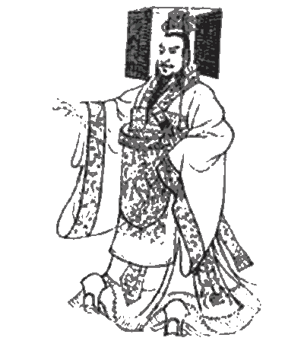
Dynasty Ancient China
Rulers of the Ch'in dynasty managed to
unify China and end the Age of Warring
States by 221BCE. The Ch'in rulers
clearly explained their laws to the
people—and then strictly enforced
them. Ch’in rulers standardized
weights and measures and carried out
irrigation projects. The Ch’in also gave
peasant farmers the land they lived on.
The West first learned of China during the Ch'in dynasty. It is from Ch'in that we get the word China.

Slide 34
Dynasty Ancient China
Rulers of the Ch'in dynasty managed to
unify China and end the Age of Warring
States by 221BCE. The Ch'in rulers
clearly explained their laws to the
people—and then strictly enforced
them. Ch’in rulers standardized
weights and measures and carried out
irrigation projects. The Ch’in also gave
peasant farmers the land they lived on.
The West first learned of China during the Ch'in dynasty. It is from Ch'in that we get the word China.

Slide 35
Dynasty Ancient China
Rulers of the Ch'in dynasty managed to
unify China and end the Age of Warring
States by 221BCE. The Ch'in rulers
clearly explained their laws to the
people—and then strictly enforced
them. Ch’in rulers standardized
weights and measures and carried out
irrigation projects. The Ch’in also gave
peasant farmers the land they lived on.
The West first learned of China during the Ch'in dynasty. It is from Ch'in that we get the word China.

Slide 36
Dynasty Ancient China
Rulers of the Ch'in dynasty managed to
unify China and end the Age of Warring
States by 221BCE. The Ch'in rulers
clearly explained their laws to the
people—and then strictly enforced
them. Ch’in rulers standardized
weights and measures and carried out
irrigation projects. The Ch’in also gave
peasant farmers the land they lived on.
The West first learned of China during the Ch'in dynasty. It is from Ch'in that we get the word China.

Slide 37
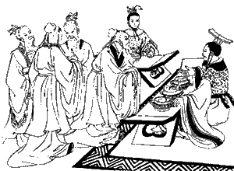
Dynasty Ancient China
A group known as the Legalists influenced the Ch'in Dynasty. The Legalists believed that a powerful leader and a stable legal system were needed to create social order. The Legalists tried to suppress all thoughts that disagreed with their philosophy. People who discussed ideas not approved by the Legalists faced execution. One Ch’in ruler ordered 460 scholars to be buried alive because the scholars disagreed with the teachings of the Legalists.

Slide 38
Dynasty Ancient China
A group known as the Legalists influenced the Ch'in Dynasty. The Legalists believed that a powerful leader and a stable legal system were needed to create social order. The Legalists tried to suppress all thoughts that disagreed with their philosophy. People who discussed ideas not approved by the Legalists faced execution. One Ch’in ruler ordered 460 scholars to be buried alive because the scholars disagreed with the teachings of the Legalists.

Slide 39
Dynasty Ancient China
A group known as the Legalists influenced the Ch'in Dynasty. The Legalists believed that a powerful leader and a stable legal system were needed to create social order. The Legalists tried to suppress all thoughts that disagreed with their philosophy. People who discussed ideas not approved by the Legalists faced execution. One Ch’in ruler ordered 460 scholars to be buried alive because the scholars disagreed with the teachings of the Legalists.

Slide 40
Dynasty Ancient China
A group known as the Legalists influenced the Ch'in Dynasty. The Legalists believed that a powerful leader and a stable legal system were needed to create social order. The Legalists tried to suppress all thoughts that disagreed with their philosophy. People who discussed ideas not approved by the Legalists faced execution. One Ch’in ruler ordered 460 scholars to be buried alive because the scholars disagreed with the teachings of the Legalists.

Slide 41
Dynasty Ancient China
A group known as the Legalists influenced the Ch'in Dynasty. The Legalists believed that a powerful leader and a stable legal system were needed to create social order. The Legalists tried to suppress all thoughts that disagreed with their philosophy. People who discussed ideas not approved by the Legalists faced execution. One Ch’in ruler ordered 460 scholars to be buried alive because the scholars disagreed with the teachings of the Legalists.

Slide 42
Dynasty Ancient China
China grew into a powerful empire during the Han Dynasty, between 202BCE and 220CE. Scholars trained in the teachings of Confucius ran the Han governments with great skill. During the Han Dynasty, the Chinese invented paper, recorded the history of their land, and first learned of Buddhism.

Slide 43
Dynasty Ancient China
China grew into a powerful empire during the Han Dynasty, between 202BCE and 220CE. Scholars trained in the teachings of Confucius ran the Han governments with great skill. During the Han Dynasty, the Chinese invented paper, recorded the history of their land, and first learned of Buddhism.

Slide 44
Dynasty Ancient China
China grew into a powerful empire during the Han Dynasty, between 202BCE and 220CE. Scholars trained in the teachings of Confucius ran the Han governments with great skill. During the Han Dynasty, the Chinese invented paper, recorded the history of their land, and first learned of Buddhism.

Slide 45
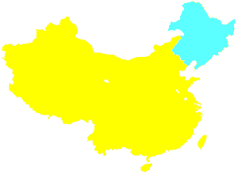
Dynasty Ancient China
The last Chinese dynasty to rule came from a region of northeast China called Manchuria. The Manchus (also known as the Qing) were weak rulers who were unable to stop other nations from interfering with China.

Slide 46
Dynasty Ancient China
The last Chinese dynasty to rule came from a region of northeast China called Manchuria. The Manchus (also known as the Qing) were weak rulers who were unable to stop other nations from interfering with China.

Slide 47
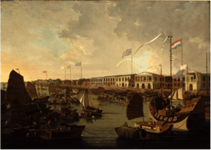
Dynasty Ancient China
The British seized Hong Kong in 1841, but more importantly, by the middle of the nineteenth century, the British forced the Chinese government to allow them to sell a dangerous drug called opium to the Chinese people. The British defeated the Manchus in a series of conflicts that later became known as the Opium Wars.

Slide 48
Dynasty Ancient China
The British seized Hong Kong in 1841, but more importantly, by the middle of the nineteenth century, the British forced the Chinese government to allow them to sell a dangerous drug called opium to the Chinese people. The British defeated the Manchus in a series of conflicts that later became known as the Opium Wars.

Slide 49
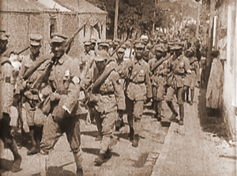
Dynasty Ancient China
In 1894, Japan seized the island of Formosa, which later
became known as Taiwan. By the dawn of the twentieth century, foreigners had overrun China. Parts of China were ruled by the British, French, American, German, Russian, and Japanese forces. The Chinese people believed that the Manchus had lost the Mandate of Heaven. They began to support a group known as the Nationalists, who pledged to free China from foreign rule. The Nationalists drove out the last of the Manchu rulers, a six-year-old boy, in 1911.

Slide 50
Dynasty Ancient China
In 1894, Japan seized the island of Formosa, which later
became known as Taiwan. By the dawn of the twentieth century, foreigners had overrun China. Parts of China were ruled by the British, French, American, German, Russian, and Japanese forces. The Chinese people believed that the Manchus had lost the Mandate of Heaven. They began to support a group known as the Nationalists, who pledged to free China from foreign rule. The Nationalists drove out the last of the Manchu rulers, a six-year-old boy, in 1911.

Slide 51
Dynasty Ancient China
In 1894, Japan seized the island of Formosa, which later
became known as Taiwan. By the dawn of the twentieth century, foreigners had overrun China. Parts of China were ruled by the British, French, American, German, Russian, and Japanese forces. The Chinese people believed that the Manchus had lost the Mandate of Heaven. They began to support a group known as the Nationalists, who pledged to free China from foreign rule. The Nationalists drove out the last of the Manchu rulers, a six-year-old boy, in 1911.

Slide 52
Dynasty Ancient China
In 1894, Japan seized the island of Formosa, which later
became known as Taiwan. By the dawn of the twentieth century, foreigners had overrun China. Parts of China were ruled by the British, French, American, German, Russian, and Japanese forces. The Chinese people believed that the Manchus had lost the Mandate of Heaven. They began to support a group known as the Nationalists, who pledged to free China from foreign rule. The Nationalists drove out the last of the Manchu rulers, a six-year-old boy, in 1911.

Slide 53
Dynasty Ancient China
In 1894, Japan seized the island of Formosa, which later
became known as Taiwan. By the dawn of the twentieth century, foreigners had overrun China. Parts of China were ruled by the British, French, American, German, Russian, and Japanese forces. The Chinese people believed that the Manchus had lost the Mandate of Heaven. They began to support a group known as the Nationalists, who pledged to free China from foreign rule. The Nationalists drove out the last of the Manchu rulers, a six-year-old boy, in 1911.

Slide 54
Dynasty Ancient China
In 1894, Japan seized the island of Formosa, which later
became known as Taiwan. By the dawn of the twentieth century, foreigners had overrun China. Parts of China were ruled by the British, French, American, German, Russian, and Japanese forces. The Chinese people believed that the Manchus had lost the Mandate of Heaven. They began to support a group known as the Nationalists, who pledged to free China from foreign rule. The Nationalists drove out the last of the Manchu rulers, a six-year-old boy, in 1911.

Slide 55
Dynasty Ancient China
Music credit:
Ishikari Love by Kevin MacLeod
(incompetech.com)
Licensed under Creative Commons: By Attribution 3.0
http://creativecommons.org/licenses/by/3.0/
Learn more about history at
www.mrdowling.com

