Slide 1
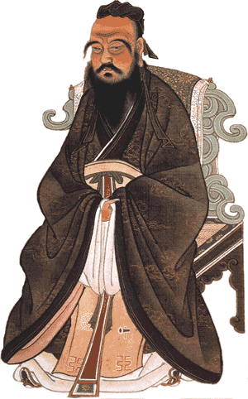
Confucius Ancient China
Confucius was a sage. A sage is a very wise man. Although he was
not well known when he was
alive, Confucius is now the
most remembered person from ancient China. Confucius was
born in 551BCE, in a period of Chinese history known as the
Age of Warring States. It was
a period that saw China
divided into many small
kingdoms.

Slide 2
Confucius Ancient China
Confucius was a sage. A sage is a very wise man. Although he was
not well known when he was
alive, Confucius is now the
most remembered person from ancient China. Confucius was
born in 551BCE, in a period of Chinese history known as the
Age of Warring States. It was
a period that saw China
divided into many small
kingdoms.

Slide 3
Confucius Ancient China
Confucius was a sage. A sage is a very wise man. Although he was
not well known when he was
alive, Confucius is now the
most remembered person from ancient China. Confucius was
born in 551BCE, in a period of Chinese history known as the
Age of Warring States. It was
a period that saw China
divided into many small
kingdoms.

Slide 4
Confucius Ancient China
Confucius was a sage. A sage is a very wise man. Although he was
not well known when he was
alive, Confucius is now the
most remembered person from ancient China. Confucius was
born in 551BCE, in a period of Chinese history known as the
Age of Warring States. It was
a period that saw China
divided into many small
kingdoms.

Slide 5
Confucius Ancient China
Confucius was a sage. A sage is a very wise man. Although he was
not well known when he was
alive, Confucius is now the
most remembered person from ancient China. Confucius was
born in 551BCE, in a period of Chinese history known as the
Age of Warring States. It was
a period that saw China
divided into many small
kingdoms.

Slide 6
Confucius Ancient China
The local rulers fought one another and were often cruel to their people. Confucius advised many leaders that peace and justice was not possible without good government, and that good government was possible
only through good leaders.

Slide 7
Confucius Ancient China
The local rulers fought one another and were often cruel to their people. Confucius advised many leaders that peace and justice was not possible without good government, and that good government was possible
only through good leaders.

Slide 8
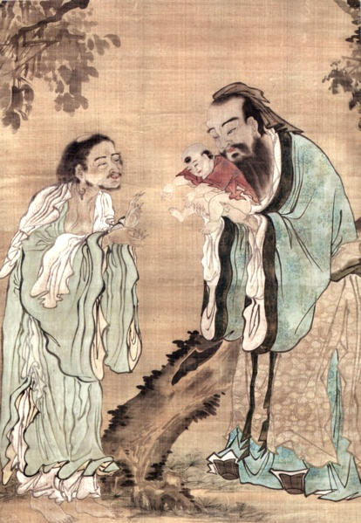
Confucius Ancient China
Confucius was concerned with how people treated one another. The great sage said, "What you do not want done to yourself, do
not do to others." He stressed
that any person, rich or poor,
could become superior. The
Chinese word jen refers to the
kindness and love each person
should have for all others and
for nature. Confucius taught
that the person who develops
jen becomes superior.

Slide 9
Confucius Ancient China
Confucius was concerned with how people treated one another. The great sage said, "What you do not want done to yourself, do
not do to others." He stressed
that any person, rich or poor,
could become superior. The
Chinese word jen refers to the
kindness and love each person
should have for all others and
for nature. Confucius taught
that the person who develops
jen becomes superior.

Slide 10
Confucius Ancient China
Confucius was concerned with how people treated one another. The great sage said, "What you do not want done to yourself, do
not do to others." He stressed
that any person, rich or poor,
could become superior. The
Chinese word jen refers to the
kindness and love each person
should have for all others and
for nature. Confucius taught
that the person who develops
jen becomes superior.

Slide 11
Confucius Ancient China
Confucius was concerned with how people treated one another. The great sage said, "What you do not want done to yourself, do
not do to others." He stressed
that any person, rich or poor,
could become superior. The
Chinese word jen refers to the
kindness and love each person
should have for all others and
for nature. Confucius taught
that the person who develops
jen becomes superior.

Slide 12
Confucius Ancient China
Confucius was concerned with how people treated one another. The great sage said, "What you do not want done to yourself, do
not do to others." He stressed
that any person, rich or poor,
could become superior. The
Chinese word jen refers to the
kindness and love each person
should have for all others and
for nature. Confucius taught
that the person who develops
jen becomes superior.

Slide 13
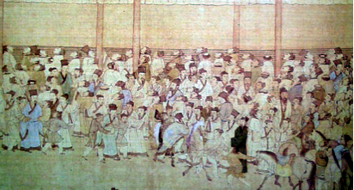
Confucius Ancient China
Confucius also taught that government officials should not use family connections to get their positions. The officials, he said, should instead earn their jobs through education and talent. Many years after Confucius died, China set up an examination system that lasted over 1300 years.

Slide 14
Confucius Ancient China
Confucius also taught that government officials should not use family connections to get their positions. The officials, he said, should instead earn their jobs through education and talent. Many years after Confucius died, China set up an examination system that lasted over 1300 years.

Slide 15
Confucius Ancient China
Confucius also taught that government officials should not use family connections to get their positions. The officials, he said, should instead earn their jobs through education and talent. Many years after Confucius died, China set up an examination system that lasted over 1300 years.

Slide 16
Confucius Ancient China
Students had to show that they read and wrote well. They also had to demonstrate their knowledge of Confucius and his philosophy. Although the Confucian examination system is no longer used in China, government workers still have to pass tests that are inspired by the old Confucian system.

Slide 17
Confucius Ancient China
Students had to show that they read and wrote well. They also had to demonstrate their knowledge of Confucius and his philosophy. Although the Confucian examination system is no longer used in China, government workers still have to pass tests that are inspired by the old Confucian system.

Slide 18
Confucius Ancient China
Students had to show that they read and wrote well. They also had to demonstrate their knowledge of Confucius and his philosophy. Although the Confucian examination system is no longer used in China, government workers still have to pass tests that are inspired by the old Confucian system.

Slide 19
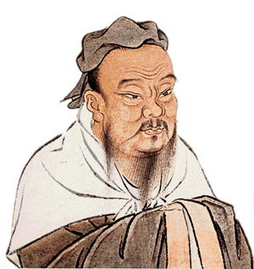
Confucius Ancient China
Confucius believed that society functioned best if everyone respected laws and behaved according to the duties demanded by their positions. He taught that parents were superior to children, men superior to women, and rulers superior to subjects. Confucius said,
"Let the ruler rule as he should and the minister be a minister as he should. Let the father act as the father should and the son act as the son should."

Slide 20
Confucius Ancient China
Confucius believed that society functioned best if everyone respected laws and behaved according to the duties demanded by their positions. He taught that parents were superior to children, men superior to women, and rulers superior to subjects. Confucius said,
"Let the ruler rule as he should and the minister be a minister as he should. Let the father act as the father should and the son act as the son should."

Slide 21
Confucius Ancient China
Confucius believed that society functioned best if everyone respected laws and behaved according to the duties demanded by their positions. He taught that parents were superior to children, men superior to women, and rulers superior to subjects. Confucius said,
"Let the ruler rule as he should and the minister be a minister as he should. Let the father act as the father should and the son act as the son should."

Slide 22
Confucius Ancient China
Confucius believed that society functioned best if everyone respected laws and behaved according to the duties demanded by their positions. He taught that parents were superior to children, men superior to women, and rulers superior to subjects. Confucius said,
"Let the ruler rule as he should and the minister be a minister as he should. Let the father act as the father should and the son act as the son should."

Slide 23
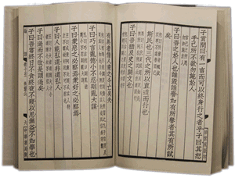
Confucius Ancient China
Despite his obscure life, Confucius left an amazing legacy. A legacy is something handed down from the past. Confucius never wrote down his philosophy, but he made an enormous impact on many people. His students compiled a book known as the Analects after Confucius died. The Analects became the model for official and personal behavior for many Chinese people. Many governments have tried to suppress the teachings of Confucius, but his philosophy remains an important part of Chinese culture to this day.

Slide 24
Confucius Ancient China
Despite his obscure life, Confucius left an amazing legacy. A legacy is something handed down from the past. Confucius never wrote down his philosophy, but he made an enormous impact on many people. His students compiled a book known as the Analects after Confucius died. The Analects became the model for official and personal behavior for many Chinese people. Many governments have tried to suppress the teachings of Confucius, but his philosophy remains an important part of Chinese culture to this day.

Slide 25
Confucius Ancient China
Despite his obscure life, Confucius left an amazing legacy. A legacy is something handed down from the past. Confucius never wrote down his philosophy, but he made an enormous impact on many people. His students compiled a book known as the Analects after Confucius died. The Analects became the model for official and personal behavior for many Chinese people. Many governments have tried to suppress the teachings of Confucius, but his philosophy remains an important part of Chinese culture to this day.

Slide 26
Confucius Ancient China
Despite his obscure life, Confucius left an amazing legacy. A legacy is something handed down from the past. Confucius never wrote down his philosophy, but he made an enormous impact on many people. His students compiled a book known as the Analects after Confucius died. The Analects became the model for official and personal behavior for many Chinese people. Many governments have tried to suppress the teachings of Confucius, but his philosophy remains an important part of Chinese culture to this day.

Slide 27
Confucius Ancient China
Despite his obscure life, Confucius left an amazing legacy. A legacy is something handed down from the past. Confucius never wrote down his philosophy, but he made an enormous impact on many people. His students compiled a book known as the Analects after Confucius died. The Analects became the model for official and personal behavior for many Chinese people. Many governments have tried to suppress the teachings of Confucius, but his philosophy remains an important part of Chinese culture to this day.

Slide 28
Confucius Ancient China
Despite his obscure life, Confucius left an amazing legacy. A legacy is something handed down from the past. Confucius never wrote down his philosophy, but he made an enormous impact on many people. His students compiled a book known as the Analects after Confucius died. The Analects became the model for official and personal behavior for many Chinese people. Many governments have tried to suppress the teachings of Confucius, but his philosophy remains an important part of Chinese culture to this day.

Slide 29
Confucius Ancient China
Music credit:
Cartoon Battle by Kevin MacLeod
(incompetech.com)
Licensed under Creative Commons: By Attribution 3.0
http://creativecommons.org/licenses/by/3.0/
Learn more about history at
www.mrdowling.com

