Slide 1
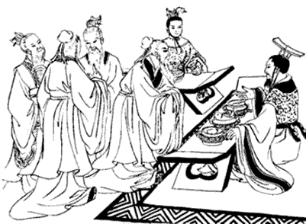
The Legalists Ancient China
Confucius taught that people are basically good, but about 250 years after the death of the great Chinese sage, a group of scholars known as the Legalists brought in a different view. The Legalists believed that humankind was evil and that, unless controlled, people would be concerned only with their own interests.

Slide 2
The Legalists Ancient China
Confucius taught that people are basically good, but about 250 years after the death of the great Chinese sage, a group of scholars known as the Legalists brought in a different view. The Legalists believed that humankind was evil and that, unless controlled, people would be concerned only with their own interests.

Slide 3
The Legalists Ancient China
The Legalists believed that society functioned best through strong government control and absolute obedience to authority, so they created laws that ordered strict punishments and rewards for behavior.

Slide 4
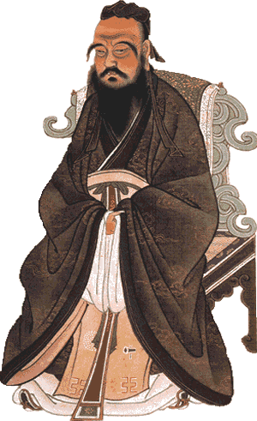
The Legalists Ancient China
Confucius believed in virtue and natural order, but the Legalists believed that all human activity should be directed toward increasing the power of the ruler and the government. The Legalists held power by suppressing anyone who disagreed with them.

Slide 5
The Legalists Ancient China
Confucius believed in virtue and natural order, but the Legalists believed that all human activity should be directed toward increasing the power of the ruler and the government. The Legalists held power by suppressing anyone who disagreed with them.

Slide 6
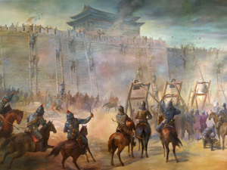
The Legalists Ancient China
China had not been a unified nation for hundreds of years when the Legalists came to power. During an era that was later called the Age of Warring States, local rulers controlled many small kingdoms.

Slide 7
The Legalists Ancient China
China had not been a unified nation for hundreds of years when the Legalists came to power. During an era that was later called the Age of Warring States, local rulers controlled many small kingdoms.

Slide 8
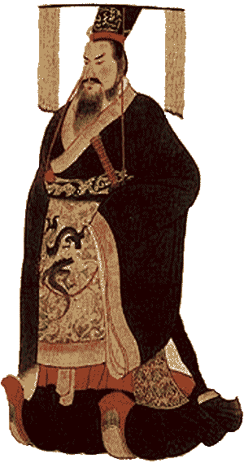
The Legalists Ancient China
The ruler of the Ch’in state embraced the Legalist philosophy. The Ch’in united China by about 214BCE by conquering most rival kingdoms. The first Ch’in ruler of a united China took the title Shih Huang-ti, which means August Lord or First Emperor.

Slide 9
The Legalists Ancient China
The ruler of the Ch’in state embraced the Legalist philosophy. The Ch’in united China by about 214BCE by conquering most rival kingdoms. The first Ch’in ruler of a united China took the title Shih Huang-ti, which means August Lord or First Emperor.

Slide 10
The Legalists Ancient China
The ruler of the Ch’in state embraced the Legalist philosophy. The Ch’in united China by about 214BCE by conquering most rival kingdoms. The first Ch’in ruler of a united China took the title Shih Huang-ti, which means August Lord or First Emperor.

Slide 11
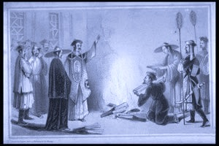
The Legalists Ancient China
To stop any criticism, Shih Huang-ti and the Legalists banned all books on history and of classic Chinese literature that glorified past rulers. The First Emperor ordered all "non-essential" books collected and burned. He allowed only books on agriculture, medicine and pharmacy. Books written about Confucius and his philosophy were destroyed. During this period hundreds of scholars were put to death—many of them being buried alive.

Slide 12
The Legalists Ancient China
To stop any criticism, Shih Huang-ti and the Legalists banned all books on history and of classic Chinese literature that glorified past rulers. The First Emperor ordered all "non-essential" books collected and burned. He allowed only books on agriculture, medicine and pharmacy. Books written about Confucius and his philosophy were destroyed. During this period hundreds of scholars were put to death—many of them being buried alive.

Slide 13
The Legalists Ancient China
To stop any criticism, Shih Huang-ti and the Legalists banned all books on history and of classic Chinese literature that glorified past rulers. The First Emperor ordered all "non-essential" books collected and burned. He allowed only books on agriculture, medicine and pharmacy. Books written about Confucius and his philosophy were destroyed. During this period hundreds of scholars were put to death—many of them being buried alive.

Slide 14
The Legalists Ancient China
To stop any criticism, Shih Huang-ti and the Legalists banned all books on history and of classic Chinese literature that glorified past rulers. The First Emperor ordered all "non-essential" books collected and burned. He allowed only books on agriculture, medicine and pharmacy. Books written about Confucius and his philosophy were destroyed. During this period hundreds of scholars were put to death—many of them being buried alive.

Slide 15
The Legalists Ancient China
To stop any criticism, Shih Huang-ti and the Legalists banned all books on history and of classic Chinese literature that glorified past rulers. The First Emperor ordered all "non-essential" books collected and burned. He allowed only books on agriculture, medicine and pharmacy. Books written about Confucius and his philosophy were destroyed. During this period hundreds of scholars were put to death—many of them being buried alive.

Slide 16
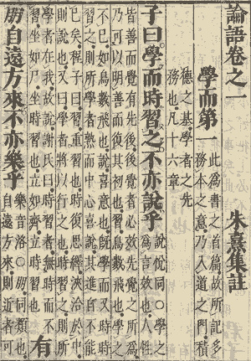
The Legalists Ancient China
The Legalists lost power shortly after the death of the First Emperor, and the succeeding rulers ended laws that destroyed books. Confucius’ teaching managed to survive the Burning of the Books because his philosophy was often handed down orally from master to student. Thus, it was possible to reconstruct the texts from both memory and the surviving manuscripts.

Slide 17
The Legalists Ancient China
The Legalists lost power shortly after the death of the First Emperor, and the succeeding rulers ended laws that destroyed books. Confucius’ teaching managed to survive the Burning of the Books because his philosophy was often handed down orally from master to student. Thus, it was possible to reconstruct the texts from both memory and the surviving manuscripts.

Slide 18
The Legalists Ancient China
The Legalists lost power shortly after the death of the First Emperor, and the succeeding rulers ended laws that destroyed books. Confucius’ teaching managed to survive the Burning of the Books because his philosophy was often handed down orally from master to student. Thus, it was possible to reconstruct the texts from both memory and the surviving manuscripts.

Slide 19
Confucius Ancient China
Music credit:
Ishikari Lore by Kevin MacLeod
(incompetech.com)
Licensed under Creative Commons: By Attribution 3.0
http://creativecommons.org/licenses/by/3.0/
Learn more about history at
www.mrdowling.com

