Slide 1
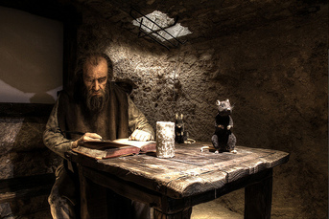
Marco Polo Ancient China
It was the year 1298. A sailor from Venice named Rustichello is in a jail in Genoa, listening to incredible stories from a fellow prisoner. Rustichello and the other man were captured in a sea battle between Genoa and Venice, two Italian city-states at war over control of trade routes in the Mediterranean Sea.

Slide 2
Marco Polo Ancient China
It was the year 1298. A sailor from Venice named Rustichello is in a jail in Genoa, listening to incredible stories from a fellow prisoner. Rustichello and the other man were captured in a sea battle between Genoa and Venice, two Italian city-states at war over control of trade routes in the Mediterranean Sea.

Slide 3
Marco Polo Ancient China
It was the year 1298.
A sailor from Venice named Rustichello is in a jail in Genoa, listening to incredible stories from a fellow prisoner. Rustichello and the other man were captured in a sea battle between Genoa and Venice, two Italian city-states at war over control of trade routes in the Mediterranean Sea.

Slide 4
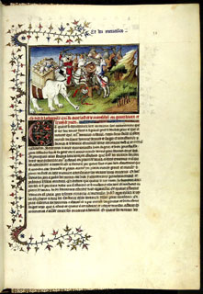
Marco Polo Ancient China
The other prisoner described a twenty-four year journey, during which he worked for a rich and powerful ruler in a faraway land we now call China. Before he went to sea, Rustichello was an experienced writer of romance novels, so he was perfectly suited to compile the stories of his fellow prisoner. He did so
in a book he called Description of the World. It is better known, however, as the Travels of Marco Polo.

Slide 5
Marco Polo Ancient China
The other prisoner described a twenty-four year journey, during which he worked for a rich and powerful ruler in a faraway land we now call China. Before he went to sea, Rustichello was an experienced writer of romance novels, so he was perfectly suited to compile the stories of his fellow prisoner. He did so
in a book he called Description of the World. It is better known, however, as the Travels of Marco Polo.

Slide 6
Marco Polo Ancient China
The other prisoner described a twenty-four year journey, during which he worked for a rich and powerful ruler in a faraway land we now call China. Before he went to sea, Rustichello was an experienced writer of romance novels, so he was perfectly suited to compile the stories of his fellow prisoner. He did so
in a book he called Description of the World. It is better known, however, as the Travels of Marco Polo.

Slide 7
Marco Polo Ancient China
The other prisoner described a twenty-four year journey, during which he worked for a rich and powerful ruler in a faraway land we now call China. Before he went to sea, Rustichello was an experienced writer of romance novels, so he was perfectly suited to compile the stories of his fellow prisoner. He did so
in a book he called Description of the World. It is better known, however, as the Travels of Marco Polo.

Slide 8
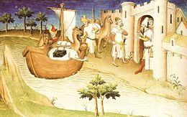
Marco Polo Ancient China
Marco Polo reported that his great adventure began shortly after meeting his father— Nicoló—in 1269. They met for the first time when Marco was fifteen years old. Nicoló Polo and his brother Maffeo were merchants from Venice. The Polo brothers often traveled to the grand city of Constantinople (now Istanbul, Turkey), where they traded goods with merchants from many Mediterranean and Black Sea ports.

Slide 9
Marco Polo Ancient China
Marco Polo reported that his great adventure began shortly after meeting his father— Nicoló—in 1269. They met for the first time when Marco was fifteen years old. Nicoló Polo and his brother Maffeo were merchants from Venice. The Polo brothers often traveled to the grand city of Constantinople (now Istanbul, Turkey), where they traded goods with merchants from many Mediterranean and Black Sea ports.

Slide 10
Marco Polo Ancient China
Marco Polo reported that his great adventure began shortly after meeting his father— Nicoló—in 1269. They met for the first time when Marco was fifteen years old. Nicoló Polo and his brother Maffeo were merchants from Venice. The Polo brothers often traveled to the grand city of Constantinople (now Istanbul, Turkey), where they traded goods with merchants from many Mediterranean and Black Sea ports.

Slide 11
Marco Polo Ancient China
Marco Polo reported that his great adventure began shortly after meeting his father— Nicoló—in 1269. They met for the first time when Marco was fifteen years old. Nicoló Polo and his brother Maffeo were merchants from Venice. The Polo brothers often traveled to the grand city of Constantinople (now Istanbul, Turkey), where they traded goods with merchants from many Mediterranean and Black Sea ports.

Slide 12
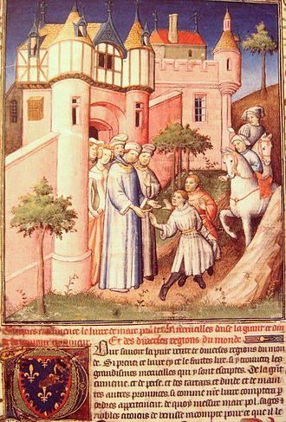
Marco Polo Ancient China
Marco's father and uncle had been away from home for young Marco’s entire life because they continued east from Constantinople to trade in markets along the Silk Road. The Silk Road was a network of trade routes that connected Europe with China. When the brothers attempted to return to Venice, they found their route was blocked by a conflict between two local warlords.

Slide 13
Marco Polo Ancient China
Marco's father and uncle had been away from home for young Marco’s entire life because they continued east from Constantinople to trade in markets along the Silk Road. The Silk Road was a network of trade routes that connected Europe with China. When the brothers attempted to return to Venice, they found their route was blocked by a conflict between two local warlords.

Slide 14
Marco Polo Ancient China
Marco's father and uncle had been away from home for young Marco’s entire life because they continued east from Constantinople to trade in markets along the Silk Road. The Silk Road was a network of trade routes that connected Europe with China. When the brothers attempted to return to Venice, they found their route was blocked by a conflict between two local warlords.

Slide 15
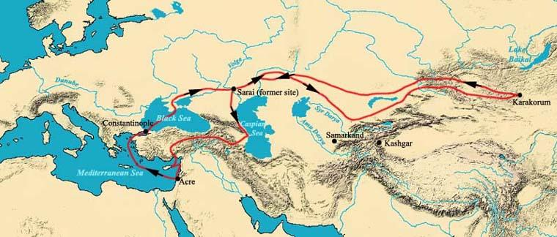
Marco Polo Ancient China
Instead of returning home, the Polo brothers accepted the invitation of a Mongol governor to travel east to meet Kublai Khan, who was the king of all Mongols in his palace in faraway China. Their journey lasted three years.

Slide 16
Marco Polo Ancient China
Instead of returning home, the Polo brothers accepted the invitation of a Mongol governor to travel east to meet Kublai Khan, who was the king of all Mongols in his palace in faraway China. Their journey lasted three years.

Slide 17
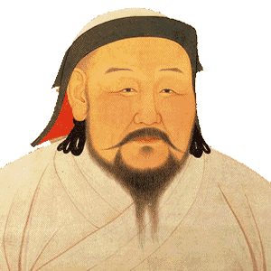
Marco Polo Ancient China
Kublai Khan ruled a vast and rich land that was unknown to all but a few Europeans. He was impressed with the Nicoló and Maffeo and the stories the brothers told of their Christian faith. Kublai Khan asked the Polo brothers to return to his palace with 100 Christian scholars and oil from a holy lamp in Jerusalem. The brothers told the great khan this oil would have magic healing powers.

Slide 18
Marco Polo Ancient China
Kublai Khan ruled a vast and rich land that was unknown to all but a few Europeans. He was impressed with the Nicoló and Maffeo and the stories the brothers told of their Christian faith. Kublai Khan asked the Polo brothers to return to his palace with 100 Christian scholars and oil from a holy lamp in Jerusalem. The brothers told the great khan this oil would have magic healing powers.

Slide 19
Marco Polo Ancient China
Kublai Khan ruled a vast and rich land that was unknown to all but a few Europeans. He was impressed with the Nicoló and Maffeo and the stories the brothers told of their Christian faith. Kublai Khan asked the Polo brothers to return to his palace with 100 Christian scholars and oil from a holy lamp in Jerusalem. The brothers told the great khan this oil would have magic healing powers.

Slide 20
Marco Polo Ancient China
Kublai Khan ruled a vast and rich land that was unknown to all but a few Europeans. He was impressed with the Nicoló and Maffeo and the stories the brothers told of their Christian faith. Kublai Khan asked the Polo brothers to return to his palace with 100 Christian scholars and oil from a holy lamp in Jerusalem. The brothers told the great khan this oil would have magic healing powers.

Slide 21
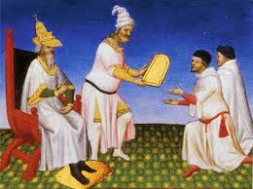
Marco Polo Ancient China
The khan gave the brothers a golden tablet to present along the way. The tablet announced that the brothers represented the great Mongol ruler and were guaranteed his protection on their dangerous journey home.

Slide 22
Marco Polo Ancient China
The khan gave the brothers a golden tablet to present along the way. The tablet announced that the brothers represented the great Mongol ruler and were guaranteed his protection on their dangerous journey home.

Slide 23
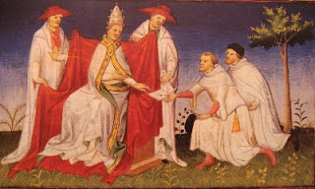
Marco Polo Ancient China
Nicoló and Maffeo Polo returned to Venice to prepare for a second journey to China, but this time they took along Nicoló's son, Marco. Before leaving, the Polos visited Pope Gregory, the head of their church. The Pope gave the Polos many gifts to deliver to Kublai Khan, but instead of the 100 scholars, Gregory sent only two friars.

Slide 24
Marco Polo Ancient China
Nicoló and Maffeo Polo returned to Venice to prepare for a second journey to China, but this time they took along Nicoló's son, Marco. Before leaving, the Polos visited Pope Gregory, the head of their church. The Pope gave the Polos many gifts to deliver to Kublai Khan, but instead of the 100 scholars, Gregory sent only two friars.

Slide 25
Marco Polo Ancient China
Nicoló and Maffeo Polo returned to Venice to prepare for a second journey to China, but this time they took along Nicoló's son, Marco. Before leaving, the Polos visited Pope Gregory, the head of their church. The Pope gave the Polos many gifts to deliver to Kublai Khan, but instead of the 100 scholars, Gregory sent only two friars.

Slide 26
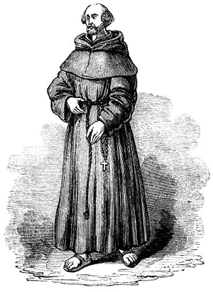
Marco Polo Ancient China
At the time of Marco Polo, friars were members of the clergy, but friars did not share the status or education of a priest. A friar was addressed as brother while a priest was called father. The friars began the journey with the Polos, but when they saw the dangers they faced on the Silk Road, the representatives of the pope returned home.

Slide 27
Marco Polo Ancient China
At the time of Marco Polo, friars were members of the clergy, but friars did not share the status or education of a priest. A friar was addressed as brother while a priest was called father. The friars began the journey with the Polos, but when they saw the dangers they faced on the Silk Road, the representatives of the pope returned home.

Slide 28
Marco Polo Ancient China
At the time of Marco Polo, friars were members of the clergy, but friars did not share the status or education of a priest. A friar was addressed as brother while a priest was called father. The friars began the journey with the Polos, but when they saw the dangers they faced on the Silk Road, the representatives of the pope returned home.

Slide 29
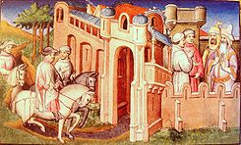
Marco Polo Ancient China
Rustichello wrote that Polo’s four-year journey across the Silk Road provided Marco with first-hand experience of the many cultures of the Middle East and Asia. Finally, they arrived once again at the palace of Kublai Khan, who Marco described as “the greatest lord the world had ever known." Kublai Khan’s palace was surrounded by walls that were four miles long. The palace was decorated with gold and silver and the walls were adorned with beautiful pictures.

Slide 30
Marco Polo Ancient China
Rustichello wrote that Polo’s four-year journey across the Silk Road provided Marco with first-hand experience of the many cultures of the Middle East and Asia. Finally, they arrived once again at the palace of Kublai Khan, who Marco described as “the greatest lord the world had ever known." Kublai Khan’s palace was surrounded by walls that were four miles long. The palace was decorated with gold and silver and the walls were adorned with beautiful pictures.

Slide 31
Marco Polo Ancient China
Rustichello wrote that Polo’s four-year journey across the Silk Road provided Marco with first-hand experience of the many cultures of the Middle East and Asia. Finally, they arrived once again at the palace of Kublai Khan, who Marco described as “the greatest lord the world had ever known." Kublai Khan’s palace was surrounded by walls that were four miles long. The palace was decorated with gold and silver and the walls were adorned with beautiful pictures.

Slide 32
Marco Polo Ancient China
Rustichello wrote that Polo’s four-year journey across the Silk Road provided Marco with first-hand experience of the many cultures of the Middle East and Asia. Finally, they arrived once again at the palace of Kublai Khan, who Marco described as “the greatest lord the world had ever known." Kublai Khan’s palace was surrounded by walls that were four miles long. The palace was decorated with gold and silver and the walls were adorned with beautiful pictures.

Slide 33
Marco Polo Ancient China
Kublai Khan did not trust many of his advisors, so according to Rustichello’s book, he sent Marco to govern a Chinese city for three years. While in China, the Polo family became rich by trading in jewelry and gold.

Slide 34
Marco Polo Ancient China
Kublai Khan did not trust many of his advisors, so according to Rustichello’s book, he sent Marco to govern a Chinese city for three years. While in China, the Polo family became rich by trading in jewelry and gold.

Slide 35
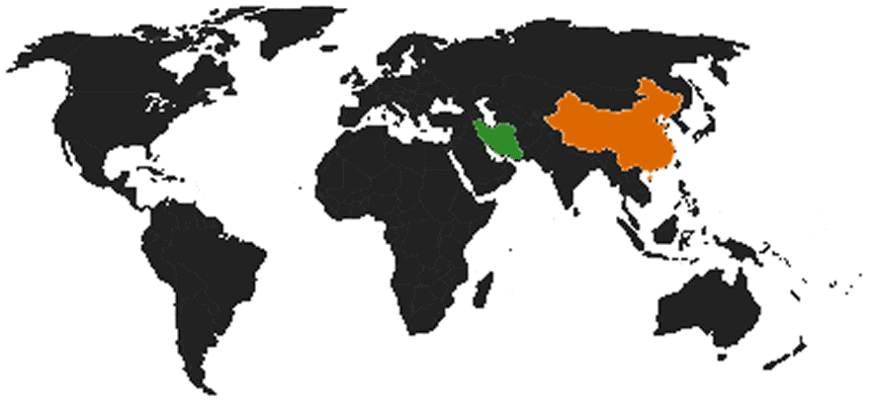
Marco Polo Ancient China
Marco Polo claimed Kublai Khan would not allow the Polos to return home for seventeen years. Finally, in 1292, an opportunity arose when Kublai Khan asked the family to escort a young woman to Persia to be the bride of one of Kublai's nephews. Persia was an ancient kingdom far west of China, but nearer to the Polos’ home in Venice.

Slide 36
Marco Polo Ancient China
Marco Polo claimed Kublai Khan would not allow the Polos to return home for seventeen years. Finally, in 1292, an opportunity arose when Kublai Khan asked the family to escort a young woman to Persia to be the bride of one of Kublai's nephews. Persia was an ancient kingdom far west of China, but nearer to the Polos’ home in Venice.

Slide 37
Marco Polo Ancient China
Marco Polo claimed Kublai Khan would not allow the Polos to return home for seventeen years. Finally, in 1292, an opportunity arose when Kublai Khan asked the family to escort a young woman to Persia to be the bride of one of Kublai's nephews. Persia was an ancient kingdom far west of China, but nearer to the Polos’ home in Venice.

Slide 38
Marco Polo Ancient China
Marco Polo reported that thirteen ships carrying six hundred passengers left the palace of Kublai Khan, but by the time the party reached Persia, only eighteen passengers remained alive. The Polos also learned that Kublai Khan's nephew had already died by the time they arrived. After leaving Persia, the Polos returned home to Venice in 1295— ending a journey that had lasted twenty-four years.

Slide 39
Marco Polo Ancient China
Marco Polo reported that thirteen ships carrying six hundred passengers left the palace of Kublai Khan, but by the time the party reached Persia, only eighteen passengers remained alive. The Polos also learned that Kublai Khan's nephew had already died by the time they arrived. After leaving Persia, the Polos returned home to Venice in 1295— ending a journey that had lasted twenty-four years.

Slide 40
Marco Polo Ancient China
Marco Polo reported that thirteen ships carrying six hundred passengers left the palace of Kublai Khan, but by the time the party reached Persia, only eighteen passengers remained alive. The Polos also learned that Kublai Khan's nephew had already died by the time they arrived. After leaving Persia, the Polos returned home to Venice in 1295— ending a journey that had lasted twenty-four years.

Slide 41
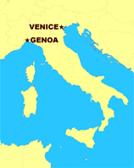
Marco Polo Ancient China
Soon after the Polos returned home, Venice went to war with the rival city-state of Genoa. Marco Polo went to sea to protect his city, but he was captured by Genoa and put in the prison where he met Rustichello.

Slide 42
Marco Polo Ancient China
Soon after the Polos returned home, Venice went to war with the rival city-state of Genoa. Marco Polo went to sea to protect his city, but he was captured by Genoa and put in the prison where he met Rustichello.

Slide 43
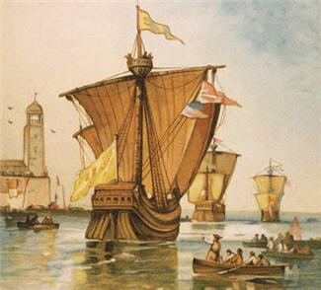
Marco Polo Ancient China
Rustichello wrote Description of the World before the invention of the printing press, so copies were made by hand. The book delighted its readers and stimulated interest in China and the cultures along the Silk Road. Christopher Columbus owned a copy and studied it closely before beginning his journey in 1492 to what he thought would be China.

Slide 44
Marco Polo Ancient China
Rustichello wrote Description of the World before the invention of the printing press, so copies were made by hand. The book delighted its readers and stimulated interest in China and the cultures along the Silk Road. Christopher Columbus owned a copy and studied it closely before beginning his journey in 1492 to what he thought would be China.

Slide 45
Marco Polo Ancient China
Rustichello wrote Description of the World before the invention of the printing press, so copies were made by hand. The book delighted its readers and stimulated interest in China and the cultures along the Silk Road. Christopher Columbus owned a copy and studied it closely before beginning his journey in 1492 to what he thought would be China.

Slide 46
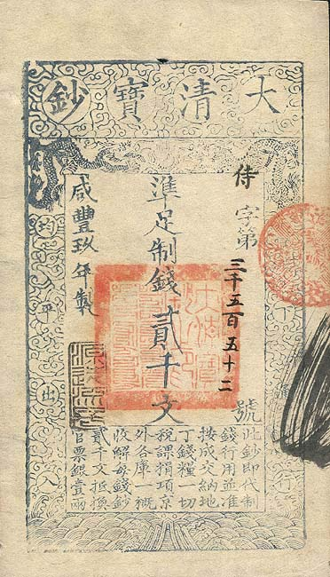
Marco Polo Ancient China
Some observers saw Marco Polo as an astute observer with a keen memory. Some of his most fantastic claims are easy for us to understand today. Marco Polo described paper money, unknown in Venice, but which had been used by the Chinese for more than a thousand years.

Slide 47
Marco Polo Ancient China
Some observers saw Marco Polo as an astute observer with a keen memory. Some of his most fantastic claims are easy for us to understand today. Marco Polo described paper money, unknown in Venice, but which had been used by the Chinese for more than a thousand years.

Slide 48
Marco Polo Ancient China
Some observers saw Marco Polo as an astute observer with a keen memory. Some of his most fantastic claims are easy for us to understand today. Marco Polo described paper money, unknown in Venice, but which had been used by the Chinese for more than a thousand years.

Slide 49
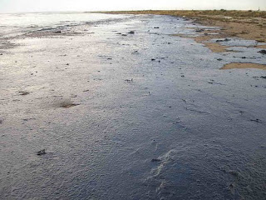
Marco Polo Ancient China
He described a spring that gushed a stream of oil. The oil was said to be tasteless, but good for burning. Marco may have been describing petroleum, or crude oil, which is now used to make gasoline, plastic and other products.

Slide 50
Marco Polo Ancient China
He described a spring that gushed a stream of oil. The oil was said to be tasteless, but good for burning. Marco may have been describing petroleum, or crude oil, which is now used to make gasoline, plastic and other products.

Slide 51
Marco Polo Ancient China
He described a spring that gushed a stream of oil. The oil was said to be tasteless, but good for burning. Marco may have been describing petroleum, or crude oil, which is now used to make gasoline, plastic and other products.

Slide 52
Marco Polo Ancient China
Others argued that Marco Polo made up his stories based on gossip and stories he heard. After all, Marco Polo reported seeing unicorns and he gave a first-hand description of a battle that occurred years before he left Venice. Marco failed to mention the Great Wall of China, tea, or rice.

Slide 53
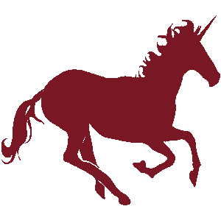
Marco Polo Ancient China
Others argued that Marco Polo made up his stories based on gossip and stories he heard. After all, Marco Polo reported seeing unicorns and he gave a first-hand description of a battle that occurred years before he left Venice. Marco failed to mention the Great Wall of China, tea, or rice.

Slide 54
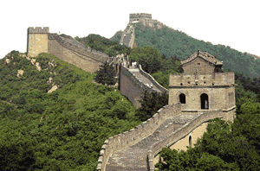
Marco Polo Ancient China
Others argued that Marco Polo made up his stories based on gossip and stories he heard. After all, Marco Polo reported seeing unicorns and he gave a first-hand description of a battle that occurred years before he left Venice. Marco failed to mention the Great Wall of China, tea, or rice.

Slide 55
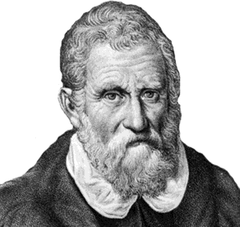
Marco Polo Ancient China
The Chinese have no records of the Polo family, and it is unlikely Marco could have been a governor. Many people described Marco Polo's book as Il Milione ("The Million") for they claimed that it contained a million lies. As an old man, Marco was asked if he invented the stories in his book. His answer was that he barely told half of what he actually saw.

Slide 56
Marco Polo Ancient China
The Chinese have no records of the Polo family, and it is unlikely Marco could have been a governor. Many people described Marco Polo's book as Il Milione ("The Million") for they claimed that it contained a million lies. As an old man, Marco was asked if he invented the stories in his book. His answer was that he barely told half of what he actually saw.

Slide 57
Marco Polo Ancient China
The Chinese have no records of the Polo family, and it is unlikely Marco could have been a governor. Many people described Marco Polo's book as Il Milione ("The Million") for they claimed that it contained a million lies. As an old man, Marco was asked if he invented the stories in his book. His answer was that he barely told half of what he actually saw.

Slide 58
Marco Polo Ancient China
The Chinese have no records of the Polo family, and it is unlikely Marco could have been a governor. Many people described Marco Polo's book as Il Milione ("The Million") for they claimed that it contained a million lies. As an old man, Marco was asked if he invented the stories in his book. His answer was that he barely told half of what he actually saw.

Slide 59
Marco Polo Ancient China
Music credit:
Brittle Rile by Kevin MacLeod
(incompetech.com)
Licensed under Creative Commons: By Attribution 3.0
http://creativecommons.org/licenses/by/3.0/
Learn more about history at
www.mrdowling.com

