Slide 1
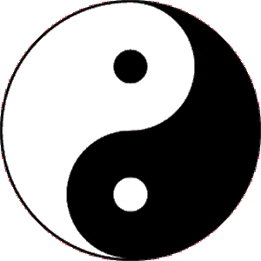
Taoism – An Introduction Chinese History
Taoism is a religious tradition that began in China about 2,500 years ago—at about the same time Confucius lived. While Confucius was interested in how people treated one another, Taoism is a spiritual
philosophy that focuses on a person's outlook on life and the world around them.

Slide 2
Taoism – An Introduction Chinese History
Taoism is a religious tradition that began in China about 2,500 years ago—at about the same time Confucius lived. While Confucius was interested in how people treated one another, Taoism is a spiritual
philosophy that focuses on a person's outlook on life and the world around them.

Slide 3
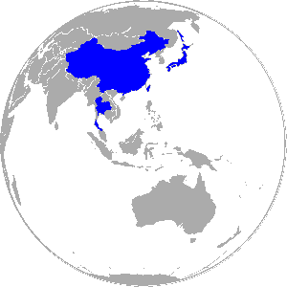
Taoism – An Introduction Chinese History
Taoism is practiced today in China, Taiwan, Hong King, Singapore, Japan, and Thailand, but there are Taoists throughout the world.

Slide 4
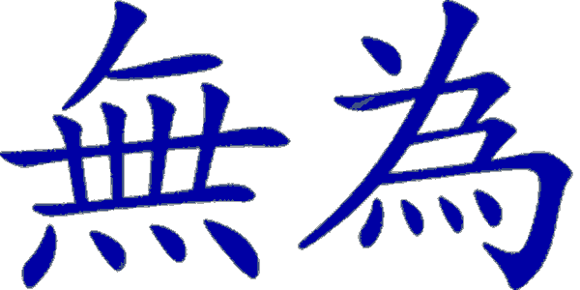
Taoism – An Introduction Chinese History
Taoists believe that humankind, nature, and heaven are all interconnected, and that harmony exists when everything acts according to its own nature. Living in harmony with one’s own nature is known in Taoism as wu wei.

Slide 5
Taoism – An Introduction Chinese History
Taoists believe that humankind, nature, and heaven are all interconnected, and that harmony exists when everything acts according to its own nature. Living in harmony with one’s own nature is known in Taoism as wu wei.

Slide 6
Taoism – An Introduction Chinese History
A person who practices wu wei avoids aggression and bends to accommodate life’s problems rather than break under their weight. A Taoist strives to live in harmony with the natural order.

Slide 7
Taoism – An Introduction Chinese History
A person who practices wu wei avoids aggression and bends to accommodate life’s problems rather than break under their weight. A Taoist strives to live in harmony with the natural order.

Slide 8
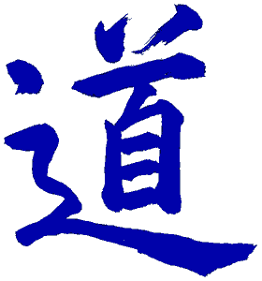
Taoism – An Introduction Chinese History
The natural order is an unknowable force called the Tao. Tao can be translated as “the way.” Taoists view the Tao as the connection that makes all life and movement in nature possible. They believe that when a person lives out their life on earth, the Tao returns them to heaven.

Slide 9
Taoism – An Introduction Chinese History
The natural order is an unknowable force called the Tao. Tao can be translated as “the way.” Taoists view the Tao as the connection that makes all life and movement in nature possible. They believe that when a person lives out their life on earth, the Tao returns them to heaven.

Slide 10
Taoism – An Introduction Chinese History
The natural order is an unknowable force called the Tao. Tao can be translated as “the way.” Taoists view the Tao as the connection that makes all life and movement in nature possible. They believe that when a person lives out their life on earth, the Tao returns them to heaven.

Slide 11
Taoism – An Introduction Chinese History
The natural order is an unknowable force called the Tao. Tao can be translated as “the way.” Taoists view the Tao as the connection that makes all life and movement in nature possible. They believe that when a person lives out their life on earth, the Tao returns them to heaven.

Slide 12
Taoism – An Introduction Chinese History
The Tao is composed of two opposite energies called yin and yang. Taoists believe everything in existence has the characteristics of both the yin and the yang.

Slide 13
Taoism – An Introduction Chinese History
The Tao is composed of two opposite energies called yin and yang. Taoists believe everything in existence has the characteristics of both the yin and the yang.

Slide 14
Taoism – An Introduction Chinese History
The yin is cold, dark, and mysterious; it is associated with the earth and is female. The yang is warm, bright and positive; it is associated with the heavens and is male. The interaction of yin and yang are revealed in changes. These changes include the seasons along with the flowering of living things and their eventual decay.

Slide 15
Taoism – An Introduction Chinese History
The yin is cold, dark, and mysterious; it is associated with the earth and is female. The yang is warm, bright and positive; it is associated with the heavens and is male. The interaction of yin and yang are revealed in changes. These changes include the seasons along with the flowering of living things and their eventual decay.

Slide 16
Taoism – An Introduction Chinese History
The yin is cold, dark, and mysterious; it is associated with the earth and is female. The yang is warm, bright and positive; it is associated with the heavens and is male. The interaction of yin and yang are revealed in changes. These changes include the seasons along with the flowering of living things and their eventual decay.

Slide 17
Taoism – An Introduction Chinese History
The yin is cold, dark, and mysterious; it is associated with the earth and is female. The yang is warm, bright and positive; it is associated with the heavens and is male. The interaction of yin and yang are revealed in changes. These changes include the seasons along with the flowering of living things and their eventual decay.

Slide 18
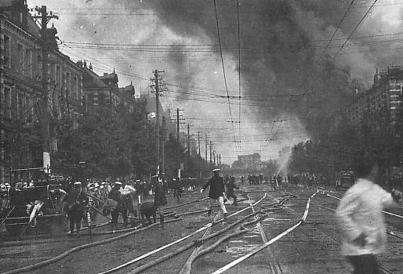
Taoism – An Introduction Chinese History
Taoists believe earthquakes, floods, and tornadoes are the results of disturbances of yin and yang, but they believe, in time, the Tao will reassert itself and order will return. Unhappiness in life comes from people acting against the Tao by disrupting the natural order of life.

Slide 19
Taoism – An Introduction Chinese History
Taoists believe earthquakes, floods, and tornadoes are the results of disturbances of yin and yang, but they believe, in time, the Tao will reassert itself and order will return. Unhappiness in life comes from people acting against the Tao by disrupting the natural order of life.

Slide 20
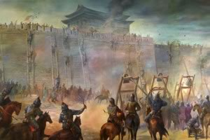
Taoism – An Introduction Chinese History
Taoism developed during a period of disorder in Chinese history we call the Age of Warring States. Local warlords engaged in battles; greed was rampant and many Chinese people lived in a constant state of fear.

Slide 21
Taoism – An Introduction Chinese History
Taoism developed during a period of disorder in Chinese history we call the Age of Warring States. Local warlords engaged in battles; greed was rampant and many Chinese people lived in a constant state of fear.

Slide 22
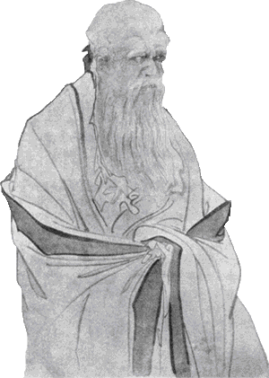
Taoism – An Introduction Chinese History
Legends say the founder of Taoism is Lao Tzu, though it is possible he never existed. Lao Tzu is said to have been a scholar who worked as a keeper of records for a Chou lord.

Slide 23
Taoism – An Introduction Chinese History
Legends say the founder of Taoism is Lao Tzu, though it is possible he never existed. Lao Tzu is said to have been a scholar who worked as a keeper of records for a Chou lord.

Slide 24
Taoism – An Introduction Chinese History
Lao Tzu was unhappy with moral decay of his time, so he withdrew to his home to think about the meaning of life. Lao Tzu’s meditation made him a very wise man.

Slide 25
Taoism – An Introduction Chinese History
Lao Tzu was unhappy with moral decay of his time, so he withdrew to his home to think about the meaning of life. Lao Tzu’s meditation made him a very wise man.

Slide 26
Taoism – An Introduction Chinese History
Once, while traveling, a gatekeeper recognized Lao Tzu and asked him to write down his wisdom. According to legend, Lao Tzu wrote the Tao Te Ching, then rode through the gate, never to be seen again.

Slide 27
Taoism – An Introduction Chinese History
Once, while traveling, a gatekeeper recognized Lao Tzu and asked him to write down his wisdom. According to legend, Lao Tzu wrote the Tao Te Ching, then rode through the gate, never to be seen again.

Slide 28
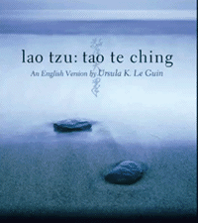
Taoism – An Introduction Chinese History
The Tao Te Ching means “the Way of Life.” It is a very short book—an English language translation is only 128 pages. The Tao Te Ching recommends bending to accommodate rather than breaking under the stresses of life. The book discourages learning or ambition, instead stressing that we should live according to our nature.

Slide 29
Taoism – An Introduction Chinese History
The Tao Te Ching means “the Way of Life.” It is a very short book—an English language translation is only 128 pages. The Tao Te Ching recommends bending to accommodate rather than breaking under the stresses of life. The book discourages learning or ambition, instead stressing that we should live according to our nature.

Slide 30
Taoism – An Introduction Chinese History
The Tao Te Ching means “the Way of Life.” It is a very short book—an English language translation is only 128 pages. The Tao Te Ching recommends bending to accommodate rather than breaking under the stresses of life. The book discourages learning or ambition, instead stressing that we should live according to our nature.

Slide 31
Taoism – An Introduction Chinese History
The Tao Te Ching means “the Way of Life.” It is a very short book—an English language translation is only 128 pages. The Tao Te Ching recommends bending to accommodate rather than breaking under the stresses of life. The book discourages learning or ambition, instead stressing that we should live according to our nature.

Slide 32
Taoism – An Introduction Chinese History
It places nature above culture, and a solitary individual above society. According to the Tao Te Ching, inaction is better than action. By not allowing events to unfold according to their nature, a person has challenged the Tao.

Slide 33
Taoism – An Introduction Chinese History
It places nature above culture, and a solitary individual above society. According to the Tao Te Ching, inaction is better than action. By not allowing events to unfold according to their nature, a person has challenged the Tao.

Slide 34
Taoism – An Introduction Chinese History
It places nature above culture, and a solitary individual above society. According to the Tao Te Ching, inaction is better than action. By not allowing events to unfold according to their nature, a person has challenged the Tao.

Slide 35
Taoism – An Introduction Chinese History
Many Taoists compare the Tao to water. When it is restricted, water seeks the weakest spot of any obstruction and applies constant force until it is free.

Slide 36
Taoism – An Introduction Chinese History
Many Taoists compare the Tao to water. When it is restricted, water seeks the weakest spot of any obstruction and applies constant force until it is free.

Slide 37
Taoism – An Introduction Chinese History
Given the slightest opening, water will pass through and will widen the opening if possible. Water always seeks to do the easiest thing for as long as it can.

Slide 38
Taoism – An Introduction Chinese History
Given the slightest opening, water will pass through and will widen the opening if possible. Water always seeks to do the easiest thing for as long as it can.

Slide 39
Taoism – An Introduction Chinese History
The Tao Te Ching says, “there is nothing stronger and weaker than water, any yet there is nothing better for attacking hard and strong things.”

Slide 40
Taoism – An Introduction Chinese History
Music credit:
Eastminster by Kevin McLeod
(imcompetech.com)
Licensed under Creative Commons: By Attribution 3.0 http://creativecommons.org/licenses/by/3.0/
Learn more about history at
www.mrdowling.com

