Slide 1
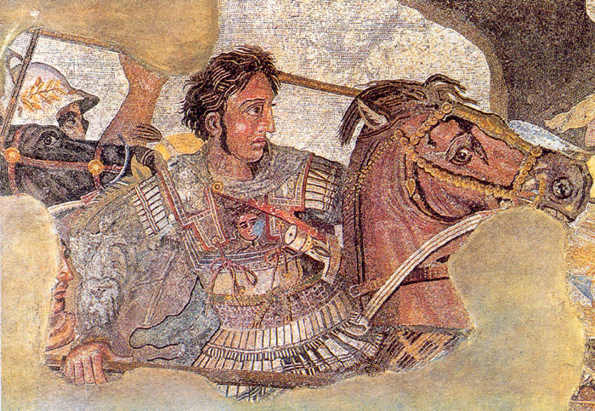

ALEXANDER THE GREAT ANCIENT GREECE
Alexander the Great was a young general who amassed the largest empire of the ancient world in just thirteen years. His career was brief because he died a young man,
but Alexander’s
legacy was a
blending of
cultures we now
call the Hellenistic
civilization.

Slide 2
ALEXANDER THE GREAT ANCIENT GREECE
Alexander the Great was a young general who amassed the largest empire of the ancient world in just thirteen years. His career was brief because he died a young man,
but Alexander’s
legacy was a
blending of
cultures we now
call the Hellenistic
civilization.

Slide 3
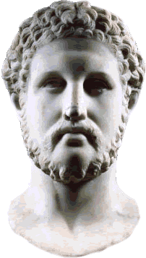
ALEXANDER THE GREAT ANCIENT GREECE
Alexander’s father was King Philip of Macedonia. Macedonia is a mountainous land north of the Greek peninsula. From a young age, Phillip trained Alexander in warfare and by the age of sixteen, the young man was leading an army on his own. Alexander succeeded his father in power at age nineteen after Philip’s assassination in 336BCE.

Slide 4
ALEXANDER THE GREAT ANCIENT GREECE
Alexander’s father was King Philip of Macedonia. Macedonia is a mountainous land north of the Greek peninsula. From a young age, Phillip trained Alexander in warfare and by the age of sixteen, the young man was leading an army on his own. Alexander succeeded his father in power at age nineteen after Philip’s assassination in 336BCE.

Slide 5
ALEXANDER THE GREAT ANCIENT GREECE
Alexander’s father was King Philip of Macedonia. Macedonia is a mountainous land north of the Greek peninsula. From a young age, Phillip trained Alexander in warfare and by the age of sixteen, the young man was leading an army on his own. Alexander succeeded his father in power at age nineteen after Philip’s assassination in 336BCE.

Slide 6
ALEXANDER THE GREAT ANCIENT GREECE
Alexander’s father was King Philip of Macedonia. Macedonia is a mountainous land north of the Greek peninsula. From a young age, Phillip trained Alexander in warfare and by the age of sixteen, the young man was leading an army on his own. Alexander succeeded his father in power at age nineteen after Philip’s assassination in 336BCE.

Slide 7
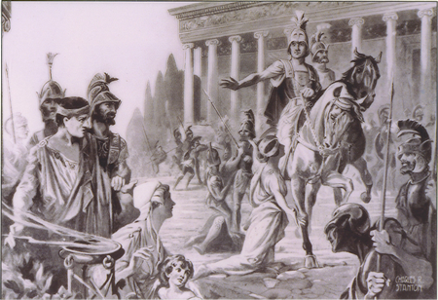
ALEXANDER THE GREAT ANCIENT GREECE
Philip’s armies had conquered
most of the Greek poli by that
time, but the Greeks believed
they could free themselves of
Macedonian rule since their
new king was a “mere boy.”
Alexander proved the Greeks wrong by leading an army that captured Thebes; the young general burned all but one home in the polis as a warning to the other Greeks. Alexander then turned his attention to Persia, the longtime enemy of Greece and the mightiest empire in the world at that time.

Slide 8
ALEXANDER THE GREAT ANCIENT GREECE
Philip’s armies had conquered
most of the Greek poli by that
time, but the Greeks believed
they could free themselves of
Macedonian rule since their
new king was a “mere boy.”
Alexander proved the Greeks wrong by leading an army that captured Thebes; the young general burned all but one home in the polis as a warning to the other Greeks. Alexander then turned his attention to Persia, the longtime enemy of Greece and the mightiest empire in the world at that time.

Slide 9
ALEXANDER THE GREAT ANCIENT GREECE
Philip’s armies had conquered
most of the Greek poli by that
time, but the Greeks believed
they could free themselves of
Macedonian rule since their
new king was a “mere boy.”
Alexander proved the Greeks wrong by leading an army that captured Thebes; the young general burned all but one home in the polis as a warning to the other Greeks. Alexander then turned his attention to Persia, the longtime enemy of Greece and the mightiest empire in the world at that time.

Slide 10
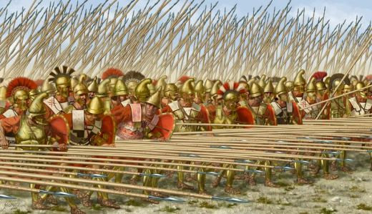
ALEXANDER THE GREAT ANCIENT GREECE
In 333BCE, Alexander led an army of 40,000 soldiers, 30,000 sailors and 100 ships into Asia Minor (modern day Turkey). Alexander’s forces conquered several Persian provinces before turning south to face the army of Persian King Darius III.

Slide 11
ALEXANDER THE GREAT ANCIENT GREECE
In 333BCE, Alexander led an army of 40,000 soldiers, 30,000 sailors and 100 ships into Asia Minor (modern day Turkey). Alexander’s forces conquered several Persian provinces before turning south to face the army of Persian King Darius III.

Slide 12
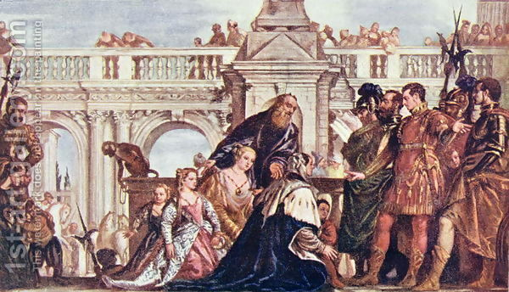
ALEXANDER THE GREAT ANCIENT GREECE
Alexander’s army was less than half the size of the Persian forces, but the Macedonian outmaneuvered the Persians, causing Darius to flee the battlefield. Alexander captured the wife and daughters of Darius. The young general treated the Persian king’s family with great respect and the woman accompanied him for the rest of his life.

Slide 13
ALEXANDER THE GREAT ANCIENT GREECE
Alexander’s army was less than half the size of the Persian forces, but the Macedonian outmaneuvered the Persians, causing Darius to flee the battlefield. Alexander captured the wife and daughters of Darius. The young general treated the Persian king’s family with great respect and the woman accompanied him for the rest of his life.

Slide 14
ALEXANDER THE GREAT ANCIENT GREECE
Alexander’s army was less than half the size of the Persian forces, but the Macedonian outmaneuvered the Persians, causing Darius to flee the battlefield. Alexander captured the wife and daughters of Darius. The young general treated the Persian king’s family with great respect and the woman accompanied him for the rest of his life.

Slide 15
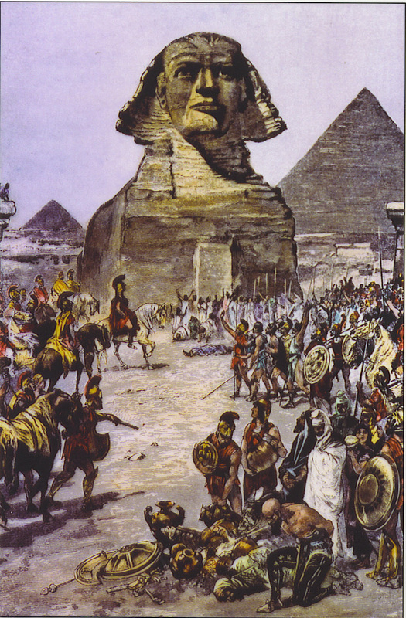
ALEXANDER THE GREAT ANCIENT GREECE
In 332BCE, Alexander moved south to Egypt. The Egyptian people welcomed the conquering general as a hero. They declared Alexander a pharaoh and a god because he freed them from harsh Persian rule.

Slide 16
ALEXANDER THE GREAT ANCIENT GREECE
In 332BCE, Alexander moved south to Egypt. The Egyptian people welcomed the conquering general as a hero. They declared Alexander a pharaoh and a god because he freed them from harsh Persian rule.

Slide 17
ALEXANDER THE GREAT ANCIENT GREECE
In 332BCE, Alexander moved south to Egypt. The Egyptian people welcomed the conquering general as a hero. They declared Alexander a pharaoh and a god because he freed them from harsh Persian rule.

Slide 18
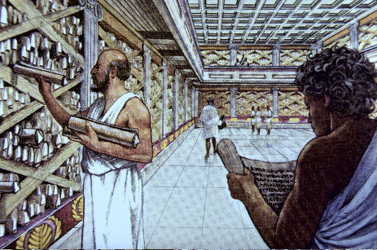
ALEXANDER THE GREAT ANCIENT GREECE
The young general founded Alexandria, a city that would become the greatest center of learning in the ancient world. A library in Alexandria housed the accumulated knowledge of the Greeks. The library operated until the
seventh century
of the Common
Era, long after
the fall of the
Greek and Roman
civilizations.

Slide 19
ALEXANDER THE GREAT ANCIENT GREECE
The young general founded Alexandria, a city that would become the greatest center of learning in the ancient world. A library in Alexandria housed the accumulated knowledge of the Greeks. The library operated until the
seventh century
of the Common
Era, long after
the fall of the
Greek and Roman
civilizations.

Slide 20
ALEXANDER THE GREAT ANCIENT GREECE
The young general founded Alexandria, a city that would become the greatest center of learning in the ancient world. A library in Alexandria housed the accumulated knowledge of the Greeks. The library operated until the
seventh century
of the Common
Era, long after
the fall of the
Greek and Roman
civilizations.

Slide 21
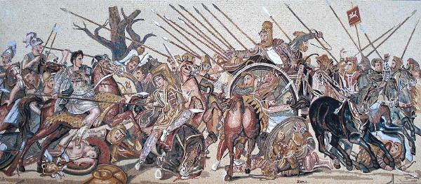
ALEXANDER THE GREAT ANCIENT GREECE
Alexander marched his army east where they again defeated the forces of King Darius. Darius again fled the battlefield, but the Persian king was killed soon after by his advisors.

Slide 22
ALEXANDER THE GREAT ANCIENT GREECE
Alexander marched his army east where they again defeated the forces of King Darius. Darius again fled the battlefield, but the Persian king was killed soon after by his advisors.

Slide 23
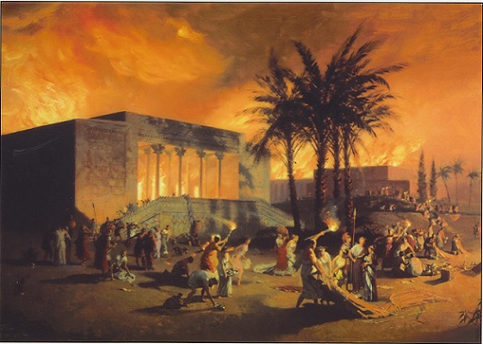
ALEXANDER THE GREAT ANCIENT GREECE
Alexander’s army looted the Persian capital at Persepolis, but the young general divided the treasures of Persepolis among his soldiers, making
the men richer
than they could
have ever
expected to be.

Slide 24
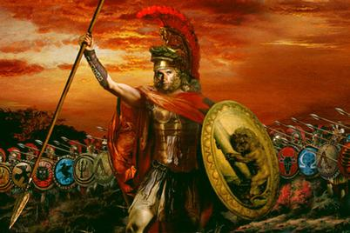
ALEXANDER THE GREAT ANCIENT GREECE
Although a young man,
Alexander was a military
genius, possibly the greatest
warrior of all time. His
troops were better trained
and organized than the
Persian army. Alexander’s soldiers admired their leader because of his personal courage. Alexander led his soldiers in battle instead of remaining behind the lines. The troops saw that the young general was sharing their danger and was not asking them to take any risks he would not take himself.

Slide 25
ALEXANDER THE GREAT ANCIENT GREECE
Although a young man,
Alexander was a military
genius, possibly the greatest
warrior of all time. His
troops were better trained
and organized than the
Persian army. Alexander’s soldiers admired their leader because of his personal courage. Alexander led his soldiers in battle instead of remaining behind the lines. The troops saw that the young general was sharing their danger and was not asking them to take any risks he would not take himself.

Slide 26
ALEXANDER THE GREAT ANCIENT GREECE
Although a young man,
Alexander was a military
genius, possibly the greatest
warrior of all time. His
troops were better trained
and organized than the
Persian army. Alexander’s soldiers admired their leader because of his personal courage. Alexander led his soldiers in battle instead of remaining behind the lines. The troops saw that the young general was sharing their danger and was not asking them to take any risks he would not take himself.

Slide 27
ALEXANDER THE GREAT ANCIENT GREECE
Although a young man,
Alexander was a military
genius, possibly the greatest
warrior of all time. His
troops were better trained
and organized than the
Persian army. Alexander’s soldiers admired their leader because of his personal courage. Alexander led his soldiers in battle instead of remaining behind the lines. The troops saw that the young general was sharing their danger and was not asking them to take any risks he would not take himself.

Slide 28
ALEXANDER THE GREAT ANCIENT GREECE
Although a young man,
Alexander was a military
genius, possibly the greatest
warrior of all time. His
troops were better trained
and organized than the
Persian army. Alexander’s soldiers admired their leader because of his personal courage. Alexander led his soldiers in battle instead of remaining behind the lines. The troops saw that the young general was sharing their danger and was not asking them to take any risks he would not take himself.

Slide 29
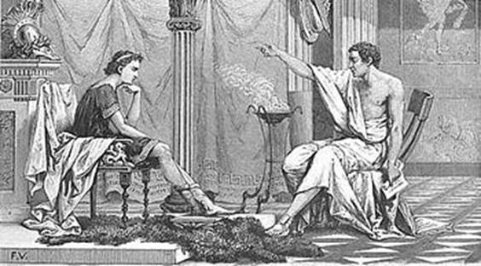
ALEXANDER THE GREAT ANCIENT GREECE
As a child, Alexander was tutored by the Greek philosopher Aristotle. Aristotle taught Alexander that the Greeks were the most advanced people in the world and that all other cultures were barbarians. Once Alexander conquered the Persians, he had a change of heart. Alexander adopted many Persian customs. He
took the Persian title
“King of Kings” and
married one of the
daughters King Darius
abandoned on the
battlefield.

Slide 30
ALEXANDER THE GREAT ANCIENT GREECE
As a child, Alexander was tutored by the Greek philosopher Aristotle. Aristotle taught Alexander that the Greeks were the most advanced people in the world and that all other cultures were barbarians. Once Alexander conquered the Persians, he had a change of heart. Alexander adopted many Persian customs. He
took the Persian title
“King of Kings” and
married one of the
daughters King Darius
abandoned on the
battlefield.

Slide 31
ALEXANDER THE GREAT ANCIENT GREECE
As a child, Alexander was tutored by the Greek philosopher Aristotle. Aristotle taught Alexander that the Greeks were the most advanced people in the world and that all other cultures were barbarians. Once Alexander conquered the Persians, he had a change of heart. Alexander adopted many Persian customs. He
took the Persian title
“King of Kings” and
married one of the
daughters King Darius
abandoned on the
battlefield.

Slide 32
ALEXANDER THE GREAT ANCIENT GREECE
As a child, Alexander was tutored by the Greek philosopher Aristotle. Aristotle taught Alexander that the Greeks were the most advanced people in the world and that all other cultures were barbarians. Once Alexander conquered the Persians, he had a change of heart. Alexander adopted many Persian customs. He
took the Persian title
“King of Kings” and
married one of the
daughters King Darius
abandoned on the
battlefield.

Slide 33
ALEXANDER THE GREAT ANCIENT GREECE
As a child, Alexander was tutored by the Greek philosopher Aristotle. Aristotle taught Alexander that the Greeks were the most advanced people in the world and that all other cultures were barbarians. Once Alexander conquered the Persians, he had a change of heart. Alexander adopted many Persian customs. He
took the Persian title
“King of Kings” and
married one of the
daughters King Darius
abandoned on the
battlefield.

Slide 34
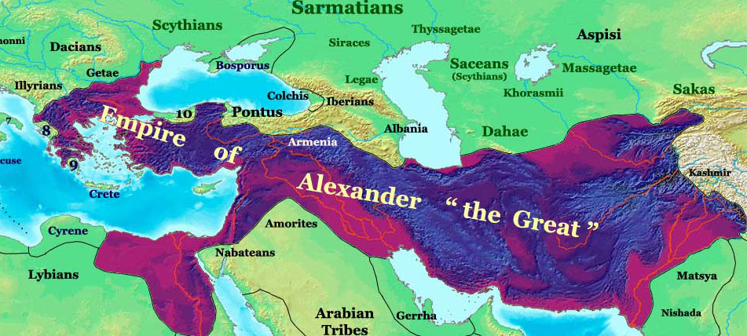
ALEXANDER THE GREAT ANCIENT GREECE
Alexander’s army marched as far east as the edge of the Indian subcontinent in 326 BCE, but the heavy monsoon rains and a revolt among his soldiers forced the young general to end his conquests.

Slide 35
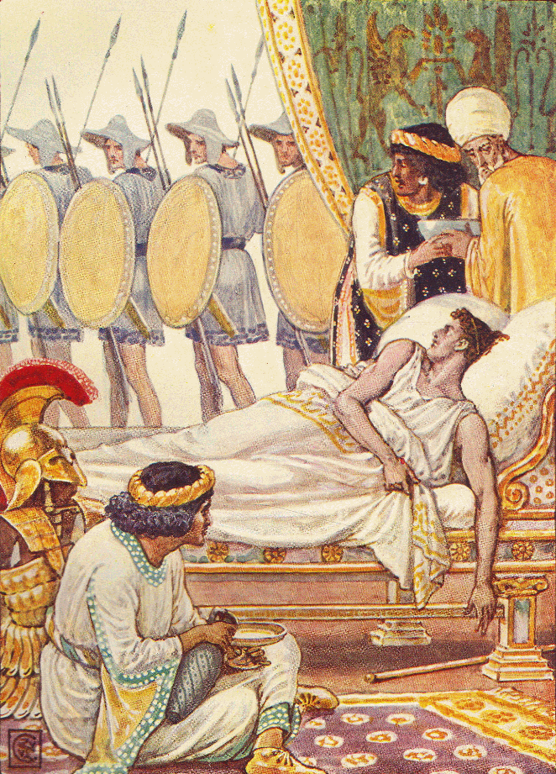
ALEXANDER THE GREAT ANCIENT GREECE
Alexander was only thirty-three years old in 323BCE, but he fell ill from a fever and died. The great conqueror was too young to make plans for a successor, so the empire Alexander created in less than thirteen years quickly crumbled after his death.

Slide 36
ALEXANDER THE GREAT ANCIENT GREECE
Alexander was only thirty-three years old in 323BCE, but he fell ill from a fever and died. The great conqueror was too young to make plans for a successor, so the empire Alexander created in less than thirteen years quickly crumbled after his death.

Slide 37
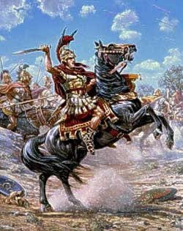
ALEXANDER THE GREAT ANCIENT GREECE
Alexander changed the world, but
not through his accomplishments
on the battlefield. Alexander’s
empire combined Greek culture
with the customs of Persia and
the other lands he conquered.
Later historians called this
combination of cultures the Hellenistic civilization. Hellenism is a word derived from the Greeks’ traditional name for themselves. Long after Alexander’s empire fell apart, Hellenism produced great advances in science, philosophy, and drama.

Slide 38
ALEXANDER THE GREAT ANCIENT GREECE
Alexander changed the world, but
not through his accomplishments
on the battlefield. Alexander’s
empire combined Greek culture
with the customs of Persia and
the other lands he conquered.
Later historians called this
combination of cultures the Hellenistic civilization. Hellenism is a word derived from the Greeks’ traditional name for themselves. Long after Alexander’s empire fell apart, Hellenism produced great advances in science, philosophy, and drama.

Slide 39
ALEXANDER THE GREAT ANCIENT GREECE
Alexander changed the world, but
not through his accomplishments
on the battlefield. Alexander’s
empire combined Greek culture
with the customs of Persia and
the other lands he conquered.
Later historians called this
combination of cultures the Hellenistic civilization. Hellenism is a word derived from the Greeks’ traditional name for themselves. Long after Alexander’s empire fell apart, Hellenism produced great advances in science, philosophy, and drama.

Slide 40
ALEXANDER THE GREAT ANCIENT GREECE
Alexander changed the world, but
not through his accomplishments
on the battlefield. Alexander’s
empire combined Greek culture
with the customs of Persia and
the other lands he conquered.
Later historians called this
combination of cultures the Hellenistic civilization. Hellenism is a word derived from the Greeks’ traditional name for themselves. Long after Alexander’s empire fell apart, Hellenism produced great advances in science, philosophy, and drama.

Slide 41

ALEXANDER THE GREAT ANCIENT GREECE
Learn more about history at
www.mrdowling.com

