Slide 1
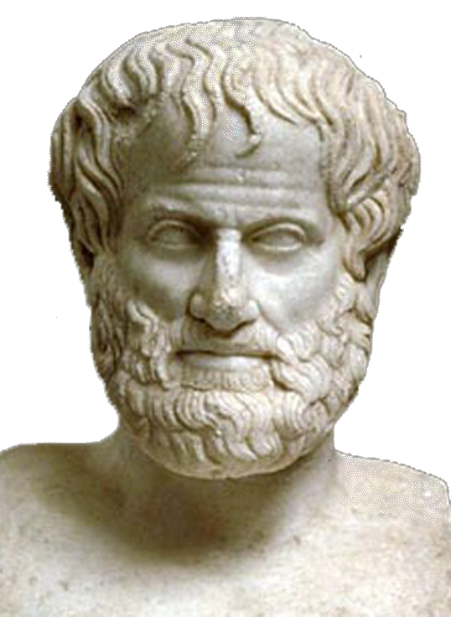

Aristotle Ancient Greece
Aristotle was the greatest scientist of the ancient world. He believed in using logic and reason to explain natural events in an era when most people believed storms and good harvests were a consequence of the anger or the pleasure of the gods.

Slide 2
Aristotle Ancient Greece
Aristotle was the greatest scientist of the ancient world. He believed in using logic and reason to explain natural events in an era when most people believed storms and good harvests were a consequence of the anger or the pleasure of the gods.

Slide 3
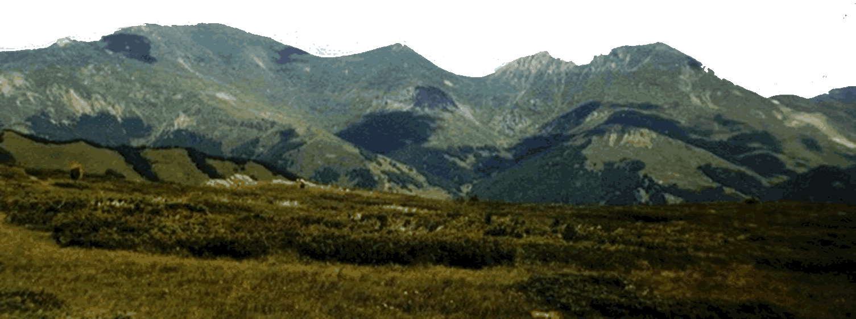
Aristotle Ancient Greece
Aristotle was born in Macedonia, a mountainous land north of the Greek peninsula. At that time, many Greeks viewed Macedonia as an old fashioned land with no culture.

Slide 4
Aristotle Ancient Greece
Aristotle was born in Macedonia, a mountainous land north of the Greek peninsula. At that time, many Greeks viewed Macedonia as an old fashioned land with no culture.

Slide 5
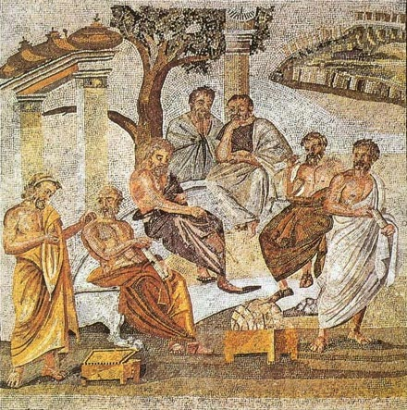
Aristotle Ancient Greece
Aristotle moved to Athens and studied at Plato’s Academy. Plato was a well known philosopher and a student of Socrates. Aristotle remained at the school for more than twenty years until shortly after Plato died.

Slide 6
Aristotle Ancient Greece
Aristotle moved to Athens and studied at Plato’s Academy. Plato was a well known philosopher and a student of Socrates. Aristotle remained at the school for more than twenty years until shortly after Plato died.

Slide 7
Aristotle Ancient Greece
Aristotle moved to Athens and studied at Plato’s Academy. Plato was a well known philosopher and a student of Socrates. Aristotle remained at the school for more than twenty years until shortly after Plato died.

Slide 8
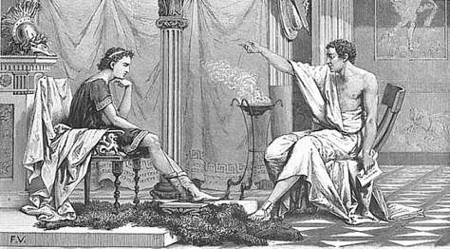
Aristotle Ancient Greece
Aristotle then returned to Macedonia, where King Philip hired him to prepare his thirteen-year-old son, Alexander, for his future role as a military leader. His student would one day
be known as
Alexander the
Great, one of the
greatest military
conquerors of all
time.

Slide 9
Aristotle Ancient Greece
Aristotle then returned to Macedonia, where King Philip hired him to prepare his thirteen-year-old son, Alexander, for his future role as a military leader. His student would one day
be known as
Alexander the
Great, one of the
greatest military
conquerors of all
time.

Slide 10
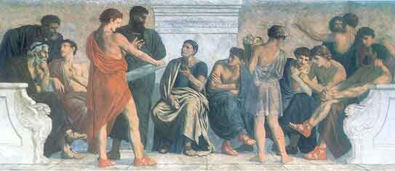
Aristotle Ancient Greece
Once Alexander
became King of
Macedonia, Aristotle
returned to Athens
and opened a school
he called the Lyceum. For the next twelve years, Aristotle organized his school as a center of research on astronomy, zoology, geography, geology, physics, anatomy, and many other fields.

Slide 11
Aristotle Ancient Greece
Once Alexander
became King of
Macedonia, Aristotle
returned to Athens
and opened a school
he called the Lyceum. For the next twelve years, Aristotle organized his school as a center of research on astronomy, zoology, geography, geology, physics, anatomy, and many other fields.

Slide 12
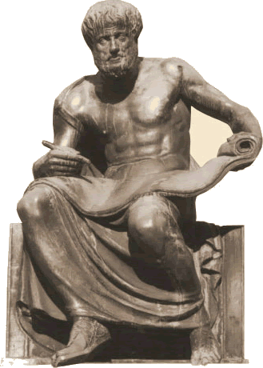
Aristotle Ancient Greece
Aristotle wrote 170 books, 47 of which still exist more than two thousand years later. Aristotle was also a philosopher who wrote about

Slide 13
Aristotle Ancient Greece
Aristotle wrote 170 books, 47 of which still exist more than two thousand years later. Aristotle was also a philosopher who wrote about

Slide 14
Aristotle Ancient Greece
ethics
(the study of moral principals),

Slide 15
Aristotle Ancient Greece
psychology
(the study of the mind and its functions),

Slide 16
Aristotle Ancient Greece
economics
(the study of the production,
consumption, and transfer of wealth),

Slide 17
Aristotle Ancient Greece
theology
(the study of religious beliefs),

Slide 18
Aristotle Ancient Greece
political science
(the study of government),

Slide 19
Aristotle Ancient Greece
and
rhetoric
(the art of effective or
persuasive speaking or writing).

Slide 20
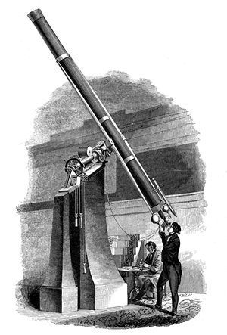
Aristotle Ancient Greece
Later inventions such as the telescope and microscope would prove many of Aristotle’s theories to be incorrect, but his ideas formed the basis of modern science.

Slide 21

Music courtesy of Kevin MacLeod
http://incompetech.com/music/royalty-free/
Learn more about history at
www.mrdowling.com

