Slide 1
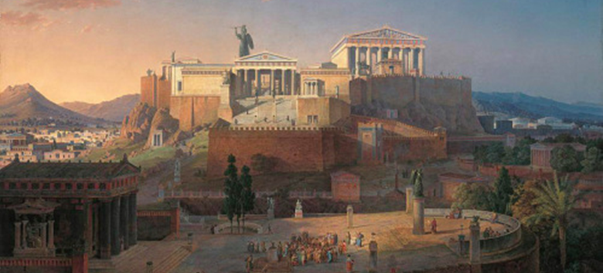

Athenian Democracy Ancient Greece
Athens is the capital and largest city in modern Greece, but Athens also has a long history that dates back 7000 years. Modern ideas about democracy first developed in ancient Athens.

Slide 2
Athenian Democracy Ancient Greece
Athens is the capital and largest city in modern Greece, but Athens also has a long history that dates back 7000 years. Modern ideas about democracy first developed in ancient Athens.

Slide 3
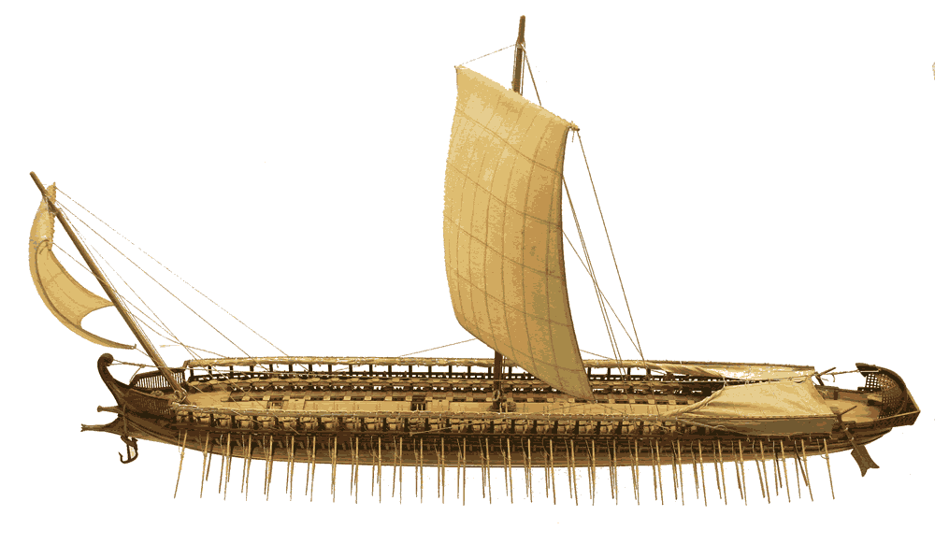
Athenian Democracy Ancient Greece
Unlike Sparta, it was difficult for the rulers of ancient Athens to have complete control over their citizens. Athens developed as a merchant poli whose ships traded with many faraway places. The traders were exposed to many new ideas.

Slide 4
Athenian Democracy Ancient Greece
Unlike Sparta, it was difficult for the rulers of ancient Athens to have complete control over their citizens. Athens developed as a merchant poli whose ships traded with many faraway places. The traders were exposed to many new ideas.

Slide 5
Athenian Democracy Ancient Greece
Unlike Sparta, it was difficult for the rulers of ancient Athens to have complete control over their citizens. Athens developed as a merchant poli whose ships traded with many faraway places. The traders were exposed to many new ideas.

Slide 6
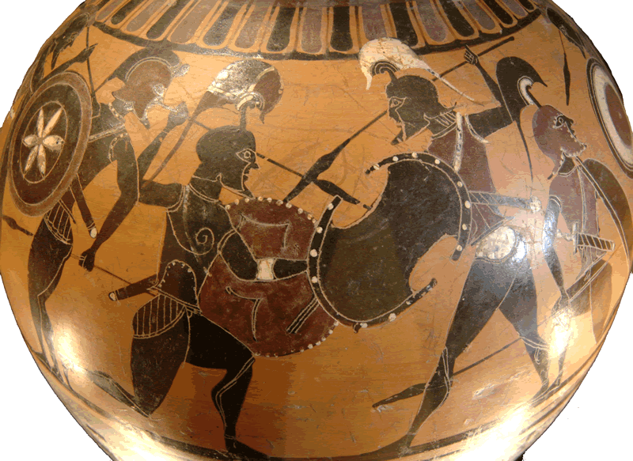
Athenian Democracy Ancient Greece
The first Athenian rulers were warriors who controlled the poli by force. The warrior families called themselves aristocrats. Aristoi- comes from a Greek word meaning “best people.”

Slide 7
Athenian Democracy Ancient Greece
The first Athenian rulers were warriors who controlled the poli by force. The warrior families called themselves aristocrats. Aristoi- comes from a Greek word meaning “best people.”

Slide 8
Athenian Democracy Ancient Greece
The first Athenian rulers were warriors who controlled the poli by force. The warrior families called themselves aristocrats. Aristoi- comes from a Greek word meaning “best people.”

Slide 9
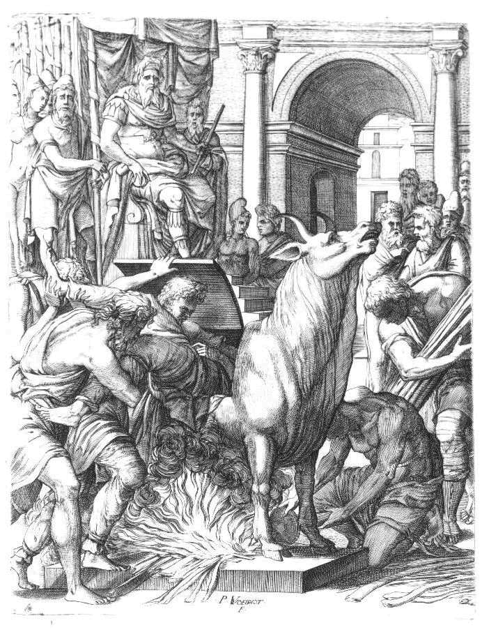
Athenian Democracy Ancient Greece
The tyrant was the leader of the aristocrats. Today we use the term tyrant to describe a cruel ruler, but many of the Athenian tyrants were kind and effective leaders.

Slide 10
Athenian Democracy Ancient Greece
The tyrant was the leader of the aristocrats. Today we use the term tyrant to describe a cruel ruler, but many of the Athenian tyrants were kind and effective leaders.

Slide 11
Athenian Democracy Ancient Greece
One tyrant named Draco created a written legal system and a court to enforce his laws. Draco’s court meted out harsh punishments for even minor offenses. Today
we use the word
draconian to
describe laws
that are
unnecessarily
harsh or unjust.

Slide 12
Athenian Democracy Ancient Greece
One tyrant named Draco created a written legal system and a court to enforce his laws. Draco’s court meted out harsh punishments for even minor offenses. Today
we use the word
draconian to
describe laws
that are
unnecessarily
harsh or unjust.

Slide 13
Athenian Democracy Ancient Greece
One tyrant named Draco created a written legal system and a court to enforce his laws. Draco’s court meted out harsh punishments for even minor offenses. Today
we use the word
draconian to
describe laws
that are
unnecessarily
harsh or unjust.

Slide 14
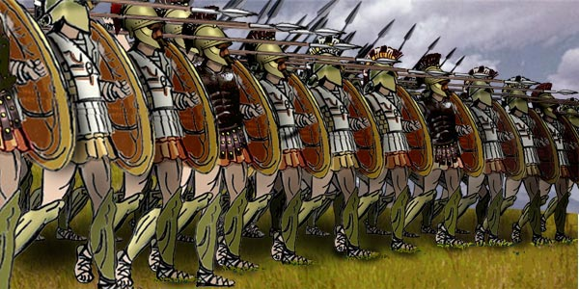
Athenian Democracy Ancient Greece
The Athenian army fought in a phalanx, a military formation of soldiers with overlapping shields that moved together as a unit. The mighty phalanx was more powerful than any individual aristocratic warrior.

Slide 15
Athenian Democracy Ancient Greece
The Athenian army fought in a phalanx, a military formation of soldiers with overlapping shields that moved together as a unit. The mighty phalanx was more powerful than any individual aristocratic warrior.

Slide 16
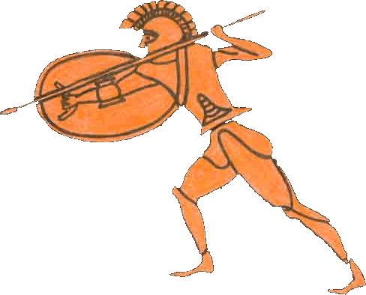
Athenian Democracy Ancient Greece
Soldiers no longer
needed to be wealthy
enough to afford
a horse, so
Athenians from
less prosperous families
could join the army. The
aristocratic leaders
learned to consider the
needs of all Athenian families to keep from losing support from the army.

Slide 17
Athenian Democracy Ancient Greece
Soldiers no longer
needed to be wealthy
enough to afford
a horse, so
Athenians from
less prosperous families
could join the army. The
aristocratic leaders
learned to consider the
needs of all Athenian families to keep from losing support from the army.

Slide 18
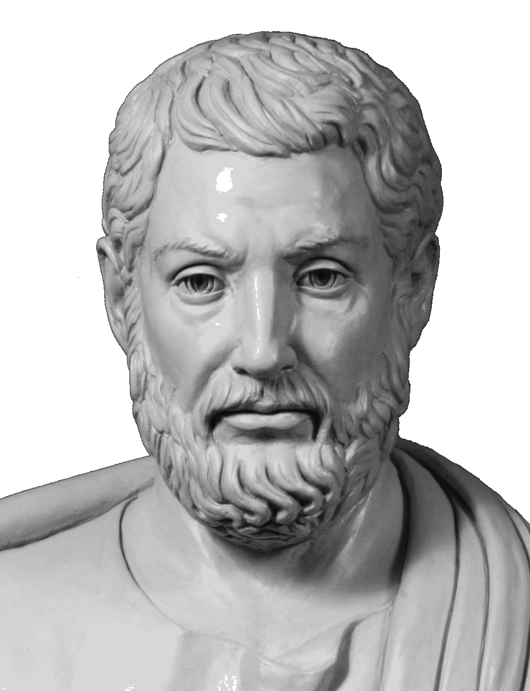
Athenian Democracy Ancient Greece
In 594BCE, Solon became
the leader of Athens.
Solon repealed Draco’s
harshest laws assembled
a group of ordinary citizens
to vote on how Athens
was to be governed.
The Assembly gathered
forty times a year and
was open to all male citizens with at least two years of military service.

Slide 19
Athenian Democracy Ancient Greece
In 594BCE, Solon became
the leader of Athens.
Solon repealed Draco’s
harshest laws assembled
a group of ordinary citizens
to vote on how Athens
was to be governed.
The Assembly gathered
forty times a year and
was open to all male citizens with at least two years of military service.

Slide 20
Athenian Democracy Ancient Greece
In 594BCE, Solon became
the leader of Athens.
Solon repealed Draco’s
harshest laws assembled
a group of ordinary citizens
to vote on how Athens
was to be governed.
The Assembly gathered
forty times a year and
was open to all male citizens with at least two years of military service.

Slide 21
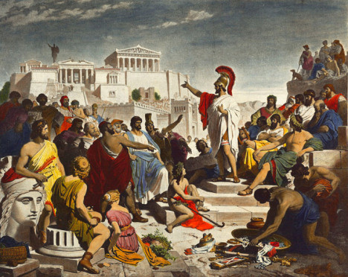
Athenian Democracy Ancient Greece
The word for people
in ancient Greek
was demos. Kratos
meant rule. The
government created
by Solon was a
democracy, where
the people ruled the
polis. Most democratic nations have elected representatives to make laws, but Athens was a direct democracy because the citizens acted as lawmakers.

Slide 22
Athenian Democracy Ancient Greece
The word for people
in ancient Greek
was demos. Kratos
meant rule. The
government created
by Solon was a
democracy, where
the people ruled the
polis. Most democratic nations have elected representatives to make laws, but Athens was a direct democracy because the citizens acted as lawmakers.

Slide 23
Athenian Democracy Ancient Greece
The word for people
in ancient Greek
was demos. Kratos
meant rule. The
government created
by Solon was a
democracy, where
the people ruled the
polis. Most democratic nations have elected representatives to make laws, but Athens was a direct democracy because the citizens acted as lawmakers.

Slide 24
Athenian Democracy Ancient Greece
The word for people
in ancient Greek
was demos. Kratos
meant rule. The
government created
by Solon was a
democracy, where
the people ruled the
polis. Most democratic nations have elected representatives to make laws, but Athens was a direct democracy because the citizens acted as lawmakers.

Slide 25
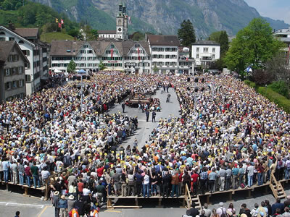
Athenian Democracy Ancient Greece
Direct democracy was possible in ancient Athens and is how many small towns govern today, but gathering all citizens together to make decisions is not practical in large countries
such as the
United States.

Slide 26
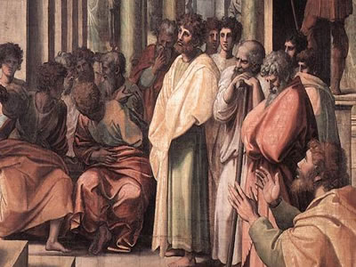
Athenian Democracy Ancient Greece
A council known as the
boule managed the daily affairs of the polis. Members of the
boule were not elected;
they were chosen
randomly from the
Assembly so that every
qualified person had an equal opportunity to serve on the council. At the end of the year, members of the boule appeared before the Assembly to account for their work.

Slide 27
Athenian Democracy Ancient Greece
A council known as the
boule managed the daily affairs of the polis. Members of the
boule were not elected;
they were chosen
randomly from the
Assembly so that every
qualified person had an equal opportunity to serve on the council. At the end of the year, members of the boule appeared before the Assembly to account for their work.

Slide 28
Athenian Democracy Ancient Greece
A council known as the
boule managed the daily affairs of the polis. Members of the
boule were not elected;
they were chosen
randomly from the
Assembly so that every
qualified person had an equal opportunity to serve on the council. At the end of the year, members of the boule appeared before the Assembly to account for their work.

Slide 29
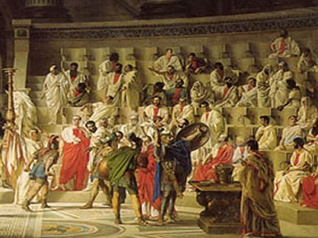
Athenian Democracy Ancient Greece
Only adult males born in Athens participated in the assembly. Athens encouraged outsiders to move to their polis, but only
free-born males
could vote.
Women could
own property
but were not
allowed to vote.

Slide 30
Athenian Democracy Ancient Greece
Only adult males born in Athens participated in the assembly. Athens encouraged outsiders to move to their polis, but only
free-born males
could vote.
Women could
own property
but were not
allowed to vote.

Slide 31
Athenian Democracy Ancient Greece
Only adult males born in Athens participated in the assembly. Athens encouraged outsiders to move to their polis, but only
free-born males
could vote.
Women could
own property
but were not
allowed to vote.

Slide 32
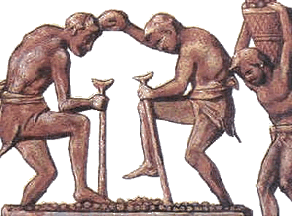
Athenian Democracy Ancient Greece
The members of the Assembly had time to work on public affairs because slaves did most of the physical work in the polis. About one in four people living in Athens were slaves. The members of the Assembly
accounted for only
about one-fourth
of the total
population
of Athens.

Slide 33
Athenian Democracy Ancient Greece
The members of the Assembly had time to work on public affairs because slaves did most of the physical work in the polis. About one in four people living in Athens were slaves. The members of the Assembly
accounted for only
about one-fourth
of the total
population
of Athens.

Slide 34
Athenian Democracy Ancient Greece
The members of the Assembly had time to work on public affairs because slaves did most of the physical work in the polis. About one in four people living in Athens were slaves. The members of the Assembly
accounted for only
about one-fourth
of the total
population
of Athens.

Slide 35
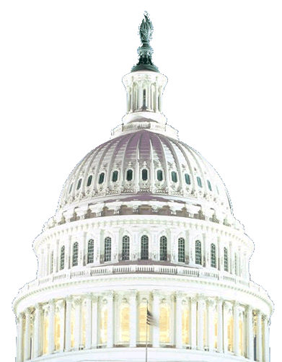
Athenian Democracy Ancient Greece
Participation in government by common people was an idea that eventually became a model for other governments. The democratic government in Athens inspired the writers of the
American Constitution.
Athenian democracy was
limited, but it gave some
people the opportunity
to make decisions about
how they were governed.

Slide 36
Athenian Democracy Ancient Greece
Participation in government by common people was an idea that eventually became a model for other governments. The democratic government in Athens inspired the writers of the
American Constitution.
Athenian democracy was
limited, but it gave some
people the opportunity
to make decisions about
how they were governed.

Slide 37
Athenian Democracy Ancient Greece
Participation in government by common people was an idea that eventually became a model for other governments. The democratic government in Athens inspired the writers of the
American Constitution.
Athenian democracy was
limited, but it gave some
people the opportunity
to make decisions about
how they were governed.

Slide 38

Learn more about history at
www.mrdowling.com

