Slide 1
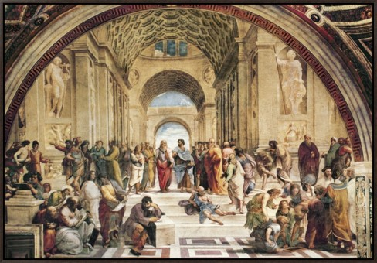
The Early Greeks Ancient Greece
Most of our study of ancient Greece is focused on what we call the Classical Age. The Classical Age of Greece is a two hundred year period that began about 500 years before the Common Era.

Slide 2
The Early Greeks Ancient Greece
Most of our study of ancient Greece is focused on what we call the Classical Age. The Classical Age of Greece is a two hundred year period that began about 500 years before the Common Era.

Slide 3
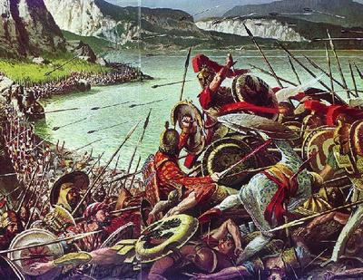
The Early Greeks Ancient Greece
During the Classical Age, the Greek poli combined to defeat the powerful Persian Empire. The Greeks of the Classical Era created art, architecture and literature that have influenced the way we live today.

Slide 4
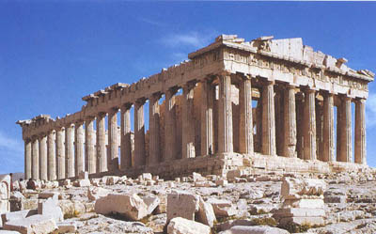
The Early Greeks Ancient Greece
During the Classical Age, the Greek poli combined to defeat the powerful Persian Empire. The Greeks of the Classical Era created art, architecture and literature that have influenced the way we live today.

Slide 5
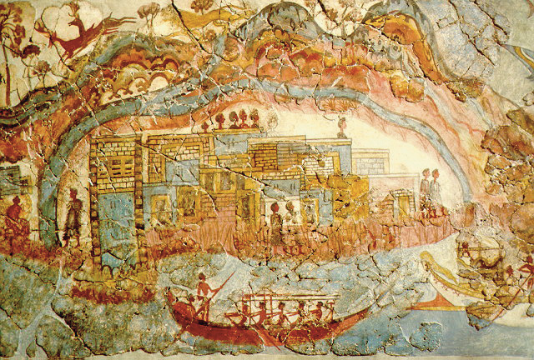
The Early Greeks Ancient Greece
The Classical Age came centuries after two earlier civilizations, the Minoans and the Mycenaeans, flourished and then vanished, leaving the Greeks in a period later called the Dark Age of Ancient Greece.

Slide 6
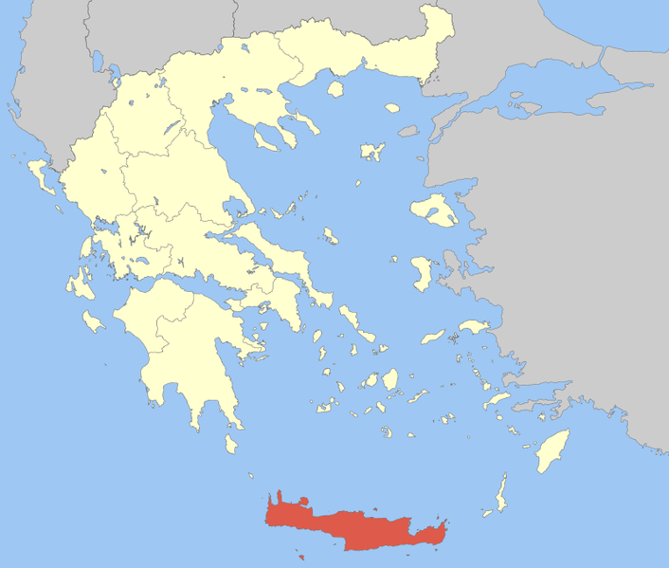
The Early Greeks Ancient Greece
The Minoan culture
developed on Crete,
an island southeast
of the Greek mainland.
The Minoans developed
a system of writing and
traded with other
cultures that bordered
the Mediterranean Sea, but the Minoan civilization mysteriously disappeared about 1450BCE. There is some evidence that the fall of the Minoan civilization is related to a catastrophic volcanic eruption.

Slide 7
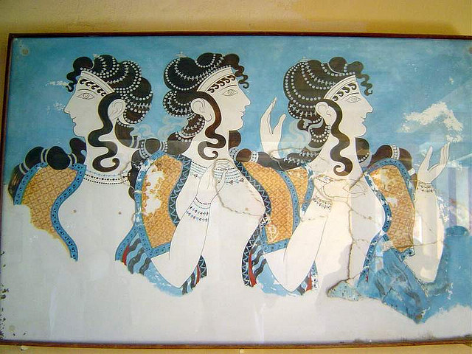
The Early Greeks Ancient Greece
The Minoan culture
developed on Crete,
an island southeast
of the Greek mainland.
The Minoans developed
a system of writing and
traded with other
cultures that bordered
the Mediterranean Sea, but the Minoan civilization mysteriously disappeared about 1450BCE. There is some evidence that the fall of the Minoan civilization is related to a catastrophic volcanic eruption.

Slide 8
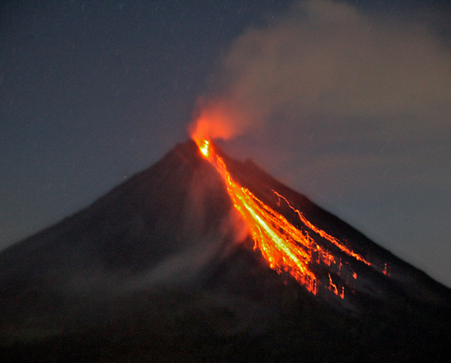
The Early Greeks Ancient Greece
The Minoan culture
developed on Crete,
an island southeast
of the Greek mainland.
The Minoans developed
a system of writing and
traded with other
cultures that bordered
the Mediterranean Sea, but the Minoan civilization mysteriously disappeared about 1450BCE. There is some evidence that the fall of the Minoan civilization is related to a catastrophic volcanic eruption.

Slide 9
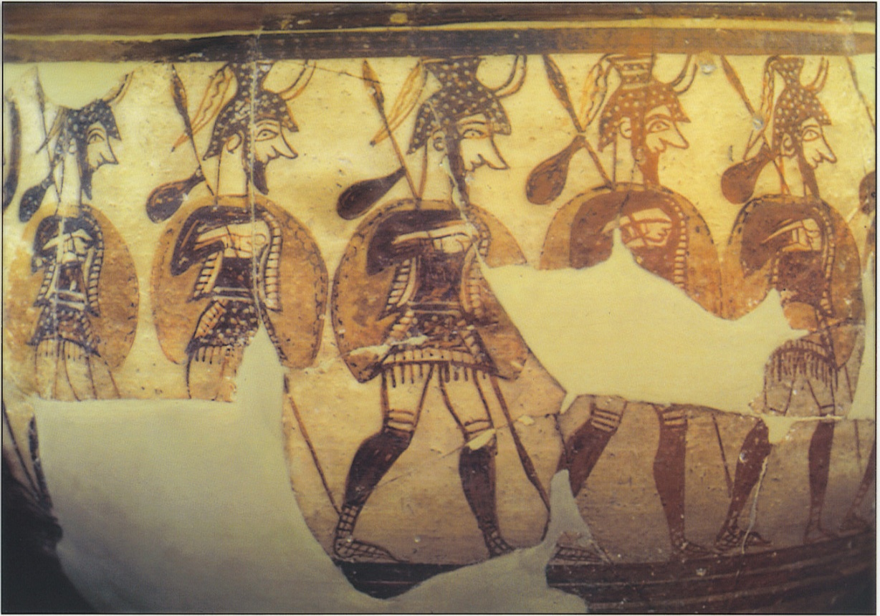
The Early Greeks Ancient Greece
The Minoans traded with the Mycenaeans, a civilization on the Greek mainland that was known for making bronze weapons and pottery. About a millennium before the Common Era, the Mycenaean culture grew weak
and was conquered
by invaders from
the north known as
Dorians.

Slide 10
The Early Greeks Ancient Greece
The Minoans traded with the Mycenaeans, a civilization on the Greek mainland that was known for making bronze weapons and pottery. About a millennium before the Common Era, the Mycenaean culture grew weak
and was conquered
by invaders from
the north known as
Dorians.

Slide 11
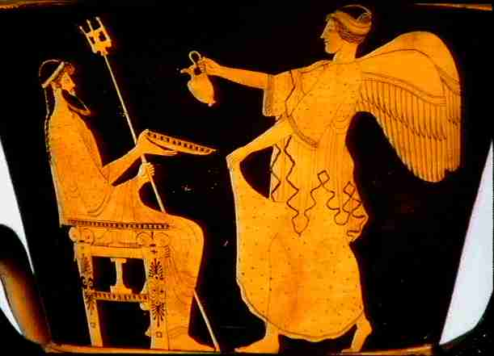
The Early Greeks Ancient Greece
For the next several
hundred years, Greece
fell into a period called
the Greek Dark Age.
There have been
several dark ages in
history. A dark age
occurs when a
civilization regresses,
or forgets some of the things they know. During the Greek Dark Age, few people could read and write.

Slide 12
The Early Greeks Ancient Greece
For the next several
hundred years, Greece
fell into a period called
the Greek Dark Age.
There have been
several dark ages in
history. A dark age
occurs when a
civilization regresses,
or forgets some of the things they know. During the Greek Dark Age, few people could read and write.

Slide 13
The Early Greeks Ancient Greece
For the next several
hundred years, Greece
fell into a period called
the Greek Dark Age.
There have been
several dark ages in
history. A dark age
occurs when a
civilization regresses,
or forgets some of the things they know. During the Greek Dark Age, few people could read and write.

Slide 14
The Early Greeks Ancient Greece
For the next several
hundred years, Greece
fell into a period called
the Greek Dark Age.
There have been
several dark ages in
history. A dark age
occurs when a
civilization regresses,
or forgets some of the things they know. During the Greek Dark Age, few people could read and write.

Slide 15
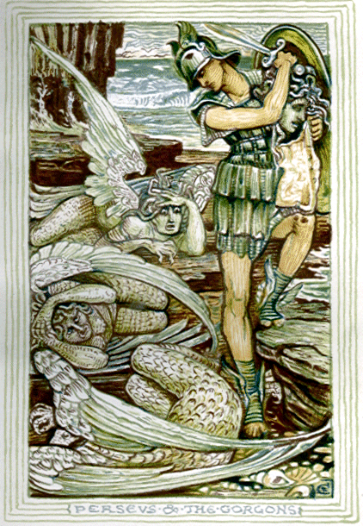
The Early Greeks Ancient Greece
The Greeks of the Classical Era had no written records of the Minoans and the Mycenaeans, but the Classical Greeks had many legends handed down by word of mouth. These stories became the basis of what the Greeks later called their Heroic Era.

Slide 16
The Early Greeks Ancient Greece
The Greeks of the Classical Era had no written records of the Minoans and the Mycenaeans, but the Classical Greeks had many legends handed down by word of mouth. These stories became the basis of what the Greeks later called their Heroic Era.

Slide 17
The Early Greeks Ancient Greece
Music courtesy of Kevin MacLeod
http://incompetech.com/music/royalty-free/
Learn more about history at
www.mrdowling.com

