Slide 1
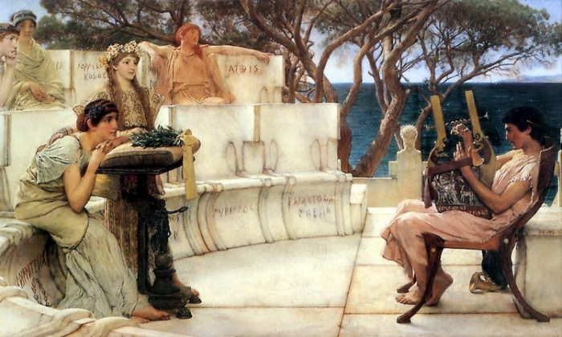

The Iliad and the Odyssey Ancient Greece
During the Greek Dark Age, poets called bards traveled to different poli. The bards told stories in the form of long poems called epics. People would often pay to hear the bards describe stories of the distant past.

Slide 2
The Iliad and the Odyssey Ancient Greece
During the Greek Dark Age, poets called bards traveled to different poli. The bards told stories in the form of long poems called epics. People would often pay to hear the bards describe stories of the distant past.

Slide 3
The Iliad and the Odyssey Ancient Greece
During the Greek Dark Age, poets called bards traveled to different poli. The bards told stories in the form of long poems called epics. People would often pay to hear the bards describe stories of the distant past.

Slide 4
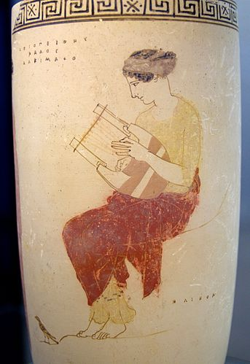
The Iliad and the Odyssey Ancient Greece
The bards would sing many of the epic poems while accompanied by a stringed instrument called a lyre. The musical epics were called lyric poetry.

Slide 5
The Iliad and the Odyssey Ancient Greece
The bards would sing many of the epic poems while accompanied by a stringed instrument called a lyre. The musical epics were called lyric poetry.

Slide 6
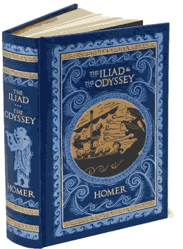
The Iliad and the Odyssey Ancient Greece
The two oldest surviving examples of Greek literature are the Iliad and the Odyssey, epic poems that describe the Trojan War, a conflict between the Greeks and the city of Troy that the epics say was fought almost 1200 years before the Common Era.

Slide 7
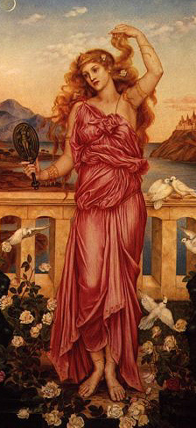
The Iliad and the Odyssey Ancient Greece
The Trojan War was fought over Helen, who according to legend was the beautiful daughter of Zeus and the wife of the king of the Greek polis of Sparta. The war began after a Trojan prince named Paris kidnapped Helen.

Slide 8
The Iliad and the Odyssey Ancient Greece
The Trojan War was fought over Helen, who according to legend was the beautiful daughter of Zeus and the wife of the king of the Greek polis of Sparta. The war began after a Trojan prince named Paris kidnapped Helen.

Slide 9
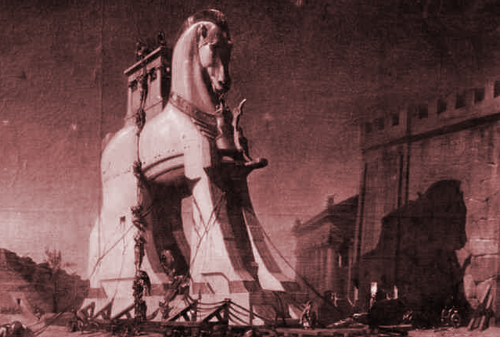
The Iliad and the Odyssey Ancient Greece
According to the Odyssey, the Trojan War ended when the Greeks pretended to give up their quest for Helen. The Greeks left a huge wooden horse as a peace offering to the Trojans. The Greek navy pretended to sail
away, but they
only sailed out
to a hidden
location.

Slide 10
The Iliad and the Odyssey Ancient Greece
According to the Odyssey, the Trojan War ended when the Greeks pretended to give up their quest for Helen. The Greeks left a huge wooden horse as a peace offering to the Trojans. The Greek navy pretended to sail
away, but they
only sailed out
to a hidden
location.

Slide 11
The Iliad and the Odyssey Ancient Greece
According to the Odyssey, the Trojan War ended when the Greeks pretended to give up their quest for Helen. The Greeks left a huge wooden horse as a peace offering to the Trojans. The Greek navy pretended to sail
away, but they
only sailed out
to a hidden
location.

Slide 12
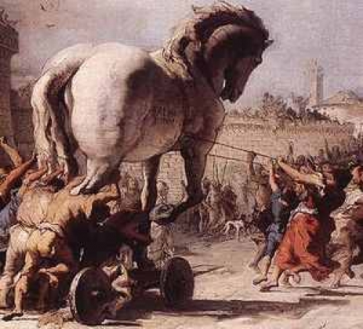
The Iliad and the Odyssey Ancient Greece
The joyous Trojans
opened the city gates
and pulled in the giant
statue. After a great
victory celebration of
their defeat of the
Greek army, the people
of Troy slept for the
night. As the Trojans
slept, Greek soldiers
emerged from their hiding place inside the wooden horse, opened the city gates, and began to burn the sleeping city.

Slide 13
The Iliad and the Odyssey Ancient Greece
The joyous Trojans
opened the city gates
and pulled in the giant
statue. After a great
victory celebration of
their defeat of the
Greek army, the people
of Troy slept for the
night. As the Trojans
slept, Greek soldiers
emerged from their hiding place inside the wooden horse, opened the city gates, and began to burn the sleeping city.

Slide 14
The Iliad and the Odyssey Ancient Greece
The joyous Trojans
opened the city gates
and pulled in the giant
statue. After a great
victory celebration of
their defeat of the
Greek army, the people
of Troy slept for the
night. As the Trojans
slept, Greek soldiers
emerged from their hiding place inside the wooden horse, opened the city gates, and began to burn the sleeping city.

Slide 15
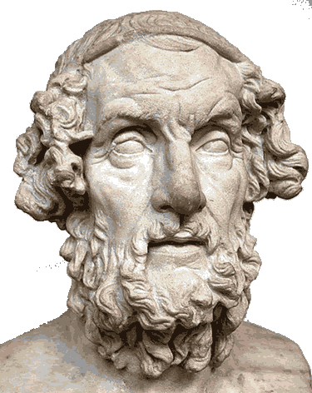
The Iliad and the Odyssey Ancient Greece
Modern scholars believe the Iliad and the Odyssey are based on oral legends, but the epics are often attributed to a storyteller named Homer. The language of the Iliad and the Odyssey suggest that Homer came from the western coast of the modern nation of Turkey.

Slide 16
The Iliad and the Odyssey Ancient Greece
Modern scholars believe the Iliad and the Odyssey are based on oral legends, but the epics are often attributed to a storyteller named Homer. The language of the Iliad and the Odyssey suggest that Homer came from the western coast of the modern nation of Turkey.

Slide 17
The Iliad and the Odyssey Ancient Greece
Homer’s name can be translated from a word that means blind, but the vivid imagery of the Iliad and the Odyssey suggest that the author of the poems must have had sight at some point in his life.

Slide 18
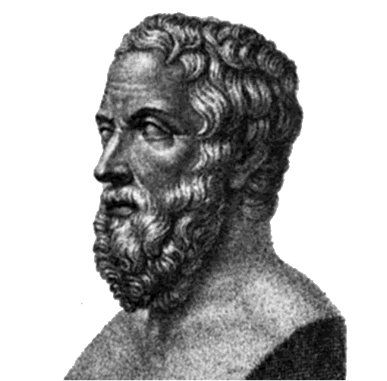
The Iliad and the Odyssey Ancient Greece
We have only a few clues about who Homer might have been. Herodotus was a Greek writer who lived in the fifth century before the Common Era. Herodotus is often called “the Father of History.” The great historian estimated that the story of the Trojan War was at that time at least seven centuries old.

Slide 19
The Iliad and the Odyssey Ancient Greece
We have only a few clues about who Homer might have been. Herodotus was a Greek writer who lived in the fifth century before the Common Era. Herodotus is often called “the Father of History.” The great historian estimated that the story of the Trojan War was at that time at least seven centuries old.

Slide 20
The Iliad and the Odyssey Ancient Greece
We have only a few clues about who Homer might have been. Herodotus was a Greek writer who lived in the fifth century before the Common Era. Herodotus is often called “the Father of History.” The great historian estimated that the story of the Trojan War was at that time at least seven centuries old.

Slide 21
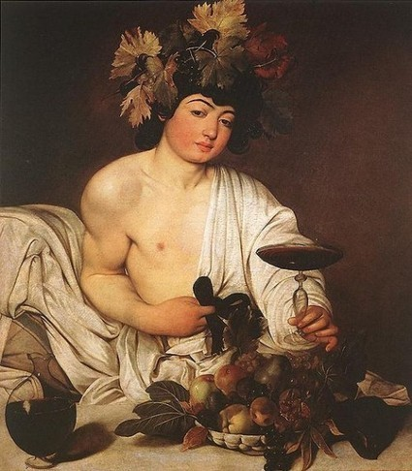
The Iliad and the Odyssey Ancient Greece
The epic stories of the bards are the foundation of Greek theater. During the Classical Age, the Greeks often performed plays at festivals honoring Dionysus. Dionysus was the Greek god of the harvest, but he was also the god of pleasure.

Slide 22
The Iliad and the Odyssey Ancient Greece
The epic stories of the bards are the foundation of Greek theater. During the Classical Age, the Greeks often performed plays at festivals honoring Dionysus. Dionysus was the Greek god of the harvest, but he was also the god of pleasure.

Slide 23
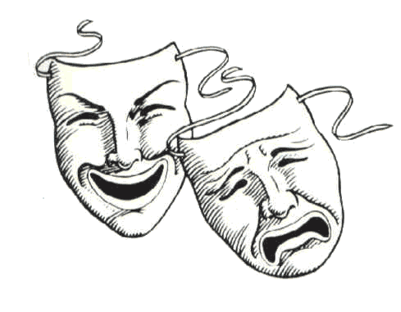
The Iliad and the Odyssey Ancient Greece
In many Greek
plays, a few actors
played roles while a
chorus narrated the
play and offered
advice to the characters.
Greek tragedies were plays
that described great conflicts and often
ended unhappily; Greek comedies told
amusing stories about Greek culture and society and generally had happy endings.

Slide 24
The Iliad and the Odyssey Ancient Greece
In many Greek
plays, a few actors
played roles while a
chorus narrated the
play and offered
advice to the characters.
Greek tragedies were plays
that described great conflicts and often
ended unhappily; Greek comedies told
amusing stories about Greek culture and society and generally had happy endings.

Slide 25

The Iliad and the Odyssey Ancient Greece
The modern movies we see today are rooted in the plays of ancient Greece and the stories of the mysterious Heroic Era of ancient Greece.

Slide 26

The Iliad and the Odyssey Ancient Greece
Music courtesy of Kevin MacLeod
http://incompetech.com/music/royalty-free/
Learn more about history at
www.mrdowling.com

