Slide 1
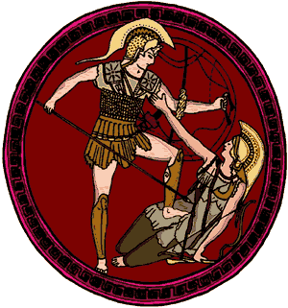
THE PELOPONNESIAN WAR ANCIENT GREECE
The Greek victories over the Persians in the fifth century before the Common Era led to an expansion of Greek culture we now call the Golden Age of Greece.” During this period of political stability, democracy flourished in Athens under a revered leader named Pericles. The Greeks also made advances in art, drama, poetry and philosophy. The Golden Age ended with conflicts between Athens and Sparta that led to the 27-year long Peloponnesian War.

Slide 2
THE PELOPONNESIAN WAR ANCIENT GREECE
The Greek victories over the Persians in the fifth century before the Common Era led to an expansion of Greek culture we now call the Golden Age of Greece.” During this period of political stability, democracy flourished in Athens under a revered leader named Pericles. The Greeks also made advances in art, drama, poetry and philosophy. The Golden Age ended with conflicts between Athens and Sparta that led to the 27-year long Peloponnesian War.

Slide 3
THE PELOPONNESIAN WAR ANCIENT GREECE
The Greek victories over the Persians in the fifth century before the Common Era led to an expansion of Greek culture we now call the Golden Age of Greece.” During this period of political stability, democracy flourished in Athens under a revered leader named Pericles. The Greeks also made advances in art, drama, poetry and philosophy. The Golden Age ended with conflicts between Athens and Sparta that led to the 27-year long Peloponnesian War.

Slide 4
THE PELOPONNESIAN WAR ANCIENT GREECE
The Greek victories over the Persians in the fifth century before the Common Era led to an expansion of Greek culture we now call the Golden Age of Greece.” During this period of political stability, democracy flourished in Athens under a revered leader named Pericles. The Greeks also made advancements in art, drama, poetry and philosophy. The Golden Age ended with conflicts between Athens and Sparta that led to the 27-year long Peloponnesian War.

Slide 5
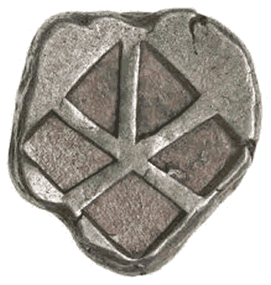
THE PELOPONNESIAN WAR ANCIENT GREECE
Athens was the founder of the
Delian League, an alliance of
Greek poli that defeated the
Persians. Athens collected
taxes from the other poli to
maintain the military forces
required to combat the Persians.
The Athenians also used money
from the Delian League to construct a colossal temple dedicated to the goddess Athena.

Slide 6
THE PELOPONNESIAN WAR ANCIENT GREECE
Athens was the founder of the
Delian League, an alliance of
Greek poli that defeated the
Persians. Athens collected
taxes from the other poli to
maintain the military forces
required to combat the Persians.
The Athenians also used money
from the Delian League to construct a colossal temple dedicated to the goddess Athena.

Slide 7
THE PELOPONNESIAN WAR ANCIENT GREECE
Athens was the founder of the
Delian League, an alliance of
Greek poli that defeated the
Persians. Athens collected
taxes from the other poli to
maintain the military forces
required to combat the Persians.
The Athenians also used money
from the Delian League to construct a colossal temple dedicated to the goddess Athena.

Slide 8
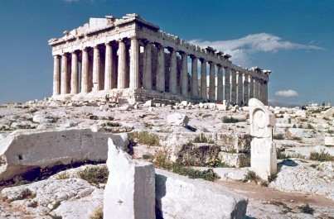
THE PELOPONNESIAN WAR ANCIENT GREECE
In 447BCE, Athens began construction of the Parthenon at the top of the Acropolis (“high city”) of Athens. Resentment grew among many poli as Athens demonstrated its wealth at the same time the Athenians antagonized the rival city of Sparta.

Slide 9
THE PELOPONNESIAN WAR ANCIENT GREECE
In 447BCE, Athens began construction of the Parthenon at the top of the Acropolis (“high city”) of Athens. Resentment grew among many poli as Athens demonstrated its wealth at the same time the Athenians antagonized the rival city of Sparta.

Slide 10
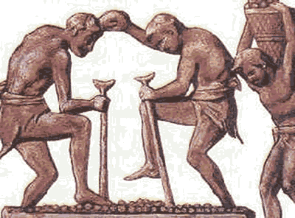
THE PELOPONNESIAN WAR ANCIENT GREECE
Sparta called on the other Greek poli for assistance to quell a helot uprising. The helots were slaves forced to farm the land that fed the Spartans. Athens sent a force of 4000 soldiers, but the Spartans rejected the Athenian support.

Slide 11
THE PELOPONNESIAN WAR ANCIENT GREECE
Sparta called on the other Greek poli for assistance to quell a helot uprising. The helots were slaves forced to farm the land that fed the Spartans. Athens sent a force of 4000 soldiers, but the Spartans rejected the Athenian support.

Slide 12
THE PELOPONNESIAN WAR ANCIENT GREECE
Sparta called on the other Greek poli for assistance to quell a helot uprising. The helots were slaves forced to farm the land that fed the Spartans. Athens sent a force of 4000 soldiers, but the Spartans rejected the Athenian support.

Slide 13
THE PELOPONNESIAN WAR ANCIENT GREECE
Thucydides later suggested that the Spartans feared the Athenians would switch sides once the Athenians were inside the Spartan city walls. The offended Athens ended their alliance with Sparta and at the end of the uprising, Athens assisted many of the escaped helots.

Slide 14
THE PELOPONNESIAN WAR ANCIENT GREECE
Thucydides later suggested that the Spartans feared the Athenians would switch sides once the Athenians were inside the Spartan city walls. The offended Athens ended their alliance with Sparta and at the end of the uprising, Athens assisted many of the escaped helots.

Slide 15
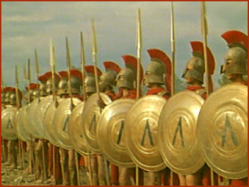
THE PELOPONNESIAN WAR ANCIENT GREECE
In 433BCE, Athens placed a ban on trade with a poli allied with Sparta. Athens’ high taxes of the other poli caused a weakening of the Delian League, so Sparta declared war to end the Athenian dominance of the Greek peninsula.

Slide 16
THE PELOPONNESIAN WAR ANCIENT GREECE
In 433BCE, Athens placed a ban on trade with a poli allied with Sparta. Athens’ high taxes of the other poli caused a weakening of the Delian League, so Sparta declared war to end the Athenian dominance of the Greek peninsula.

Slide 17
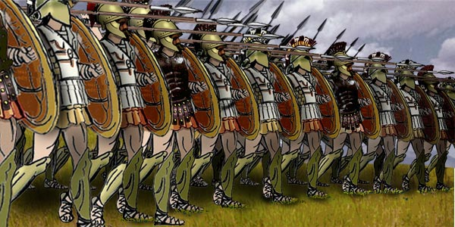
THE PELOPONNESIAN WAR ANCIENT GREECE
Sparta began a siege, or military blockade of Athens. Athens prepared for the siege by building long walls on either side of a four-mile road that connected Athens with a port. The Athenians resisted the siege for more than a year by receiving supplies at the port from their allies.

Slide 18
THE PELOPONNESIAN WAR ANCIENT GREECE
Sparta began a siege, or military blockade of Athens. Athens prepared for the siege by building long walls on either side of a four-mile road that connected Athens with a port. The Athenians resisted the siege for more than a year by receiving supplies at the port from their allies.

Slide 19
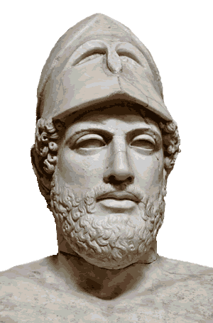
THE PELOPONNESIAN WAR ANCIENT GREECE
Pericles ordered the farmers living in the Athenian countryside to move inside the city walls for safety. The cramped and unsanitary living conditions inside Athens under siege were an easy target for disease. A plague, or contagious illness, spread through the
overcrowded polis. The sickness killed
more than 30,000 Athenians, about
two-thirds of the population. Pericles,
the leader of Athens during the Golden
Age, was among the victims. The
Spartans abandoned their blockade
because the soldiers feared catching
the disease.

Slide 20
THE PELOPONNESIAN WAR ANCIENT GREECE
Pericles ordered the farmers living in the Athenian countryside to move inside the city walls for safety. The cramped and unsanitary living conditions inside Athens under siege were an easy target for disease. A plague, or contagious illness, spread through the
overcrowded polis. The sickness killed
more than 30,000 Athenians, about
two-thirds of the population. Pericles,
the leader of Athens during the Golden
Age, was among the victims. The
Spartans abandoned their blockade
because the soldiers feared catching
the disease.

Slide 21
THE PELOPONNESIAN WAR ANCIENT GREECE
Pericles ordered the farmers living in the Athenian countryside to move inside the city walls for safety. The cramped and unsanitary living conditions inside Athens under siege were an easy target for disease. A plague, or contagious illness, spread through the
overcrowded polis. The sickness killed
more than 30,000 Athenians, about
two-thirds of the population. Pericles,
the leader of Athens during the Golden
Age, was among the victims. The
Spartans abandoned their blockade
because the soldiers feared catching
the disease.

Slide 22
THE PELOPONNESIAN WAR ANCIENT GREECE
Pericles ordered the farmers living in the Athenian countryside to move inside the city walls for safety. The cramped and unsanitary living conditions inside Athens under siege were an easy target for disease. A plague, or contagious illness, spread through the
overcrowded polis. The sickness killed
more than 30,000 Athenians, about
two-thirds of the population. Pericles,
the leader of Athens during the Golden
Age, was among the victims. The
Spartans abandoned their blockade
because the soldiers feared catching
the disease.

Slide 23
THE PELOPONNESIAN WAR ANCIENT GREECE
Pericles ordered the farmers living in the Athenian countryside to move inside the city walls for safety. The cramped and unsanitary living conditions inside Athens under siege were an easy target for disease. A plague, or contagious illness, spread through the
overcrowded polis. The sickness killed
more than 30,000 Athenians, about
two-thirds of the population. Pericles,
the leader of Athens during the Golden
Age, was among the victims. The
Spartans abandoned their blockade
because the soldiers feared catching
the disease.

Slide 24
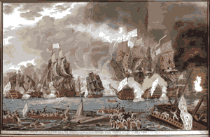
THE PELOPONNESIAN WAR ANCIENT GREECE
Sparta and Athens agreed
to a truce after a series of
victories by the Athenian
navy. The war had
weakened both poli, but
Persia, still bitter from
their military losses to
Athens, ended the brief period of peace. The Persians hoped to destroy the weakened Athens by contributing resources that allowed Sparta to create a powerful navy.

Slide 25
THE PELOPONNESIAN WAR ANCIENT GREECE
Sparta and Athens agreed
to a truce after a series of
victories by the Athenian
navy. The war had
weakened both poli, but
Persia, still bitter from
their military losses to
Athens, ended the brief period of peace. The Persians hoped to destroy the weakened Athens by contributing resources that allowed Sparta to create a powerful navy.

Slide 26
THE PELOPONNESIAN WAR ANCIENT GREECE
Sparta and Athens agreed
to a truce after a series of
victories by the Athenian
navy. The war had
weakened both poli, but
Persia, still bitter from
their military losses to
Athens, ended the brief period of peace. The Persians hoped to destroy the weakened Athens by contributing resources that allowed Sparta to create a powerful navy.

Slide 27
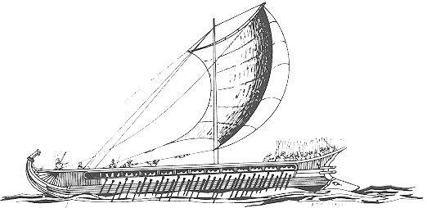
THE PELOPONNESIAN WAR ANCIENT GREECE
In 404BCE, the Spartans once again began a siege, but this time the Persian-sponsored Spartan fleet prevented ships from supplying Athens. Athens resisted the siege for almost a year, but without supplies from their allies, the starving Athenians were no longer capable of
stopping the Spartan
army from attacking.

Slide 28
THE PELOPONNESIAN WAR ANCIENT GREECE
In 404BCE, the Spartans once again began a siege, but this time the Persian-sponsored Spartan fleet prevented ships from supplying Athens. Athens resisted the siege for almost a year, but without supplies from their allies, the starving Athenians were no longer capable of
stopping the Spartan
army from attacking.

Slide 29
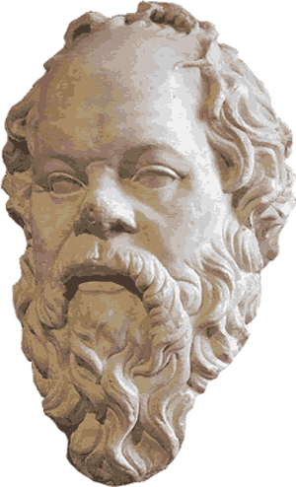
THE PELOPONNESIAN WAR ANCIENT GREECE
The Peloponnesian War claimed thousands of lives and humbled both Athens and Sparta. A critic of the rulers of Athens named Socrates caused an uproar in the polis that eventually led to his execution.

Slide 30
THE PELOPONNESIAN WAR ANCIENT GREECE
The Peloponnesian War claimed thousands of lives and humbled both Athens and Sparta. A critic of the rulers of Athens named Socrates caused an uproar in the polis that eventually led to his execution.

Slide 31
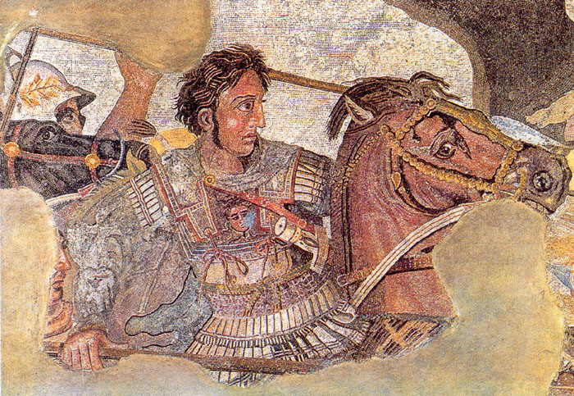
THE PELOPONNESIAN WAR ANCIENT GREECE
Conflicts continued among the Greek poli, who paid little attention to the growing military power of Macedonia, the mountainous land north of the Greek peninsula. Soon after the Peloponnesian War, Macedonia King Phillip conquered most of the Greek peninsula. His son, Alexander the Great, conquered the rest of the peninsula and went on to create the most powerful empire the world had known at that time.

Slide 32
THE PELOPONNESIAN WAR ANCIENT GREECE
Conflicts continued among the Greek poli, who paid little attention to the growing military power of Macedonia, the mountainous land north of the Greek peninsula. Soon after the Peloponnesian War, Macedonia King Phillip conquered most of the Greek peninsula. His son, Alexander the Great, conquered the rest of the peninsula and went on to create the most powerful empire the world had known at that time.

Slide 33
THE PELOPONNESIAN WAR ANCIENT GREECE
Conflicts continued among the Greek poli, who paid little attention to the growing military power of Macedonia, the mountainous land north of the Greek peninsula. Soon after the Peloponnesian War, Macedonia King Phillip conquered most of the Greek peninsula. His son, Alexander the Great, conquered the rest of the peninsula and went on to create the most powerful empire the world had known at that time.

Slide 34
THE PELOPONNESIAN WAR ANCIENT GREECE
Music by Dan-O at DanoSongs.com
Learn more about history at
www.mrdowling.com

