Slide 1
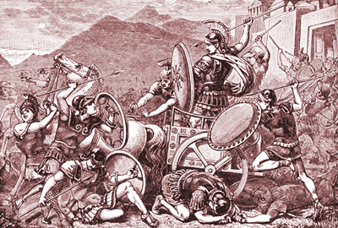

Persia Ancient Greece
Wars among the
Greek poli were
common in the
fifth century before
the Common Era,
but the city-states
united to defend
themselves against
Persia, the most powerful empire in the world at that time. The victorious Greeks developed a sense of confidence that led to an era we now call the Classical Age of Greece.

Slide 2
Persia Ancient Greece
Wars among the
Greek poli were
common in the
fifth century before
the Common Era,
but the city-states
united to defend
themselves against
Persia, the most powerful empire in the world at that time. The victorious Greeks developed a sense of confidence that led to an era we now call the Classical Age of Greece.

Slide 3
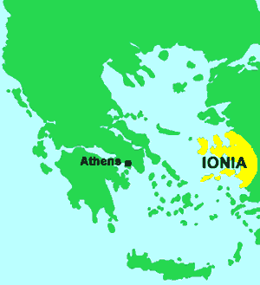
Persia Ancient Greece
The Persian Empire conquered Ionia. Ionia is east of the Greek peninsula in Asia Minor, land that is now part of the modern nation of Turkey. In 499BCE, Athens sent its army to aid an Ionian rebellion against the Persians.

Slide 4
Persia Ancient Greece
The Persian Empire conquered Ionia. Ionia is east of the Greek peninsula in Asia Minor, land that is now part of the modern nation of Turkey. In 499BCE, Athens sent its army to aid an Ionian rebellion against the Persians.

Slide 5
Persia Ancient Greece
The Persian Empire conquered Ionia. Ionia is east of the Greek peninsula in Asia Minor, land that is now part of the modern nation of Turkey. In 499BCE, Athens sent its army to aid an Ionian rebellion against the Persians.

Slide 6
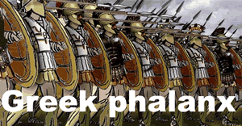
Persia Ancient Greece
Athens used a battle
formation called a
phalanx. In a
phalanx, heavily
armed soldiers held
overlapping shields
that protected the combatants on either side. The phalanx required soldiers to depend on one another for their safety, so Athenian warriors fought as a unit instead of as individuals. The well-trained Athenian phalanx helped the Ionians repel the Persians from Ionian land.

Slide 7
Persia Ancient Greece
Athens used a battle
formation called a
phalanx. In a
phalanx, heavily
armed soldiers held
overlapping shields
that protected the combatants on either side. The phalanx required soldiers to depend on one another for their safety, so Athenian warriors fought as a unit instead of as individuals. The well-trained Athenian phalanx helped the Ionians repel the Persians from Ionian land.

Slide 8
Persia Ancient Greece
Athens used a battle
formation called a
phalanx. In a
phalanx, heavily
armed soldiers held
overlapping shields
that protected the combatants on either side. The phalanx required soldiers to depend on one another for their safety, so Athenian warriors fought as a unit instead of as individuals. The well-trained Athenian phalanx helped the Ionians repel the Persians from Ionian land.

Slide 9
Persia Ancient Greece
Athens used a battle
formation called a
phalanx. In a
phalanx, heavily
armed soldiers held
overlapping shields
that protected the combatants on either side. The phalanx required soldiers to depend on one another for their safety, so Athenian warriors fought as a unit instead of as individuals. The well-trained Athenian phalanx helped the Ionians repel the Persians from Ionian land.

Slide 10
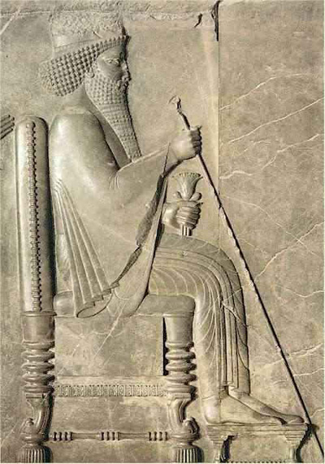
Persia Ancient Greece
King Darius of Persia swore revenge
on Athens. In 490BCE, Persian ships
carried about 20,000 warriors to
Marathon, a flat plain twenty-six miles
from Athens. The Persians planned to
use Marathon as a base from which to
attack, but a spy alerted Athens. The Athenian army was outnumbered by about two to one, but they marched through the night to make a surprise attack on the Persian forces at dawn. The frightened Persians fled to their ships and retreated from Greece.

Slide 11
Persia Ancient Greece
King Darius of Persia swore revenge
on Athens. In 490BCE, Persian ships
carried about 20,000 warriors to
Marathon, a flat plain twenty-six miles
from Athens. The Persians planned to
use Marathon as a base from which to
attack, but a spy alerted Athens. The Athenian army was outnumbered by about two to one, but they marched through the night to make a surprise attack on the Persian forces at dawn. The frightened Persians fled to their ships and retreated from Greece.

Slide 12
Persia Ancient Greece
King Darius of Persia swore revenge
on Athens. In 490BCE, Persian ships
carried about 20,000 warriors to
Marathon, a flat plain twenty-six miles
from Athens. The Persians planned to
use Marathon as a base from which to
attack, but a spy alerted Athens. The Athenian army was outnumbered by about two to one, but they marched through the night to make a surprise attack on the Persian forces at dawn. The frightened Persians fled to their ships and retreated from Greece.

Slide 13
Persia Ancient Greece
King Darius of Persia swore revenge
on Athens. In 490BCE, Persian ships
carried about 20,000 warriors to
Marathon, a flat plain twenty-six miles
from Athens. The Persians planned to
use Marathon as a base from which to
attack, but a spy alerted Athens. The Athenian army was outnumbered by about two to one, but they marched through the night to make a surprise attack on the Persian forces at dawn. The frightened Persians fled to their ships and retreated from Greece.

Slide 14
Persia Ancient Greece
King Darius of Persia swore revenge
on Athens. In 490BCE, Persian ships
carried about 20,000 warriors to
Marathon, a flat plain twenty-six miles
from Athens. The Persians planned to
use Marathon as a base from which to
attack, but a spy alerted Athens. The Athenian army was outnumbered by about two to one, but they marched through the night to make a surprise attack on the Persian forces at dawn. The frightened Persians fled to their ships and retreated from Greece.

Slide 15
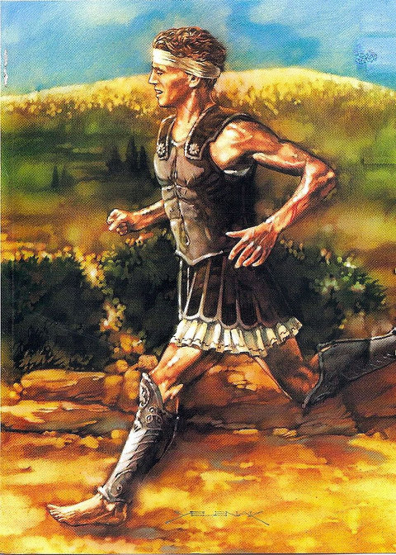
Persia Ancient Greece
A messenger named Pheidippides ran to Athens without stopping to announce Athens’ surprise victory at Marathon, but the runner died from exhaustion shortly after gasping out his news.

Slide 16
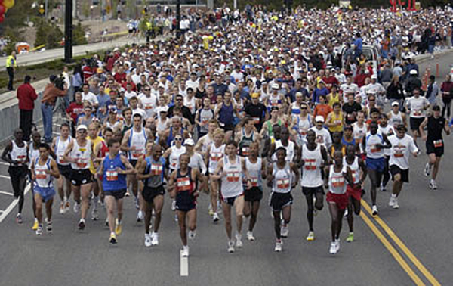
Persia Ancient Greece
A modern marathon is a foot race that is named in honor of Pheidippides’ run. Modern marathons are exactly 26 miles, 385 yards. This is the distance Pheidippides is believed to have run.

Slide 17
Persia Ancient Greece
A modern marathon is a foot race that is named in honor of Pheidippides’ run. Modern marathons are exactly 26 miles, 385 yards. This is the distance Pheidippides is believed to have run.

Slide 18
Persia Ancient Greece
A modern marathon is a foot race that is named in honor of Pheidippides’ run. Modern marathons are exactly 26 miles, 385 yards. This is the distance Pheidippides is believed to have run.

Slide 19
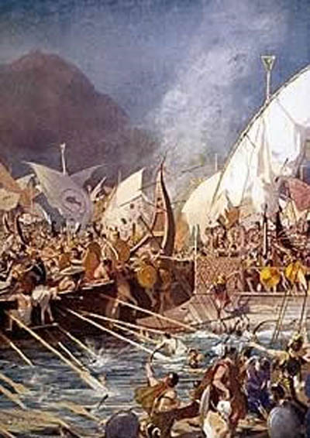
Persia Ancient Greece
Ten years after the Persian retreat at Marathon, Darius’ son, Xerxes, prepared for another invasion of Greece. Xerxes sent about 200,000 soldiers and 800 ships to fight the Greeks at the Battle of Salamis in 460BCE.

Slide 20
Persia Ancient Greece
Ten years after the Persian retreat at Marathon, Darius’ son, Xerxes, prepared for another invasion of Greece. Xerxes sent about 200,000 soldiers and 800 ships to fight the Greeks at the Battle of Salamis in 460BCE.

Slide 21
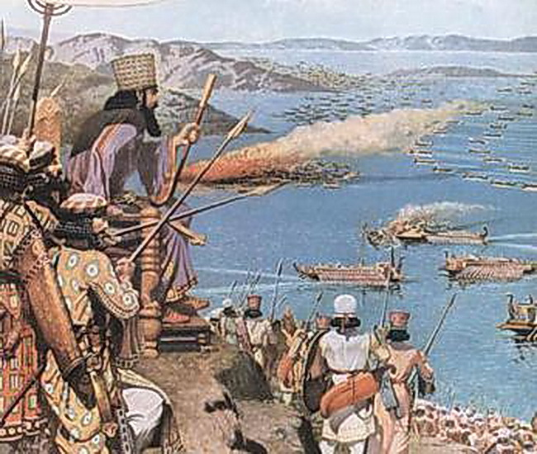
Persia Ancient Greece
The Persian king
watched from a
mountaintop as
the Greeks
managed to
destroy the
Persian fleet.
Xerxes was so
enraged by
Persia’s loss that he beheaded the few Persian captains who were able to escape the wrath of the Greek armies.

Slide 22
Persia Ancient Greece
The Persian king
watched from a
mountaintop as
the Greeks
managed to
destroy the
Persian fleet.
Xerxes was so
enraged by
Persia’s loss that he beheaded the few Persian captains who were able to escape the wrath of the Greek armies.

Slide 23
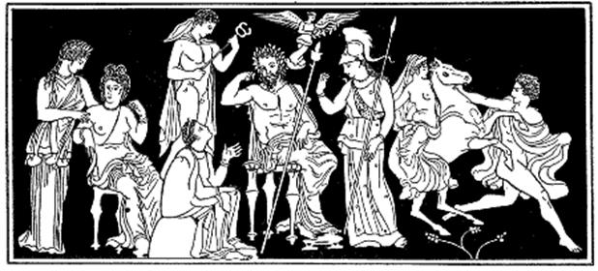
Persia Ancient Greece
Athens had twice resisted the most powerful empire in the world, but Athens was certain that Persia would make another attempt to conquer Greece. Athens asked all of the Greek poli to meet on the island of Delios where the poli formed an alliance known as the Delian League. Each member of the
Delian League
contributed
soldiers, ships
and money to
fight the Persians.

Slide 24
Persia Ancient Greece
Athens had twice resisted the most powerful empire in the world, but Athens was certain that Persia would make another attempt to conquer Greece. Athens asked all of the Greek poli to meet on the island of Delios where the poli formed an alliance known as the Delian League. Each member of the
Delian League
contributed
soldiers, ships
and money to
fight the Persians.

Slide 25
Persia Ancient Greece
Athens had twice resisted the most powerful empire in the world, but Athens was certain that Persia would make another attempt to conquer Greece. Athens asked all of the Greek poli to meet on the island of Delios where the poli formed an alliance known as the Delian League. Each member of the
Delian League
contributed
soldiers, ships
and money to
fight the Persians.

Slide 26
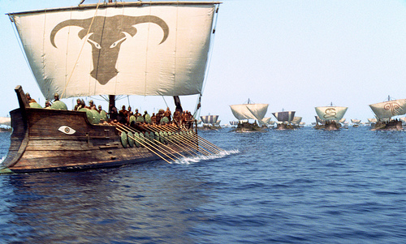
Persia Ancient Greece
The Delian League
used its powers first
to punish the poli
that supported
Persia in the past.
Then, the combined
forces of the league
conquered the remaining Persian territories in Ionia. The united Greeks no longer feared the Persians because the Greeks had enough military power to fend off the powerful empire in the world.

Slide 27
Persia Ancient Greece
The Delian League
used its powers first
to punish the poli
that supported
Persia in the past.
Then, the combined
forces of the league
conquered the remaining Persian territories in Ionia. The united Greeks no longer feared the Persians because the Greeks had enough military power to fend off the powerful empire in the world.

Slide 28
Persia Ancient Greece
The Delian League
used its powers first
to punish the poli
that supported
Persia in the past.
Then, the combined
forces of the league
conquered the remaining Persian territories in Ionia. The united Greeks no longer feared the Persians because the Greeks had enough military power to fend off the powerful empire in the world.

Slide 29
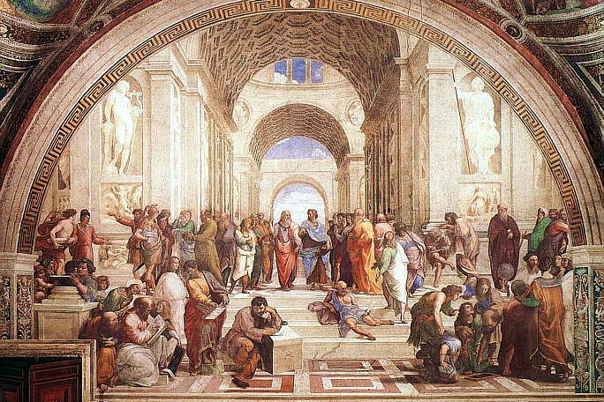
Persia Ancient Greece
Historians call the period the followed the Greek victories over the Persians the Classical Age of Greece. During the classical age, artists, poets, sculptors and architects developed a culture that was unique to Greece.

Slide 30
Persia Ancient Greece
Historians call the period the followed the Greek victories over the Persians the Classical Age of Greece. During the classical age, artists, poets, sculptors and architects developed a culture that was unique to Greece.

Slide 31
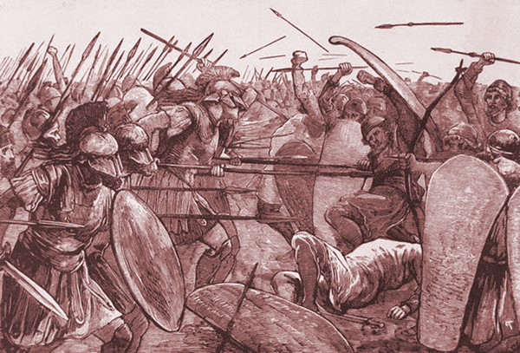
Persia Ancient Greece
Sparta and Athens were the two most powerful poli of the Classical Age. Sparta was a disciplined military power that discouraged traveling and visitors. Athens was a port city whose merchant ships traveled throughout the Mediterranean Sea.
In time, the rivalry
between Sparta and
Athens would lead
of the end of the
Classical Era.

Slide 32
Persia Ancient Greece
Sparta and Athens were the two most powerful poli of the Classical Age. Sparta was a disciplined military power that discouraged traveling and visitors. Athens was a port city whose merchant ships traveled throughout the Mediterranean Sea.
In time, the rivalry
between Sparta and
Athens would lead
of the end of the
Classical Era.

Slide 33
Persia Ancient Greece
Sparta and Athens were the two most powerful poli of the Classical Age. Sparta was a disciplined military power that discouraged traveling and visitors. Athens was a port city whose merchant ships traveled throughout the Mediterranean Sea.
In time, the rivalry
between Sparta and
Athens would lead
of the end of the
Classical Era.

Slide 34
Persia Ancient Greece
Sparta and Athens were the two most powerful poli of the Classical Age. Sparta was a disciplined military power that discouraged traveling and visitors. Athens was a port city whose merchant ships traveled throughout the Mediterranean Sea.
In time, the rivalry
between Sparta and
Athens would lead
of the end of the
Classical Era.

Slide 35

Persia Ancient Greece
Learn more about history at
www.mrdowling.com

