Slide 1
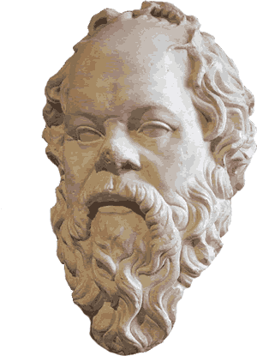
Plato Ancient Greece
What we know about
Socrates comes mostly
from his student, Plato.
Plato called Socrates
"the best of all men I
have ever known." Plato
wrote down his teacher’s
ideas in a series of dialogues.
A dialogue is a conversation between two people.

Slide 2
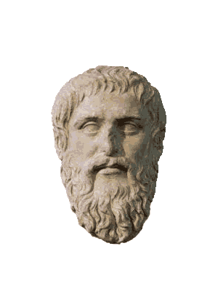
Plato Ancient Greece
What we know about
Socrates comes mostly
from his student, Plato.
Plato called Socrates
"the best of all men I
have ever known." Plato
wrote down his teacher’s
ideas in a series of dialogues.
A dialogue is a conversation between two people.

Slide 3
Plato Ancient Greece
What we know about
Socrates comes mostly
from his student, Plato.
Plato called Socrates
"the best of all men I
have ever known." Plato
wrote down his teacher’s
ideas in a series of dialogues.
A dialogue is a conversation between two people.

Slide 4
Plato Ancient Greece
What we know about
Socrates comes mostly
from his student, Plato.
Plato called Socrates
"the best of all men I
have ever known." Plato
wrote down his teacher’s
ideas in a series of dialogues.
A dialogue is a conversation between two people.

Slide 5
Plato Ancient Greece
Plato was a young man when he began to study with Socrates. Plato came from a very wealthy and powerful family. He was named Aristocles, but he was better known as Plato, a nickname that means “broad.” Plato’s nickname could have referred either to the philosopher’s broad shoulders, or to the breadth of his great intellect.

Slide 6
Plato Ancient Greece
Plato was a young man when he began to study with Socrates. Plato came from a very wealthy and powerful family. He was named Aristocles, but he was better known as Plato, a nickname that means “broad.” Plato’s nickname could have referred either to the philosopher’s broad shoulders, or to the breadth of his great intellect.

Slide 7
Plato Ancient Greece
Plato was a young man when he began to study with Socrates. Plato came from a very wealthy and powerful family. He was named Aristocles, but he was better known as Plato, a nickname that means “broad.” Plato’s nickname could have referred either to the philosopher’s broad shoulders, or to the breadth of his great intellect.

Slide 8
Plato Ancient Greece
Plato was a young man when he began to study with Socrates. Plato came from a very wealthy and powerful family. He was named Aristocles, but he was better known as Plato, a nickname that means “broad.” Plato’s nickname could have referred either to the philosopher’s broad shoulders, or to the breadth of his great intellect.

Slide 9
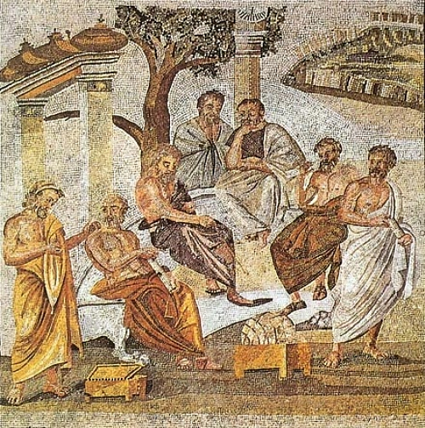
Plato Ancient Greece
When Socrates died, Plato left Athens for more than a decade. He returned to start the Academy, a school where Plato and his invited guests would discuss philosophy.

Slide 10
Plato Ancient Greece
When Socrates died, Plato left Athens for more than a decade. He returned to start the Academy, a school where Plato and his invited guests would discuss philosophy.

Slide 11
Plato Ancient Greece
Plato saw his imperfect world and thought of ways he could improve society. Plato wrote about utopia. A utopia is an imaginary place where governments and social conditions are perfect. No government has ever adopted Plato’s ideas, but his philosophy influenced leaders for over two thousand years.

Slide 12
Plato Ancient Greece
Plato saw his imperfect world and thought of ways he could improve society. Plato wrote about utopia. A utopia is an imaginary place where governments and social conditions are perfect. No government has ever adopted Plato’s ideas, but his philosophy influenced leaders for over two thousand years.

Slide 13
Plato Ancient Greece
Plato saw his imperfect world and thought of ways he could improve society. Plato wrote about utopia. A utopia is an imaginary place where governments and social conditions are perfect. No government has ever adopted Plato’s ideas, but his philosophy influenced leaders for over two thousand years.

Slide 14
Plato Ancient Greece
Plato saw his imperfect world and thought of ways he could improve society. Plato wrote about utopia. A utopia is an imaginary place where governments and social conditions are perfect. No government has ever adopted Plato’s ideas, but his philosophy influenced leaders for over two thousand years.

Slide 15
Plato Ancient Greece
Plato argued in favor of an "aristocracy of merit," or rule by the best and the wisest people. Plato believed that government should raise all children so that everyone would have equal opportunities.

Slide 16
Plato Ancient Greece
Plato argued in favor of an "aristocracy of merit," or rule by the best and the wisest people. Plato believed that government should raise all children so that everyone would have equal opportunities.

Slide 17
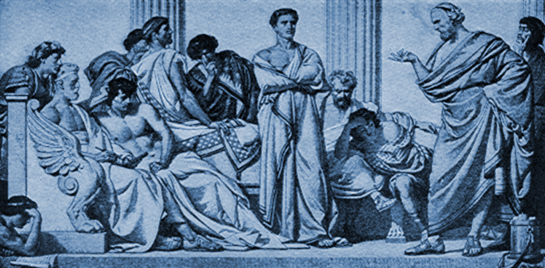
Plato Ancient Greece
Schools would test children on a regular basis. Students who did poorly would be sent to work, while those who did well would continue their studies. Plato believed a small group of intelligent and educated men and women should govern society. This small group would select the best and the brightest students to join them.

Slide 18
Plato Ancient Greece
Schools would test children on a regular basis. Students who did poorly would be sent to work, while those who did well would continue their studies. Plato believed a small group of intelligent and educated men and women should govern society. This small group would select the best and the brightest students to join them.

Slide 19
Plato Ancient Greece
Schools would test children on a regular basis. Students who did poorly would be sent to work, while those who did well would continue their studies. Plato believed a small group of intelligent and educated men and women should govern society. This small group would select the best and the brightest students to join them.

Slide 20
Plato Ancient Greece
Schools would test children on a regular basis. Students who did poorly would be sent to work, while those who did well would continue their studies. Plato believed a small group of intelligent and educated men and women should govern society. This small group would select the best and the brightest students to join them.

Slide 21
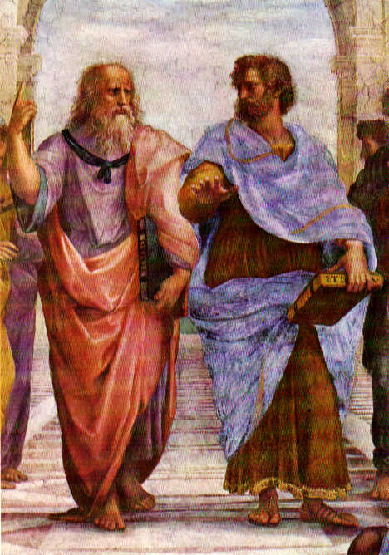
Plato Ancient Greece
Later in his life Plato mentored a young man named Aristotle. A mentor is someone who teaches or gives help and advice to a less experienced and often younger person. Aristotle’s ideas would form the basis of modern science.

Slide 22
Plato Ancient Greece
Later in his life Plato mentored a young man named Aristotle. A mentor is someone who teaches or gives help and advice to a less experienced and often younger person. Aristotle’s ideas would form the basis of modern science.

Slide 23
Plato Ancient Greece
Later in his life Plato mentored a young man named Aristotle. A mentor is someone who teaches or gives help and advice to a less experienced and often younger person. Aristotle’s ideas would form the basis of modern science.

Slide 24
Music courtesy of Kevin MacLeod
http://incompetech.com/music/royalty-free/
Learn more about history at
www.mrdowling.com

