Slide 1
Socrates Ancient Greece
Wisdom can be defined as the knowledge of what is right and true. The ancient Greeks discussed, debated, and studied wisdom. This is called philosophy. The word philosophy comes from the Greek term meaning "the love of wisdom."

Slide 2
Socrates Ancient Greece
Wisdom can be defined as the knowledge of what is right and true. The ancient Greeks discussed, debated, and studied wisdom. This is called philosophy. The word philosophy comes from the Greek term meaning "the love of wisdom."

Slide 3
Socrates Ancient Greece
Wisdom can be defined as the knowledge of what is right and true. The ancient Greeks discussed, debated, and studied wisdom. This is called philosophy. The word philosophy comes from the Greek term meaning "the love of wisdom."

Slide 4
Socrates Ancient Greece
Wisdom can be defined as the knowledge of what is right and true. The ancient Greeks discussed, debated, and studied wisdom. This is called philosophy. The word philosophy comes from the Greek term meaning "the love of wisdom."

Slide 5
Socrates Ancient Greece
The Greeks believed they could become wise by using reason. Reason is the ability to think clearly. Greek philosophers developed logic, a step-by-step method of using reason to think through a problem. A philosopher named Socrates challenged the leaders of Athens by asked his students to use reason and logic instead of following the directions of the leaders of Athens.

Slide 6
Socrates Ancient Greece
The Greeks believed they could become wise by using reason. Reason is the ability to think clearly. Greek philosophers developed logic, a step-by-step method of using reason to think through a problem. A philosopher named Socrates challenged the leaders of Athens by asked his students to use reason and logic instead of following the directions of the leaders of Athens.

Slide 7
Socrates Ancient Greece
The Greeks believed they could become wise by using reason. Reason is the ability to think clearly. Greek philosophers developed logic, a step-by-step method of using reason to think through a problem. A philosopher named Socrates challenged the leaders of Athens by asked his students to use reason and logic instead of following the directions of the leaders of Athens.

Slide 8
Socrates Ancient Greece
The Greeks believed they could become wise by using reason. Reason is the ability to think clearly. Greek philosophers developed logic, a step-by-step method of using reason to think through a problem. A philosopher named Socrates challenged the leaders of Athens by asked his students to use reason and logic instead of following the directions of the leaders of Athens.

Slide 9
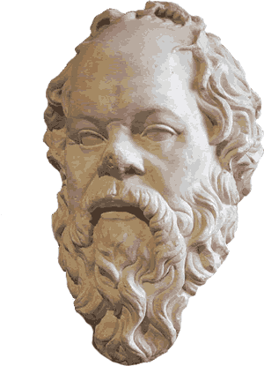
Socrates Ancient Greece
Socrates was a retired stonecutter. As a young man he fought in the Peloponnesian War and served in the boule, but he devoted the last years of his life to philosophy. Socrates believed that we could find truth by thinking logically and trusting our inner voices. Socrates told his students that “wisdom begins in wonder.”

Slide 10
Socrates Ancient Greece
Socrates was a retired stonecutter. As a young man he fought in the Peloponnesian War and served in the boule, but he devoted the last years of his life to philosophy. Socrates believed that we could find truth by thinking logically and trusting our inner voices. Socrates told his students that “wisdom begins in wonder.”

Slide 11
Socrates Ancient Greece
Socrates was a retired stonecutter. As a young man he fought in the Peloponnesian War and served in the boule, but he devoted the last years of his life to philosophy. Socrates believed that we could find truth by thinking logically and trusting our inner voices. Socrates told his students that “wisdom begins in wonder.”

Slide 12
Socrates Ancient Greece
Socrates was a retired stonecutter. As a young man he fought in the Peloponnesian War and served in the boule, but he devoted the last years of his life to philosophy. Socrates believed that we could find truth by thinking logically and trusting our inner voices. Socrates told his students that “wisdom begins in wonder.”

Slide 13
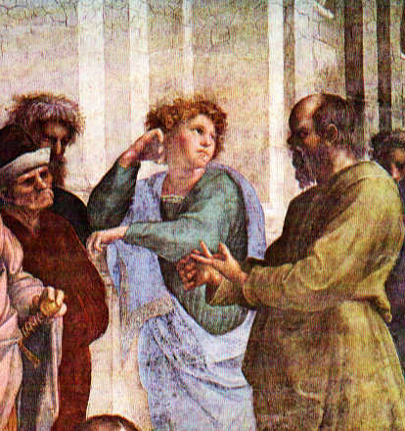
Socrates Ancient Greece
Socrates did not teach in a school. The old philosopher drifted around Athens, engaging his students in arguments about justice, bravery, and ethics. Socrates taught by asking questions that forced his students to use logic. When teachers ask questions that encourage students to draw conclusions, they are using the "Socratic method" of teaching.

Slide 14
Socrates Ancient Greece
Socrates did not teach in a school. The old philosopher drifted around Athens, engaging his students in arguments about justice, bravery, and ethics. Socrates taught by asking questions that forced his students to use logic. When teachers ask questions that encourage students to draw conclusions, they are using the "Socratic method" of teaching.

Slide 15
Socrates Ancient Greece
Socrates did not teach in a school. The old philosopher drifted around Athens, engaging his students in arguments about justice, bravery, and ethics. Socrates taught by asking questions that forced his students to use logic. When teachers ask questions that encourage students to draw conclusions, they are using the "Socratic method" of teaching.

Slide 16
Socrates Ancient Greece
Socrates did not teach in a school. The old philosopher drifted around Athens, engaging his students in arguments about justice, bravery, and ethics. Socrates taught by asking questions that forced his students to use logic. When teachers ask questions that encourage students to draw conclusions, they are using the "Socratic method" of teaching.

Slide 17
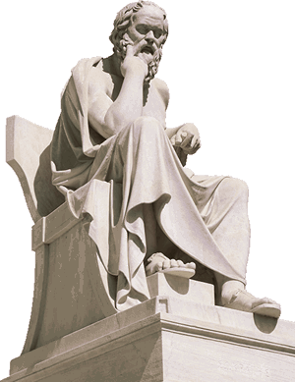
Socrates Ancient Greece
A priest called the Oracle of Delphi pronounced Socrates the wisest man in Greece. Socrates concluded that while others professed knowledge they did not have, Socrates knew how little he knew. Socrates asked many questions, but he gave few answers. He often denied knowing the answers to the questions he asked.

Slide 18
Socrates Ancient Greece
A priest called the Oracle of Delphi pronounced Socrates the wisest man in Greece. Socrates concluded that while others professed knowledge they did not have, Socrates knew how little he knew. Socrates asked many questions, but he gave few answers. He often denied knowing the answers to the questions he asked.

Slide 19
Socrates Ancient Greece
A priest called the Oracle of Delphi pronounced Socrates the wisest man in Greece. Socrates concluded that while others professed knowledge they did not have, Socrates knew how little he knew. Socrates asked many questions, but he gave few answers. He often denied knowing the answers to the questions he asked.

Slide 20
Socrates Ancient Greece
A priest called the Oracle of Delphi pronounced Socrates the wisest man in Greece. Socrates concluded that while others professed knowledge they did not have, Socrates knew how little he knew. Socrates asked many questions, but he gave few answers. He often denied knowing the answers to the questions he asked.

Slide 21
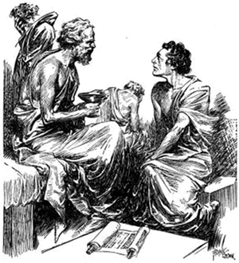
Socrates Ancient Greece
Socrates did not write any books because he believed in the superiority of rhetoric over writing. Rhetoric is speech that is used to persuade someone. What we know about Socrates comes mostly from his student, Plato. Plato wrote down his teacher’s ideas in a series of dialogues. A dialogue is a conversation between two people.

Slide 22
Socrates Ancient Greece
Socrates did not write any books because he believed in the superiority of rhetoric over writing. Rhetoric is speech that is used to persuade someone. What we know about Socrates comes mostly from his student, Plato. Plato wrote down his teacher’s ideas in a series of dialogues. A dialogue is a conversation between two people.

Slide 23
Socrates Ancient Greece
Socrates did not write any books because he believed in the superiority of rhetoric over writing. Rhetoric is speech that is used to persuade someone. What we know about Socrates comes mostly from his student, Plato. Plato wrote down his teacher’s ideas in a series of dialogues. A dialogue is a conversation between two people.

Slide 24
Socrates Ancient Greece
Socrates did not write any books because he believed in the superiority of rhetoric over writing. Rhetoric is speech that is used to persuade someone. What we know about Socrates comes mostly from his student, Plato. Plato wrote down his teacher’s ideas in a series of dialogues. A dialogue is a conversation between two people.

Slide 25
Socrates Ancient Greece
Socrates did not write any books because he believed in the superiority of rhetoric over writing. Rhetoric is speech that is used to persuade someone. What we know about Socrates comes mostly from his student, Plato. Plato wrote down his teacher’s ideas in a series of dialogues. A dialogue is a conversation between two people.

Slide 26
Socrates Ancient Greece
Athens had recently lost the Peloponnesian War to Sparta, and the humiliated leaders of the polis did not want a critic like Socrates challenging their authority. Socrates called himself a “gadfly.” A gadfly is a pest that bites livestock. Socrates tried to use his criticism of Athens to “sting” the polis into recovering the Golden Age that existed before the long war.

Slide 27
Socrates Ancient Greece
Athens had recently lost the Peloponnesian War to Sparta, and the humiliated leaders of the polis did not want a critic like Socrates challenging their authority. Socrates called himself a “gadfly.” A gadfly is a pest that bites livestock. Socrates tried to use his criticism of Athens to “sting” the polis into recovering the Golden Age that existed before the long war.

Slide 28
Socrates Ancient Greece
Athens had recently lost the Peloponnesian War to Sparta, and the humiliated leaders of the polis did not want a critic like Socrates challenging their authority. Socrates called himself a “gadfly.” A gadfly is a pest that bites livestock. Socrates tried to use his criticism of Athens to “sting” the polis into recovering the Golden Age that existed before the long war.

Slide 29
Socrates Ancient Greece
Athens had recently lost the Peloponnesian War to Sparta, and the humiliated leaders of the polis did not want a critic like Socrates challenging their authority. Socrates called himself a “gadfly.” A gadfly is a pest that bites livestock. Socrates tried to use his criticism of Athens to “sting” the polis into recovering the Golden Age that existed before the long war.

Slide 30
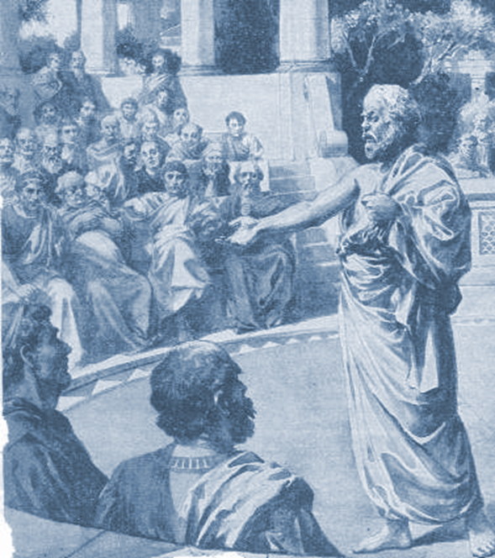
Socrates Ancient Greece
The Athenian leaders threatened to bring Socrates to trial on two charges. Socrates refused to honor the gods. He was also charged with corrupting the youth of Athens by teaching the young people to trust their own judgment instead of following the
rules of the city leaders. Most Athenians expected
the seventy-year-old
Socrates to leave Athens
before his arrest, but the
old philosopher remained
in Athens, stood trial, and
was found guilty.

Slide 31
Socrates Ancient Greece
The Athenian leaders threatened to bring Socrates to trial on two charges. Socrates refused to honor the gods. He was also charged with corrupting the youth of Athens by teaching the young people to trust their own judgment instead of following the
rules of the city leaders. Most Athenians expected
the seventy-year-old
Socrates to leave Athens
before his arrest, but the
old philosopher remained
in Athens, stood trial, and
was found guilty.

Slide 32
Socrates Ancient Greece
The Athenian leaders threatened to bring Socrates to trial on two charges. Socrates refused to honor the gods. He was also charged with corrupting the youth of Athens by teaching the young people to trust their own judgment instead of following the
rules of the city leaders. Most Athenians expected
the seventy-year-old
Socrates to leave Athens
before his arrest, but the
old philosopher remained
in Athens, stood trial, and
was found guilty.

Slide 33
Socrates Ancient Greece
The Athenian leaders threatened to bring Socrates to trial on two charges. Socrates refused to honor the gods. He was also charged with corrupting the youth of Athens by teaching the young people to trust their own judgment instead of following the
rules of the city leaders. Most Athenians expected
the seventy-year-old
Socrates to leave Athens
before his arrest, but the
old philosopher remained
in Athens, stood trial, and
was found guilty.

Slide 34
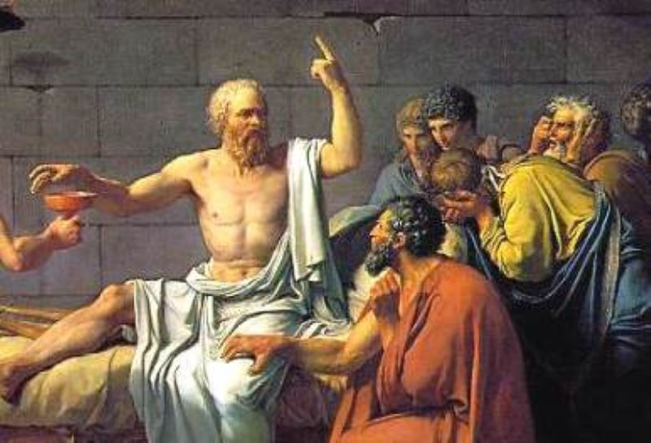
Socrates Ancient Greece
Socrates refused to participate in a plan to escape from prison. The philosopher calmly accepted his death by drinking from a cup of poison hemlock, the customary practice of execution of his time. Socrates believed that he must obey the law, even if he disagreed with it.

Slide 35
Socrates Ancient Greece
Socrates refused to participate in a plan to escape from prison. The philosopher calmly accepted his death by drinking from a cup of poison hemlock, the customary practice of execution of his time. Socrates believed that he must obey the law, even if he disagreed with it.

Slide 36
Socrates Ancient Greece
Socrates refused to participate in a plan to escape from prison. The philosopher calmly accepted his death by drinking from a cup of poison hemlock, the customary practice of execution of his time. Socrates believed that he must obey the law, even if he disagreed with it.

Slide 37
Socrates Ancient Greece
Music courtesy of Dano-O
at http://danosongs.com.
Learn more about history at
www.mrdowling.com

