Slide 1
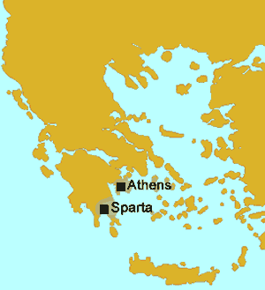

Sparta Ancient Greece
Sparta was an ancient Greek polis that was surrounded by enemies, so Spartan citizens began preparing for war at birth.

Slide 2
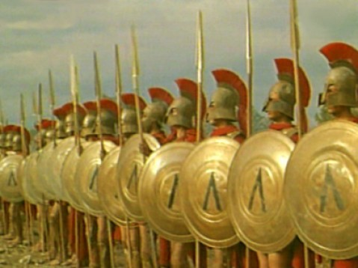
Sparta Ancient Greece
Spartan rulers examined newborn babies to determine if they were healthy and strong
enough to be of value to the polis. The rulers
killed sickly or malformed infants deemed incapable of
contributing to
the security of
Sparta.

Slide 3
Sparta Ancient Greece
Spartan rulers examined newborn babies to determine if they were healthy and strong
enough to be of value to the polis. The rulers
killed sickly or malformed infants deemed incapable of
contributing to
the security of
Sparta.

Slide 4
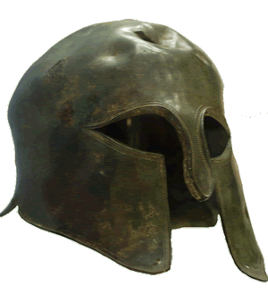
Sparta Ancient Greece
Spartans had to conform to strict rules. Spartan boys would leave their homes at age seven to begin training as warriors.

Slide 5
Sparta Ancient Greece
Spartans had to conform to strict rules. Spartan boys would leave their homes at age seven to begin training as warriors.

Slide 6
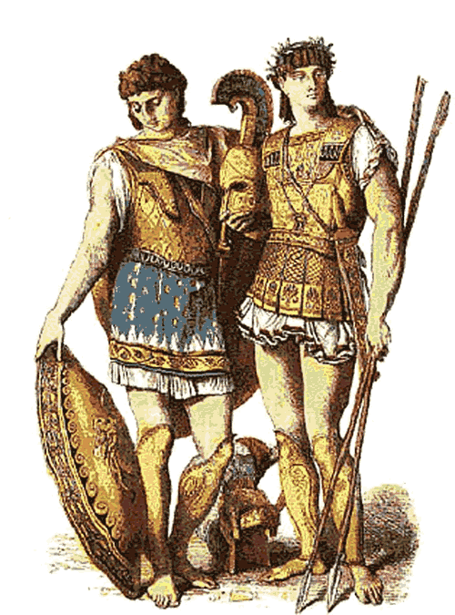
Sparta Ancient Greece
The boys would live in military housing called barracks where they faced rigorous training and discipline. Spartan trainers underfed the boys. If they
caught a boy stealing food, the boy would be beaten--not for stealing but for being caught.

Slide 7
Sparta Ancient Greece
The boys would live in military housing called barracks where they faced rigorous training and discipline. Spartan trainers underfed the boys. If they
caught a boy stealing food, the boy would be beaten--not for stealing but for being caught.

Slide 8
Sparta Ancient Greece
The boys would live in military housing called barracks where they faced rigorous training and discipline. Spartan trainers underfed the boys. If they
caught a boy stealing food, the boy would be beaten--not for stealing but for being caught.

Slide 9
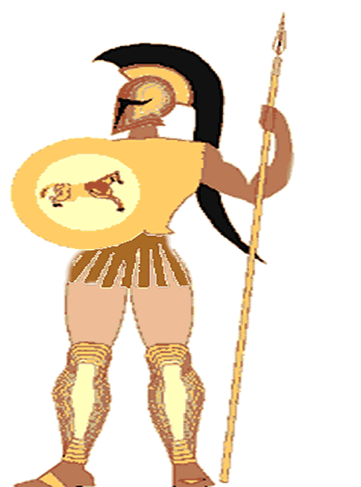
Sparta Ancient Greece
Spartan men could marry when they were twenty years old, but Sparta did not allow the men to live with their families until they reached thirty. A Spartan soldier who had not found a wife by age thirty would customarily capture an unmarried woman of his choice. Spartan men would continue to serve in the military until they were sixty years old. Both men and women in Sparta competed in athletic contests to keep physically fit.

Slide 10
Sparta Ancient Greece
Spartan men could marry when they were twenty years old, but Sparta did not allow the men to live with their families until they reached thirty. A Spartan soldier who had not found a wife by age thirty would customarily capture an unmarried woman of his choice. Spartan men would continue to serve in the military until they were sixty years old. Both men and women in Sparta competed in athletic contests to keep physically fit.

Slide 11
Sparta Ancient Greece
Spartan men could marry when they were twenty years old, but Sparta did not allow the men to live with their families until they reached thirty. A Spartan soldier who had not found a wife by age thirty would customarily capture an unmarried woman of his choice. Spartan men would continue to serve in the military until they were sixty years old. Both men and women in Sparta competed in athletic contests to keep physically fit.

Slide 12
Sparta Ancient Greece
Spartan men could marry when they were twenty years old, but Sparta did not allow the men to live with their families until they reached thirty. A Spartan soldier who had not found a wife by age thirty would customarily capture an unmarried woman of his choice. Spartan men would continue to serve in the military until they were sixty years old. Both men and women in Sparta competed in athletic contests to keep physically fit.

Slide 13
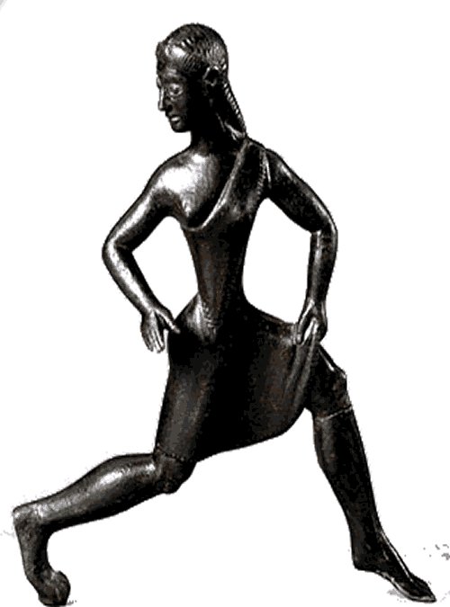
Sparta Ancient Greece
Spartan men were constantly in
training for war, so women
completed many of the duties of
running the polis. Woman were
the sole owners of at least one
third of Spartan land. Spartan
girls were raised to be tough so
the women could bear strong
children for the polis.

Slide 14
Sparta Ancient Greece
Spartan men were constantly in
training for war, so women
completed many of the duties of
running the polis. Woman were
the sole owners of at least one
third of Spartan land. Spartan
girls were raised to be tough so
the women could bear strong
children for the polis.

Slide 15
Sparta Ancient Greece
Spartan men were constantly in
training for war, so women
completed many of the duties of
running the polis. Woman were
the sole owners of at least one
third of Spartan land. Spartan
girls were raised to be tough so
the women could bear strong
children for the polis.

Slide 16
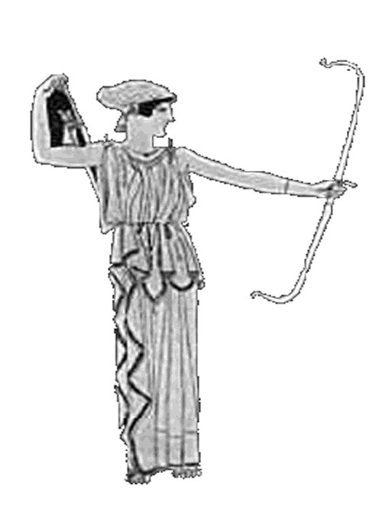
Sparta Ancient Greece
The people of other poli would tell the story of a Spartan mother who killed her son for running away from his duties. Spartan women were known for being stoic. A stoic person can endure pain or hardship without showing their feelings or complaining.

Slide 17
Sparta Ancient Greece
The people of other poli would tell the story of a Spartan mother who killed her son for running away from his duties. Spartan women were known for being stoic. A stoic person can endure pain or hardship without showing their feelings or complaining.

Slide 18
Sparta Ancient Greece
The people of other poli would tell the story of a Spartan mother who killed her son for running away from his duties. Spartan women were known for being stoic. A stoic person can endure pain or hardship without showing their feelings or complaining.

Slide 19
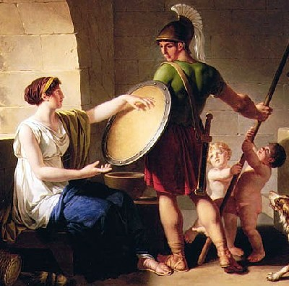
Sparta Ancient Greece
When Spartan soldiers went to battle, their mothers and wives would present the warriors with their shield and say: "With this, or upon this." The soldier was expected to return to Sparta either victorious with his shield in hand, or
be carried home dead
upon his shield. If a
Spartan soldier returned
home alive and without
his shield, the soldier
faced banishment from
the polis or death.

Slide 20
Sparta Ancient Greece
When Spartan soldiers went to battle, their mothers and wives would present the warriors with their shield and say: "With this, or upon this." The soldier was expected to return to Sparta either victorious with his shield in hand, or
be carried home dead
upon his shield. If a
Spartan soldier returned
home alive and without
his shield, the soldier
faced banishment from
the polis or death.

Slide 21
Sparta Ancient Greece
When Spartan soldiers went to battle, their mothers and wives would present the warriors with their shield and say: "With this, or upon this." The soldier was expected to return to Sparta either victorious with his shield in hand, or
be carried home dead
upon his shield. If a
Spartan soldier returned
home alive and without
his shield, the soldier
faced banishment from
the polis or death.

Slide 22
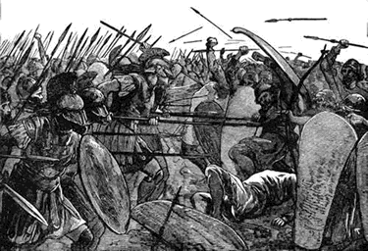
Sparta Ancient Greece
The Spartans were Dorians who invaded the land they occupied on the Peloponnesus, a peninsula in southern Greece. Spartan warriors expanded
their territory by capturing neighboring lands. They called the people they captured helots.

Slide 23
Sparta Ancient Greece
The Spartans were Dorians who invaded the land they occupied on the Peloponnesus, a peninsula in southern Greece. Spartan warriors expanded
their territory by capturing neighboring lands. They called the people they captured helots.

Slide 24
Sparta Ancient Greece
The Spartans were Dorians who invaded the land they occupied on the Peloponnesus, a peninsula in southern Greece. Spartan warriors expanded
their territory by capturing neighboring lands. They called the people they captured helots.

Slide 25
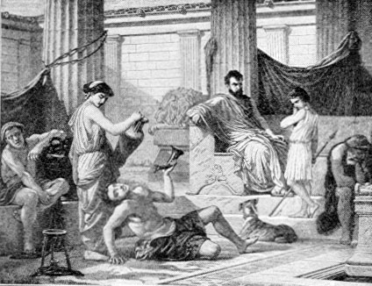
Sparta Ancient Greece
The Spartans forced
helots to farm the land
the helots once owned,
but the helots had to
provide half of their
harvest to Sparta. A
Spartan police force
spied on the helots
and killed anyone suspected of being a threat. Every year, Sparta would declare war on the helots and Spartan warriors would kill helots as part of their training.

Slide 26
Sparta Ancient Greece
The Spartans forced
helots to farm the land
the helots once owned,
but the helots had to
provide half of their
harvest to Sparta. A
Spartan police force
spied on the helots
and killed anyone suspected of being a threat. Every year, Sparta would declare war on the helots and Spartan warriors would kill helots as part of their training.

Slide 27
Sparta Ancient Greece
The Spartans forced
helots to farm the land
the helots once owned,
but the helots had to
provide half of their
harvest to Sparta. A
Spartan police force
spied on the helots
and killed anyone suspected of being a threat. Every year, Sparta would declare war on the helots and Spartan warriors would kill helots as part of their training.

Slide 28
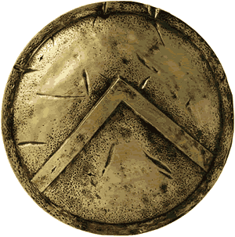
Sparta Ancient Greece
Spartan laws discouraged anything that would distract citizens from their disciplined military life. Sparta did not welcome visitors from other cities, and did not allow their
citizens to travel. The Spartans
were not interested in other
ways of life and did not want
to bring new ideas to their
polis. Today, we use spartan as
an adjective to describe someone
who leads a rigorously disciplined life that includes few comforts or luxuries.

Slide 29
Sparta Ancient Greece
Spartan laws discouraged anything that would distract citizens from their disciplined military life. Sparta did not welcome visitors from other cities, and did not allow their
citizens to travel. The Spartans
were not interested in other
ways of life and did not want
to bring new ideas to their
polis. Today, we use spartan as
an adjective to describe someone
who leads a rigorously disciplined life that includes few comforts or luxuries.

Slide 30
Sparta Ancient Greece
Spartan laws discouraged anything that would distract citizens from their disciplined military life. Sparta did not welcome visitors from other cities, and did not allow their
citizens to travel. The Spartans
were not interested in other
ways of life and did not want
to bring new ideas to their
polis. Today, we use spartan as
an adjective to describe someone
who leads a rigorously disciplined life that includes few comforts or luxuries.

Slide 31
Sparta Ancient Greece
Spartan laws discouraged anything that would distract citizens from their disciplined military life. Sparta did not welcome visitors from other cities, and did not allow their
citizens to travel. The Spartans
were not interested in other
ways of life and did not want
to bring new ideas to their
polis. Today, we use spartan as
an adjective to describe someone
who leads a rigorously disciplined life that includes few comforts or luxuries.

Slide 32
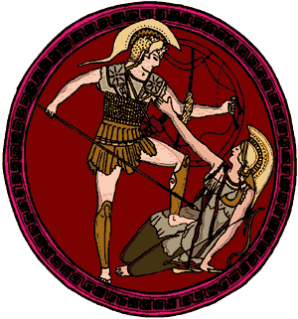
Sparta Ancient Greece
Sparta’s army eventually came into conflict with Athens, a trading poli that developed the strongest navy of ancient Greece. In 431BCE, Sparta and Athens began a twenty-seven year long conflict called the Peloponnesian War.

Slide 33
Sparta Ancient Greece
Sparta’s army eventually came into conflict with Athens, a trading poli that developed the strongest navy of ancient Greece. In 431BCE, Sparta and Athens began a twenty-seven year long conflict called the Peloponnesian War.

Slide 34
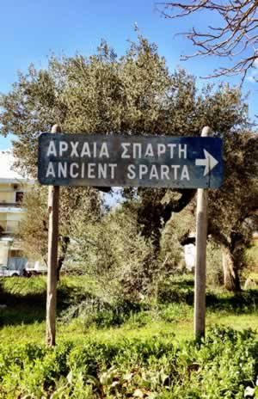
Sparta Ancient Greece
The Romans conquered Sparta in 146BCE, ending centuries of independence for the polis. In 1834, Greece began construction of a new city on the site of ancient Sparta. Modern Sparti is a small city with fewer than 20,000 inhabitants that lives on among the ruins of one of the most powerful cities in history.

Slide 35
Sparta Ancient Greece
The Romans conquered Sparta in 146BCE, ending centuries of independence for the polis. In 1834, Greece began construction of a new city on the site of ancient Sparta. Modern Sparti is a small city with fewer than 20,000 inhabitants that lives on among the ruins of one of the most powerful cities in history.

Slide 36
Sparta Ancient Greece
The Romans conquered Sparta in 146BCE, ending centuries of independence for the polis. In 1834, Greece began construction of a new city on the site of ancient Sparta. Modern Sparti is a small city with fewer than 20,000 inhabitants that lives on among the ruins of one of the most powerful cities in history.

Slide 37

Sparta Ancient Greece
Learn more about history at
www.mrdowling.com

