Slide 1
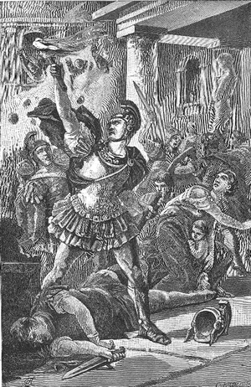

Julius Caesar Ancient Rome
Rome was growing and quite wealthy after the second Punic War, but the republic faced serious problems.
Many Roman politicians took bribes and often encouraged violent mobs to help them rise to power. Soldiers returning home from years at war could not find work because rich landowners used slaves to do the work once done by poor Romans.

Slide 2
Julius Caesar Ancient Rome
Rome was growing and quite wealthy after the second Punic War, but the republic faced serious problems.
Many Roman politicians took bribes and often encouraged violent mobs to help them rise to power. Soldiers returning home from years at war could not find work because rich landowners used slaves to do the work once done by poor Romans.

Slide 3
Julius Caesar Ancient Rome
Rome was growing and quite wealthy after the second Punic War, but the republic faced serious problems.
Many Roman politicians took bribes and often encouraged violent mobs to help them rise to power. Soldiers returning home from years at war could not find work because rich landowners used slaves to do the work once done by poor Romans.

Slide 4
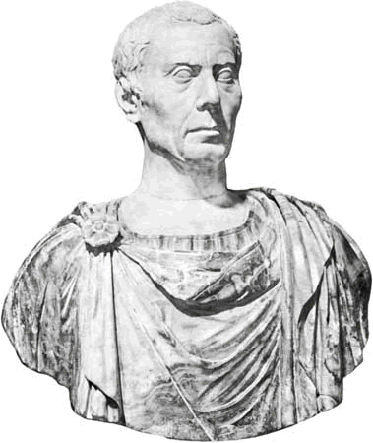
Julius Caesar Ancient Rome
The republic also became embroiled in several civil wars. A civil war is a
war within a nation. Many Romans wanted a strong leader, and the ambitious Julius Caesar was an obvious choice.
Gaius Julius Caesar was a
patrician and popular general
when he was first elected
consul in 59BCE. Marcus
Biblius was Caesar’s
co-consul, but Caesar paid no
attention to the wishes of Biblius
and the Senate.

Slide 5
Julius Caesar Ancient Rome
The republic also became embroiled in several civil wars. A civil war is a
war within a nation. Many Romans wanted a strong leader, and the ambitious Julius Caesar was an obvious choice.
Gaius Julius Caesar was a
patrician and popular general
when he was first elected
consul in 59BCE. Marcus
Biblius was Caesar’s
co-consul, but Caesar paid no
attention to the wishes of Biblius
and the Senate.

Slide 6
Julius Caesar Ancient Rome
The republic also became embroiled in several civil wars. A civil war is a
war within a nation. Many Romans wanted a strong leader, and the ambitious Julius Caesar was an obvious choice.
Gaius Julius Caesar was a
patrician and popular general
when he was first elected
consul in 59BCE. Marcus
Biblius was Caesar’s
co-consul, but Caesar paid no
attention to the wishes of Biblius
and the Senate.

Slide 7
Julius Caesar Ancient Rome
The republic also became embroiled in several civil wars. A civil war is a
war within a nation. Many Romans wanted a strong leader, and the ambitious Julius Caesar was an obvious choice.
Gaius Julius Caesar was a
patrician and popular general
when he was first elected
consul in 59BCE. Marcus
Biblius was Caesar’s
co-consul, but Caesar paid no
attention to the wishes of Biblius
and the Senate.

Slide 8
Julius Caesar Ancient Rome
The republic also became embroiled in several civil wars. A civil war is a
war within a nation. Many Romans wanted a strong leader, and the ambitious Julius Caesar was an obvious choice.
Gaius Julius Caesar was a
patrician and popular general
when he was first elected
consul in 59BCE. Marcus
Biblius was Caesar’s
co-consul, but Caesar paid no
attention to the wishes of Biblius
and the Senate.

Slide 9
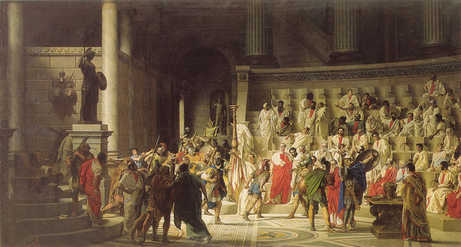
Julius Caesar Ancient Rome
Caesar ordered the redistribution of lands to the poor, a decision that made him very popular with the Roman people but angered many wealthy landowning senators. Biblius attempted to veto Caesar’s act, but Caesar’s mob attacked the co-consul. The terrified Biblius retired to his home and left Caesar in control of the Roman government.

Slide 10
Julius Caesar Ancient Rome
Caesar ordered the redistribution of lands to the poor, a decision that made him very popular with the Roman people but angered many wealthy landowning senators. Biblius attempted to veto Caesar’s act, but Caesar’s mob attacked the co-consul. The terrified Biblius retired to his home and left Caesar in control of the Roman government.

Slide 11
Julius Caesar Ancient Rome
Caesar ordered the redistribution of lands to the poor, a decision that made him very popular with the Roman people but angered many wealthy landowning senators. Biblius attempted to veto Caesar’s act, but Caesar’s mob attacked the co-consul. The terrified Biblius retired to his home and left Caesar in control of the Roman government.

Slide 12
Julius Caesar Ancient Rome
The Senate tried to block Caesar’s decisions, so he formed a partnership with his former enemies, Crassus and Pompey. Historians often refer to this alliance as the First Triumvirate. A triumvirate is a partnership of three equal rulers. Neither Crassus nor Pompey were consuls, but the three generals were so popular with the Roman people that they were able to ignore the wishes of the Senate.

Slide 13
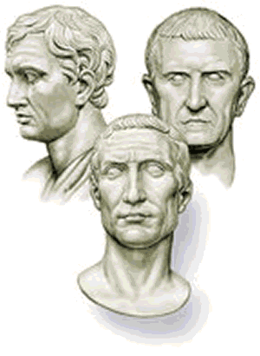
Julius Caesar Ancient Rome
The Senate tried to block Caesar’s decisions, so he formed a partnership with his former enemies, Crassus and Pompey. Historians often refer to this alliance as the First Triumvirate. A triumvirate is a partnership of three equal rulers. Neither Crassus nor Pompey were consuls, but the three generals were so popular with the Roman people that they were able to ignore the wishes of the Senate.

Slide 14
Julius Caesar Ancient Rome
The Senate tried to block Caesar’s decisions, so he formed a partnership with his former enemies, Crassus and Pompey. Historians often refer to this alliance as the First Triumvirate. A triumvirate is a partnership of three equal rulers. Neither Crassus nor Pompey were consuls, but the three generals were so popular with the Roman people that they were able to ignore the wishes of the Senate.

Slide 15
Julius Caesar Ancient Rome
The Senate tried to block Caesar’s decisions, so he formed a partnership with his former enemies, Crassus and Pompey. Historians often refer to this alliance as the First Triumvirate. A triumvirate is a partnership of three equal rulers. Neither Crassus nor Pompey were consuls, but the three generals were so popular with the Roman people that they were able to ignore the wishes of the Senate.

Slide 16
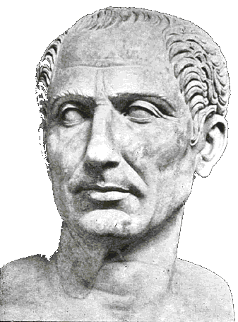
Julius Caesar Ancient Rome
Under Roman law, an official could not be arrested while he was in power. Knowing the Senate would have him jailed as soon as he left the consulship, Caesar arranged to be appointed governor of a Roman province in Gaul. Gaul was a territory northwest of the Italian peninsula.

Slide 17
Julius Caesar Ancient Rome
Under Roman law, an official could not be arrested while he was in power. Knowing the Senate would have him jailed as soon as he left the consulship, Caesar arranged to be appointed governor of a Roman province in Gaul. Gaul was a territory northwest of the Italian peninsula.

Slide 18
Julius Caesar Ancient Rome
Under Roman law, an official could not be arrested while he was in power. Knowing the Senate would have him jailed as soon as he left the consulship, Caesar arranged to be appointed governor of a Roman province in Gaul. Gaul was a territory northwest of the Italian peninsula.

Slide 19
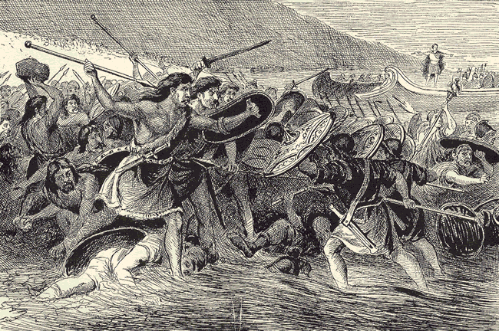
Julius Caesar Ancient Rome
Upon taking office in Gaul, Caesar used his personal fortune to raise a private army. For the next nine years Caesar led his troops across western Europe, killing or enslaving millions and conquering lands that added to the Roman Republic.

Slide 20
Julius Caesar Ancient Rome
Upon taking office in Gaul, Caesar used his personal fortune to raise a private army. For the next nine years Caesar led his troops across western Europe, killing or enslaving millions and conquering lands that added to the Roman Republic.

Slide 21
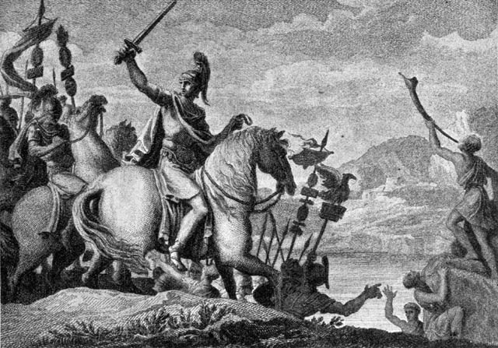
Julius Caesar Ancient Rome
In 49BCE, the Senate ordered Caesar to disband his personal army and to return to Rome as a private citizen. Caesar once again feared arrest, so he ignored the order and marched his army back to Rome. Caesar’s orders
clearly told him not to
bring his troops across
the Rubicon River.

Slide 22
Julius Caesar Ancient Rome
In 49BCE, the Senate ordered Caesar to disband his personal army and to return to Rome as a private citizen. Caesar once again feared arrest, so he ignored the order and marched his army back to Rome. Caesar’s orders
clearly told him not to
bring his troops across
the Rubicon River.

Slide 23
Julius Caesar Ancient Rome
In 49BCE, the Senate ordered Caesar to disband his personal army and to return to Rome as a private citizen. Caesar once again feared arrest, so he ignored the order and marched his army back to Rome. Caesar’s orders
clearly told him not to
bring his troops across
the Rubicon River.

Slide 24
Julius Caesar Ancient Rome
When Caesar reached the river, he knew he faced an important decision. Caesar knew that if he obeyed the Senate and disbanded his army, his career would be over; but if he marched his troops across the river, the Senate would order Pompey and his army to retaliate. Today when
people say they are
“crossing the Rubicon,”
they refer to a very
significant decision that
cannot be undone.

Slide 25
Julius Caesar Ancient Rome
When Caesar reached the river, he knew he faced an important decision. Caesar knew that if he obeyed the Senate and disbanded his army, his career would be over; but if he marched his troops across the river, the Senate would order Pompey and his army to retaliate. Today when
people say they are
“crossing the Rubicon,”
they refer to a very
significant decision that
cannot be undone.

Slide 26
Julius Caesar Ancient Rome
When Caesar reached the river, he knew he faced an important decision. Caesar knew that if he obeyed the Senate and disbanded his army, his career would be over; but if he marched his troops across the river, the Senate would order Pompey and his army to retaliate. Today when
people say they are
“crossing the Rubicon,”
they refer to a very
significant decision that
cannot be undone.

Slide 27
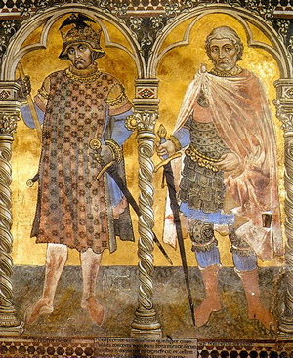
Julius Caesar Ancient Rome
As Caesar’s army approached Rome, many frightened senators fled the city. Pompey announced that “Rome cannot be defended,” and retreated south with his army. The remaining senators named Caesar dictator. For the next several months, Caesar and his army pursued Pompey through the Mediterranean until Pompey led his army to Egypt.

Slide 28
Julius Caesar Ancient Rome
As Caesar’s army approached Rome, many frightened senators fled the city. Pompey announced that “Rome cannot be defended,” and retreated south with his army. The remaining senators named Caesar dictator. For the next several months, Caesar and his army pursued Pompey through the Mediterranean until Pompey led his army to Egypt.

Slide 29
Julius Caesar Ancient Rome
As Caesar’s army approached Rome, many frightened senators fled the city. Pompey announced that “Rome cannot be defended,” and retreated south with his army. The remaining senators named Caesar dictator. For the next several months, Caesar and his army pursued Pompey through the Mediterranean until Pompey led his army to Egypt.

Slide 30
Julius Caesar Ancient Rome
As Caesar’s army approached Rome, many frightened senators fled the city. Pompey announced that “Rome cannot be defended,” and retreated south with his army. The remaining senators named Caesar dictator. For the next several months, Caesar and his army pursued Pompey through the Mediterranean until Pompey led his army to Egypt.

Slide 31
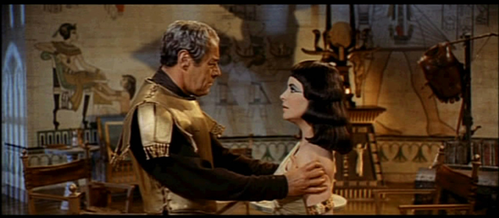
Julius Caesar Ancient Rome
When Caesar arrived in Egypt, he met Ptolemy XIII, the ten-year-old ruler of the ancient land. Hoping to gain favor with Rome, Ptolemy presented Caesar with Pompey’s decapitated head. Caesar then met and fell in love with Cleopatra, Ptolemy older sister. Caesar spent a year with Cleopatra, and then returned to Rome as a conquering hero.

Slide 32
Julius Caesar Ancient Rome
When Caesar arrived in Egypt, he met Ptolemy XIII, the ten-year-old ruler of the ancient land. Hoping to gain favor with Rome, Ptolemy presented Caesar with Pompey’s decapitated head. Caesar then met and fell in love with Cleopatra, Ptolemy older sister. Caesar spent a year with Cleopatra, and then returned to Rome as a conquering hero.

Slide 33
Julius Caesar Ancient Rome
When Caesar arrived in Egypt, he met Ptolemy XIII, the ten-year-old ruler of the ancient land. Hoping to gain favor with Rome, Ptolemy presented Caesar with Pompey’s decapitated head. Caesar then met and fell in love with Cleopatra, Ptolemy older sister. Caesar spent a year with Cleopatra, and then returned to Rome as a conquering hero.

Slide 34
Julius Caesar Ancient Rome
When Caesar arrived in Egypt, he met Ptolemy XIII, the ten-year-old ruler of the ancient land. Hoping to gain favor with Rome, Ptolemy presented Caesar with Pompey’s decapitated head. Caesar then met and fell in love with Cleopatra, Ptolemy older sister. Caesar spent a year with Cleopatra, and then returned to Rome as a conquering hero.

Slide 35
Julius Caesar Ancient Rome
The Senate elected, then re-elected Caesar consul, breaking the Roman tradition that a consul serve only one year. While in power, Caesar settled 80,000 of his soldiers in colonies, built buildings and
monuments throughout the city,
and reformed the calendar.
When Caesar came to power, the
calendar was out of alignment with
the seasons. Caesar instituted the
Julian calendar of 365¼ days. Caesar
added a month to the calendar and
named it July for himself. Caesar’s
calendar is closely related to the
calendar we use today.

Slide 36
Julius Caesar Ancient Rome
The Senate elected, then re-elected Caesar consul, breaking the Roman tradition that a consul serve only one year. While in power, Caesar settled 80,000 of his soldiers in colonies, built buildings and
monuments throughout the city,
and reformed the calendar.
When Caesar came to power, the
calendar was out of alignment with
the seasons. Caesar instituted the
Julian calendar of 365¼ days. Caesar
added a month to the calendar and
named it July for himself. Caesar’s
calendar is closely related to the
calendar we use today.

Slide 37
Julius Caesar Ancient Rome
The Senate elected, then re-elected Caesar consul, breaking the Roman tradition that a consul serve only one year. While in power, Caesar settled 80,000 of his soldiers in colonies, built buildings and
monuments throughout the city,
and reformed the calendar.
When Caesar came to power, the
calendar was out of alignment with
the seasons. Caesar instituted the
Julian calendar of 365¼ days. Caesar
added a month to the calendar and
named it July for himself. Caesar’s
calendar is closely related to the
calendar we use today.

Slide 38
Julius Caesar Ancient Rome
The Senate elected, then re-elected Caesar consul, breaking the Roman tradition that a consul serve only one year. While in power, Caesar settled 80,000 of his soldiers in colonies, built buildings and
monuments throughout the city,
and reformed the calendar.
When Caesar came to power, the
calendar was out of alignment with
the seasons. Caesar instituted the
Julian calendar of 365¼ days. Caesar
added a month to the calendar and
named it July for himself. Caesar’s
calendar is closely related to the
calendar we use today.

Slide 39
Julius Caesar Ancient Rome
The Senate elected, then re-elected Caesar consul, breaking the Roman tradition that a consul serve only one year. While in power, Caesar settled 80,000 of his soldiers in colonies, built buildings and
monuments throughout the city,
and reformed the calendar.
When Caesar came to power, the
calendar was out of alignment with
the seasons. Caesar instituted the
Julian calendar of 365¼ days. Caesar
added a month to the calendar and
named it July for himself. Caesar’s
calendar is closely related to the
calendar we use today.

Slide 40
Julius Caesar Ancient Rome
The Senate elected, then re-elected Caesar consul, breaking the Roman tradition that a consul serve only one year. While in power, Caesar settled 80,000 of his soldiers in colonies, built buildings and
monuments throughout the city,
and reformed the calendar.
When Caesar came to power, the
calendar was out of alignment with
the seasons. Caesar instituted the
Julian calendar of 365¼ days. Caesar
added a month to the calendar and
named it July for himself. Caesar’s
calendar is closely related to the
calendar we use today.

Slide 41
Julius Caesar Ancient Rome
In 44BCE, Caesar arranged to be named dictator for life. A dictator is a ruler with complete control. The Senate had appointed dictators in the past, but only in great emergencies and for a period of no more than six months.
Caesar ignored the Senate and ruled
without their consent. Many Senators
became enraged because Caesar broke
with Roman tradition and behaved as if
he were a king. On March 15, 44BCE, a
mob of sixty senators stabbed the
dictator to death in the Roman Forum.
Ironically, Caesar fell to his death at the
foot of a statue of Pompey, the general
who Caesar defeated.

Slide 42
Julius Caesar Ancient Rome
In 44BCE, Caesar arranged to be named dictator for life. A dictator is a ruler with complete control. The Senate had appointed dictators in the past, but only in great emergencies and for a period of no more than six months.
Caesar ignored the Senate and ruled
without their consent. Many Senators
became enraged because Caesar broke
with Roman tradition and behaved as if
he were a king. On March 15, 44BCE, a
mob of sixty senators stabbed the
dictator to death in the Roman Forum.
Ironically, Caesar fell to his death at the
foot of a statue of Pompey, the general
who Caesar defeated.

Slide 43
Julius Caesar Ancient Rome
In 44BCE, Caesar arranged to be named dictator for life. A dictator is a ruler with complete control. The Senate had appointed dictators in the past, but only in great emergencies and for a period of no more than six months.
Caesar ignored the Senate and ruled
without their consent. Many Senators
became enraged because Caesar broke
with Roman tradition and behaved as if
he were a king. On March 15, 44BCE, a
mob of sixty senators stabbed the
dictator to death in the Roman Forum.
Ironically, Caesar fell to his death at the
foot of a statue of Pompey, the general
who Caesar defeated.

Slide 44
Julius Caesar Ancient Rome
In 44BCE, Caesar arranged to be named dictator for life. A dictator is a ruler with complete control. The Senate had appointed dictators in the past, but only in great emergencies and for a period of no more than six months.
Caesar ignored the Senate and ruled
without their consent. Many Senators
became enraged because Caesar broke
with Roman tradition and behaved as if
he were a king. On March 15, 44BCE, a
mob of sixty senators stabbed the
dictator to death in the Roman Forum.
Ironically, Caesar fell to his death at the
foot of a statue of Pompey, the general
who Caesar defeated.

Slide 45
Julius Caesar Ancient Rome
In 44BCE, Caesar arranged to be named dictator for life. A dictator is a ruler with complete control. The Senate had appointed dictators in the past, but only in great emergencies and for a period of no more than six months.
Caesar ignored the Senate and ruled
without their consent. Many Senators
became enraged because Caesar broke
with Roman tradition and behaved as if
he were a king. On March 15, 44BCE, a
mob of sixty senators stabbed the
dictator to death in the Roman Forum.
Ironically, Caesar fell to his death at the
foot of a statue of Pompey, the general
who Caesar defeated.

Slide 46
Julius Caesar Ancient Rome
In 44BCE, Caesar arranged to be named dictator for life. A dictator is a ruler with complete control. The Senate had appointed dictators in the past, but only in great emergencies and for a period of no more than six months.
Caesar ignored the Senate and ruled
without their consent. Many Senators
became enraged because Caesar broke
with Roman tradition and behaved as if
he were a king. On March 15, 44BCE, a
mob of sixty senators stabbed the
dictator to death in the Roman Forum.
Ironically, Caesar fell to his death at the
foot of a statue of Pompey, the general
who Caesar defeated.

Slide 47
Julius Caesar Ancient Rome
With Caesar dead, Rome fell into a period of civil wars that would lead to the end of the Roman Republic and the creation of the first Roman Emperor.

Slide 48

Julius Caesar Ancient Rome
Learn more about history at
www.mrdowling.com

