Slide 1
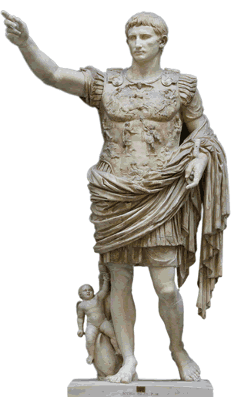

The Empire After Augustus Ancient Rome
Caesar Augustus showed
great respect for the Senate,
but later emperors made no secret of their power. The Senate continued to exist after the reign of Augustus, but senators had little say over the affairs of the empire. Some of the emperors who followed Augustus ruled wisely. Others were foolish
and cruel.

Slide 2
The Empire After Augustus Ancient Rome
Caesar Augustus showed
great respect for the Senate,
but later emperors made no secret of their power. The Senate continued to exist after the reign of Augustus, but senators had little say over the affairs of the empire. Some of the emperors who followed Augustus ruled wisely. Others were foolish
and cruel.

Slide 3
The Empire After Augustus Ancient Rome
Caesar Augustus showed
great respect for the Senate,
but later emperors made no secret of their power. The Senate continued to exist after the reign of Augustus, but senators had little say over the affairs of the empire. Some of the emperors who followed Augustus ruled wisely. Others were foolish
and cruel.

Slide 4
The Empire After Augustus Ancient Rome
Caesar Augustus showed
great respect for the Senate,
but later emperors made no secret of their power. The Senate continued to exist after the reign of Augustus, but senators had little say over the affairs of the empire. Some of the emperors who followed Augustus ruled wisely. Others were foolish
and cruel.

Slide 5
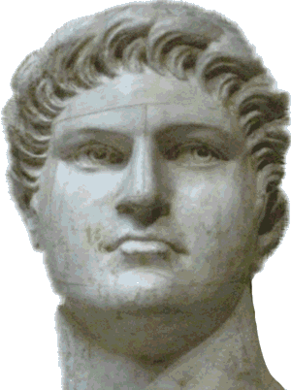
The Empire After Augustus Ancient Rome
Nero was perhaps the most notorious emperor in Roman history. Nero became emperor at the age of seventeen after his mother conspired to kill his stepfather.

Slide 6
The Empire After Augustus Ancient Rome
Nero was perhaps the most notorious emperor in Roman history. Nero became emperor at the age of seventeen after his mother conspired to kill his stepfather.

Slide 7
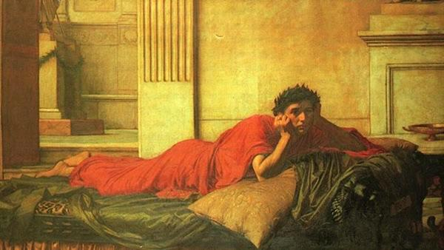
The Empire After Augustus Ancient Rome
Once Nero came to power, he ordered his mother’s execution. He also killed two wives and a stepbrother. Not only did Nero rule the empire ruthlessly by day, at night he prowled the streets of Rome assaulting women.

Slide 8
The Empire After Augustus Ancient Rome
Once Nero came to power, he ordered his mother’s execution. He also killed two wives and a stepbrother. Not only did Nero rule the empire ruthlessly by day, at night he prowled the streets of Rome assaulting women.

Slide 9
The Empire After Augustus Ancient Rome
Once Nero came to power, he ordered his mother’s execution. He also killed two wives and a stepbrother. Not only did Nero rule the empire ruthlessly by day, at night he prowled the streets of Rome assaulting women.

Slide 10
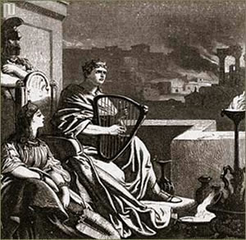
The Empire After Augustus Ancient Rome
Nero believed himself to
be the most talented
person in the Roman
Empire. Never before
had an emperor performed
on a stage as an actor or
singer. Many Roman
nobles considered Nero’s
performances to be outrageous and lacking talent, but no one would risk torture or death by criticizing the emperor.

Slide 11
The Empire After Augustus Ancient Rome
Nero believed himself to
be the most talented
person in the Roman
Empire. Never before
had an emperor performed
on a stage as an actor or
singer. Many Roman
nobles considered Nero’s
performances to be outrageous and lacking talent, but no one would risk torture or death by criticizing the emperor.

Slide 12
The Empire After Augustus Ancient Rome
Nero believed himself to
be the most talented
person in the Roman
Empire. Never before
had an emperor performed
on a stage as an actor or
singer. Many Roman
nobles considered Nero’s
performances to be outrageous and lacking talent, but no one would risk torture or death by criticizing the emperor.

Slide 13
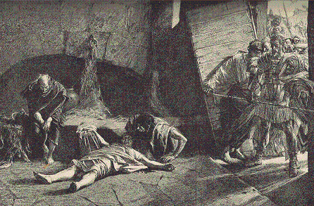
The Empire After Augustus Ancient Rome
In AD67, Nero toured Greece. He participated in many games and contests, but no rival dared to beat the emperor. As Nero devoted himself to his outside pursuits, he lost ruling power. In AD68, Nero faced an attack from his soldiers. His guard claimed Nero cried
out, “What an artist
the world is losing,”
as he stabbed
himself in the neck.

Slide 14
The Empire After Augustus Ancient Rome
In AD67, Nero toured Greece. He participated in many games and contests, but no rival dared to beat the emperor. As Nero devoted himself to his outside pursuits, he lost ruling power. In AD68, Nero faced an attack from his soldiers. His guard claimed Nero cried
out, “What an artist
the world is losing,”
as he stabbed
himself in the neck.

Slide 15
The Empire After Augustus Ancient Rome
In AD67, Nero toured Greece. He participated in many games and contests, but no rival dared to beat the emperor. As Nero devoted himself to his outside pursuits, he lost ruling power. In AD68, Nero faced an attack from his soldiers. His guard claimed Nero cried
out, “What an artist
the world is losing,”
as he stabbed
himself in the neck.

Slide 16
The Empire After Augustus Ancient Rome
In AD67, Nero toured Greece. He participated in many games and contests, but no rival dared to beat the emperor. As Nero devoted himself to his outside pursuits, he lost ruling power. In AD68, Nero faced an attack from his soldiers. His guard claimed Nero cried
out, “What an artist
the world is losing,”
as he stabbed
himself in the neck.

Slide 17
The Empire After Augustus Ancient Rome
In AD67, Nero toured Greece. He participated in many games and contests, but no rival dared to beat the emperor. As Nero devoted himself to his outside pursuits, he lost ruling power. In AD68, Nero faced an attack from his soldiers. His guard claimed Nero cried
out, “What an artist
the world is losing,”
as he stabbed
himself in the neck.

Slide 18
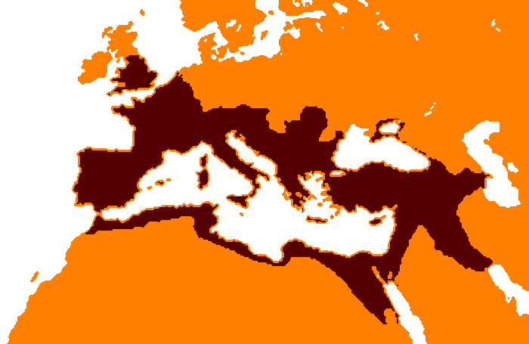
The Empire After Augustus Ancient Rome
It was under the emperor
Trajan that, by AD117, the
Roman Empire reached its
greatest size. The empire
extended from Britain and
Spain, across France,
southern Germany, and
the Balkan Mountains.
The empire also included North Africa and stretched as far east as the Caspian Sea. By that time, the empire completely surrounded the vast Mediterranean Sea, which later historians described as being a mere “Roman lake.”

Slide 19
The Empire After Augustus Ancient Rome
It was under the emperor
Trajan that, by AD117, the
Roman Empire reached its
greatest size. The empire
extended from Britain and
Spain, across France,
southern Germany, and
the Balkan Mountains.
The empire also included North Africa and stretched as far east as the Caspian Sea. By that time, the empire completely surrounded the vast Mediterranean Sea, which later historians described as being a mere “Roman lake.”

Slide 20
The Empire After Augustus Ancient Rome
It was under the emperor
Trajan that, by AD117, the
Roman Empire reached its
greatest size. The empire
extended from Britain and
Spain, across France,
southern Germany, and
the Balkan Mountains.
The empire also included North Africa and stretched as far east as the Caspian Sea. By that time, the empire completely surrounded the vast Mediterranean Sea, which later historians described as being a mere “Roman lake.”

Slide 21
The Empire After Augustus Ancient Rome
It was under the emperor
Trajan that, by AD117, the
Roman Empire reached its
greatest size. The empire
extended from Britain and
Spain, across France,
southern Germany, and
the Balkan Mountains.
The empire also included North Africa and stretched as far east as the Caspian Sea. By that time, the empire completely surrounded the vast Mediterranean Sea, which later historians described as being a mere “Roman lake.”

Slide 22
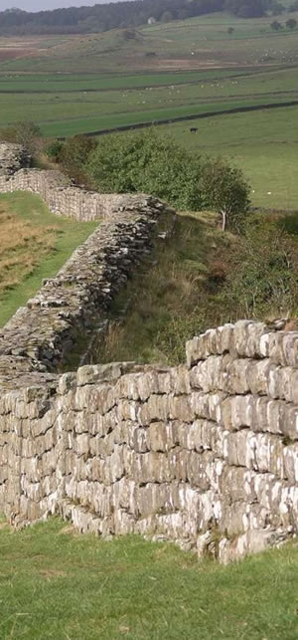
The Empire After Augustus Ancient Rome
In AD121, the emperor Hadrian built a wall across northern England to keep out invaders from Scotland. The Romans called the Scots “barbarians,” possibly because their Celtic language reminded the Romans of the sounds made by sheep.

Slide 23
The Empire After Augustus Ancient Rome
In AD121, the emperor Hadrian built a wall across northern England to keep out invaders from Scotland. The Romans called the Scots “barbarians,” possibly because their Celtic language reminded the Romans of the sounds made by sheep.

Slide 24
The Empire After Augustus Ancient Rome
In time, the Romans used this term for any civilization they considered uncultured. Eventually, another group of barbarian warriors—from Germany—would lead to the end of the Roman Empire.

Slide 25
The Empire After Augustus Ancient Rome
In time, the Romans used this term for any civilization they considered uncultured. Eventually, another group of barbarian warriors—from Germany—would lead to the end of the Roman Empire.

Slide 26

Music credit:
Today More Than Tomorrow
by Dan-O and DanoSongs.com
Learn more about history at
www.mrdowling.com

