Slide 1
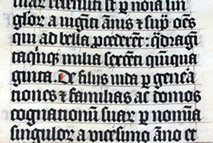
Latin and Other European Languages Ancient Rome
Latin was the language of the Roman Empire. First spoken only in and near the city of Rome, Latin became the official language of business and government as the Roman Empire spread to most of Europe. Few people speak Latin as their primary language today, though Latin survives in several Romance languages.

Slide 2
Latin and Other European Languages Ancient Rome
Latin was the language of the Roman Empire. First spoken only in and near the city of Rome, Latin became the official language of business and government as the Roman Empire spread to most of Europe. Few people speak Latin as their primary language today, though Latin survives in several Romance languages.

Slide 3
Latin and Other European Languages Ancient Rome
Latin was the language of the Roman Empire. First spoken only in and near the city of Rome, Latin became the official language of business and government as the Roman Empire spread to most of Europe. Few people speak Latin as their primary language today, though Latin survives in several Romance languages.

Slide 4
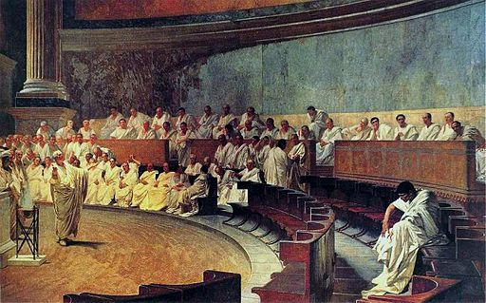
Latin and Other European Languages Ancient Rome
Classical Latin was the language of literature and the language spoken in the Senate; the common people and Roman soldiers generally spoke a variant the language known as Vulgar Latin.

Slide 5
Latin and Other European Languages Ancient Rome
Vernacular languages are the languages or dialects spoken by the ordinary people of a region or country. These local languages blended with Vulgar Latin to form what we now call Romance languages.

Slide 6
Latin and Other European Languages Ancient Rome
Vernacular languages are the languages or dialects spoken by the ordinary people of a region or country. These local languages blended with Vulgar Latin to form what we now call Romance languages.

Slide 7
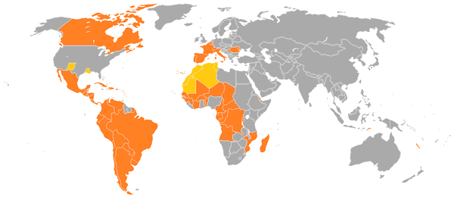
Latin and Other European Languages Ancient Rome
Romance refers to the fact that the languages originated in Rome. Today there are approximately twenty-five commonly spoken Romance languages. They include Italian, Spanish, Portuguese, French, and Romanian.

Slide 8
Latin and Other European Languages Ancient Rome
Romance refers to the fact that the languages originated in Rome. Today there are approximately twenty-five commonly spoken Romance languages. They include Italian, Spanish, Portuguese, French, and Romanian.

Slide 9
Latin and Other European Languages Ancient Rome
Romance refers to the fact that the languages originated in Rome. Today there are approximately twenty-five commonly spoken Romance languages. They include Italian, Spanish, Portuguese, French, and Romanian.

Slide 10
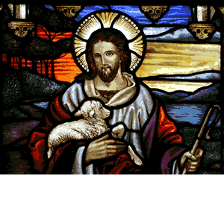
Latin and Other European Languages Ancient Rome
The power of the Roman Empire faded at about the same time Christianity spread through Europe. Roman provinces began to assert their authority beginning in the fifth century of the Common Era, but Latin remained the language of the church for centuries. Today, Latin is the language of the Roman Catholic Church and the official language of the Vatican city-state.

Slide 11
Latin and Other European Languages Ancient Rome
The power of the Roman Empire faded at about the same time Christianity spread through Europe. Roman provinces began to assert their authority beginning in the fifth century of the Common Era, but Latin remained the language of the church for centuries. Today, Latin is the language of the Roman Catholic Church and the official language of the Vatican city-state.

Slide 12
Latin and Other European Languages Ancient Rome
The power of the Roman Empire faded at about the same time Christianity spread through Europe. Roman provinces began to assert their authority beginning in the fifth century of the Common Era, but Latin remained the language of the church for centuries. Today, Latin is the language of the Roman Catholic Church and the official language of the Vatican city-state.

Slide 13
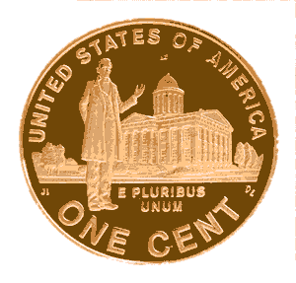
Latin and Other European Languages Ancient Rome
Many students throughout the world continue to study Latin as Latin vocabulary is still widely used in law, medicine and philosophy. E pluribus unum (“out of many, one”) is a Latin phrase found on most American currency.

Slide 14
Latin and Other European Languages Ancient Rome
Many students throughout the world continue to study Latin as Latin vocabulary is still widely used in law, medicine and philosophy. E pluribus unum (“out of many, one”) is a Latin phrase found on most American currency.

Slide 15
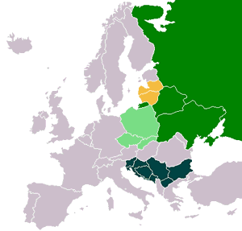
Latin and Other European Languages Ancient Rome
Most Europeans speak Romance, Slavic or Germanic languages. Slavic languages are spoken primarily in Eastern Europe, particularly in Poland, Russia, Croatia, Slovenia, Bulgaria, Macedonia, Bosnia and Serbia.

Slide 16
Latin and Other European Languages Ancient Rome
Most Europeans speak Romance, Slavic or Germanic languages. Slavic languages are spoken primarily in Eastern Europe, particularly in Poland, Russia, Croatia, Slovenia, Bulgaria, Macedonia, Bosnia and Serbia.

Slide 17
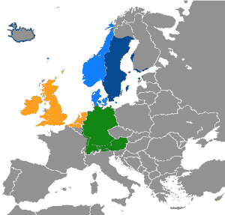
Latin and Other European Languages Ancient Rome
Germanic languages are spoken primarily in northern Europe, including the Netherlands, Sweden, Denmark, Germany and the United Kingdom.

Slide 18
Latin and Other European Languages Ancient Rome
Modern English evolved from Germanic speaking tribes who settled in Great Britain in the tenth and eleventh centuries. Scholars believe that English as spoken in AD1000 would sound similar to the Frisian languages spoken in the Netherlands and Denmark today. The Germanic speakers displaced Latin and many Celtic languages that were spoken at that time in Great Britain.

Slide 19
Latin and Other European Languages Ancient Rome
Modern English evolved from Germanic speaking tribes who settled in Great Britain in the tenth and eleventh centuries. Scholars believe that English as spoken in AD1000 would sound similar to the Frisian languages spoken in the Netherlands and Denmark today. The Germanic speakers displaced Latin and many Celtic languages that were spoken at that time in Great Britain.

Slide 20
Latin and Other European Languages Ancient Rome
Modern English evolved from Germanic speaking tribes who settled in Great Britain in the tenth and eleventh centuries. Scholars believe that English as spoken in AD1000 would sound similar to the Frisian languages spoken in the Netherlands and Denmark today. The Germanic speakers displaced Latin and many Celtic languages that were spoken at that time in Great Britain.

Slide 21
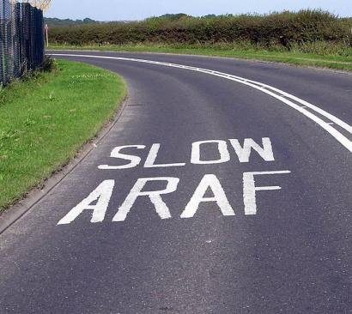
Latin and Other European Languages Ancient Rome
About 400,000 people in Wales speak Welsh, one of the few Celtic languages that is neither extinct nor classified as “endangered” by UNESCO. Celtic languages were prominent before the expansion of the Roman Empire. Despite the scarcity of speakers, the influence of the Celtic people lives on in stories and myths.

Slide 22
Latin and Other European Languages Ancient Rome
About 400,000 people in Wales speak Welsh, one of the few Celtic languages that is neither extinct nor classified as “endangered” by UNESCO. Celtic languages were prominent before the expansion of the Roman Empire. Despite the scarcity of speakers, the influence of the Celtic people lives on in stories and myths.

Slide 23
Latin and Other European Languages Ancient Rome
About 400,000 people in Wales speak Welsh, one of the few Celtic languages that is neither extinct nor classified as “endangered” by UNESCO. Celtic languages were prominent before the expansion of the Roman Empire. Despite the scarcity of speakers, the influence of the Celtic people lives on in stories and myths.

Slide 24
Latin and Other European Languages Ancient Rome
Leprechauns, Halloween and the Blarney Stone are remnants of Celtic culture. Irish students are often encouraged to study traditional Celtic languages, but most Irish people speak English in everyday conversation.

Slide 25
Latin and Other European Languages Ancient Rome
Leprechauns, Halloween and the Blarney Stone are remnants of Celtic culture. Irish students are often encouraged to study traditional Celtic languages, but most Irish people speak English in everyday conversation.

Slide 26
The Punic Wars Ancient Rome
Music credit: “As I Figure” by Kevin MacLeod (incompetech.com)
Licensed under Creative Commons: By Attribution 3.0
http://creativecommons.org/licenses/by/3.0/
Learn more about history at
www.mrdowling.com

