Slide 1
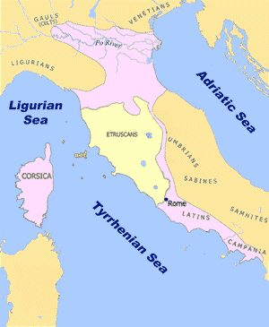
The Patricians and the Plebeians Ancient Rome
Sometime before the first surviving written historical account, Rome was controlled by the Etruscans, a brutal civilization from the northern part of the Italian peninsula. Etruscan kings rained terror for more than a century until the Romans rebelled and expelled their ruler in 509bce.

Slide 2
The Patricians and the Plebeians Ancient Rome
Sometime before the first surviving written historical account, Rome was controlled by the Etruscans, a brutal civilization from the northern part of the Italian peninsula. Etruscan kings rained terror for more than a century until the Romans rebelled and expelled their ruler in 509bce.

Slide 3
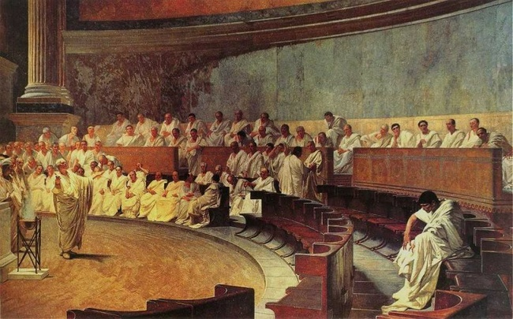
The Patricians and the Plebeians Ancient Rome
The early Romans were miserable living under a king, so they created a republic, a form of government in which elected officials share power.

Slide 4
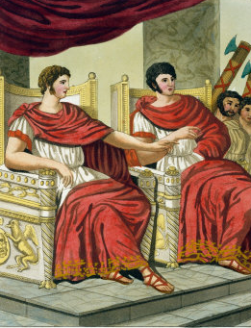
The Patricians and the Plebeians Ancient Rome
In place of a king, the Romans elected two consuls with equal power. The consuls served for only one year and could not be re-elected. The consuls held veto power over one another. Veto means “I forbid” in Latin, the language of the Romans. Neither consul could make a law without the consent of the other. The Romans never wanted power concentrated in one person again.

Slide 5
The Patricians and the Plebeians Ancient Rome
In place of a king, the Romans elected two consuls with equal power. The consuls served for only one year and could not be re-elected. The consuls held veto power over one another. Veto means “I forbid” in Latin, the language of the Romans. Neither consul could make a law without the consent of the other. The Romans never wanted power concentrated in one person again.

Slide 6
The Patricians and the Plebeians Ancient Rome
In place of a king, the Romans elected two consuls with equal power. The consuls served for only one year and could not be re-elected. The consuls held veto power over one another. Veto means “I forbid” in Latin, the language of the Romans. Neither consul could make a law without the consent of the other. The Romans never wanted power concentrated in one person again.

Slide 7
The Patricians and the Plebeians Ancient Rome
In place of a king, the Romans elected two consuls with equal power. The consuls served for only one year and could not be re-elected. The consuls held veto power over one another. Veto means “I forbid” in Latin, the language of the Romans. Neither consul could make a law without the consent of the other. The Romans never wanted power concentrated in one person again.

Slide 8
The Patricians and the Plebeians Ancient Rome
In place of a king, the Romans elected two consuls with equal power. The consuls served for only one year and could not be re-elected. The consuls held veto power over one another. Veto means “I forbid” in Latin, the language of the Romans. Neither consul could make a law without the consent of the other. The Romans never wanted power concentrated in one person again.

Slide 9
The Patricians and the Plebeians Ancient Rome
In place of a king, the Romans elected two consuls with equal power. The consuls served for only one year and could not be re-elected. The consuls held veto power over one another. Veto means “I forbid” in Latin, the language of the Romans. Neither consul could make a law without the consent of the other. The Romans never wanted power concentrated in one person again.

Slide 10
The Patricians and the Plebeians Ancient Rome
The Roman Senate advised the consuls. Senate is derived from a word meaning elder because many Romans considered the senators to be the oldest and wisest of their people.

Slide 11
The Patricians and the Plebeians Ancient Rome
The Roman Senate advised the consuls. Senate is derived from a word meaning elder because many Romans considered the senators to be the oldest and wisest of their people.

Slide 12
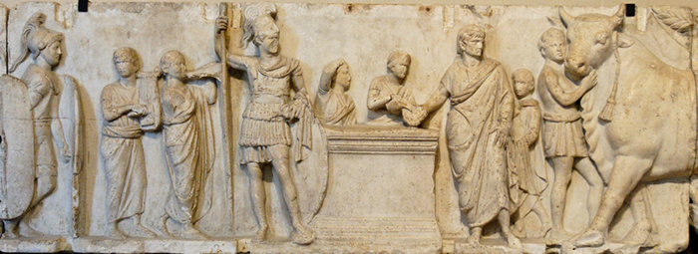
The Patricians and the Plebeians Ancient Rome
The consuls and senators came from the patrician “order” – mostly wealthy landowning families believed to have descended from the leaders of the rebellion against the Etruscans.

Slide 13
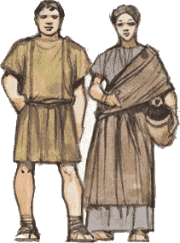
The Patricians and the Plebeians Ancient Rome
The plebeians were the merchants, farmers, and craft workers of Rome. The patricians excluded the plebeians from the consulship and the Senate, so when the Senate declared war in 491bce, the plebeians refused to
fight. A legend says the plebeians withdrew from the city until they were given the right to elect their own leaders. Historians later called this the Struggle of the Orders.

Slide 14
The Patricians and the Plebeians Ancient Rome
The plebeians were the merchants, farmers, and craft workers of Rome. The patricians excluded the plebeians from the consulship and the Senate, so when the Senate declared war in 491bce, the plebeians refused to
fight. A legend says the plebeians withdrew from the city until they were given the right to elect their own leaders. Historians later called this the Struggle of the Orders.

Slide 15
The Patricians and the Plebeians Ancient Rome
The plebeians were the merchants, farmers, and craft workers of Rome. The patricians excluded the plebeians from the consulship and the Senate, so when the Senate declared war in 491bce, the plebeians refused to
fight. A legend says the plebeians withdrew from the city until they were given the right to elect their own leaders. Historians later called this the Struggle of the Orders.

Slide 16
The Patricians and the Plebeians Ancient Rome
The plebeians were the merchants, farmers, and craft workers of Rome. The patricians excluded the plebeians from the consulship and the Senate, so when the Senate declared war in 491bce, the plebeians refused to
fight. A legend says the plebeians withdrew from the city until they were given the right to elect their own leaders. Historians later called this the Struggle of the Orders.

Slide 17
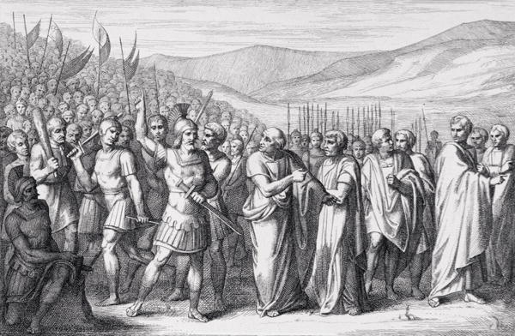
The Patricians and the Plebeians Ancient Rome
The patricians and the plebeians negotiated a settlement that allowed the plebeians a voice in Roman government. The plebeians elected tribunes, who represented their order against any mistreatment by the consuls or the Senate. Tribunes could veto a law passed by the Senate or the consuls.

Slide 18
The Patricians and the Plebeians Ancient Rome
The patricians and the plebeians negotiated a settlement that allowed the plebeians a voice in Roman government. The plebeians elected tribunes, who represented their order against any mistreatment by the consuls or the Senate. Tribunes could veto a law passed by the Senate or the consuls.

Slide 19
The Patricians and the Plebeians Ancient Rome
The patricians and the plebeians negotiated a settlement that allowed the plebeians a voice in Roman government. The plebeians elected tribunes, who represented their order against any mistreatment by the consuls or the Senate. Tribunes could veto a law passed by the Senate or the consuls.

Slide 20
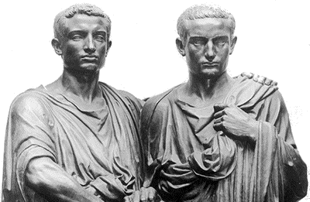
The Patricians and the Plebeians Ancient Rome
The Roman word for a chamber or a meeting room is camera. The Roman government was bicameral because both the patricians and the plebeians had representatives in the Roman Republic. The Struggle
of the Orders ended
in 287bce, when laws passed by the Tribunes were binding for all Romans.

Slide 21
The Patricians and the Plebeians Ancient Rome
The Roman word for a chamber or a meeting room is camera. The Roman government was bicameral because both the patricians and the plebeians had representatives in the Roman Republic. The Struggle
of the Orders ended
in 287bce, when laws passed by the Tribunes were binding for all Romans.

Slide 22
The Patricians and the Plebeians Ancient Rome
The Roman word for a chamber or a meeting room is camera. The Roman government was bicameral because both the patricians and the plebeians had representatives in the Roman Republic. The Struggle
of the Orders ended
in 287bce, when laws passed by the Tribunes were binding for all Romans.

Slide 23
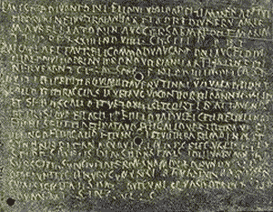
The Patricians and the Plebeians Ancient Rome
The patricians and the plebeians agreed on the Law of Twelve Tables in 449bce. The Twelve Tables were a legal code that everyone could see. Citizens could no longer be charged in secret, and even elected officials were required to follow the law, though an official could not be charged with a crime until after he left office.

Slide 24
The Patricians and the Plebeians Ancient Rome
The patricians and the plebeians agreed on the Law of Twelve Tables in 449bce. The Twelve Tables were a legal code that everyone could see. Citizens could no longer be charged in secret, and even elected officials were required to follow the law, though an official could not be charged with a crime until after he left office.

Slide 25
The Patricians and the Plebeians Ancient Rome
The patricians and the plebeians agreed on the Law of Twelve Tables in 449bce. The Twelve Tables were a legal code that everyone could see. Citizens could no longer be charged in secret, and even elected officials were required to follow the law, though an official could not be charged with a crime until after he left office.

Slide 26
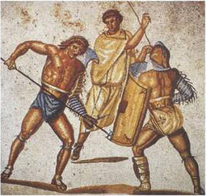
The Patricians and the Plebeians Ancient Rome
The patricians and the plebeians shared power in Rome, but a third order had no voice in how they were ruled. They were the slaves. Many people captured in war became slaves. Some were former criminals. Others–very poor Romans–sold themselves and their families into slavery to keep from starving. Roman law considered slaves to be property, so slaves had no legal rights. As many as one-third of the Roman people were slaves.

Slide 27
The Patricians and the Plebeians Ancient Rome
The patricians and the plebeians shared power in Rome, but a third order had no voice in how they were ruled. They were the slaves. Many people captured in war became slaves. Some were former criminals. Others–very poor Romans–sold themselves and their families into slavery to keep from starving. Roman law considered slaves to be property, so slaves had no legal rights. As many as one-third of the Roman people were slaves.

Slide 28
The Patricians and the Plebeians Ancient Rome
The patricians and the plebeians shared power in Rome, but a third order had no voice in how they were ruled. They were the slaves. Many people captured in war became slaves. Some were former criminals. Others–very poor Romans–sold themselves and their families into slavery to keep from starving. Roman law considered slaves to be property, so slaves had no legal rights. As many as one-third of the Roman people were slaves.

Slide 29
The Patricians and the Plebeians Ancient Rome
The patricians and the plebeians shared power in Rome, but a third order had no voice in how they were ruled. They were the slaves. Many people captured in war became slaves. Some were former criminals. Others–very poor Romans–sold themselves and their families into slavery to keep from starving. Roman law considered slaves to be property, so slaves had no legal rights. As many as one-third of the Roman people were slaves.

Slide 30
The Patricians and the Plebeians Ancient Rome
The patricians and the plebeians shared power in Rome, but a third order had no voice in how they were ruled. They were the slaves. Many people captured in war became slaves. Some were former criminals. Others–very poor Romans–sold themselves and their families into slavery to keep from starving. Roman law considered slaves to be property, so slaves had no legal rights. As many as one-third of the Roman people were slaves.

Slide 31
The Patricians and the Plebeians Ancient Rome
The patricians and the plebeians shared power in Rome, but a third order had no voice in how they were ruled. They were the slaves. Many people captured in war became slaves. Some were former criminals. Others–very poor Romans–sold themselves and their families into slavery to keep from starving. Roman law considered slaves to be property, so slaves had no legal rights. As many as one-third of the Roman people were slaves.

Slide 32
The Patricians and the Plebeians Ancient Rome
The patricians and the plebeians shared power in Rome, but a third order had no voice in how they were ruled. They were the slaves. Many people captured in war became slaves. Some were former criminals. Others–very poor Romans–sold themselves and their families into slavery to keep from starving. Roman law considered slaves to be property, so slaves had no legal rights. As many as one-third of the Roman people were slaves.

Slide 33
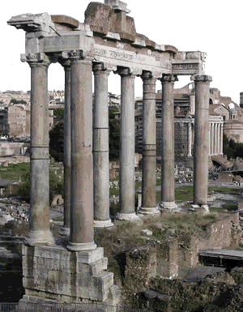
The Patricians and the Plebeians Ancient Rome
The senate met in the Forum, a marketplace in the valley among the hills that surround Rome. The meetings usually took place outdoors and ended at sunset, so a senator could stop a law from passing by talking continuously until the end of the day.

Slide 34
The Patricians and the Plebeians Ancient Rome
The senate met in the Forum, a marketplace in the valley among the hills that surround Rome. The meetings usually took place outdoors and ended at sunset, so a senator could stop a law from passing by talking continuously until the end of the day.

Slide 35
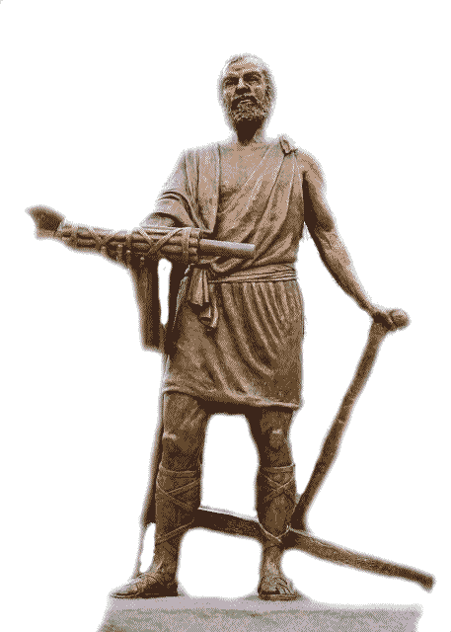
The Patricians and the Plebeians Ancient Rome
In times of great emergency, the Romans would select a dictator to rule the Republic. The dictator had complete control over Rome, but the dictator could serve for only six months.

Slide 36
The Patricians and the Plebeians Ancient Rome
In times of great emergency, the Romans would select a dictator to rule the Republic. The dictator had complete control over Rome, but the dictator could serve for only six months.

Slide 37
The Patricians and the Plebeians Ancient Rome
The Romans were at war in 458bce when the Senate asked Cincinnatus to lead them as a dictator. Cincinnatus organized the Romans and ended the war in just sixteen days. He could have remained in power for the remainder of his term and used the office to enrich himself, but Cincinnatus returned power to the Senate and went back to his farm.

Slide 38
The Patricians and the Plebeians Ancient Rome
The Romans were at war in 458bce when the Senate asked Cincinnatus to lead them as a dictator. Cincinnatus organized the Romans and ended the war in just sixteen days. He could have remained in power for the remainder of his term and used the office to enrich himself, but Cincinnatus returned power to the Senate and went back to his farm.

Slide 39
The Patricians and the Plebeians Ancient Rome
The Romans were at war in 458bce when the Senate asked Cincinnatus to lead them as a dictator. Cincinnatus organized the Romans and ended the war in just sixteen days. He could have remained in power for the remainder of his term and used the office to enrich himself, but Cincinnatus returned power to the Senate and went back to his farm.

Slide 40
The Patricians and the Plebeians Ancient Rome
The Roman republic never officially ended. Powerful leaders such as Julius Caesar and Caesar Augustus began to take authority from senators and tribunes in the first century BCE. The Romans returned power to one person after about five hundred years as a republic.

Slide 41
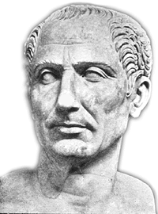
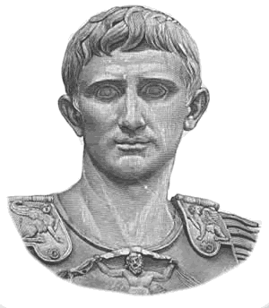
The Patricians and the Plebeians Ancient Rome
The Roman republic never officially ended. Powerful leaders such as Julius Caesar and Caesar Augustus began to take authority from senators and tribunes in the first century BCE. The Romans returned power to one person after about five hundred years as a republic.

Slide 42
The Patricians and the Plebeians Ancient Rome
The Roman republic never officially ended. Powerful leaders such as Julius Caesar and Caesar Augustus began to take authority from senators and tribunes in the first century BCE. The Romans returned power to one person after about five hundred years as a republic.

Slide 43
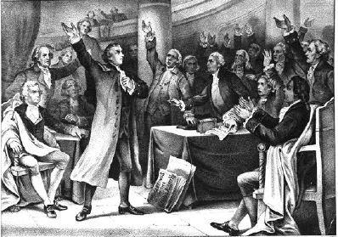
The Patricians and the Plebeians Ancient Rome
More than two thousand years after the Romans formed their republic, a group of colonists in America rebelled against the English king and formed the United States of America. The founders of the new American nation wrote a Constitution that looked to ancient Rome for as model for their new government.

Slide 44
The Patricians and the Plebeians Ancient Rome
More than two thousand years after the Romans formed their republic, a group of colonists in America rebelled against the English king and formed the United States of America. The founders of the new American nation wrote a Constitution that looked to ancient Rome for as model for their new government.

Slide 45
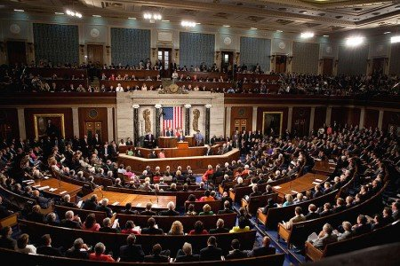
The Patricians and the Plebeians Ancient Rome
Like the Roman model, the American government is bicameral. Each of the fifty states elects two Senators to represent them in Congress. The United States Constitution allots seats in the House of Representatives based the population of each state. Each state has at least one of the 435 seats in the House of Representatives.

Slide 46
The Patricians and the Plebeians Ancient Rome
Like the Roman model, the American government is bicameral. Each of the fifty states elects two Senators to represent them in Congress. The United States Constitution allots seats in the House of Representatives based the population of each state. Each state has at least one of the 435 seats in the House of Representatives.

Slide 47
The Patricians and the Plebeians Ancient Rome
Like the Roman model, the American government is bicameral. Each of the fifty states elects two Senators to represent them in Congress. The United States Constitution allots seats in the House of Representatives based the population of each state. Each state has at least one of the 435 seats in the House of Representatives.

Slide 48
The Patricians and the Plebeians Ancient Rome
Like the Roman model, the American government is bicameral. Each of the fifty states elects two Senators to represent them in Congress. The United States Constitution allots seats in the House of Representatives based the population of each state. Each state has at least one of the 435 seats in the House of Representatives.

Slide 49
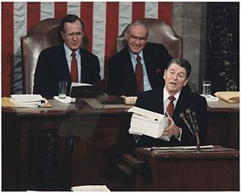
The Patricians and the Plebeians Ancient Rome
The framers of the American Constitution borrowed the Roman idea of sharing power among many groups. The president can veto a law made by Congress, but under the American system, a vote of two-thirds of each house of Congress can override the president’s veto. Every elected official must follow the law. Even the president can be removed from office by Congress for what the Constitution describes as “high crimes and misdemeanors.”

Slide 50
The Patricians and the Plebeians Ancient Rome
The framers of the American Constitution borrowed the Roman idea of sharing power among many groups. The president can veto a law made by Congress, but under the American system, a vote of two-thirds of each house of Congress can override the president’s veto. Every elected official must follow the law. Even the president can be removed from office by Congress for what the Constitution describes as “high crimes and misdemeanors.”

Slide 51
The Patricians and the Plebeians Ancient Rome
The framers of the American Constitution borrowed the Roman idea of sharing power among many groups. The president can veto a law made by Congress, but under the American system, a vote of two-thirds of each house of Congress can override the president’s veto. Every elected official must follow the law. Even the president can be removed from office by Congress for what the Constitution describes as “high crimes and misdemeanors.”

Slide 52
The Patricians and the Plebeians Ancient Rome
The framers of the American Constitution borrowed the Roman idea of sharing power among many groups. The president can veto a law made by Congress, but under the American system, a vote of two-thirds of each house of Congress can override the president’s veto. Every elected official must follow the law. Even the president can be removed from office by Congress for what the Constitution describes as “high crimes and misdemeanors.”

Slide 53
The Patricians and the Plebeians Ancient Rome
Music credit:
Dan-O at http://danosongs.com
Learn more about history at
www.mrdowling.com

