Slide 1
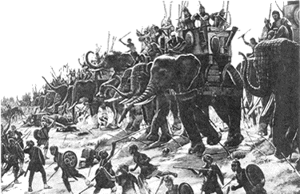
The Punic Wars Ancient Rome
Rome fought three wars with Carthage between 264BCE and 146BCE. The wars established Rome as a world power and left Carthage, once a powerful empire, in ruins.

Slide 2
The Punic Wars Ancient Rome
Rome fought three wars with Carthage between 264BCE and 146BCE. The wars established Rome as a world power and left Carthage, once a powerful empire, in ruins.

Slide 3
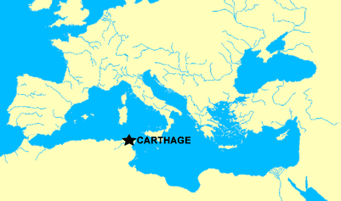
The Punic Wars Ancient Rome
Carthage was a city in North Africa originally founded as a trading post by the Phoenicians. Since historians have tended to label the conflicts by the Roman name, we know them as the Punic Wars. Punica was a Latin word for Phoenician.

Slide 4
The Punic Wars Ancient Rome
Carthage was a city in North Africa originally founded as a trading post by the Phoenicians. Since historians have tended to label the conflicts by the Roman name, we know them as the Punic Wars. Punica was a Latin word for Phoenician.

Slide 5
The Punic Wars Ancient Rome
Carthage was a city in North Africa originally founded as a trading post by the Phoenicians. Since historians have tended to label the conflicts by the Roman name, we know them as the Punic Wars. Punica was a Latin word for Phoenician.

Slide 6
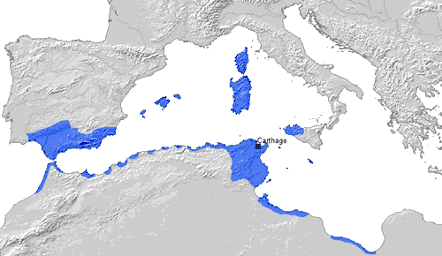
The Punic Wars Ancient Rome
By the time of the first Punic War, Carthage had created an empire that stretched across North Africa and into the southern coast of modern day Spain. Merchant ships from Carthage traded with cities throughout the Mediterranean Sea. To protect its profitable sea trade, Carthage developed a powerful navy.

Slide 7
The Punic Wars Ancient Rome
By the time of the first Punic War, Carthage had created an empire that stretched across North Africa and into the southern coast of modern day Spain. Merchant ships from Carthage traded with cities throughout the Mediterranean Sea. To protect its profitable sea trade, Carthage developed a powerful navy.

Slide 8
The Punic Wars Ancient Rome
By the time of the first Punic War, Carthage had created an empire that stretched across North Africa and into the southern coast of modern day Spain. Merchant ships from Carthage traded with cities throughout the Mediterranean Sea. To protect its profitable sea trade, Carthage developed a powerful navy.

Slide 9
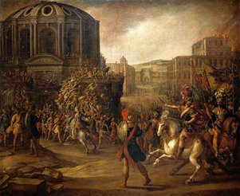
The Punic Wars Ancient Rome
Meanwhile, the Romans had completed their conquest of the Italian peninsula by 263BCE. Because Rome’s economy depended on the plunder of their army, the Roman Senate had to keep the army busy. Otherwise, an idle army might have turned against the Senate. So the Senate turned their sights on Carthage.

Slide 10
The Punic Wars Ancient Rome
Meanwhile, the Romans had completed their conquest of the Italian peninsula by 263BCE. Because Rome’s economy depended on the plunder of their army, the Roman Senate had to keep the army busy. Otherwise, an idle army might have turned against the Senate. So the Senate turned their sights on Carthage.

Slide 11
The Punic Wars Ancient Rome
Meanwhile, the Romans had completed their conquest of the Italian peninsula by 263BCE. Because Rome’s economy depended on the plunder of their army, the Roman Senate had to keep the army busy. Otherwise, an idle army might have turned against the Senate. So the Senate turned their sights on Carthage.

Slide 12
The Punic Wars Ancient Rome
Meanwhile, the Romans had completed their conquest of the Italian peninsula by 263BCE. Because Rome’s economy depended on the plunder of their army, the Roman Senate had to keep the army busy. Otherwise, an idle army might have turned against the Senate. So the Senate turned their sights on Carthage.

Slide 13
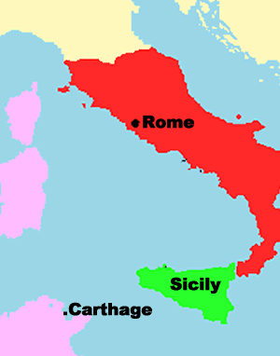
The Punic Wars Ancient Rome
Rome and Carthage fought the first Punic War over Sicily, a Mediterranean island off the coast of the Italian peninsula. Carthage controlled Sicily in 264BCE, so the Romans found an excuse to declare war. Carthage had imprisoned a small group of Roman fortune seekers, so the Romans went to war in retaliation for their capture.

Slide 14
The Punic Wars Ancient Rome
Rome and Carthage fought the first Punic War over Sicily, a Mediterranean island off the coast of the Italian peninsula. Carthage controlled Sicily in 264BCE, so the Romans found an excuse to declare war. Carthage had imprisoned a small group of Roman fortune seekers, so the Romans went to war in retaliation for their capture.

Slide 15
The Punic Wars Ancient Rome
Rome and Carthage fought the first Punic War over Sicily, a Mediterranean island off the coast of the Italian peninsula. Carthage controlled Sicily in 264BCE, so the Romans found an excuse to declare war. Carthage had imprisoned a small group of Roman fortune seekers, so the Romans went to war in retaliation for their capture.

Slide 16
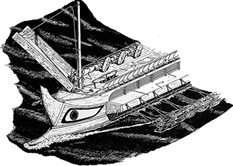
The Punic Wars Ancient Rome
Rome had a powerful army, but their new foe was overseas, where they had little experience. They lacked the naval skill to sink ships, so they found a way to fight a land war at sea.

Slide 17
The Punic Wars Ancient Rome
Rome had a powerful army, but their new foe was overseas, where they had little experience. They lacked the naval skill to sink ships, so they found a way to fight a land war at sea.

Slide 18
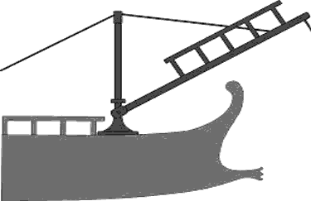
The Punic Wars Ancient Rome
The Romans outfitted their vessels with a hinged bridge equipped with an iron spike. Roman sailors used pulleys to lower the bridge to face an enemy ship. The Roman ship would ram into an enemy vessel.

Slide 19
The Punic Wars Ancient Rome
The Romans outfitted their vessels with a hinged bridge equipped with an iron spike. Roman sailors used pulleys to lower the bridge to face an enemy ship. The Roman ship would ram into an enemy vessel.

Slide 20
The Punic Wars Ancient Rome
The Romans outfitted their vessels with a hinged bridge equipped with an iron spike. Roman sailors used pulleys to lower the bridge to face an enemy ship. The Roman ship would ram into an enemy vessel.

Slide 21
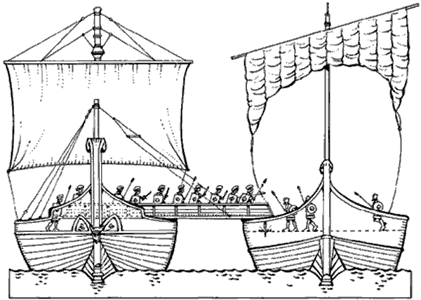
The Punic Wars Ancient Rome
The spike attached the two ships and allowed soldiers to cross over and attack in hand-to-hand combat—where Rome was more experienced than Carthage.

Slide 22
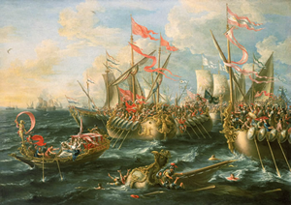
The Punic Wars Ancient Rome
To try to close the gap in naval power, the Romans captured a Carthaginian warship and used it as a model to build their fleet. They won a few early victories and captured most of Sicily, but the inexperience of the Roman navy left them unprepared for a catastrophic storm that destroyed two-thirds of their fleet and killed thousands of Roman sailors. Rome raised a second and a third fleet, but storms also destroyed most of the additional ships.

Slide 23
The Punic Wars Ancient Rome
To try to close the gap in naval power, the Romans captured a Carthaginian warship and used it as a model to build their fleet. They won a few early victories and captured most of Sicily, but the inexperience of the Roman navy left them unprepared for a catastrophic storm that destroyed two-thirds of their fleet and killed thousands of Roman sailors. Rome raised a second and a third fleet, but storms also destroyed most of the additional ships.

Slide 24
The Punic Wars Ancient Rome
To try to close the gap in naval power, the Romans captured a Carthaginian warship and used it as a model to build their fleet. They won a few early victories and captured most of Sicily, but the inexperience of the Roman navy left them unprepared for a catastrophic storm that destroyed two-thirds of their fleet and killed thousands of Roman sailors. Rome raised a second and a third fleet, but storms also destroyed most of the additional ships.

Slide 25
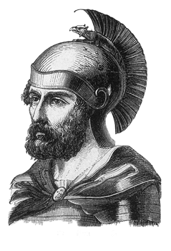
The Punic Wars Ancient Rome
A Carthaginian general named Hamilcar Barca recaptured most of Sicily, but Carthage did not have the money or manpower to continue to engage in the conflict. In 241BCE, an exhausted Carthage surrendered Sicily to the Romans.

Slide 26
The Punic Wars Ancient Rome
A Carthaginian general named Hamilcar Barca recaptured most of Sicily, but Carthage did not have the money or manpower to continue to engage in the conflict. In 241BCE, an exhausted Carthage surrendered Sicily to the Romans.

Slide 27
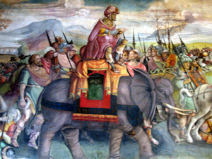
The Punic Wars Ancient Rome
A generation after the first Punic War in 218BCE, a young Carthaginian general named Hannibal, the son of Hamilcar Barca, sought revenge from his base in Spain.

Slide 28
The Punic Wars Ancient Rome
He led an army of 40,000 soldiers, 8,000 horses and 37 war elephants in a daring and difficult journey over the Alps, a treacherous mountain range that stood between Spain and the Italian peninsula.

Slide 29
The Punic Wars Ancient Rome
Hannibal’s army won decisive victories against Rome in northern Italy despite being outnumbered more than two to one. In the Battle of Canae, Hannibal’s army surrounded the Romans, killing between 50,000 to 80,000 Roman soldiers.

Slide 30
The Punic Wars Ancient Rome
Hannibal’s army won decisive victories against Rome in northern Italy despite being outnumbered more than two to one. In the Battle of Canae, Hannibal’s army surrounded the Romans, killing between 50,000 to 80,000 Roman soldiers.

Slide 31
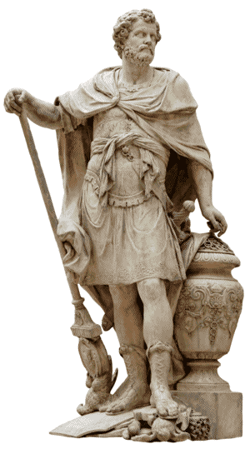
The Punic Wars Ancient Rome
As a result of their humiliation at Canae, Rome changed their strategy. They sent a new army to northern Italy with instructions to withdraw. Hannibal spent the next twelve years destroying the Roman countryside, but his army had no opponent to fight.

Slide 32
The Punic Wars Ancient Rome
As a result of their humiliation at Canae, Rome changed their strategy. They sent a new army to northern Italy with instructions to withdraw. Hannibal spent the next twelve years destroying the Roman countryside, but his army had no opponent to fight.

Slide 33
The Punic Wars Ancient Rome
As a result of their humiliation at Canae, Rome changed their strategy. They sent a new army to northern Italy with instructions to withdraw. Hannibal spent the next twelve years destroying the Roman countryside, but his army had no opponent to fight.

Slide 34
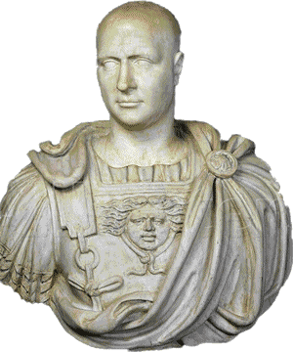
The Punic Wars Ancient Rome
After years of bloody warfare in Italy, the Roman consul Scipio proposed a daring invasion of Carthage in 203BCE. The Senate reluctantly agreed, and Scipio arrived in North Africa with an army of 7000 men, most of whom were volunteers. Scipio added to his forces when he encountered soldiers in Carthage willing to switch sides.

Slide 35
The Punic Wars Ancient Rome
After years of bloody warfare in Italy, the Roman consul Scipio proposed a daring invasion of Carthage in 203BCE. The Senate reluctantly agreed, and Scipio arrived in North Africa with an army of 7000 men, most of whom were volunteers. Scipio added to his forces when he encountered soldiers in Carthage willing to switch sides.

Slide 36
The Punic Wars Ancient Rome
After years of bloody warfare in Italy, the Roman consul Scipio proposed a daring invasion of Carthage in 203BCE. The Senate reluctantly agreed, and Scipio arrived in North Africa with an army of 7000 men, most of whom were volunteers. Scipio added to his forces when he encountered soldiers in Carthage willing to switch sides.

Slide 37
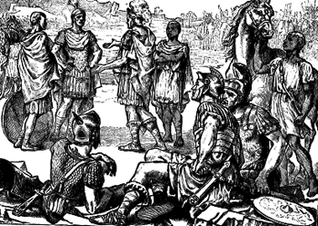
The Punic Wars Ancient Rome
Hannibal was called home to face Scipio, but he had to leave his own loyal army behind in Italy. Without Hannibal in charge, the war on the Italian peninsula turned in Rome’s favor.

Slide 38
The Punic Wars Ancient Rome
Hannibal was called home to face Scipio, but he had to leave his own loyal army behind in Italy. Without Hannibal in charge, the war on the Italian peninsula turned in Rome’s favor.

Slide 39
The Punic Wars Ancient Rome
Back in Carthage, Hannibal was given a mercenary army in place of his devoted soldiers. Mercenaries are foreign soldiers hired to fight. Hannibal was used to his loyal troops, and his new mercenary command was no match for Scipio's army. Rome defeated them and won the Second Punic War.

Slide 40
The Punic Wars Ancient Rome
Back in Carthage, Hannibal was given a mercenary army in place of his devoted soldiers. Mercenaries are foreign soldiers hired to fight. Hannibal was used to his loyal troops, and his new mercenary command was no match for Scipio's army. Rome defeated them and won the Second Punic War.

Slide 41
The Punic Wars Ancient Rome
Back in Carthage, Hannibal was given a mercenary army in place of his devoted soldiers. Mercenaries are foreign soldiers hired to fight. Hannibal was used to his loyal troops, and his new mercenary command was no match for Scipio's army. Rome defeated them and won the Second Punic War.

Slide 42
The Punic Wars Ancient Rome
Though Carthage had been defeated, the antipathy, or bad feelings caused by Hannibal’s destruction would last for generations and would lead to the third Punic War and the downfall of Carthage.

Slide 43
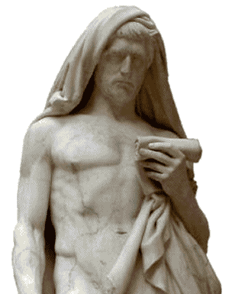
The Punic Wars Ancient Rome
Carthage was no longer in a position to hurt Rome after the second Punic War, but in 149bce, Roman antipathy toward Carthage continued to linger. A Roman senator named Cato ended every speech with the cry, “Carthage must be destroyed.” Rome attacked Carthage and the two sides fought bloody battles in a war that lasted almost three years.

Slide 44
The Punic Wars Ancient Rome
Carthage was no longer in a position to hurt Rome after the second Punic War, but in 149bce, Roman antipathy toward Carthage continued to linger. A Roman senator named Cato ended every speech with the cry, “Carthage must be destroyed.” Rome attacked Carthage and the two sides fought bloody battles in a war that lasted almost three years.

Slide 45
The Punic Wars Ancient Rome
Carthage was no longer in a position to hurt Rome after the second Punic War, but in 149bce, Roman antipathy toward Carthage continued to linger. A Roman senator named Cato ended every speech with the cry, “Carthage must be destroyed.” Rome attacked Carthage and the two sides fought bloody battles in a war that lasted almost three years.

Slide 46
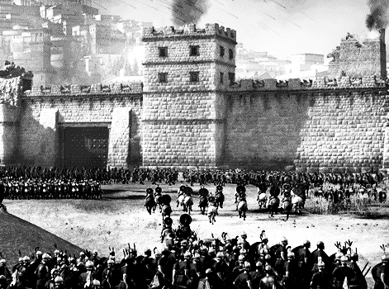
The Punic Wars Ancient Rome
After a siege in 146BCE, the Romans broke through the city walls of Carthage. Once they subdued the Carthaginian army, Roman soldiers went from house to house slaughtering the people in their homes. After destroying Carthage, the Romans sold the remaining citizens into slavery, burned the city and destroyed Carthage’s harbor.

Slide 47
The Punic Wars Ancient Rome
After a siege in 146BCE, the Romans broke through the city walls of Carthage. Once they subdued the Carthaginian army, Roman soldiers went from house to house slaughtering the people in their homes. After destroying Carthage, the Romans sold the remaining citizens into slavery, burned the city and destroyed Carthage’s harbor.

Slide 48
The Punic Wars Ancient Rome
After a siege in 146BCE, the Romans broke through the city walls of Carthage. Once they subdued the Carthaginian army, Roman soldiers went from house to house slaughtering the people in their homes. After destroying Carthage, the Romans sold the remaining citizens into slavery, burned the city and destroyed Carthage’s harbor.

Slide 49
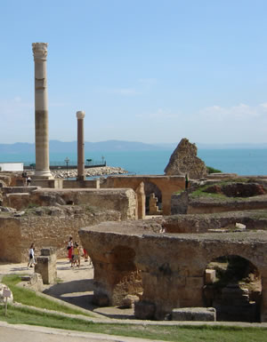
The Punic Wars Ancient Rome
Rome annexed Carthage by making the city a part of a Roman province they called Africa. Africa probably comes from a Latin word that means “sunny land without cold.” The Punic Wars established Rome as a powerful nation and the wars were an indication that Rome would develop into one of the most powerful empires in history.

Slide 50
The Punic Wars Ancient Rome
Rome annexed Carthage by making the city a part of a Roman province they called Africa. Africa probably comes from a Latin word that means “sunny land without cold.” The Punic Wars established Rome as a powerful nation and the wars were an indication that Rome would develop into one of the most powerful empires in history.

Slide 51
The Punic Wars Ancient Rome
Rome annexed Carthage by making the city a part of a Roman province they called Africa. Africa probably comes from a Latin word that means “sunny land without cold.” The Punic Wars established Rome as a powerful nation and the wars were an indication that Rome would develop into one of the most powerful empires in history.

Slide 52
The Punic Wars Ancient Rome
Music credit:
Back on Track by Kevin McLeod
(incompetech.com)
Licensed under Creative Commons: By Attribution 3.0 http://creativecommons.org/licenses/by/3.0/
Learn more about history at
www.mrdowling.com

