Slide 1
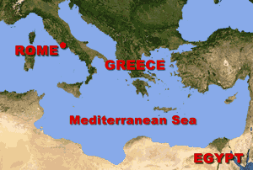
A New Power Rises Ancient Rome
Italy is a peninsula that extends into the Mediterranean Sea east of the Greek peninsula. Rome lies on the western shore near the center of the peninsula. Today Rome is the capital of the modern nation of Italy and one of the largest cities in Europe, but Rome was once the seat of a huge empire.

Slide 2
A New Power Rises Ancient Rome
Italy is a peninsula that extends into the Mediterranean Sea east of the Greek peninsula. Rome lies on the western shore near the center of the peninsula. Today Rome is the capital of the modern nation of Italy and one of the largest cities in Europe, but Rome was once the seat of a huge empire.

Slide 3
A New Power Rises Ancient Rome
Italy is a peninsula that extends into the Mediterranean Sea east of the Greek peninsula. Rome lies on the western shore near the center of the peninsula. Today Rome is the capital of the modern nation of Italy and one of the largest cities in Europe, but Rome was once the seat of a huge empire.

Slide 4
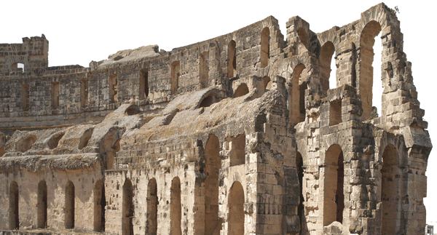
A New Power Rises Ancient Rome
In 509BCE, Rome was a small village. But as time went on--through force or persuasion—Rome controlled almost the entire Italian peninsula by 247BCE. In fact, by the second century of the Common Era, Rome developed into the greatest western empire of the ancient world. Many of our technological achievements, our ideas about law and government, and the words we use
can be traced to the ancient Romans.

Slide 5
A New Power Rises Ancient Rome
In 509BCE, Rome was a small village. But as time went on--through force or persuasion—Rome controlled almost the entire Italian peninsula by 247BCE. In fact, by the second century of the Common Era, Rome developed into the greatest western empire of the ancient world. Many of our technological achievements, our ideas about law and government, and the words we use
can be traced to the ancient Romans.

Slide 6
A New Power Rises Ancient Rome
In 509BCE, Rome was a small village. But as time went on--through force or persuasion—Rome controlled almost the entire Italian peninsula by 247BCE. In fact, by the second century of the Common Era, Rome developed into the greatest western empire of the ancient world. Many of our technological achievements, our ideas about law and government, and the words we use
can be traced to the ancient Romans.

Slide 7
A New Power Rises Ancient Rome
In 509BCE, Rome was a small village. But as time went on--through force or persuasion—Rome controlled almost the entire Italian peninsula by 247BCE. In fact, by the second century of the Common Era, Rome developed into the greatest western empire of the ancient world. Many of our technological achievements, our ideas about law and government, and the words we use
can be traced to the ancient Romans.

Slide 8
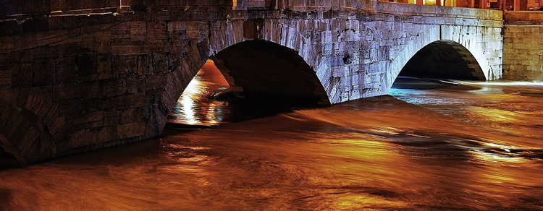
A New Power Rises Ancient Rome
Rome grew from a village to an empire in part because the city was protected from enemy attack. Rome is situated along the banks of the Tiber River about fifteen miles inland from the sea.

Slide 9
A New Power Rises Ancient Rome
Rome grew from a village to an empire in part because the city was protected from enemy attack. Rome is situated along the banks of the Tiber River about fifteen miles inland from the sea.

Slide 10
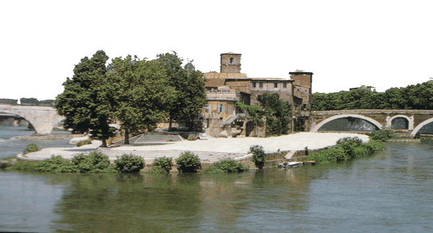
A New Power Rises Ancient Rome
The Tiber has a ford, or shallow portion near Rome. The ford made it impossible for large seagoing ships to attack the city, but experienced Roman sailors could navigate the Tiber’s waters in smaller ships.

Slide 11
A New Power Rises Ancient Rome
The Tiber has a ford, or shallow portion near Rome. The ford made it impossible for large seagoing ships to attack the city, but experienced Roman sailors could navigate the Tiber’s waters in smaller ships.

Slide 12
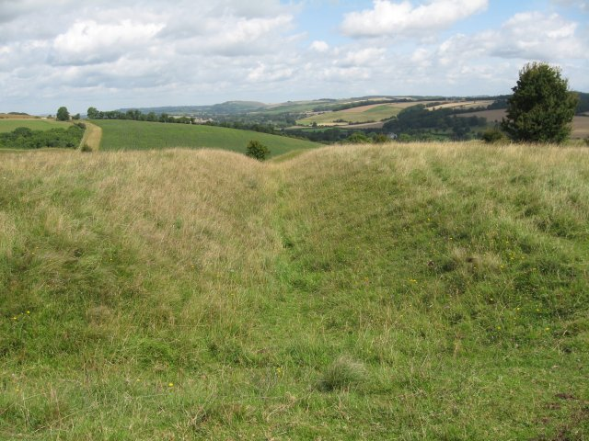
A New Power Rises Ancient Rome
Seven hills surround Rome. The hills made it harder for invaders to reach the city and served as lookout areas for the ancient Romans. Rome is also close to excellent farmland and an abundance of wood and stone, so the Romans had the resources to supply a large army.

Slide 13
A New Power Rises Ancient Rome
Seven hills surround Rome. The hills made it harder for invaders to reach the city and served as lookout areas for the ancient Romans. Rome is also close to excellent farmland and an abundance of wood and stone, so the Romans had the resources to supply a large army.

Slide 14
A New Power Rises Ancient Rome
Seven hills surround Rome. The hills made it harder for invaders to reach the city and served as lookout areas for the ancient Romans. Rome is also close to excellent farmland and an abundance of wood and stone, so the Romans had the resources to supply a large army.

Slide 15
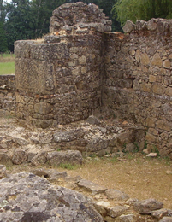
A New Power Rises Ancient Rome
Archaeological evidence suggests that the banks of the Tiber River were first inhabited about 1500BCE, but the origins of Rome are steeped in myth and legend. Many ancient Romans believed twin boys named Romulus and Remus were responsible for the foundation of the city. The legends say a king feared the twins would rob him of his throne, so he tossed the infant boys into the frigid Tiber River. Soon after, a wolf rescued Romulus and Remus and nursed the brothers back to health.

Slide 16
A New Power Rises Ancient Rome
Archaeological evidence suggests that the banks of the Tiber River were first inhabited about 1500BCE, but the origins of Rome are steeped in myth and legend. Many ancient Romans believed twin boys named Romulus and Remus were responsible for the foundation of the city. The legends say a king feared the twins would rob him of his throne, so he tossed the infant boys into the frigid Tiber River. Soon after, a wolf rescued Romulus and Remus and nursed the brothers back to health.

Slide 17
A New Power Rises Ancient Rome
Archaeological evidence suggests that the banks of the Tiber River were first inhabited about 1500BCE, but the origins of Rome are steeped in myth and legend. Many ancient Romans believed twin boys named Romulus and Remus were responsible for the foundation of the city. The legends say a king feared the twins would rob him of his throne, so he tossed the infant boys into the frigid Tiber River. Soon after, a wolf rescued Romulus and Remus and nursed the brothers back to health.

Slide 18
A New Power Rises Ancient Rome
Archaeological evidence suggests that the banks of the Tiber River were first inhabited about 1500BCE, but the origins of Rome are steeped in myth and legend. Many ancient Romans believed twin boys named Romulus and Remus were responsible for the foundation of the city. The legends say a king feared the twins would rob him of his throne, so he tossed the infant boys into the frigid Tiber River. Soon after, a wolf rescued Romulus and Remus and nursed the brothers back to health.

Slide 19
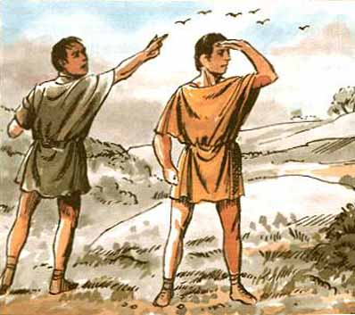
A New Power Rises Ancient Rome
Romulus and Remus decided to establish a city on the Tiber River, but the brothers could not agree on a location. Signs from the heavens told each brother to establish separate cities, and on April 21, 753BCE, Romulus completed the wall around his city. Remus belittled the wall and its builders. When Remus climbed over the wall, the enraged Romulus killed his brother with an ax. Rome is named named for Romulus, its legendary founder.

Slide 20
A New Power Rises Ancient Rome
Romulus and Remus decided to establish a city on the Tiber River, but the brothers could not agree on a location. Signs from the heavens told each brother to establish separate cities, and on April 21, 753BCE, Romulus completed the wall around his city. Remus belittled the wall and its builders. When Remus climbed over the wall, the enraged Romulus killed his brother with an ax. Rome is named named for Romulus, its legendary founder.

Slide 21
A New Power Rises Ancient Rome
Romulus and Remus decided to establish a city on the Tiber River, but the brothers could not agree on a location. Signs from the heavens told each brother to establish separate cities, and on April 21, 753BCE, Romulus completed the wall around his city. Remus belittled the wall and its builders. When Remus climbed over the wall, the enraged Romulus killed his brother with an ax. Rome is named named for Romulus, its legendary founder.

Slide 22
A New Power Rises Ancient Rome
Romulus and Remus decided to establish a city on the Tiber River, but the brothers could not agree on a location. Signs from the heavens told each brother to establish separate cities, and on April 21, 753BCE, Romulus completed the wall around his city. Remus belittled the wall and its builders. When Remus climbed over the wall, the enraged Romulus killed his brother with an ax. Rome is named named for Romulus, its legendary founder.

Slide 23
A New Power Rises Ancient Rome
Romulus and Remus decided to establish a city on the Tiber River, but the brothers could not agree on a location. Signs from the heavens told each brother to establish separate cities, and on April 21, 753BCE, Romulus completed the wall around his city. Remus belittled the wall and its builders. When Remus climbed over the wall, the enraged Romulus killed his brother with an ax. Rome is named named for Romulus, its legendary founder.

Slide 24
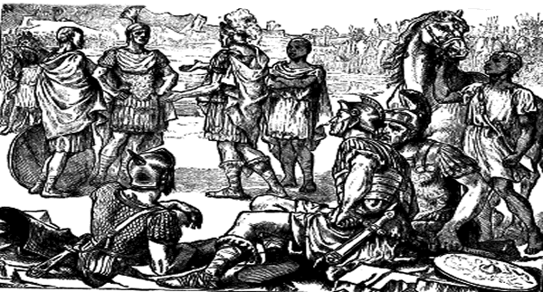
A New Power Rises Ancient Rome
Rome grew from a small town in 509BCE to the ruler of most of the Italian peninsula by 247BCE. Throughout this era, Rome was constantly at war with one or more of its neighbors. At that time, when two cities went to war, the victorious army would destroy the conquered city and either kill or sell the citizens of the conquered city into slavery.

Slide 25
A New Power Rises Ancient Rome
Rome grew from a small town in 509BCE to the ruler of most of the Italian peninsula by 247BCE. Throughout this era, Rome was constantly at war with one or more of its neighbors. At that time, when two cities went to war, the victorious army would destroy the conquered city and either kill or sell the citizens of the conquered city into slavery.

Slide 26
A New Power Rises Ancient Rome
Rome grew from a small town in 509BCE to the ruler of most of the Italian peninsula by 247BCE. Throughout this era, Rome was constantly at war with one or more of its neighbors. At that time, when two cities went to war, the victorious army would destroy the conquered city and either kill or sell the citizens of the conquered city into slavery.

Slide 27
A New Power Rises Ancient Rome
The Roman model of conquest was different. Rome expanded its territory in part because they extended many of the rights of citizenship to the people they conquered. Rome did not collect tribute from their conquered neighbors, but the Romans did require
the states to provide soldiers for
the Roman army. As a result, the
Romans had a massive source of
manpower to draw upon for their
many wars.

Slide 28
A New Power Rises Ancient Rome
The Roman model of conquest was different. Rome expanded its territory in part because they extended many of the rights of citizenship to the people they conquered. Rome did not collect tribute from their conquered neighbors, but the Romans did require
the states to provide soldiers for
the Roman army. As a result, the
Romans had a massive source of
manpower to draw upon for their
many wars.

Slide 29
A New Power Rises Ancient Rome
The Roman model of conquest was different. Rome expanded its territory in part because they extended many of the rights of citizenship to the people they conquered. Rome did not collect tribute from their conquered neighbors, but the Romans did require
the states to provide soldiers for
the Roman army. As a result, the
Romans had a massive source of
manpower to draw upon for their
many wars.

Slide 30
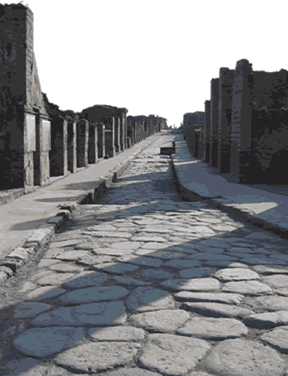
A New Power Rises Ancient Rome
The Roman army built roads that often made the conquered cities more prosperous. The soldiers spread Roman customs to their home villages once their service ended. In time, the Latin language of the area around Rome was spoken throughout the Italian peninsula.

Slide 31
A New Power Rises Ancient Rome
The Roman army built roads that often made the conquered cities more prosperous. The soldiers spread Roman customs to their home villages once their service ended. In time, the Latin language of the area around Rome was spoken throughout the Italian peninsula.

Slide 32
A New Power Rises Ancient Rome
The Roman army built roads that often made the conquered cities more prosperous. The soldiers spread Roman customs to their home villages once their service ended. In time, the Latin language of the area around Rome was spoken throughout the Italian peninsula.

Slide 33
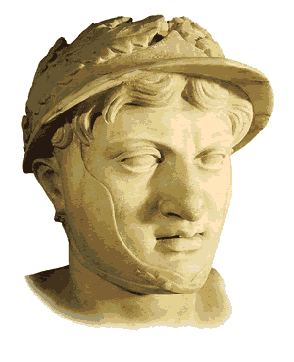
A New Power Rises Ancient Rome
The Romans did not necessarily have the best army, but the immensity of the Roman military allowed the Romans to continue fighting despite tremendous losses. In 279BCE, King Pyrrhus of Epirus defeated the Roman army in two battles. Rome had a larger supply of soldiers, and while the Romans suffered greater casualties, the losses inflicted by the Romans destroyed Pyrrhus’ smaller army.

Slide 34
A New Power Rises Ancient Rome
The Romans did not necessarily have the best army, but the immensity of the Roman military allowed the Romans to continue fighting despite tremendous losses. In 279BCE, King Pyrrhus of Epirus defeated the Roman army in two battles. Rome had a larger supply of soldiers, and while the Romans suffered greater casualties, the losses inflicted by the Romans destroyed Pyrrhus’ smaller army.

Slide 35
A New Power Rises Ancient Rome
The Romans did not necessarily have the best army, but the immensity of the Roman military allowed the Romans to continue fighting despite tremendous losses. In 279BCE, King Pyrrhus of Epirus defeated the Roman army in two battles. Rome had a larger supply of soldiers, and while the Romans suffered greater casualties, the losses inflicted by the Romans destroyed Pyrrhus’ smaller army.

Slide 36
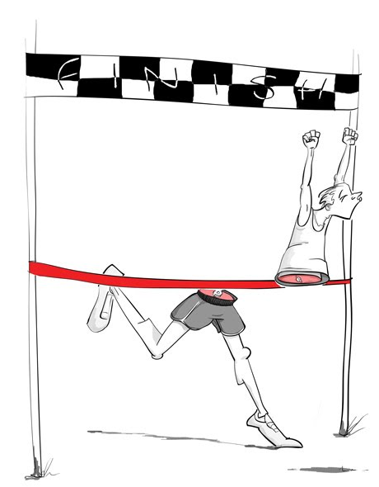
A New Power Rises Ancient Rome
Today we refer to a pyrrhic victory as an achievement with such disastrous results that it is actually a defeat. If your favorite team won a game that clinches a berth in the playoffs – but loses two star players to injury in that game – that win could turn out to be a Pyrrhic victory.

Slide 37
A New Power Rises Ancient Rome
Today we refer to a pyrrhic victory as an achievement with such disastrous results that it is actually a defeat. If your favorite team won a game that clinches a berth in the playoffs – but loses two star players to injury in that game – that win could turn out to be a Pyrrhic victory.

Slide 38
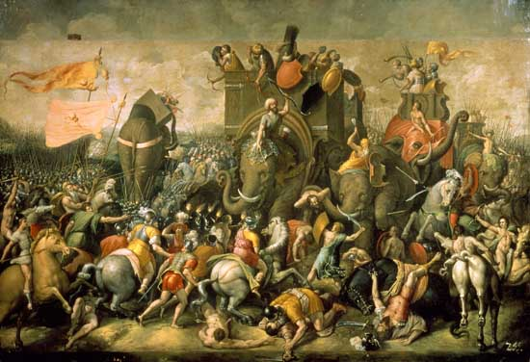
A New Power Rises Ancient Rome
Rome managed to unite most of the modern nation of Italy by 265BCE. Rome would next turn its attention to a rival in North Africa and go on to create a world empire.

Slide 39
A New Power Rises Ancient Rome
Rome managed to unite most of the modern nation of Italy by 265BCE. Rome would next turn its attention to a rival in North Africa and go on to create a world empire.

Slide 40
A New Power Rises Ancient Rome
Rome managed to unite most of the modern nation of Italy by 265BCE. Rome would next turn its attention to a rival in North Africa and go on to create a world empire.

Slide 41
A New Power Rises Ancient Rome
Music credit:
“Starburst Dreams” by
Dan-O at http://danosongs.com.
Learn more about history at
www.mrdowling.com

