Slide 1
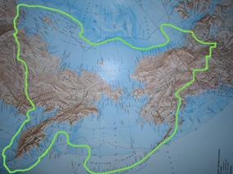
The First Americans America Before Columbus
Over thousands of years, people spread out from Africa into Europe and Asia. Long before the invention of farming, the wheel or writing, the first hunters reached Beringia. Beringia is a modern name for a strip of land that once connected Asia to Alaska in North America.

Slide 2
The First Americans America Before Columbus
Over thousands of years, people spread out from Africa into Europe and Asia. Long before the invention of farming, the wheel or writing, the first hunters reached Beringia. Beringia is a modern name for a strip of land that once connected Asia to Alaska in North America.

Slide 3
The First Americans America Before Columbus
Over thousands of years, people spread out from Africa into Europe and Asia. Long before the invention of farming, the wheel or writing, the first hunters reached Beringia. Beringia is a modern name for a strip of land that once connected Asia to Alaska in North America.

Slide 4
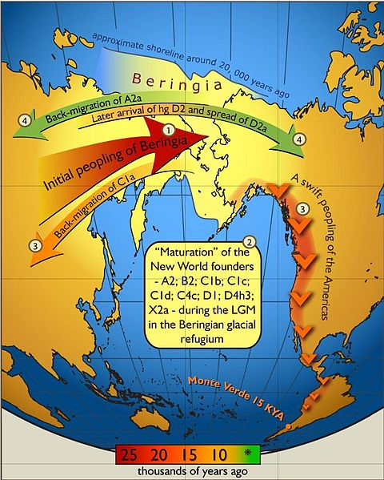
The First Americans America Before Columbus
The current evidence suggests the first humans crossed this “land bridge” at least 40,000 years ago and perhaps even earlier.

Slide 5
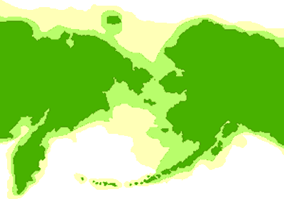
The First Americans America Before Columbus
Asia and America have been separated by the Bering Strait for about 15,000 years. The continents are now more than fifty miles apart, but at one time they were connected by a passage more than 1000 miles wide.

Slide 6
The First Americans America Before Columbus
Asia and America have been separated by the Bering Strait for about 15,000 years. The continents are now more than fifty miles apart, but at one time they were connected by a passage more than 1000 miles wide.

Slide 7
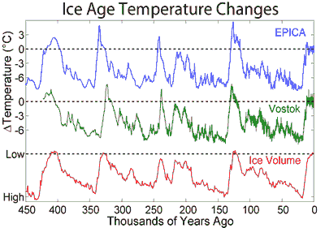
The First Americans America Before Columbus
Beringia existed during the Ice Ages, periods when the climate of the earth was colder. During an Ice Age, precipitation that fell on land would harden into large masses of ice called glaciers. The forming of glaciers caused sea levels to fall about three hundred feet.

Slide 8
The First Americans America Before Columbus
Beringia existed during the Ice Ages, periods when the climate of the earth was colder. During an Ice Age, precipitation that fell on land would harden into large masses of ice called glaciers. The forming of glaciers caused sea levels to fall about three hundred feet.

Slide 9
The First Americans America Before Columbus
Beringia existed during the Ice Ages, periods when the climate of the earth was colder. During an Ice Age, precipitation that fell on land would harden into large masses of ice called glaciers. The forming of glaciers caused sea levels to fall about three hundred feet.

Slide 10
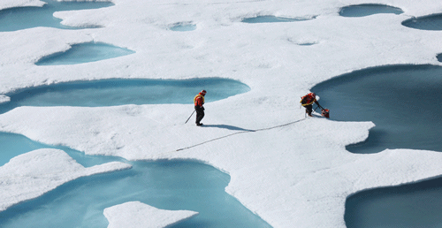
The First Americans America Before Columbus
Scientists fear modern industry has made the earth warmer, causing ice at the Polar Regions to melt. These melting ice caps could cause the oceans to rise and coastal lands to be submerged.

Slide 11
The First Americans America Before Columbus
Scientists fear modern industry has made the earth warmer, causing ice at the Polar Regions to melt. These melting ice caps could cause the oceans to rise and coastal lands to be submerged.

Slide 12
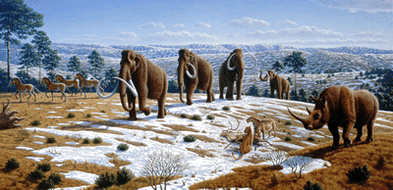
The First Americans America Before Columbus
Although the climate of Beringia was very cold, it appears to have been warmer than nearby land is today. Beringia was not covered with ice because there was very little snowfall in the region. Instead, Beringia was covered with grass and small trees that fed large mammals such as bears, bison and the now extinct woolly mammoths and mastodons.

Slide 13
The First Americans America Before Columbus
Although the climate of Beringia was very cold, it appears to have been warmer than nearby land is today. Beringia was not covered with ice because there was very little snowfall in the region. Instead, Beringia was covered with grass and small trees that fed large mammals such as bears, bison and the now extinct woolly mammoths and mastodons.

Slide 14
The First Americans America Before Columbus
Although the climate of Beringia was very cold, it appears to have been warmer than nearby land is today. Beringia was not covered with ice because there was very little snowfall in the region. Instead, Beringia was covered with grass and small trees that fed large mammals such as bears, bison and the now extinct woolly mammoths and mastodons.

Slide 15
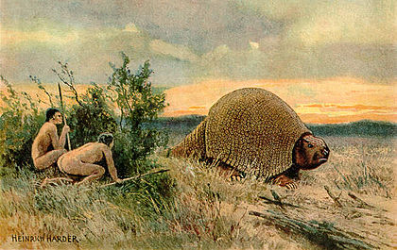
The First Americans America Before Columbus
These animals attracted human hunters to the region. The hunters who crossed Beringia into America came in small groups beginning about 40,000 years ago.

Slide 16
The First Americans America Before Columbus
These animals attracted human hunters to the region. The hunters who crossed Beringia into America came in small groups beginning about 40,000 years ago.

Slide 17
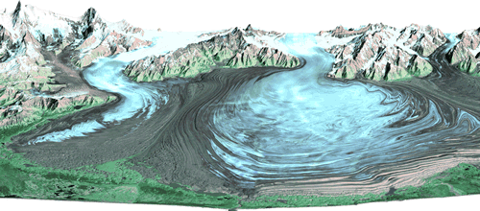
The First Americans America Before Columbus
As the earth grew warmer, the glaciers melted and the land bridge slowly closed about 15,000 years ago—this was at least 9,000 years before civilizations developed in Egypt, Mesopotamia, and China.

Slide 18
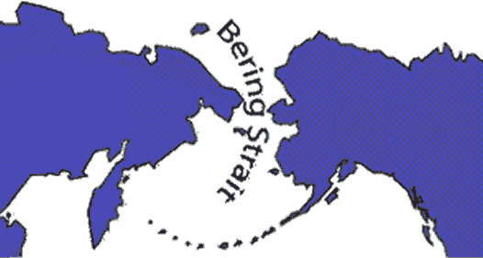
The First Americans America Before Columbus
The Inuit—traditionally known by outsiders as Eskimos—also reached America from Asia, but long after the land bridge had closed. The Inuit crossed the frigid waters of the Bering Strait in boats between 6000 and 2000BCE. Their DNA indicates that the Inuit are genetically unrelated to the other indigenous peoples of America.

Slide 19
The First Americans America Before Columbus
The Inuit—traditionally known by outsiders as Eskimos—also reached America from Asia, but long after the land bridge had closed. The Inuit crossed the frigid waters of the Bering Strait in boats between 6000 and 2000BCE. Their DNA indicates that the Inuit are genetically unrelated to the other indigenous peoples of America.

Slide 20
The First Americans America Before Columbus
The Inuit—traditionally known by outsiders as Eskimos—also reached America from Asia, but long after the land bridge had closed. The Inuit crossed the frigid waters of the Bering Strait in boats between 6000 and 2000BCE. Their DNA indicates that the Inuit are genetically unrelated to the other indigenous peoples of America.

Slide 21
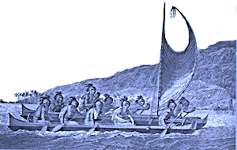
The First Americans America Before Columbus
Archaeologists are also intrigued with ancient skeleton remains found primarily in South America that do not fit the profile of the people who passed through Beringia. DNA evidence suggests that there may have been some migration to America from the Polynesian Islands of the Pacific Ocean, possibly by sailors who were blown off course.

Slide 22
The First Americans America Before Columbus
Archaeologists are also intrigued with ancient skeleton remains found primarily in South America that do not fit the profile of the people who passed through Beringia. DNA evidence suggests that there may have been some migration to America from the Polynesian Islands of the Pacific Ocean, possibly by sailors who were blown off course.

Slide 23
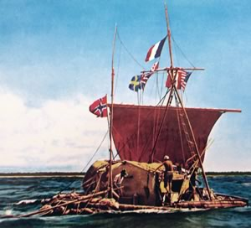
The First Americans America Before Columbus
In 1947, adventurer Thor Heyerdahl constructed a raft using ancient technology. Heyerdahl and a crew of six sailed 3770 miles on the Kon-Tiki, named for an Inca god. Their 97-day journey took them across the Pacific from Peru to the island of Puka Puka. Heyerdahl’s voyage proved that it was possible for ancient sailors to travel the Pacific Ocean, but not that it actually occurred.

Slide 24
The First Americans America Before Columbus
In 1947, adventurer Thor Heyerdahl constructed a raft using ancient technology. Heyerdahl and a crew of six sailed 3770 miles on the Kon-Tiki, named for an Inca god. Their 97-day journey took them across the Pacific from Peru to the island of Puka Puka. Heyerdahl’s voyage proved that it was possible for ancient sailors to travel the Pacific Ocean, but not that it actually occurred.

Slide 25
The First Americans America Before Columbus
In 1947, adventurer Thor Heyerdahl constructed a raft using ancient technology. Heyerdahl and a crew of six sailed 3770 miles on the Kon-Tiki, named for an Inca god. Their 97-day journey took them across the Pacific from Peru to the island of Puka Puka. Heyerdahl’s voyage proved that it was possible for ancient sailors to travel the Pacific Ocean, but not that it actually occurred.

Slide 26
The First Americans America Before Columbus
In 1947, adventurer Thor Heyerdahl constructed a raft using ancient technology. Heyerdahl and a crew of six sailed 3770 miles on the Kon-Tiki, named for an Inca god. Their 97-day journey took them across the Pacific from Peru to the island of Puka Puka. Heyerdahl’s voyage proved that it was possible for ancient sailors to travel the Pacific Ocean, but not that it actually occurred.

Slide 27
The First Americans America Before Columbus
Music credit:
Art of Garden by Dan O’Connor
(DanoSongs.com)
Licensed under Creative Commons: By Attribution 3.0 http://creativecommons.org/licenses/by/3.0/
Learn more about history at
www.mrdowling.com

