Slide 1
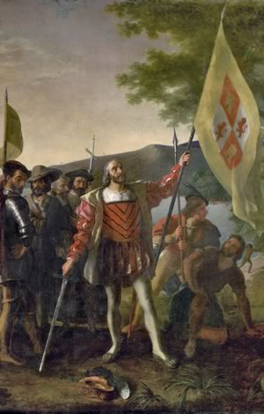
The New World America Before Columbus
When Christopher Columbus arrived in the Caribbean Sea in 1492, he called the people he encountered “Indios,” because the mariner was convinced that he had sailed to one of the islands of Southeast Asia—land many Europeans called the Indies.

Slide 2
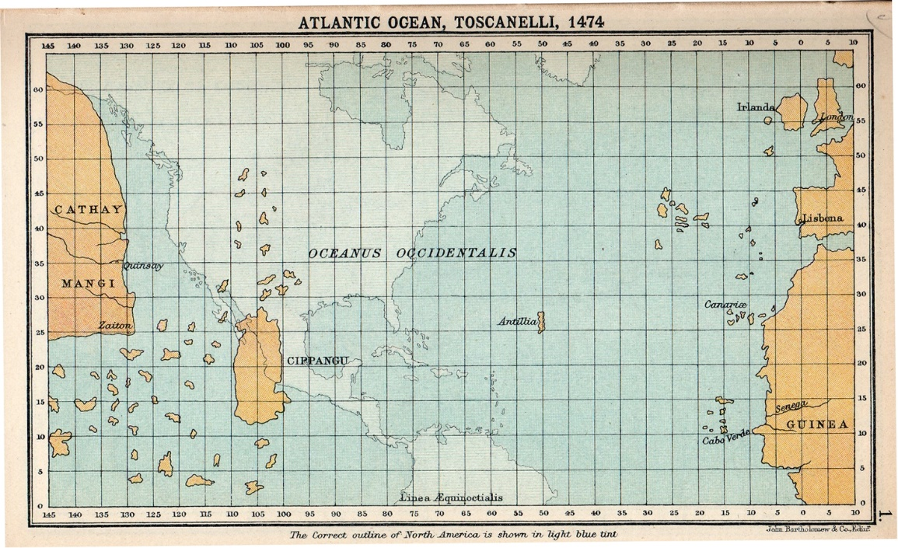
The New World America Before Columbus
Although Columbus likely died believing he reached Asia, we know today that he stumbled upon what his fellow Europeans would eventually call a New World.

Slide 3
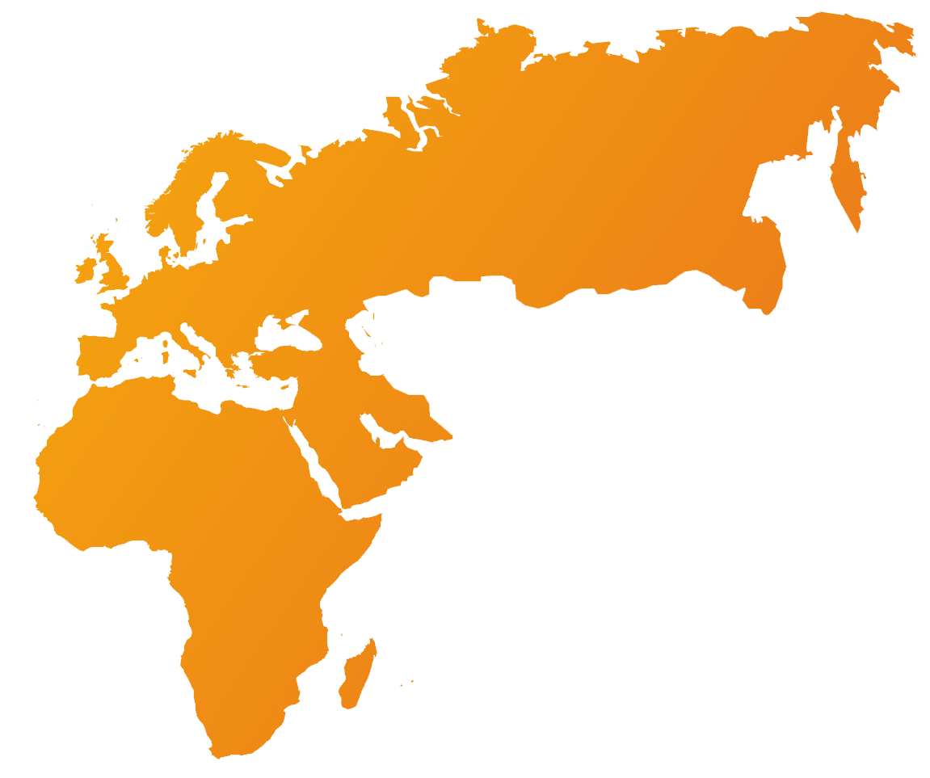
The New World America Before Columbus
Through trade routes or war, the people of the Old World—Europe, Asia, and Africa—had been trading goods, ideas, and even diseases for thousands of years before the Colombian voyage. But far from the influences of the Old World, the people of the Americas had developed their own unique cultures.

Slide 4
The New World America Before Columbus
Through trade routes or war, the people of the Old World—Europe, Asia, and Africa—had been trading goods, ideas, and even diseases for thousands of years before the Colombian voyage. But far from the influences of the Old World, the people of the Americas had developed their own unique cultures.

Slide 5
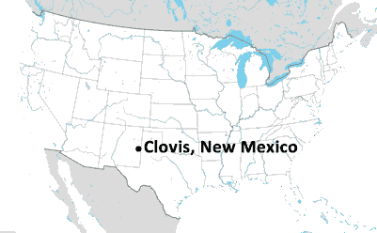
The New World America Before Columbus
The oldest agreed upon evidence of advanced civilization in the Americas comes from 13,500 year-old spear points found near Clovis, New Mexico.

Slide 6
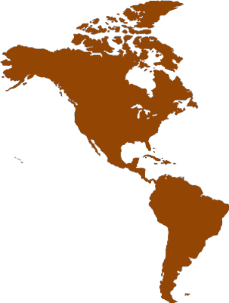
The New World America Before Columbus
By 10,000 years ago— long before civilizations in Mesopotamia, Egypt, and China flourished, humans occupied every section of North and South America from modern Alaska to the Caribbean Islands and the southern tip of South America.

Slide 7
The New World America Before Columbus
As people spread across the continents, they began to speak different languages and develop distinct cultural traditions.

Slide 8
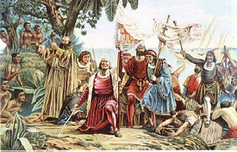
The New World America Before Columbus
By the time Columbus arrived, the population of the New World was estimated to be between 50 and 75 million—though there is some evidence that as many as 100 million people lived in the Americas in 1492. The indigenous people of the New World included about 350 major ethnic groups who spoke over 160 distinct languages.

Slide 9
The New World America Before Columbus
By the time Columbus arrived, the population of the New World was estimated to be between 50 and 75 million—though there is some evidence that as many as 100 million people lived in the Americas in 1492. The indigenous people of the New World included about 350 major ethnic groups who spoke over 160 distinct languages.

Slide 10
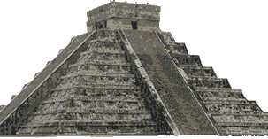
The New World America Before Columbus
Their societies ranged from simple to sophisticated. The Maya, the Incas, and the Aztecs developed complex architecture that required great mathematical skill to construct, though even today, the Yanomami people of Brazil and Venezuela live a lifestyle similar to that of nomads thousands of years ago.

Slide 11
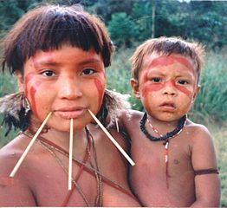
The New World America Before Columbus
Their societies ranged from simple to sophisticated. The Maya, the Incas, and the Aztecs developed complex architecture that required great mathematical skill to construct, though even today, the Yanomami people of Brazil and Venezuela live a lifestyle similar to that of nomads thousands of years ago.

Slide 12
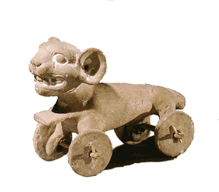
The New World America Before Columbus
It was a world without the wheel as a method of transportation. The most advanced cultures of the New World lived on mountainous land where the wheel would be of little value. Native Americans occasionally used wheels on children’s toys—but they saw no value in using the wheel as a tool for adults.

Slide 13
The New World America Before Columbus
It was a world without the wheel as a method of transportation. The most advanced cultures of the New World lived on mountainous land where the wheel would be of little value. Native Americans occasionally used wheels on children’s toys—but they saw no value in using the wheel as a tool for adults.

Slide 14
The New World America Before Columbus
It was a world without the wheel as a method of transportation. The most advanced cultures of the New World lived on mountainous land where the wheel would be of little value. Native Americans occasionally used wheels on children’s toys—but they saw no value in using the wheel as a tool for adults.

Slide 15
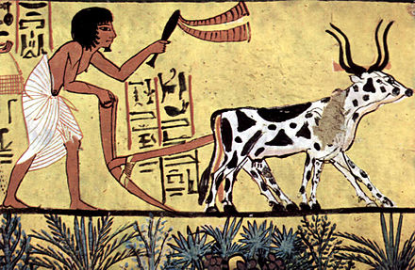
The New World America Before Columbus
Additionally, there were few animals in the New World large enough to drive a plow. The Native Americans hunted several large mammals to extinction thousands of years before the arrival of the Europeans. The remaining large animal— the bear—could
not be domesticated.

Slide 16
The New World America Before Columbus
Additionally, there were few animals in the New World large enough to drive a plow. The Native Americans hunted several large mammals to extinction thousands of years before the arrival of the Europeans. The remaining large animal— the bear—could
not be domesticated.

Slide 17
The New World America Before Columbus
Additionally, there were few animals in the New World large enough to drive a plow. The Native Americans hunted several large mammals to extinction thousands of years before the arrival of the Europeans. The remaining large animal— the bear—could
not be domesticated.

Slide 18
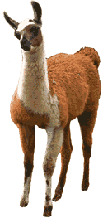
The New World America Before Columbus
The people who lived high in the Andes often used llamas to carry goods, but llamas are unpredictable and generally not strong enough to support the weight of an adult man.

Slide 19
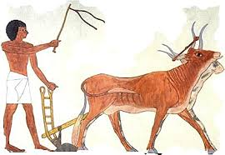
The New World America Before Columbus
The people of the Old World often lived close to their domesticated animals—often sheltering livestock inside their homes. Smallpox, measles, influenza, and other illnesses developed first in animals and eventually evolved into strains that were deadly to humans.

Slide 20
The New World America Before Columbus
The people of the Old World often lived close to their domesticated animals—often sheltering livestock inside their homes. Smallpox, measles, influenza, and other illnesses developed first in animals and eventually evolved into strains that were deadly to humans.

Slide 21
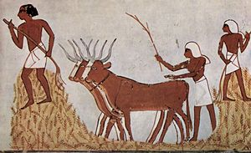
The New World America Before Columbus
The close contact with animals allowed the people of the Old World to develop some resistance, or immunity to these diseases. While it was common for many people of the Old World to die of epidemics, the diseases would not often destroy entire populations.

Slide 22
The New World America Before Columbus
The close contact with animals allowed the people of the Old World to develop some resistance, or immunity to these diseases. While it was common for many people of the Old World to die of epidemics, the diseases would not often destroy entire populations.

Slide 23
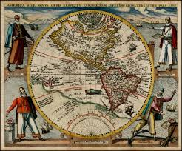
The New World America Before Columbus
The people of the Americas, however, had not been exposed to Old World illnesses. In 1492, the population of the Americas outnumbered that of Europe, but within a generation, diseases spread across the New World, killing an estimated 95 percent of the indigenous people.

Slide 24
The New World America Before Columbus
The people of the Americas, however, had not been exposed to Old World illnesses. In 1492, the population of the Americas outnumbered that of Europe, but within a generation, diseases spread across the New World, killing an estimated 95 percent of the indigenous people.

Slide 25
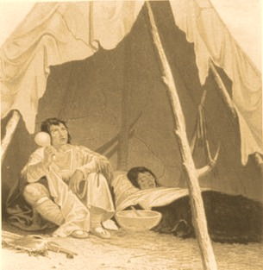
The New World America Before Columbus
The Old World’s greatest weapon in their quest to conquer America was disease, a weapon they did not know they had.

Slide 26
The New World America Before Columbus
Music credit:
Jarvik by Kevin McLeod
(imcompetech.com)
Licensed under Creative Commons: By Attribution 3.0 http://creativecommons.org/licenses/by/3.0/
Learn more about history at
www.mrdowling.com

